Slide 1
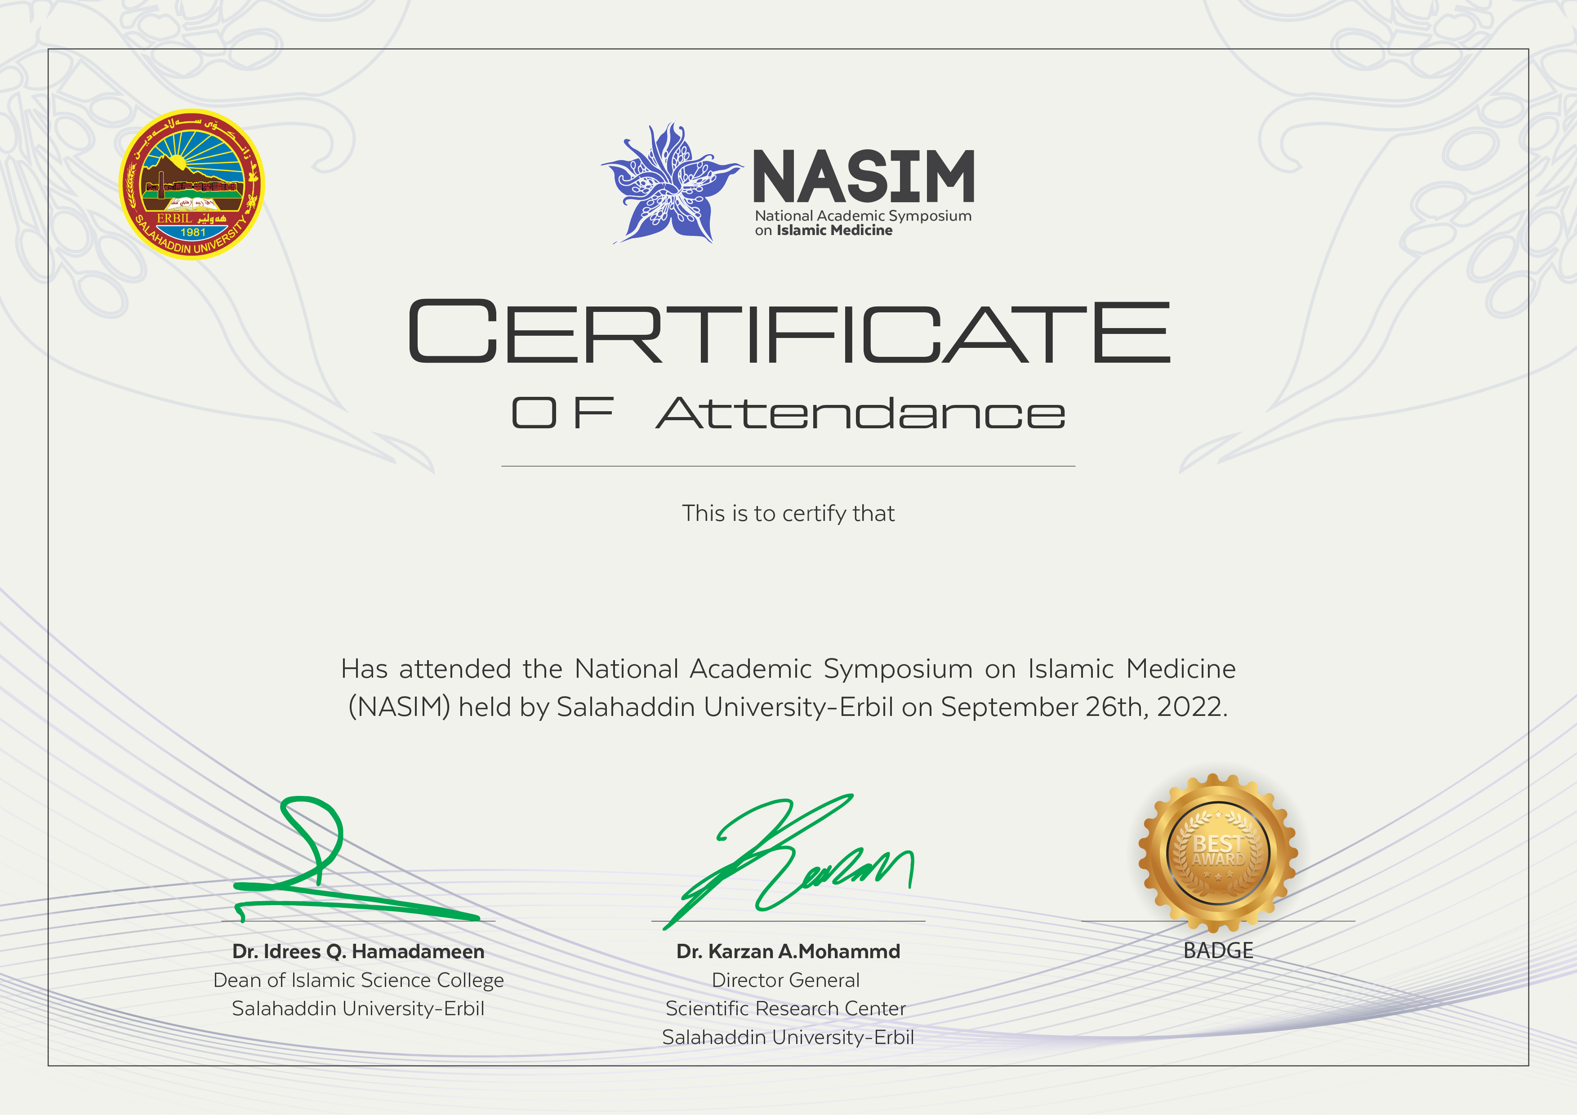
Rezhin Ali Mohammed

