Slide 1
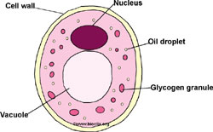
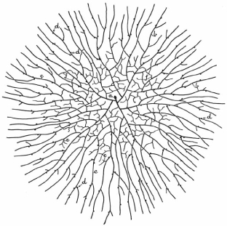
Identification of fungi
Fungi are unicellular (yeast) or multicellular (mold) or (filamentous) .
Mycelium are characteristically filamentous made thread like structure called hyphae.
They branch and fusing with one another the mass of branched hyphae is called the mycelium.
Unicellular
Mycelium

Slide 2
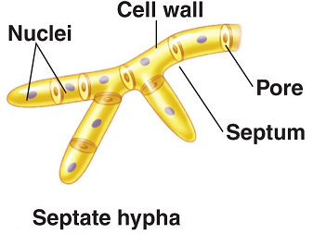
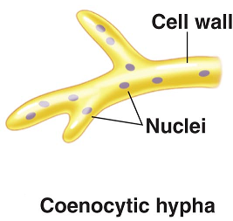
Fungal hyphae may have cross walls called septa or septa may be present with pores through which cytoplasm can flow moving nutrients throughout the fungus, the non septate hyphae called aseptate (coenocytic).
They may grow fast, up to 1 km per day, as they spread throughout a food source.
Parasitic fungi have modified hyphae called haustoria, which penetrate the host tissue but remain outside cell membrane.
Cell wall typically present, usually based on glucans and chitin, rarely on glucans and cellulose (Oomycota).

Slide 3
Fungi are heterotrophic ( “other feeding,” must feed on preformed organic material), not autotrophic ( “self feeding,” make their own food by photosynthesis).
Unlike animals (also heterotrophic), which swallow then digest, fungi digest then ingest.
Fungi produce exoenzymes to get food by absorption. Most fungi store their food as glycogen (like animals), plants store food as starch.
Fungi are reproducing sexually (meiotic) and asexually (mitotic), the most common method is asexually by production of spores, the spores vary on: Color, Size, Shape, Number of cells. Unicellular or multicellular and varies in their arrangement.

Slide 4
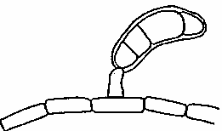
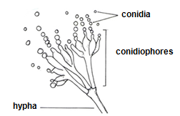
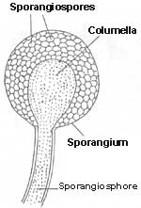
The spores produce asexually are either borne in sporangia then called sporangiospores, or produce at the tips or sides of hyphae in various ways then called conidia.

Slide 5
Fungal growth requirements
In contrast to bacteria, fungi are likely to grow in places that are:
More acidic
Have higher osmotic pressures
Are lower in moisture
Are low in nitrogen
Contain complex carbohydrates
TYPES OF MYCOSIS
Systemic
Subcutaneous
Cutaneous
Opportunistic

Slide 6
HUMAN-FUNGUS INTERACTIONS
Beneficial Effects of Fungi
Decomposition - nutrient and carbon recycling.
Biosynthetic factories. Can be used to produce drugs, antibiotics, alcohol, acids, food (e.g., fermented products, mushrooms).
Model organisms for biochemical and genetic studies.
Harmful Effects of Fungi
Destruction of food, lumber, paper, and cloth.
Animal and human diseases, including allergies.
Toxins produced by poisonous mushrooms and within food (e.g., grain, cheese, etc.).
Plant diseases.

Slide 7
Identification of Fungi
Macroscopic examination: Fungi can be identifying with the naked eyes on the basis of colonial morphology. Colonial morphology refers to the size and appearance of colonies of microorganisms. When single-celled microorganisms that are attached to a solid surface (i.e. agar media) divide they form clusters of millions of cells called colonies.
Depending on the fungi these colonies differ in properties such as colony form, elevation, shape, size, color, and margins. Colonial morphology can be viewed without the aid of a microscope.
Different types of fungi will produce different-looking colonies, some colonies may be colored, some colonies are circular in shape, and others are irregular.

Slide 8
A specific terminology is used to describe common colony types, these are:
Form: The form refers to the shape of the colony.
Circular Irregular Filamentous Rhizoid Spindle

Slide 9
Size: The size of the colony can be a useful characteristic for identification. The diameter of a representative colony may be measured.
Punctiform Small Moderate large
b. Surface: Fungal colonies are frequently shiny and smooth in appearance. Other surface descriptions might be: veined, rough, dull, wrinkled and glistening.
c. Texture: Several terms that may be appropriate for describing the texture or consistency of fungal growth are: dry, moist, mucoid, brittle, and viscous.
d. 1. Color: It is important to describe the color of the colony, such as: purple, red yellow, tan, cream, white……etc.
2. Pigmentation: Nonpigmented: (e.g. Pythium sp.) & Pigmented: pink (e.g. Fusarium sp.)

Slide 10
2. Elevation: This describes the side view of a colony, these are the most common.
Flat Raised Umbonate Crateriform
Convex Pulvinate

Slide 11
3. Margin: The margin or edge of a colony (or any growth) may be an important characteristic in identifying fungi.
Entire Undulate Lobate Curled Filiform
2. Microscopic examination: By preparing slid as followings:
1. Place a drop of fungal satin on a clean slide
2. Transfer a small piece of the fungal hyphae onto the drop using a flamed cooled needle.
3. Place a cover glass over the drop gently to avoid producing air bubbles in the satin.
4. Examine under low power then at 40X.

Slide 12
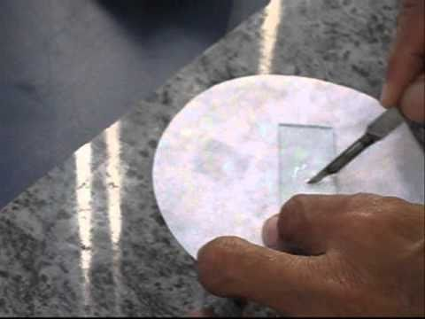
2-KOH - done on skin scrapings, nails, sputum, vaginal specimens. KOH clears tissue cells; so, fungal elements may be seen. The material is mixed with 20% KOH on a slide and a cover slip is placed. The slide is then gently heated by passing through the flame 2-3 times.
KOH serves to digest the protein debris and clears keratinised tissue and increases the visibility. Addition of Dimethyl sulphoxide (DMSO) permits rapid clearing in the absence of heat.

Slide 13
Stains used:
Lactophenol Cotton Blue - very popular for quick evaluation of fungal structures; and cell walls of fungi.
Periodic Acid - Schiff Stain (PAS) - stains polysaccharide in the cell wall of fungi. Fungi stain pink-red with blue nuclei.
Gomori Methenamine Silver Stain - silver nitrate outlines fungi in black due to the silver precipitating on the fungi cell wall.
Gridley Stain - Hyphae and yeast stain dark blue or rose. Tissues stain deep blue and background is yellow.
Mayer Mucicarmine Stain - will stain capsules of Cryptococcus neoformans deep rose.
Fluorescent Antibody Stain - extremely specific method of detecting fungi in tissues or fluids.
Papanicolaou Stain - good for initial differentiation of dimorphic fungi.
Gram Stain - generally fungi are gram positive; but Actinomyces and Nocardia are gram variable.
Acid-Fast Stain - used to differentiate the acid-fast Nocardia from other aerobic Actinomyces.

