Slide 1
Periodic table

Slide 2
Atom
Is The Smallest Particle Of An Element That Still Has All The Properties Of That Element. Atoms Are Made Up Of Three Main Particles. Protons And Neutrons Come Together In An Atom’s Nucleus, Whereas Electrons Orbit The Nucleus.
The Table Has 7 Rows (7 Periods) And 18 Columns (18 Groups).
The Atomic Number
Of An Element Is Equal To The Number Of Protons In The Nucleus Of Its Atom.
Atomic Weights = (Number Of Protons + Number Of Neutrons) In Nucleus.

Slide 3
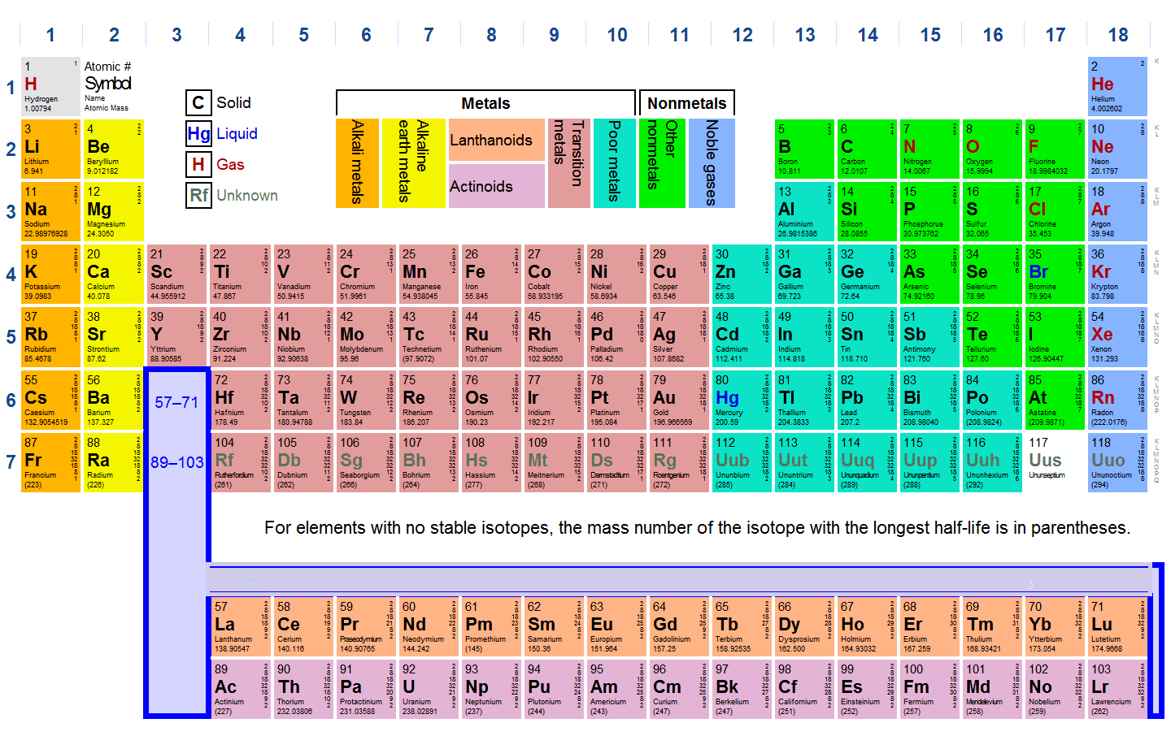

Slide 4
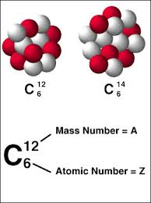
Atoms Of The Same Element That Have Different Atomic Weights Due To Different Numbers Of Neutrons In The Nucleus Are Called Isotopes (Stable And Unstable).

Slide 5
Ionization Energy:
The Energy required to remove an electron from isolated atom or molecule, increasing from left to right and bottom to top of Periodic table. Some atoms have positive or negative electrical charge, because they have an extra electron or are missing an electron. These charged atoms are called ions (O-2, K+).
Electronegativity
Is The Tendency For An Atom To Attract Electrons To Itself When It Is Chemically Combined With Another Element, Going From Left To Right Across A Period, IE Is Increase And From Bottom To Top For Group.
Atomic Radius
This Is Half The Distance Between The Two Nuclei Of A Diatomic Molecule, Going From Left To Right Across the Period and Bottom To Top Of Groups, The Size Gets Smaller.

Slide 6
Ionic Radius
It Is Measured In Either Picometers (Pm) Or Angstrom (Å), With 1 Å = 100 Pm. Typical Values Range From 30 Pm (0.3 Å) To Over 200 Pm (2 Å).
Elements Are Arranged Left To Right And Top To Bottom In Order Of Increasing Atomic Number, This Order Usually Coincides With Increasing Atomic Mass.
Groups Of Elements - Family Names:
Alkali Metals, Alkaline Earth Metals
Halogens, Noble Gases
Transition Metals
The BCNO Elements
Lanthanide And Actinide Elements.

Slide 7
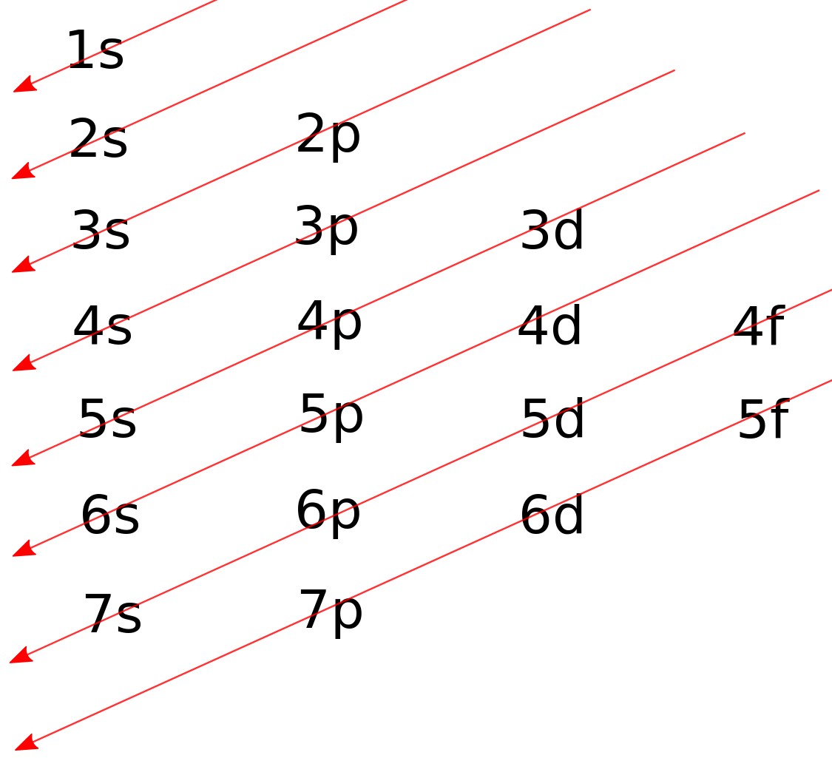
Atomic Orbital
Is A Mathematical Function That Describes The Wave-like Behavior Of Either One Electron Or A Pair Of Electrons In An Atom (S-orbital Composed Of One Orbital Contain Two Electrons, P-orbital Three Orbital’s Contain Six E⁻, D-orbital Composed Of Five Orbital’s And Ten E⁻ And F-orbital Composed Of Seven Orbital’s And Fourteen E⁻. (1s, 2s, 2p, 3s, 3p, 4s, 3d, 4p, 5s, 4d, 5p, 6s, 4f, 5d, 6p, 7s, 5f, 6d, 7p,-).

Slide 8
Orbital’s Block: Alkali Metals And The Alkaline Earth Metals: S-block (1s-7s).
Transition Metals: D-block (3d-6d).
The BCNO Elements, Halogens And Noble Gases: P-block (2p-6p).
Lanthanide And Actinide Elements (Rare Earth Elements-ree): F-block (4f-5f).
Electron configuration: is the distribution of electrons of an atom or molecule in atomic or molecular orbitals.
Noble gas configuration: Consists of the elemental symbol of the last noble gas prior to that atom, followed by the configuration of the remaining electrons.
Valence electrons : are outer shell electrons for main group elements.
Valence or valency: of an element is the measure of its combining capacity with other atoms when it forms chemical compounds or molecules

Slide 9
Exercises:
Identify the elements with the atomic numbers (Z) listed below. Find their electronic configurations, valence electrons. Establish the block and group to which each element belongs and find their valency. Z =13, 26, 37, 54
The ground state of an element contains an unpaired 3s electron, which of the following of the element? Li, Na, Mg and K.
Find the electronic configuration of the following atoms, representing the electron core by the symbol of the preceding inert gas. To which blocks do they belong? Ti, Os, and Sr.
Which of the following is the most likely empirical formula of the ionic compound that forms between Cs and S? (CsS, Cs₃S, Cs₂S).
A compound is composed of 31.57% Carbon, 5.26% Hydrogen, and 63.15% Oxygen by mass. What the empirical formula of 100% g from this compound?

