Slide 1
Teaching Reading & Writing
Rezhna Balisany

Slide 2
What is reading?
Reading is the process of transforming information by interpreting the meaning from visuals (images and texts)

Slide 3
What is Reading?
Reading is a process of constructing meaning from written texts. It is a complex skill requiring the coordination of interrelated sources of information” (Anderson, Hiebert, Scott, & Wilkinson, 1985, p. 6. Cited in Stanley, 2007.)

Slide 4
Schema theory
Schema theory tries to explain how readers utilize prior knowledge to understand and get new information from the text (Rumelhart, 1980).
Example:

Slide 5
A text about transportation, for example, would trigger our schematic knowledge about the different types of transportation:
Land | Air | Water
Bicycle Motorcycle Car Van Bus Train Subway | Airplane Jet Helicopter Hot air balloon Glider | Ship Sailboat Yacht Submarine Aircraft

Slide 6
Reading
Reading is bottom-up
Reading is also top-down
Reading is also non-linear and multi-model

Slide 7
Bottom-Up reading
Bottom-up processing, however, relies on the actual words or sounds. That is, students construct meaning from the most basic units of language, including letters, letter clusters, and words.

Slide 8
Reading is bottom-up
Phonics, sight words, vocabulary and chunks of meanings sentences….. Meanings
Example:
Although her energy enervated
and her creativity arid,
she still made time to read with
her daughter.

Slide 9
Top-down reading
Top-down processing refers to the use of background knowledge to predict the meaning of the reading or listening text. For example, readers develop hypotheses about the content of a text, which they have to confirm or reject while reading. The uptake of information is thus guided by an individual’s prior knowledge and expectations.

Slide 10
Reading is top-down
Reading is about the bigger context, our internal stories, and other comprehension clues.
Although her energy enervated
and her creativity arid,
she still made time to read with
her daughter.

Slide 11
Reading is also non-linear and multi-model
Reading especially today, goes along with images and information in other formats in a variety of layouts

Slide 13
Reading Material
Important to use good material for fast learning
“Graded” or curated text
Not too hard for the learners.

Slide 14
Reading Material
Reading material also includes:
Instructions, songs, grammar, listening, ….
It is integrated skills….
Teachers’ books- a lot of guidance for delivery.

Slide 15
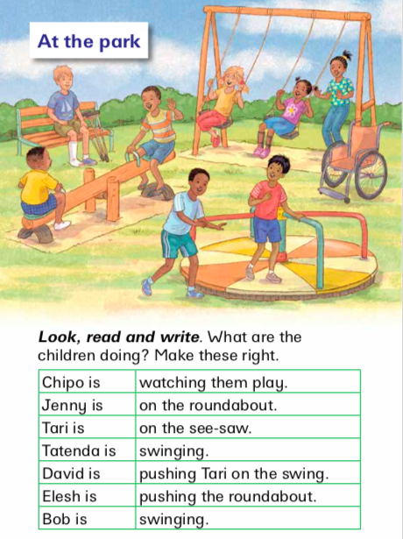
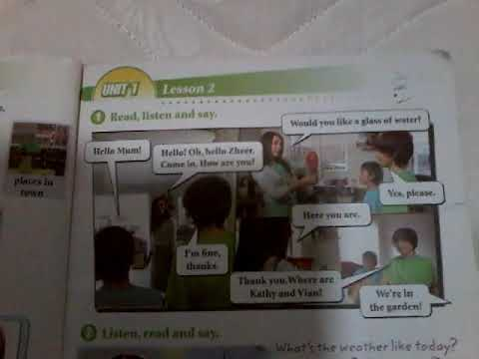

Slide 16
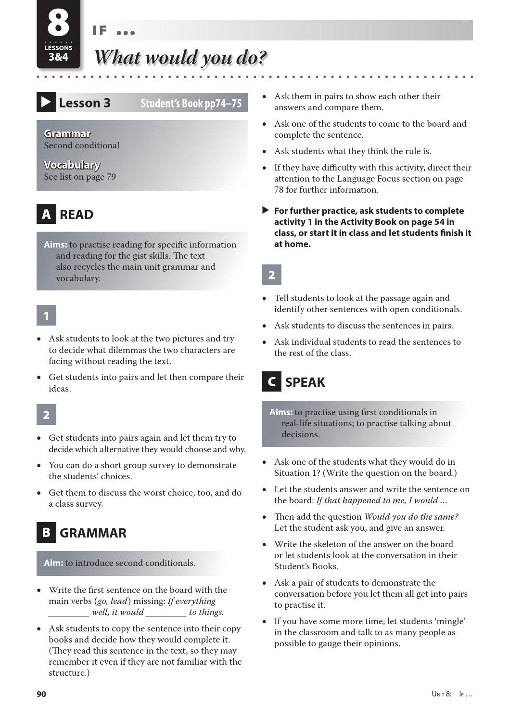
Reading Material
Teachers’ books- a lot of guidance for delivery.

Slide 17
Make Reading material interactive
Capture the students’ interest
Engage the students in the process
Ask questions
Move, act, use expressions, etc.

Slide 18
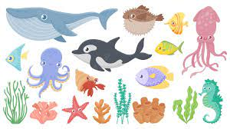

Slide 19
Quiz
How many real sharks were in the image?
1
2
3
4

Slide 21
What things were on the table?
A. a book
B. a toy shark
C. a cup of tea
D. a computer

Slide 22
Is L1 OK?
Is it OK to use L! when teaching L2?
Example??????
Always follow up/ finish with English

Slide 23
Pre-reading activities
we construct new knowledge by relying on our prior knowledge. Being able to decode the information from the text is insufficient. Teachers should encourage learners to utilize their own world knowledge and worldview to make sense of the text. This knowledge, which is often referred to as schema (see above), is the essential condition for the process of construction of meaning.

Slide 24
Pre-reading activities
Review/ activate prior knowledge )bottom-up and top-down)
Pre-teach vocabulary (bottom-up)
Study the pictures or graphics:
Ask lower order-questions
Ask higher order (critical thinking) quetions (top-down)

