Slide 1
Teaching Reading & Writing
Rezhna Balisany

Slide 2
Writing: the neglected skill
Some reasons:
“I don’t have time for it”
“My classes are too big
“I don’t know what to do with the beginners!
“I don’t like it. It’s boring”
Remember that writing in the English subject curriculum is regarded as a basic skill. It shouldn’t be neglected

Slide 3
Writing Skill
Of all the skills, writing is one that teachers and learners seem most reluctant to focus on because it requires them to make special efforts. As a result, it sometimes tends to be neglected.
(harmer, 2015, P. 360)

Slide 4
Reading and writing
Listening to read and then to write means the young learner has to link what they have heard or spoken to what they can see (read) and produce (write)
Hear a word before you ca say it
Say a word before you can read it
Read a word before you can write it.

Slide 5
Writing – a complex skill
Skill of forming letters/finding the right letters on the keyboard.
Skill of finding which words and phrases to use.
Skill of spelling and using punctuation marks.
Skill of putting the words and phrases logically together
Skill of organizing ideas into a coherent whole, using appropriate
Titles etc.

Slide 6
Writing in school
1. Writing- for -learning
Intended to help students and practice the language.
E.g. “Write three sentences using going to “
2. Writing- for -writing
Intended to to build students’ writing skills, e.g. how to develop good syntax, genre knowledge, how to structure a text well, etc.

Slide 7
Three types of writing activities
Controlled writing
Guided writing
Free writing

Slide 8
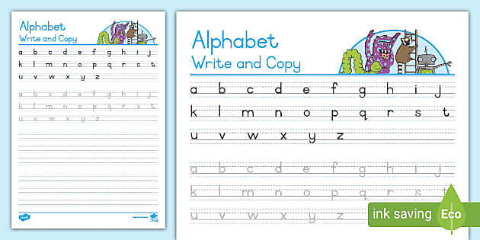
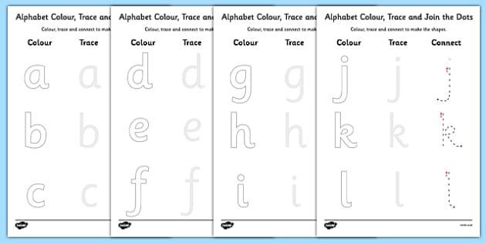
1. Controlled writing activities: students copy words
1.Tracing
2. Copying

Slide 9
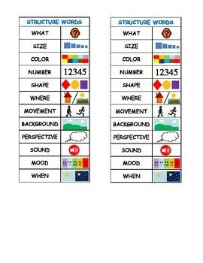
3. Visualized words
It means how the word is visualized

Slide 10
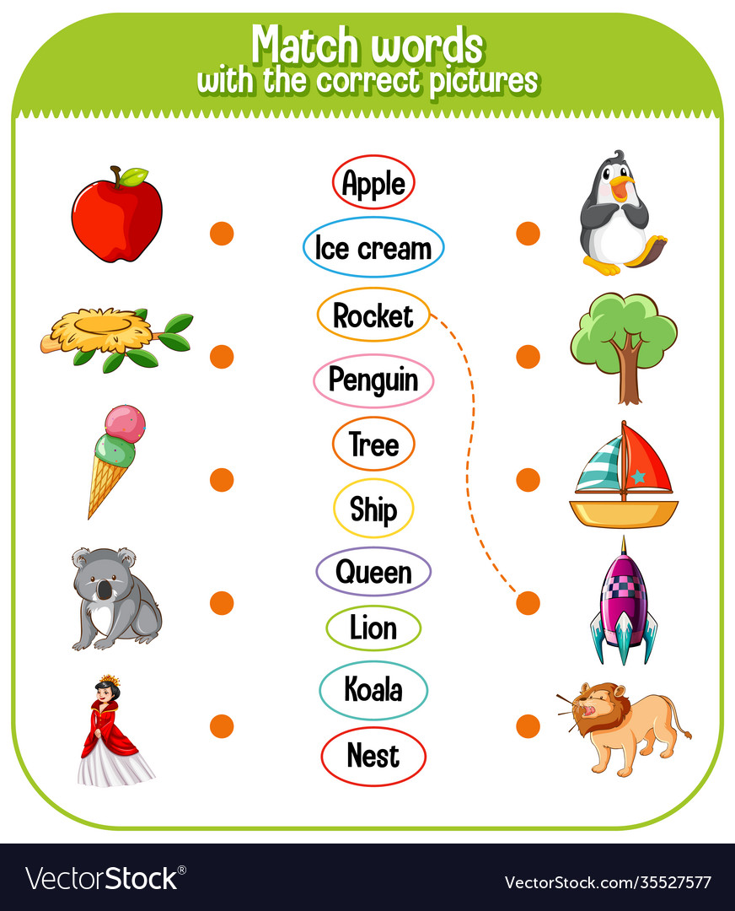
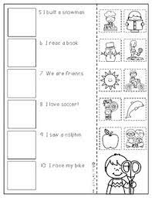
4.Matching text and picture

Slide 11
2. Guided Writing Activities
1 Filling-in activities
Add missing words to a text, such as:
Missing words in songs and rhymes
Picture story
Completing a text
Dictating a half-sentence

Slide 12
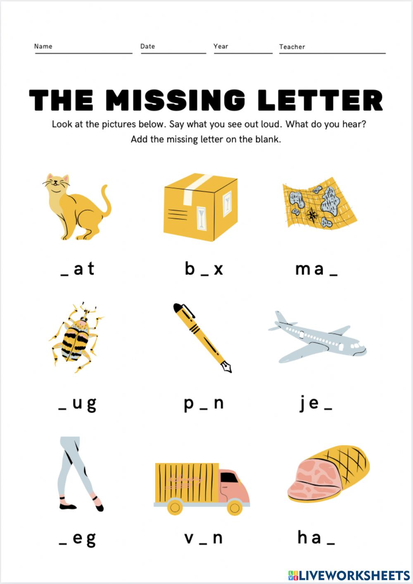

Slide 13
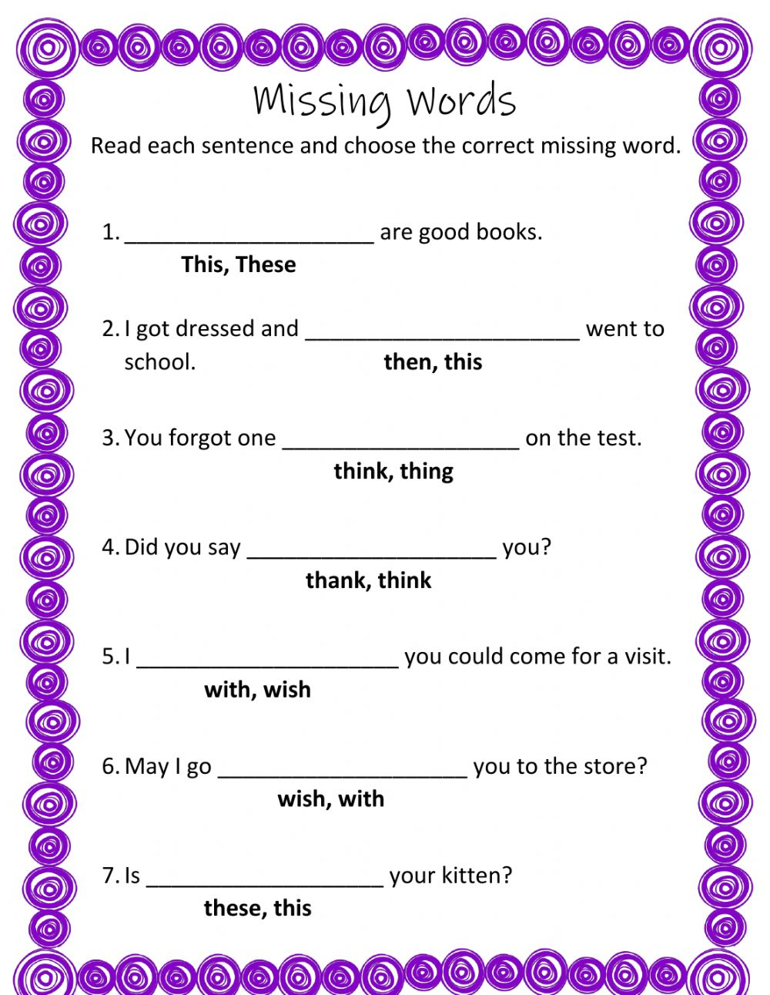

Slide 14
2. Guided Writing Activities
2. Parallel writing: A model text is provided; the students create patterns
Postcards
Letters
Invitations
- Emails
Report

Slide 15
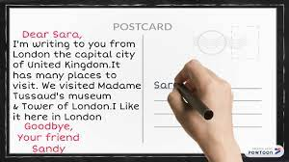

Slide 16
. 2. Guided Writing Activities
3. Dictations
Present the word before the dictation, or use words that have occurred in a text that has been recently
Use different sorts of words (S, N, V, adj, adv, and pronouns)
Read at an appropriate pace (not too slow, not too fast)
Always present the words in context.
Whole sentences can be divided into chunks
The old man/ loves to go to swimming/ when it’s hot.

Slide 17
3. Free writing activities
Students express ideas and communicative with a reader
Students (may) need information about:
The function of the text.
How to write the text?
Ideas for how to write the text

Slide 18
3. Free writing activities
Labelling
Lists
Same story, different ending
Factual texts
Digital storytelling (photo story, iMovie etc.

Slide 20
Writing after Reading
Drawing & labelling (beginners)
Putting visuals, words, or sentences in order (sentence strips)
Filling in blanks (Cloze activity)
Describing a character, an animal, a place, etc.
Writing a new ending.
Writing in a response journal

