Slide 1
Teaching Reading & Writing
Rezhna Balisany

Slide 2
Phonic
Children are taught to….
Recognise the sound that each letter makes
Identify sounds that combinations of letters make, such as “sh” or “ch”
Blend these sounds together to make a word

Slide 4
Phonic Activities
Sound-Matching: the teacher brings in objects that contain a certain sound and the children identify the common sound
Sound-Isolation- the teacher says a word and the children identify the beginning, middle, or ending sound.
Sound Blending- the teacher exaggerates each sound in a word and the children guess the word
Sound Addition/ Substitution- apples and bananas song
Sound Segmentation- children exaggerate that each sound in a word

Slide 5
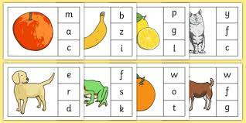

Slide 6
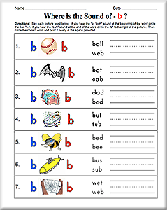

Slide 7
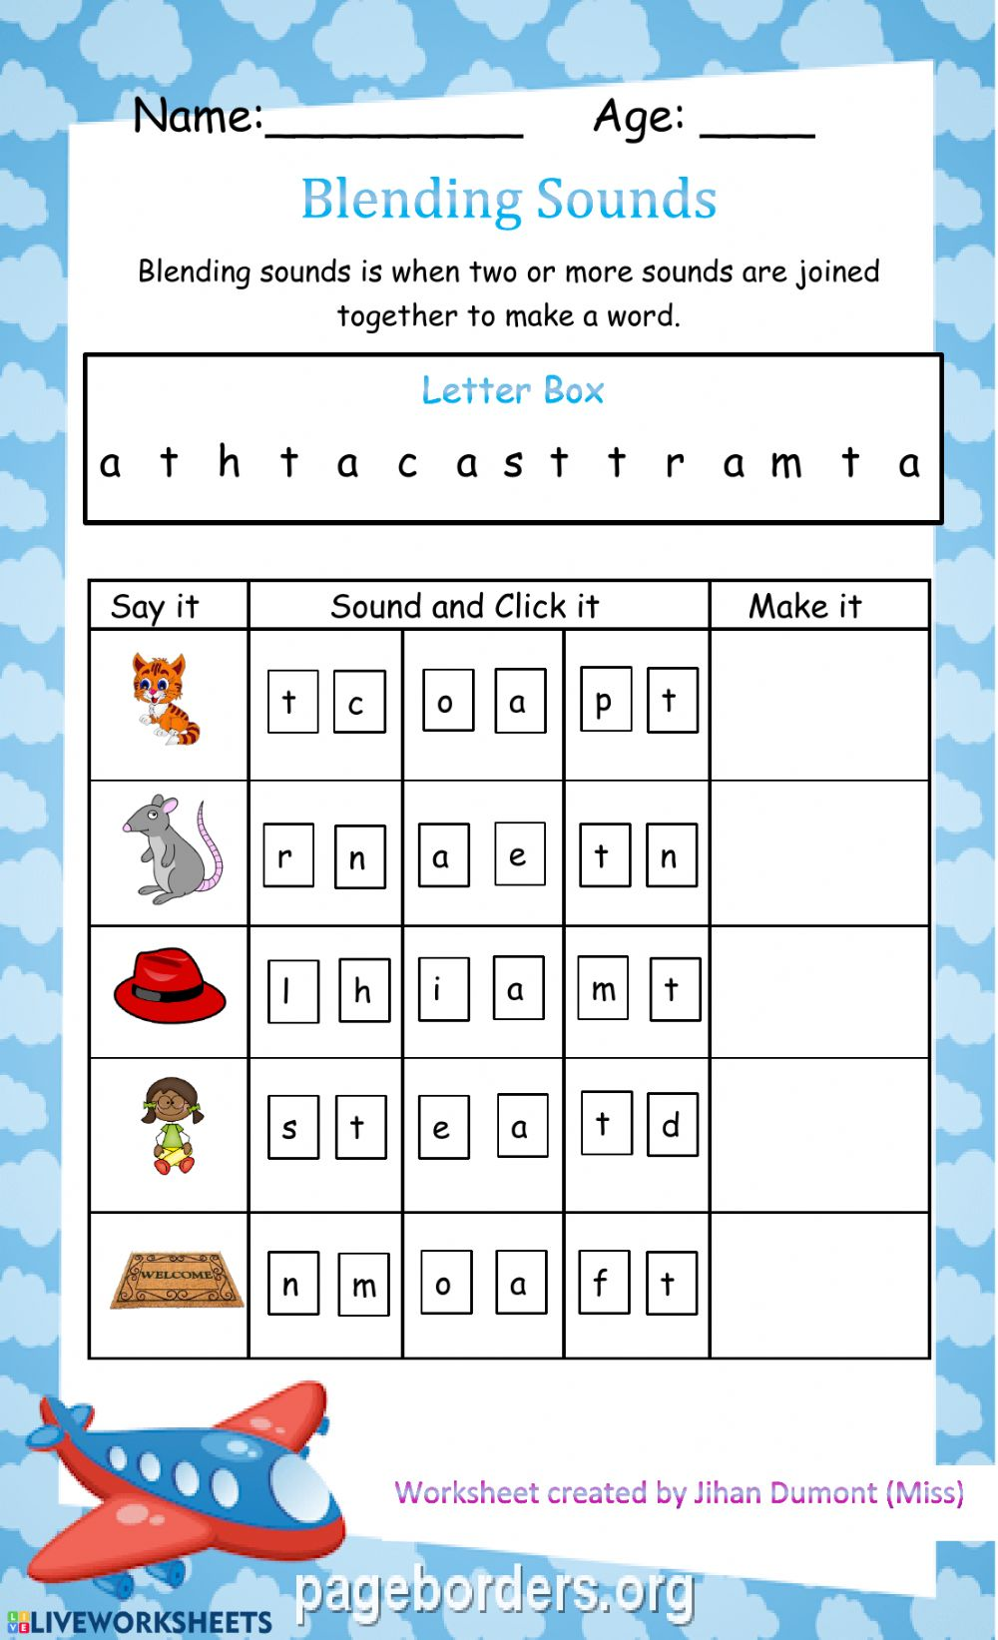

Slide 8
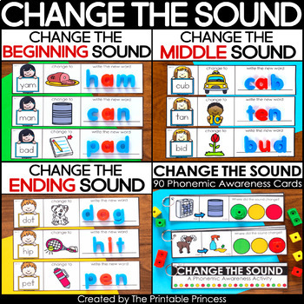

Slide 9
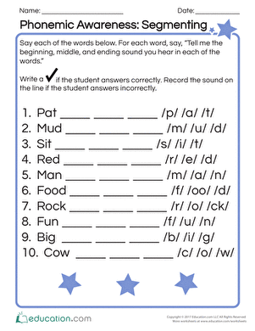

Slide 10
Which reading approach am I using to read this?
Am I using top-down or bottom- up processing?

Slide 11
Question?
-Which is easier to teach to young children?
Reading or Writing ? Why

Slide 12
Reading aloud shouldn’t be encouraged because
Reading is normally a silent activity.
Reading aloud is a frightening thing to do.
One can read aloud without understanding.

Slide 13
So, how do we teach reading?
The first thing we have to do is to prepare the students for the content of the text.
Another way of preparing children to read is by getting them to think of some of the vocabulary items that will appear on the text.
Encourage students to discuss the questions with their partners, either in pairs or in small groups, before having a class-wide discussion. This provides an opportunity to interact using English.
The weaker students gain confidence through such informal discussions

Slide 14
Recommended Procedure to be followed
Read the text slowly and clearly, while the class follows silently in their books
Ask students to read the text again, silently, and then complete the first post-reading question (Read Right-quetion1), working in pairs/ small groups.
Go over the answer with the students.
Proceed through the other question in the same way.
If appropriate, ask the students to read the text aloud once they have completed the question and are very familiar with the text to find specific bits of information

Slide 15
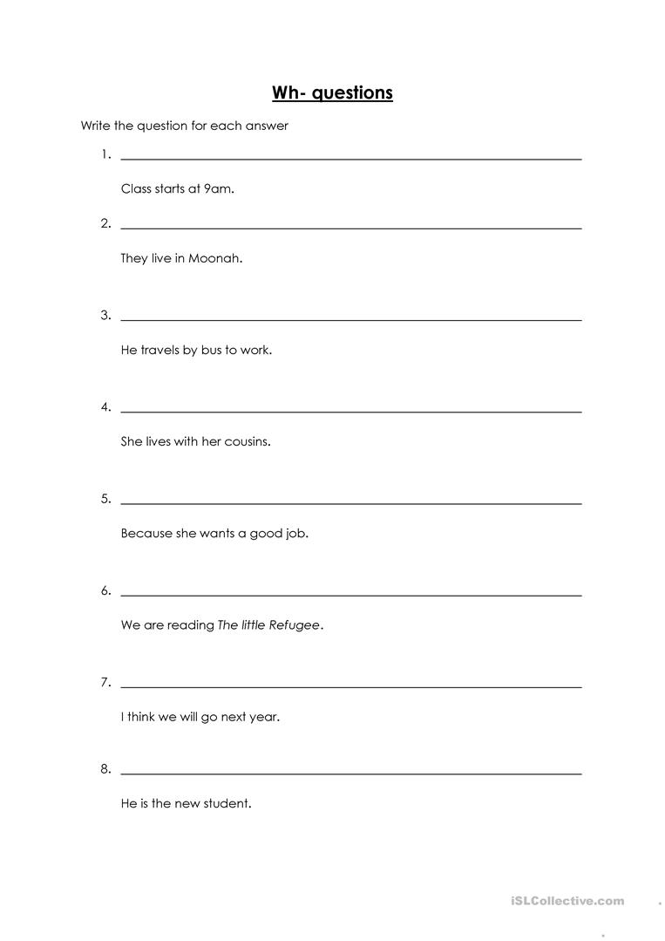

Slide 16
It is important that children begin to learn how to summarise a story or poem- to say what the story or poem is about. There is always a question which asks them to choose the sentence that best summarises the story or poem.

Slide 17
Writing in the subject curriculum Oral vs written communication
Oral communication | Written communication
Speaking | Writing
Listening | Reading

Slide 18
Reading & Writing: interactive /Cyclical.
Reading is the preparation for writing (or speaking).
Writing is the production of something to be read.
Reading: note-taking or writing to remember
Writing: re-reading notes as we write

Slide 19
Reading & Writing are Important
R & W reinforce what is learned orally
R expands the input & W helps in remembering it
R helps us learn W conventions (Capitalization, punctuation, etc.) W let us practice these.
R & W help link the classroom with home; children bring homework that requires R and / or W.
W provides a source of self-expression, and when R by others, a sense of pride.

Slide 20
What are some successful beginning R & W activities you have tried with your Young Learner?
Reading activities
Writing activities

Slide 21
Activities that connect (Reading &Writing)
Make drawings (based on a reading)
Make posters that relate to the story or the informational text.
Label. Visuals or photos(related to the text).
Write names of characters from stories or cartoons
Fill in graphic organizers with information from the story or the text.

Slide 22
Connecting R &W with stories that are Read Aloud
Before Reading:
Ask students if they think they’ll like the characters. Why or Why not?
After Reading
Have them write a list of what they liked or didn’t like about the characters (using T chart) and choose their favourite to write about (Use sentence starters)

Slide 24
Connecting R &W with stories
Before Reading
Put important words from the story on the board. Talk about the meaning.
After Reading
Ask students to use the words to retell the story.
They can dictate (students can write the sentences)
(Language Experience Approach)

Slide 25
(Language Experience Approach)
Based on the idea:
What I cant think about, I can talk about.
What I can say, I can write
What I can write, I can read.
I can read what I can write and what other people can write for me to read.
(Van Allen & Halversen)

Slide 26
Things to Do before reading
Ask students about the pictures (picture Walk.)
Picture walk involves looking at the pictures in a picture book to familiarize children with the story prior to introducing the text.
Point to and discuss titles, subtitles, and graphics of an informational text.
Find out what learners know about the subject.
Pre-teach key vocabulary. Write it on the board so they can use the words later.
Predict what the story / text will be about.
Set the questions to answer with the text.

Slide 27
Help Learners to Read Strategically
Give them idea on how to read. They may:
Read (Skim) for the main ideas.
Read (Scan) for details which means specific information that required.
Read to answer the questions
Read to be more acquainted with the topic or set of words.
Try to help learners NOT to read every word

Slide 28
Read with your Pencil
Underline important details.
Circle unknown words
Put a ? When you have a question.

Slide 29
Choosing Reading Texts for YLS
Include:
A variety of texts (songs, poems, stories, greeting cards, email, symbols, graphs, etc.) that are appropriate for the learners’ age and language level.
With interesting visuals.
On interesting & engaging topics that connect with children’s lives.
That lead to interesting 3activities (role plays, guessing games, projects, writings).

Slide 30
Reading happens all the time!
Reading doesn’t always have to be the focus.
Games like concentration involve reading
Songs with closed captions encourage reading while listening/ singing.
Visuals for projects require interpretation (and often reading of text)
Picture captions, titles, directions: all involve reading.

Slide 31
Can we write ?
Key words words from a reading can be used to create sentences.
Students can answer questions or record what their partners say (using graphic organizer).
Projects often require labeling or writing sentences or paragraphs of explanation
Poems, emails, or other texts can be created from themes or pictures
And they can write descriptions, narratives, explanations, comparisons, etc. as they become more comfortable in writing.

