Slide 1
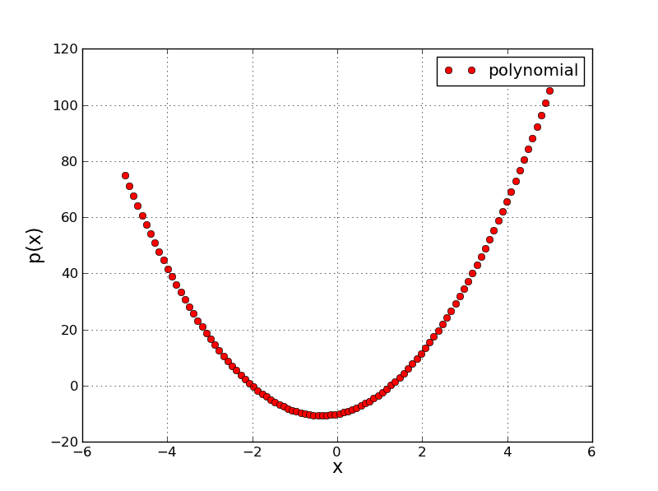
Style plotting
Lecture 7: Polynomial plotting in Python
M.Sc. Riyadh Saeed Agid
Salahaddin University – Erbil
riyadh.agid@su.edu.krd

Slide 2
Array statistics
As we know the power of computers is based on their ability to a achieve large number of calculations in a short time.
To get this in an efficient way, its very necessary to keep data tacking and organize it in an effective way.
Placing of data in an arrays is one of the best method, but Python as a programming language not recognize arrays. However, dealing with arrays is one of the important functions in NumPy package.
1D array: An array that has one row or column, vectors are example of such type of arrays.
2D array: An array of n rows and m columns where n>1, m>1. Matrices are example of 2D arrays.
nD array: an array formed from n dimensions. This is a generalization of 1 and 2D arrays.
For 1D array x:
All these functions are includes in NumPy package
len(x): length of an array.
x[0] : return entry zero.
x[3] : return entry three.
x[-1] : return the last entry.
x[-3] : return the third to last entry.

Slide 3
Note : Remember that the entries of an array of length n are numbered from 0 to n-1
x[p:t ] : return entries p to t-1.
x[p: ] : return entries p to end.
x[ :t ] : return entries from start to (t-1).
x[s:-q] : return entries s to q from end
Example:
>>> x= array([2, 4, 1, 11, 44, 6, 8, 0, 4, 3, 2],float)
>>>x[2:-2]
array([1, 11, 44, 6, 8, 0, 4])
max(x) : return the maximum entry.
min(x) : return the minimum entry.
sort(x) : sort array in ascending order.
sum (x) : sum of entries in an array.
mean(x) : calculates mean of an entry.
std(x) : calculates the standard deviations of entries.

Slide 4
Polynomials in Python
The function poly1d() can be used to define the polynomials. To use it properly you need first to specify the coefficient.
Example:
>>>y=poly1d([3,2,6])
>>> print y
By using this code you will see that this makes a polynomial with the equation 3x² + 2x +6, i.e. highest order term first. Also the terms number defines the degree of the polynomial.
Note: You should Take care when entering polynomials containing coefficients that are zero. For example 5x³ +2x must be entered with coefficients [5, 0, 2, 0].

Slide 5
Polynomial plotting
To making graph with polynomial function we need to define the following:
Define the polynomial
Organize an array of x points that you intend to plot the polynomial of interest.
Evaluate the polynomial at each array point.
Finally plot the polynomial.
Example:
Plot the function 4x² +3x-10 by creating an array of x points between -5 and 5.
>>>import matplotlib.pyplot as plt
>>>from numpy import*
>>> p= poly1d([4,3,-10])
>>>x= linspace(-5, 5, 100)
>>> y= p(x)
>>>plt.plot(x,y, ‘ro')
>>>Plt.show()
Note: Add legend and label to the axes

Slide 6
How we can get the roots of polynomial
The root of polynomial can be obtained by solving the equation p(x)=0. Witten in the form like (x-a)(x-b)=0 so a and b are the roots of polynomial. In Python programming we can find the root of above polynomial that we defined by typing roots(p).
>>> print roots(p)
[-2 1.25 ]
In this example you have to get an array of two real roots, - 2 and 1.25. which is agree with the plotting below.
x=1.25
y= 0
x=-2, y=0

Slide 7
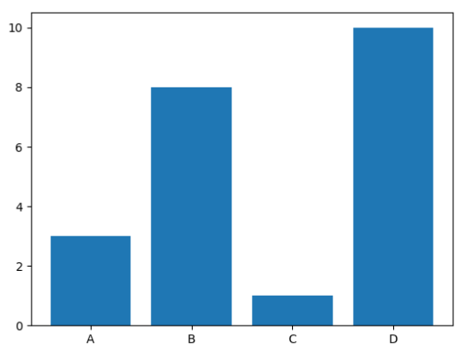
Creating Bars
With Pyplot, you can use the bar() function to draw bar graphs:
import matplotlib.pyplot as plt import numpy as np x = np.array(["A", "B", "C", "D"]) y = np.array([3, 8, 1, 10]) plt.bar(x,y) plt.show()
Bar Color
The bar() and barh() takes the keyword argument color to set the color of the bars:

Slide 8
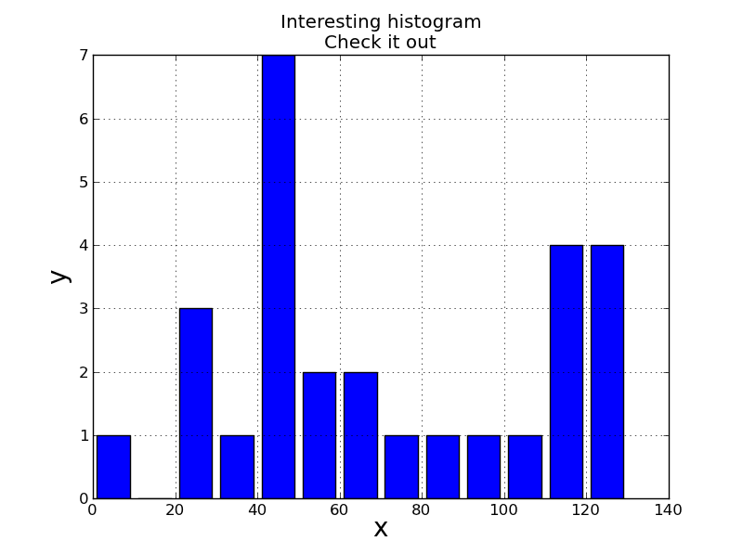
Histograms
Histograms are a very useful way to graphically display 1D data. You can plot a histogram for an array r using hist(r).
Example 1:
>>>import matplotlib.pyplot as plt
>>>ages = [22,55,62,45,21,22,34,42,42,4,99,102,110,120,121,122,130,111,115,112,80,75,65,54,44,43,42,48]
>>>bins = [0,10,20,30,40,50,60,70,80,90,100,110,120,130]
>>>plt.hist(ages, bins, histtype='bar', width=0.8)
>>>plt.xlabel('x')
>>>plt.ylabel('y')
>>>plt.title('Interesting histogram\nCheck it out')
>>>plt.legend()
>>>plt.grid()
>>>plt.show()

Slide 9
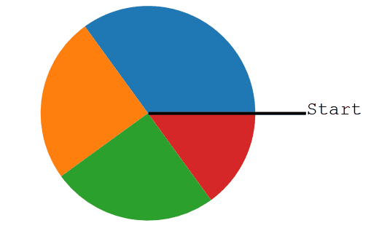
Matplotlib Pie Charts
Creating Pie Charts
With Pyplot, you can use the pie() function to draw pie charts:
import matplotlib.pyplot as plt import numpy as np y = np.array([35, 25, 25, 15]) plt.pie(y) plt.show()
NOTE:By default the plotting of the first wedge starts from the x-axis and move counterclockwise:

Slide 10
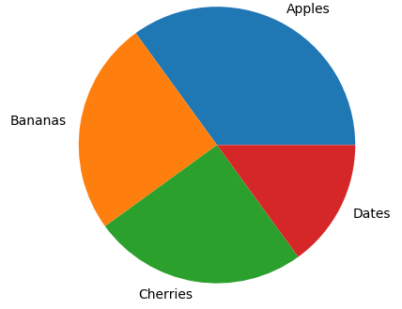
Labels
Add labels to the pie chart with the label parameter.
The label parameter must be an array with one label for each wedge:
import matplotlib.pyplot as plt import numpy as np y = np.array([35, 25, 25, 15]) mylabels = ["Apples", "Bananas", "Cherries", "Dates"] plt.pie(y, labels = mylabels) plt.show()

Slide 11
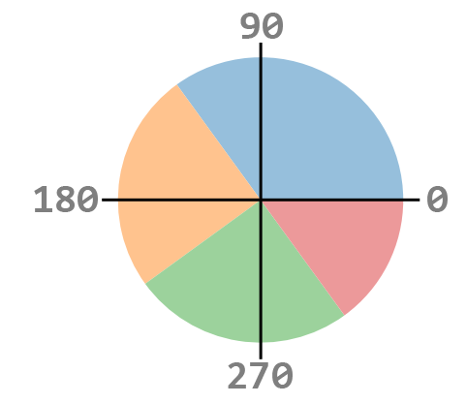
Start Angle
As mentioned the default start angle is at the x-axis, but you can change the start angle by specifying a startangle parameter.
The startangle parameter is defined with an angle in degrees, default angle is 0:

Slide 12
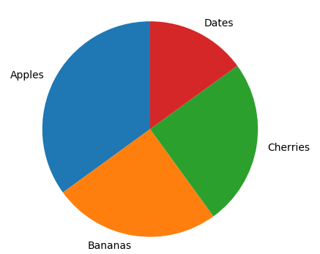
import matplotlib.pyplot as plt import numpy as np y = np.array([35, 25, 25, 15]) mylabels = ["Apples", "Bananas", "Cherries", "Dates"] plt.pie(y, labels = mylabels, startangle = 90) plt.show()

Slide 13
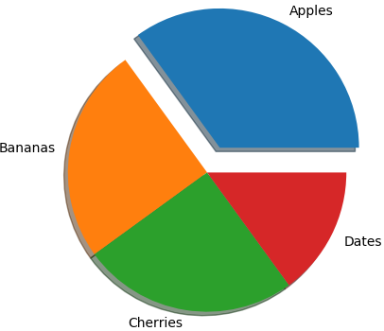
Explode
Maybe you want one of the wedges to stand out? The explode parameter allows you to do that.
Shadow
Add a shadow to the pie chart by setting the shadows parameter to True:
import matplotlib.pyplot as plt import numpy as np y = np.array([35, 25, 25, 15]) mylabels = ["Apples", "Bananas", "Cherries", "Dates"] myexplode = [0.2, 0, 0, 0] plt.pie(y, labels = mylabels, explode = myexplode, shadow = True) plt.show()

Slide 14
Python strings
Strings are the most popular types in Python. We can create them simply by enclosing characters in quotes. Python treats single quotes the same as double quotes. Strings is as simple as assigning a value to a variable.
>>>var1= ‘Hello Python’
>>>var2= ‘Python Programming’
We can access substrings, by using the square brackets for slicing along with the index or indices to obtain your substring:
Example:
>>>print var1[0]
>>>print var2[1:5]
var1[0] : H
var2[1:5]: ytho

Slide 15
>>>print ‘update string:.’ var1[:6]+’Python’
Hello Python
Length of string:
>>>len(var1)
12
Finding
>>>Print var1.count(‘t’) #counts how many times ‘t’ in the string.
1
Split slicing
>>>Print var1.split (‘space’)
[‘Hello’,’Python’]
startswith(‘H’)
>>> var1.startswith(‘H’)
True

Slide 16
endswith
>>>var1.endswith(‘n’)
True
replacing
>>>var1.replace (‘Hello’, ‘Goodbye’)
‘Goodbye Python’
String upper and lower
>>> var1.lower()
‘hello python’
>>> var1.upper()
‘HELLO PYTHON’

Slide 17
Thank you

