Slide 1
Writing and plotting
Lecture 8: Writing and plotting Python straight line program
M.Sc. Riyadh Saeed Agid
Salahaddin University – Erbil
riyadh.agid@su.edu.krd

Slide 2
Straight line program
It will let you know how to plot and analyze data, by calculating the best fit of first order polynomial function (straight line y = mx+c) fit, i.e. it will determine the best fit values of slope and line intersection with y axis.
Note: the formatting of the script with comments to explain what each code is doing.

Slide 3
#Example code: X-Y Fit
>>> from numpy import*
>>> import matplotlib.pyplot as plt
# Data from experiment entered in arrays
>>> x_array = array( [0.3, 1, 2, 3, 4, 5], dtype=float)
>>> y_array = array( [2.2, 3.6, 4, 5, 6.7, 7.45])
# Plot data points
>>> plt.plot( x_array, y_array, “kx”, markersize=10, label=“data”)
# Find and plot 1st order line of best fit
>>> p_coeff = polyfit( x_array, y_array, 1)
>>> p = poly1d( p_coeff)
>>> x = linspace( 0, 5, 100)
>>> plt.plot( x, p(x), label=“Best Fit Line”)
print p

Slide 4
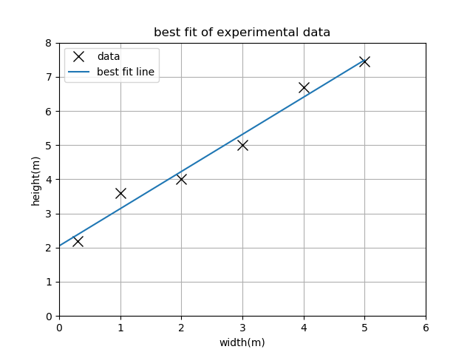
# Add titles/labels and a legend to the graph
>>> plt.title( “Best Fit of Experimental Data”)
>>> plt.xlabel( “Width (m)”)
>>> plt.ylabel( “Height (m)”)
>>> plt.legend( loc=“best”)
# Format the graph to be easily readable
>>> plt.grid()
>>> plt.xlim(0, 6)
>>> plt.ylim(0, 8)
>>> plt.show()
To find values of slope (m) and intercept (c), use these commands:
>>> print "The slope of the best fit line is ", p_coeff[0]
>>> print "The intercept of the fit line is ", p_coeff[1]

Slide 5
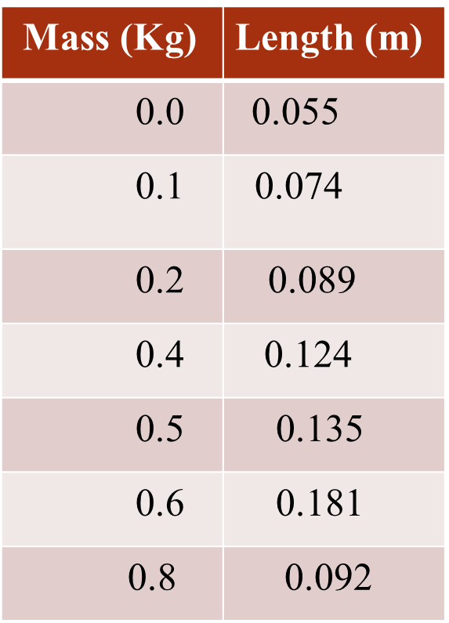
The following sections show how a program will be developed and tested that allows data to be input, plots the data and fits the best straight line to it.
You will be consider all the stages of writing and running a program.
Finally, you will have written an important program for use in this year and beyond.
H.W
For example, In an experiment the length of spring is measured versus masses and the results are given in the table a side. It is clear that the graph of length versus mass is a sensible straight line. We will use these values afterword to test any Python code that is developed. Also the full values are useful for you to test the code validity.
Notes:
For example, In an experiment the length of spring is measured versus masses and the results are given in the table aside.It is clear that the graph of length versus mass is
a sensible straight line. We will use these values afterword to test any Python code that is developed.
Also the full values are useful for you to test the code validity.

Slide 6
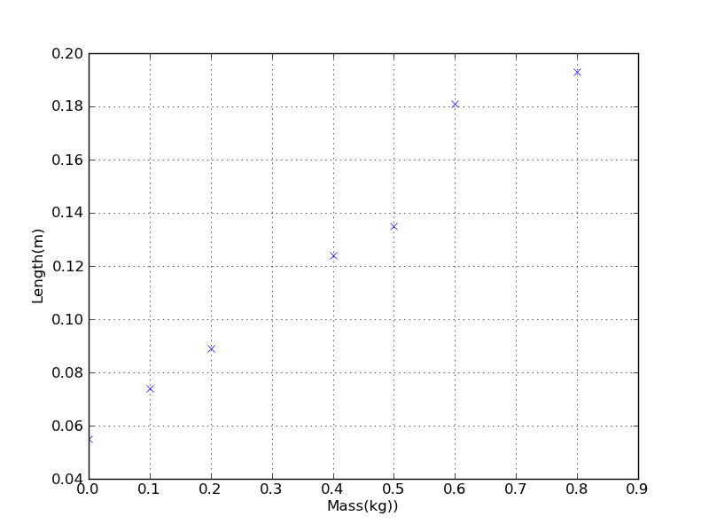
Input and data plotting
Use what you have learnt previously and do the following steps:
Make two arrays, one including the masses (name this x_data) and the second containing the lengths (call this y_data).
Make a plot of length in metres vs mass in kilograms. Choose a marker for the points but do not join the points with a line.
Label the axes of the plot.
You should get a plot looks like the figure.
The plot is based on some Python codes
that you learnt before so try to do that and
save it in your computer! H.W

Slide 7
Saving a program
You should try to keep your codes organised in a logical way so that you can use them later. Save your current program:
In your hard drive H
In a folder named (Python First semester 2rd year).
In sub-folder named week (5, 6, …).
With reasonable name such as ( straight_line_prog .py)
Make certain to use the extension .py when you intend to save the program. If you do this, then your computer will know to expect the file to contain python code (such as a .doc file is expected to be a word document).

Slide 8
Running code under Python and adding comments
As you know the written codes require NumPy and Matplotlib packages. So we need both of these packages to be available when a script is run. This can be done in one of two ways:
Run in the existing Python environment
Load the relevant packages into the program
You can also add comments when you are writing code, it is essential to use notes about what you are doing, to make it easier to read. In computer code these notes are known as comments. As in a lab diary, try to include comments that will make sense to another person. Generally, comments are the most useful for you when you come back to a program after days or months and trying to remember what you did.

Slide 9
There are two ways to add comments to a python program.
Hash symbol, #
Anything that follows hash symbol # is regarded as a comment, and will not be read by the computer.
Example
y=x+5 # python will read the expression but ignore the words.
Using of quotation marks
Using of three successive quotation marks to comment out blocks of text, these marks should be at the start and end of the block of text.
Example
x=1
“”” x=x+5”””
print x
1
The capability to use a comment to out a block of code can be useful when you trying to truck error in a program. For instance, If the code isn't working as you expected, then you can comment out one (or a few lines) of code and try running again.

Slide 10
Short quiz and answer
What is expression and statement in Python?
An expression is a combination of values, variables, and operators. A value all by itself is considered an expression. A statement is a unit of code that the Python interpreter can execute. We have seen two kinds of statement: print and assignment.
floating-point: A type that represents numbers with fractional parts.
string: A type that represents sequences of characters.
variable: A name that refers to a value.
expression: A combination of variables, operators, and values that represents a single result value.
comment: Information in a program that is meant for other programmers (or anyone reading the source code) and has no effect on the execution of the program.

Slide 11
Thank you

