Slide 1
Lecture 9: Opening files in Python
M.Sc. Riyadh Saeed Agid
Salahaddin University – Erbil
riyadh.agid@su.edu.krd

Slide 2
Opening file in Python
Files are always be part of computing in one form or another. To open file in Python follow these steps:
Specify the name of the file you wish to open. You can create the file with the file name you choose if the file name is not previously exist.
Determine what you wish, reading from the file, writing to the file or both.
Use the open() method to open a file and create a file object: file = open(“file.txt”) This open or create file.txt for reading and for writing.
Know that if you wish to open a file only for reading or only for writing, you can pass a second argument to open(). Pass 'r' for read only, 'w' for write only and 'rw' for explicit read-write.
Be sure to call the close() method to close any open file handles once you are done using the file, so that later processes can access the file: file.close

Slide 3
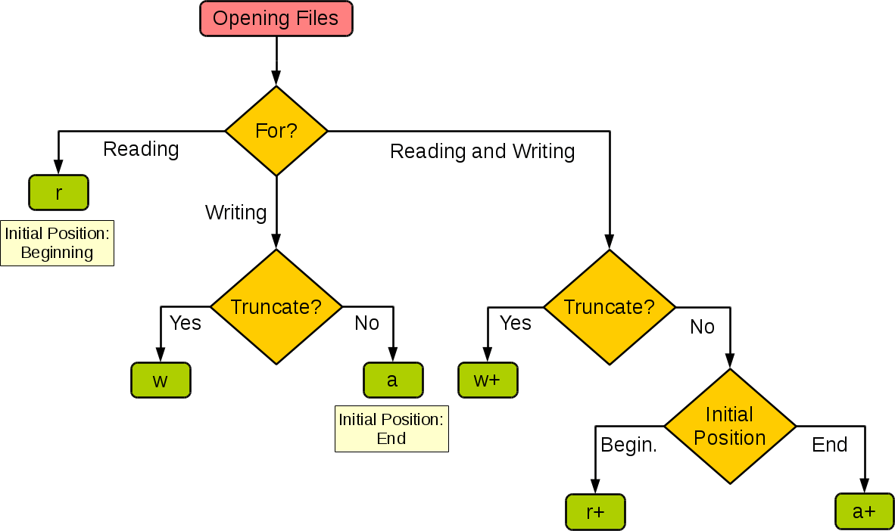

Slide 4
Example:
f= open(“filename. Extension file”, “r”)
f.close()
When you use the open function, it returns something called a file object. File objects include methods that can be used to collect any information about the opened file.
Types of file
In Python, a file is either text or binary, and the difference between them is important.
Text files are built as a sequence of lines, where each line contain a sequence of characters. This is what you know as code or syntax.
A backslash (\n) character can also be used, and it tells the interpreter that the next character – following the slash – should be treated as a new line. This character is useful when you don’t want to start a new line in the text itself but in the code.
A binary file is any type of file that is not a text file.

Slide 5
Generally the syntax for open file is:
file_object=open(“file name”,”mode”)
Mode includes mode of argument such as
‘r’ – Read mode which is used when the file is only being read
‘w’ – Write mode which is used to edit and write new information to the file (any existing files with the same name will be erased when this mode is activated)
‘a’ – Appending mode, which is used to add new data to the end of the file; that is new information is automatically amended to the end
Example:
F= open(“test.txt”, “w”)
print (F)
This opened a file under name (test) in writing mode. The stored information in the file is also displayed or print to our view.

Slide 6
Reading and writing files
The write() method
The write() method writes any string to an open file. It is important to note that Python strings can have binary data and not just text
Syntax
Fileobject.write(string);
Example
f = open("foo.txt", "w")
f.write( "Python is a great language.\nYeah that’s correct!!\n")
# Close opend file
f.close()
The write method here produce foo.txt file and would write given content in that file and finally it would close that file.

Slide 7
The read() method
Syntax
Fileobject.read([count]);
This method starts reading from the beginning of the file and if count is missing, then it tries to read as much as possible.
demofile.txt
Hello! Welcome to demofile.txt This file is for testing purposes. Good Luck!
To open the file, use the built-in open() function.
The open() function returns a file object, which has a read() method for reading the content of the file:
Example:
f = open("demofile.txt", "r") print(f.read())
Open a file on a different location:
f = open("D:\\myfiles\welcome.txt", "r") print(f.read())

Slide 8
Read Only Parts of the File
By default the read() method returns the whole text, but you can also specify how many characters you want to return:
Example
Return the 5 first characters of the file:
f = open("demofile.txt", "r") print(f.read(5))
Hello
Example
f = open("foo.txt", "r+") #open file in both reading and wrtting
str = f.read(10);
print ("Read String is : ", str)
# Close opend file
f.close()

Slide 9
Example:
f= open(“test.txt” , “w”)
f.write(“ Hello Test”)
f.write (“This is my test file”)
f.write (“ It allow me to do something new”)
f.close()
Reading text file in Python
There are some ways to read a text file.
If you need to extract a string that contains all characters in the file, you can use the following method:
file.read()
and the full code is
file= open(“test.txt”, “r”)
print (file.read())
The output of that command will display all the text inside the file.

Slide 10
In case of we want to read a file line by line and not pulling the content of the entire file at once, then we can use:
readline() function.
Why would we use something like this?
Let’s assume we like to see the first line of the file – or the second, third. Then we would execute the readline() function as many times as possible to get the data we were looking for.
Each time you run the method, it will return a string of characters that contains a single line of information from the file.
f= open(“test.txt”, “r”)
print (f.readline())

Slide 11
Deleting and renaming files in Python
Python includes module os that helps to achieve file processing such as deleting or renaming. To use such module we need to import it first as … import os.
Rename file:
syntax
os.rename(“current_file”, “new_file”)
Example:
import os
os.rename(“test1.txt”, “test2.txt”) # rename file from test1 to new name test2.
Remove file.
Syntax
os.remove(file_name)
Example:
import os
os.remove(test1.txt) # This is the path, which is to be removed..
Furthermore, The os module has several ways that help you to create, remove, and change directories

Slide 12
The mkdir()
The mkdir() method of the os module helps you to create directories in the current directory.
Syntax
os.mkdir(“newdir”)
Example
import os
os.mkdir(“test”) # make a directory test.
The chdir()
Syntax
os.chdir(“new directory”)
Example
import os
Os.chdir(“home/new directory”) # changing directory to home/new directory

Slide 13
The getcwd() :
This display the current working directory.
Syntax
os.getcwd()
Example
os.getcwd()# this will display the location of current working directory
The rmdir():
The rmdir() method deletes the directory.
Syntax
os.rmdir(‘dirname’)
Example
Following is the example to remove "/tmp/test" directory. It is required to give fully qualified name of the directory, otherwise it would search for that directory in the current directory
Import os
os.rmdir(“dir”) #will remove dir.

Slide 14
Thank you

