Slide 1
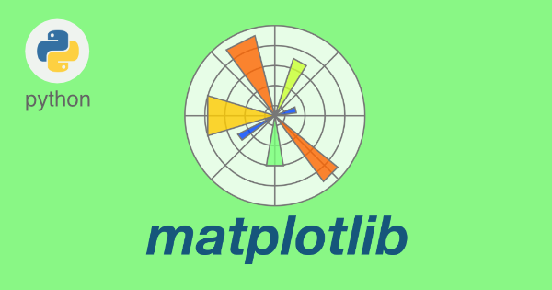
plotting in python
Lecture 6: Introduction to plotting in python
M.Sc. Riyadh Saeed Agid
Salahaddin University – Erbil
riyadh.agid@su.edu.krd

Slide 2
Installation of Matplotlib
If you have Python and PIP already installed on a system, then installation of Matplotlib is very easy.
Install it using this command:
C:\Users\Your Name>pip install matplotlib
You need to have the following installed on your computer to be able to make nice plots
Python
NumPy
Matplotlib
Also you can check which version you installed by doing :

Slide 3
>>>import numpy
>>>numpy.__version__
#It should be something like this
‘1.5.1’
>>>import matplotlib
>>>matplotlib.__ version__
#Should give you something like:
‘1.0.1’

Slide 4
Basic plotting
MatPlotLib is a python based plotting package. It is what we are using to make all of the plots in this stage. So, all of the plotting functions below are contained in the MatPlotLib package.
Function | Syntax
Open a new plotting window | figure(figsize())
Graph of y against x | plot(x, y)
Clear the plotting window | clf()
Graph of array (b) against array (a) where both axes are log scales | loglog(a, b)
Graph of array (b) against array (a) with log scale on the x axis | semilogx(a, b)
Graph of array (b) against array (a) with log scale on the y axis | semilogy(a, b)

Slide 5
Function | Description
Plot | plots y versus x as lines and/or markers
Show | displays a figure
Axis | sets some axis properties
Xlabel | sets the label for the x-axis
Ylabel | sets the label for the y-axis
Title | sets a title for the axes
Subplot | adds a subplot to the current figure
Subplots_adjust | tunes the subplot layout
Legend | places a legend on the axes
Figure | creates a new figure
Savefig | saves the current figure

Slide 6
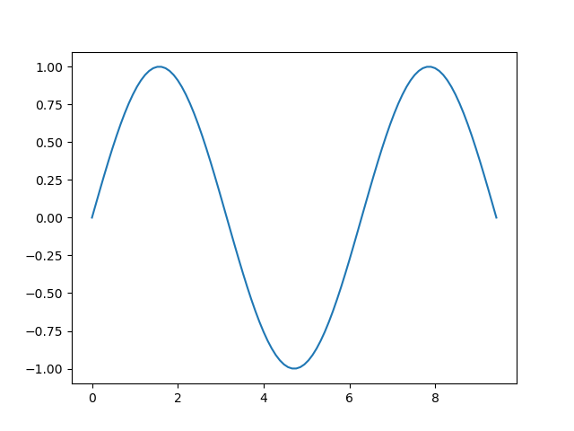
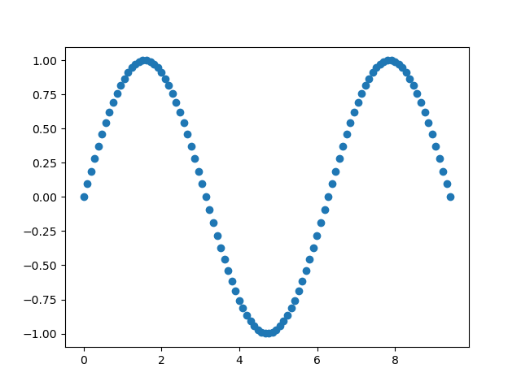
Two plot types which you will find are used very often in python, are line and scatter plots.
Line and scattered plots
The scatter() function plots one dot for each observation. It needs two arrays of the same length, one for the values of the x-axis, and one for values on the y-axis:
Example
>>> import matplotlib.pyplot as plt
>>> from numpy import*
>>> x= linspace(0, 3*pi, 100)
>>>plt.plot(x, sin(x) ) #line plot
>>> plt.show()
>>>plt.plot(x, sin(x), ‘o’) #Scattered
>>>plt.show()

Slide 7
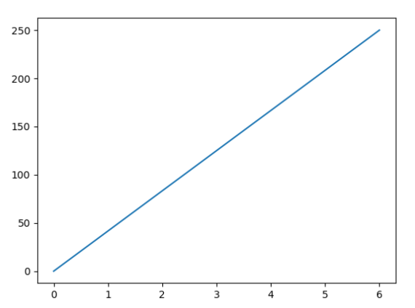
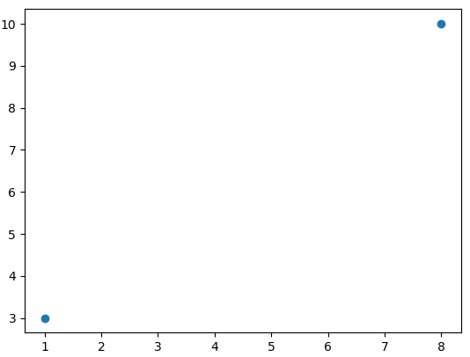
Plotting x and y points
import matplotlib.pyplot as plt
import numpy as np
x = np.array([0, 6])
y = np.array([0, 250])
plt.plot(x, y)
plt.show()
Plotting Without Line
import matplotlib.pyplot as plt import numpy as np xpoints = np.array([1, 8]) ypoints = np.array([3, 10]) plt.plot(xpoints, ypoints, 'o') plt.show()

Slide 8
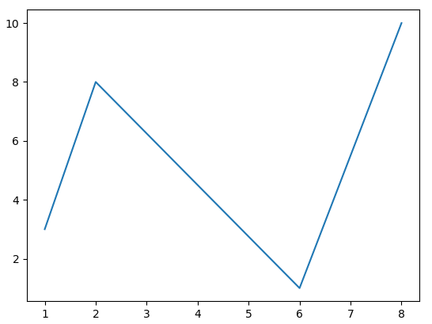
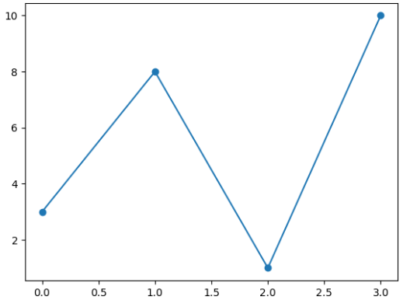
import matplotlib.pyplot as plt import numpy as np xpoints = np.array([1, 2, 6, 8]) ypoints = np.array([3, 8, 1, 10]) plt.plot(xpoints, ypoints) plt.show()
Matplotlib Markers
import matplotlib.pyplot as plt import numpy as np ypoints = np.array([3, 8, 1, 10]) plt.plot(ypoints, marker = 'o') plt.show()

Slide 9
Marker | Description
'o' | Circle
'*' | Star
'.' | Point
',' | Pixel
'x' | X
'X' | X (filled)
'+' | Plus
'P' | Plus (filled)
's' | Square
'D' | Diamond
'd' | Diamond (thin)
'p' | Pentagon
'H' | Hexagon
'h' | Hexagon
'v' | Triangle Down
'^' | Triangle Up

Slide 10
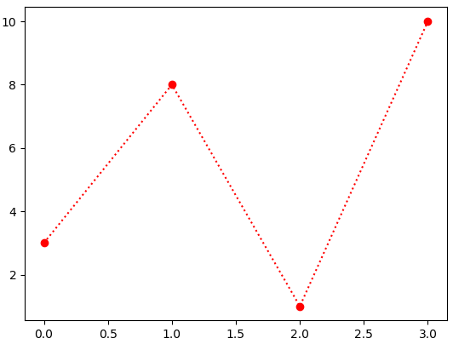
marker|line|color
import matplotlib.pyplot as plt import numpy as np ypoints = np.array([3, 8, 1, 10]) plt.plot(ypoints, 'o:r') plt.show()
Line Reference
Line Syntax | Description
'-' | Solid line
':' | Dotted line
'--' | Dashed line
'-.' | Dashed/dotted line

Slide 11
The earlier plot are by no means complete. It require an axes labels and title. Furthermore, one may also need to specify the scale or limits of the axes, or the width and colour of the lines to make the graph better and easier to read. Also, it is very useful to be able to plot more than one set of data on the same axes and to be able to distinguished between them by using different line, marker styles, and colours. Here are some colour options:
Color Reference
Character | Colour
b | blue
g | green
r | red
c | cyan
m | magenta
y | yellow
k | black

Slide 12
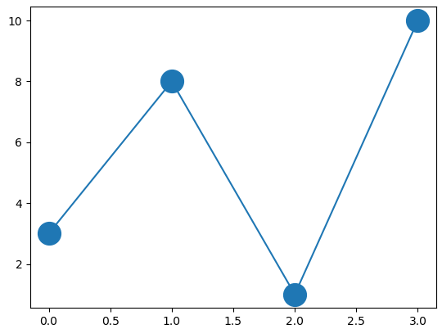
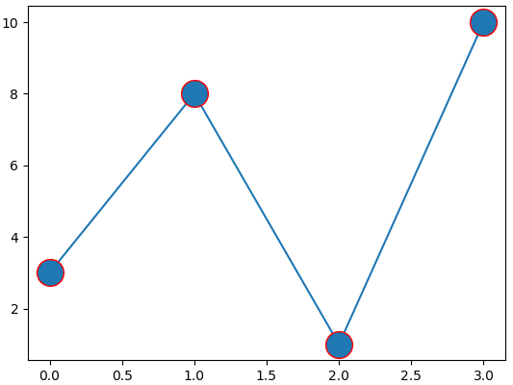
Marker Size
import matplotlib.pyplot as plt import numpy as np ypoints = np.array([3, 8, 1, 10]) plt.plot(ypoints, marker = 'o', ms = 20) plt.show()
markeredgecolor
import matplotlib.pyplot as plt import numpy as np ypoints = np.array([3, 8, 1, 10]) plt.plot(ypoints, marker = 'o', ms = 20, mec = 'r') plt.show()

Slide 13
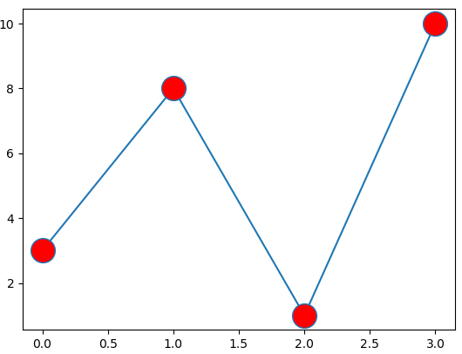
Markerfacecolor
import matplotlib.pyplot as plt import numpy as np ypoints = np.array([3, 8, 1, 10]) plt.plot(ypoints, marker = 'o', ms = 20, mfc = 'r') plt.show()

Slide 14
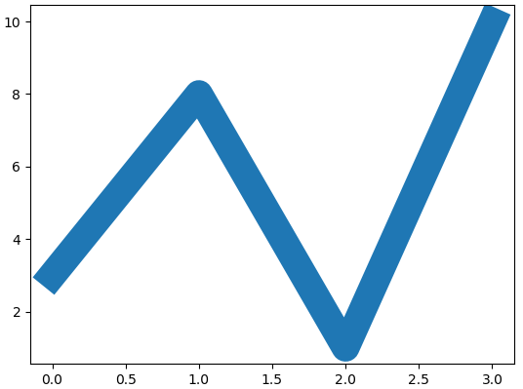
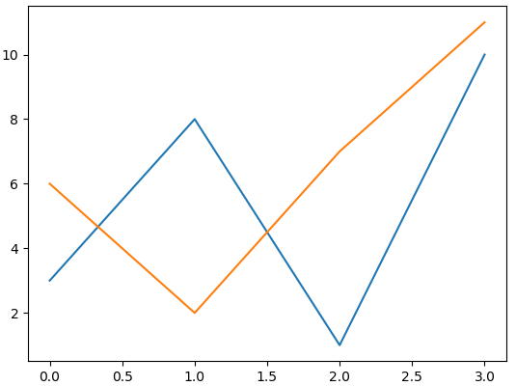
Line Width
import matplotlib.pyplot as plt import numpy as np ypoints = np.array([3, 8, 1, 10]) plt.plot(ypoints, linewidth = '20.5') plt.show()
import matplotlib.pyplot as plt import numpy as np x1 = np.array([0, 1, 2, 3]) y1 = np.array([3, 8, 1, 10]) x2 = np.array([0, 1, 2, 3]) y2 = np.array([6, 2, 7, 11]) plt.plot(x1, y1, x2, y2) plt.show()

Slide 15
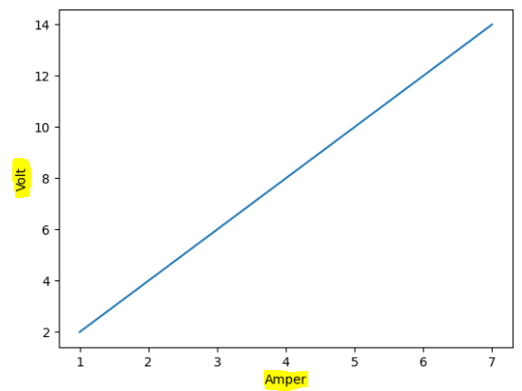
Matplotlib Labels and Title
Create Labels for a Plot
With Pyplot, you can use the xlabel() and ylabel() functions to set a label for the x- and y-axis
Example
Add labels to the x- and y-axis:
import numpy as np
import matplotlib.pyplot as plt
x = np.array([1, 2, 3, 4, 5, 6, 7])
y = np.array([2, 4, 6, 8, 10, 12, 14])
plt.plot(x, y)
plt.xlabel("Amper")
plt.ylabel("Volt")
plt.show()

Slide 16
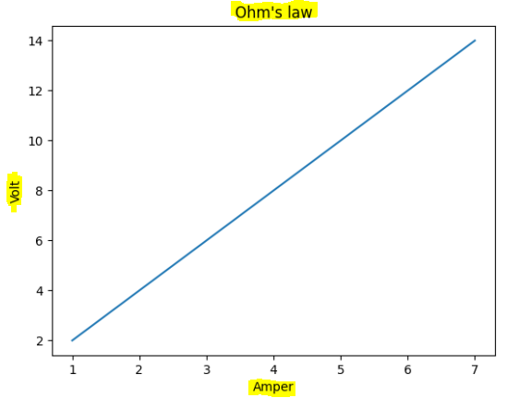
Create a Title for a Plot
With Pyplot, you can use the title() function to set a title for the plot.
Example
Add a plot title and labels for the x- and y-axis:
import numpy as np
import matplotlib.pyplot as plt
x = np.array([1, 2, 3, 4, 5, 6, 7])
y = np.array([2, 4, 6, 8, 10, 12, 14])
plt.plot(x, y)
plt.title("Ohm's law")
plt.xlabel("Amper")
plt.ylabel("Volt")
plt.show()

Slide 17
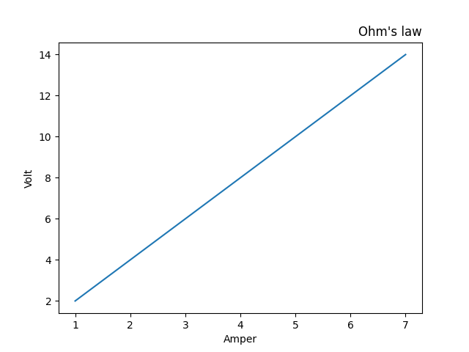
Style and Formatting plotting in Python
Position the Title
You can use the loc parameter in title() to position the title.
Legal values are: 'left', 'right', and 'center'. Default value is 'center'.
import numpy as np
import matplotlib.pyplot as plt
x = np.array([1, 2, 3, 4, 5, 6, 7])
y = np.array([2, 4, 6, 8, 10, 12, 14])
plt.plot(x, y)
plt.title("Ohm's law",loc="right")
plt.xlabel("Amper")
plt.ylabel("Volt")
plt.show()

Slide 18
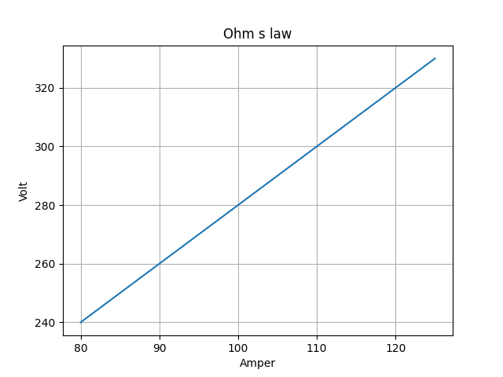
Add Grid Lines to a Plot
With Pyplot, you can use the grid() function to add grid lines to the plot.
import numpy as np import matplotlib.pyplot as plt x = np.array([80, 85, 90, 95, 100, 105, 110, 115, 120, 125])
y = np.array([240, 250, 260, 270, 280, 290, 300, 310, 320, 330])
plt.title(“Ohm's law”)
plt.xlabel(“Amper”)
plt.ylabel(“Volt”)
plt.plot(x,y) plt.grid() plt.show()

Slide 19
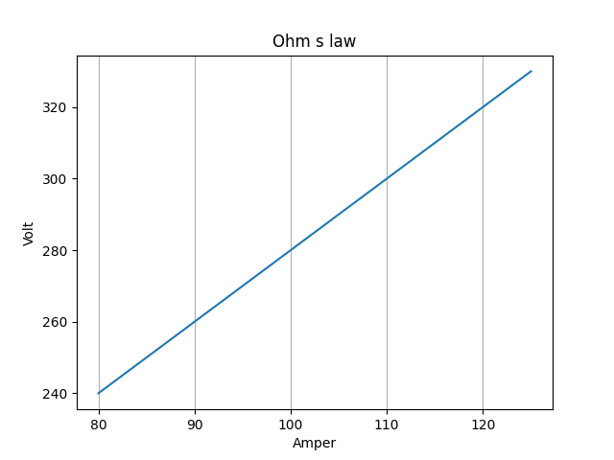
import numpy as np import matplotlib.pyplot as plt x = np.array([80, 85, 90, 95, 100, 105, 110, 115, 120, 125])
y = np.array([240, 250, 260, 270, 280, 290, 300, 310, 320, 330])
plt.title(“Ohm's law”)
plt.xlabel(“Amper”)
plt.ylabel(“Volt”)
plt.plot(x,y)
plt.grid(axis=‘x’) # we use gridlines for the y-axis: plt.show()

Slide 20
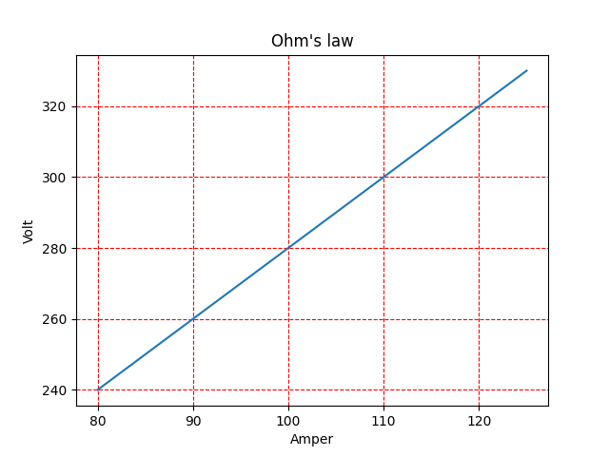
Line Properties for the Grid
Set the line properties of the grid, like this:
grid(color='color',linestyle='linestyle', linewidth =number).
import numpy as np
import matplotlib.pyplot as plt
x = np.array([80, 85, 90, 95, 100, 105, 110, 115, 120, 125])
y = np.array([240, 250, 260, 270, 280, 290, 300, 310, 320, 330])
plt.title("Ohm's law")
plt.xlabel("Amper")
plt.ylabel("Volt")
plt.plot(x, y)
plt.grid(color = 'red', linestyle = '--', linewidth = 0.8)
plt.show()

Slide 21
Matplotlib Subplots
With the subplots() function you can draw multiple plots in one figure:
the figure has
1 row
2 columns
plot is the first plot.
plt.subplot(1, 2, 1)
plt.subplot(1, 2, 2) this plot is the second plot.
Title
You can add a title to each plot with the title() function:
Super Title
You can add a title to the entire figure with the suptitle() function:

Slide 22
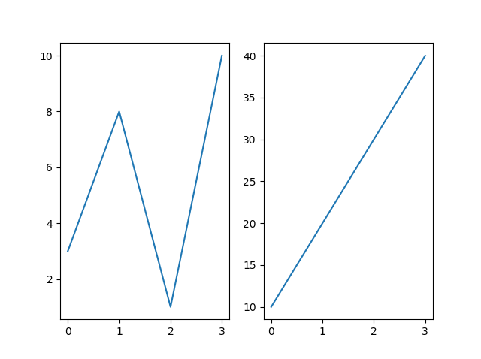
import matplotlib.pyplot as plt import numpy as np #plot 1: x = np.array([0, 1, 2, 3]) y = np.array([3, 8, 1, 10]) plt.subplot(1, 2, 1) plt.plot(x,y) #plot 2: x = np.array([0, 1, 2, 3]) y = np.array([10, 20, 30, 40]) plt.subplot(1, 2, 2) plt.plot(x,y) plt.show()

Slide 23
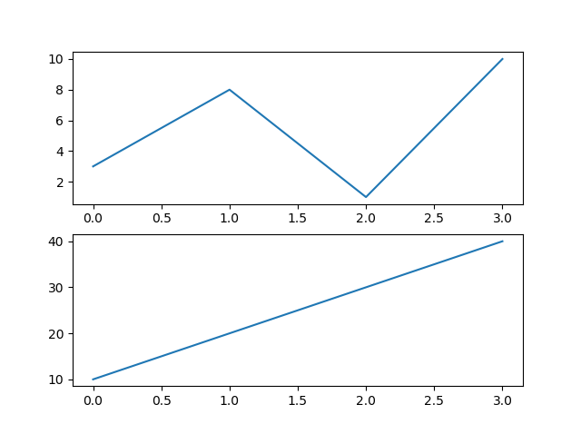
import matplotlib.pyplot as plt import numpy as np #plot 1: x = np.array([0, 1, 2, 3]) y = np.array([3, 8, 1, 10]) plt.subplot(2, 1, 1) plt.plot(x,y) #plot 2: x = np.array([0, 1, 2, 3]) y = np.array([10, 20, 30, 40]) plt.subplot(2, 1, 2) plt.plot(x,y) plt.show()

Slide 24
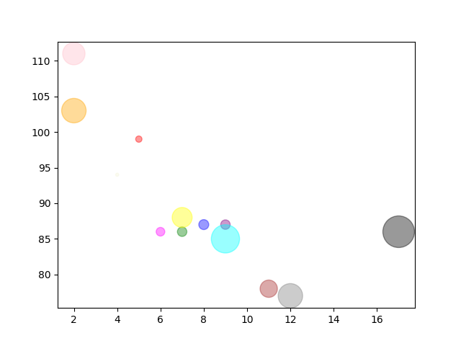
import matplotlib.pyplot as plt
import numpy as np
x = np.array([5,7,8,7,2,17,2,9,4,11,12,9,6])
y = np.array([99,86,87,88,111,86,103,87,94,78,77,85,86])
sizes = np.array([40,90,100,400,500,1000,600,90,10,300,600,800,75])
Colors=np.array(["red","green","blue","yellow","pink","black","orange","purple","beige","brown","gray","cyan","magenta"])
plt.scatter(x, y, s=sizes,c=colors, alpha=0.4)
plt.show()

Slide 25
Thank you

