Slide 1
Bearing Capacity of
Shallow Foundation

Slide 2
Ultimate Bearing Capacity of Shallow Foundation:
To perform satisfactorily, shallow foundations must have two main characteristics:
1. They have to be safe against overall shear failure in the soil that supports them.
2. They cannot undergo excessive or settlement. (The term excessive I relative, because the degree of settlement allowed for a structure depends on several considerations.)
The load per unit area of the foundation at which shear failure in soil occurs is called the ultimate bearing capacity
Mode of Bearing Capacity Failures:
Bearing capacity failures of foundations can be grouped into three categories
1- General shear failure.
2- Local shear failure
3- punching shear failure

Slide 3
A strip foundation with a width of B resting on the surface of a dense sand or stiff cohesive soil, At a certain point when a sudden failure in the soil supporting the foundation will take place, and the failure surface in the soil will extend to the ground surface 3.1a. This load per unit area, is usually referred to as the ultimate bearing capacity q_{u} of the foundation. When such sudden failure in soil takes place, it is called general shear failure.
If the foundation under consideration rests on sand or clayey soil of medium compaction. A considerable movement of the foundation is required for the failure surface in soil to extend to the ground surface 3.1b. The load per unit area at which this happens is the ultimate bearing capacity, q_{u}. Beyond that point, an increase in load will be accompanied by a large increase in foundation settlement. The load per unit area of the foundation, is referred to as the first failure load. Note that a peak value of q is not realized in this type of failure, which is called the local shear failure in soil.
If the foundation is supported by a fairly loose soil, the load–settlement plot will be like the one in Figure 3.1c. In this case, the failure surface in soil will not extend the ground surface. Beyond the ultimate failure load, the load–settlement plot will be steep and practically linear. This type of failure in soil is called the punching shear failure.

Slide 4
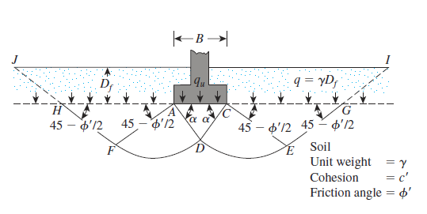
The Terzaghi Bearing-Capacity Equation
Terzaghi suggested that for a continuous, or strip, foundation (i.e., one whose width to-length ratio approaches zero), the failure surface in soil at ultimate load may be assumed to be similar to that shown in the Figure. The failure zone under the foundation can be separated into three parts :
1. The triangular zone ACD immediately under the foundation
2. The radial shear zones ADF and CDE, with the curves DE and DF being arcs of a logarithmic spiral
3. Two triangular passive zones AFH and CEG.
Figure 3.3 Bearing capacity failure in soil under a rough rigid
continuous (strip) foundation
q_{ult} = cN_{c}+ qN_{q}+ 0.5gBN_{g} ….. 3.1
(For strip footings, such as wall foundations)
For (vertical load- no eccentricity – horizontal ground – horizontal base)
Where, N_{c} , N_{q} and N_{g} are the soil-bearing capacity factors, dimensionless terms, whose values relate to the angle of internal friction .

Slide 5
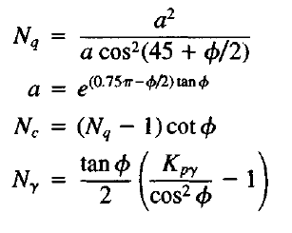
The bearing capacity factors are defined by
………. 3.2
……….. 3.3
………. 3.4
Where the K_{pg} values and variation of the bearing capacity factors which defined by equations (3.2), (3.3) and (3.4) are given in table (3.1)
q_{ult} = 1.3cN_{c}+ qN_{q}+ 0.4gBN_{g} ……. 3.5
(For square footings, typical of interior columns)
q_{ult} = 1.3cN_{c}+ qN_{q}+ 0.3gBN_{g} ……. 3.6
(For circular footings, such as towers, chimneys)
In equation (3.5), B equals to dimension of each side of the foundation in equation (3.6), B equals the diameter of the foundation.

Slide 6
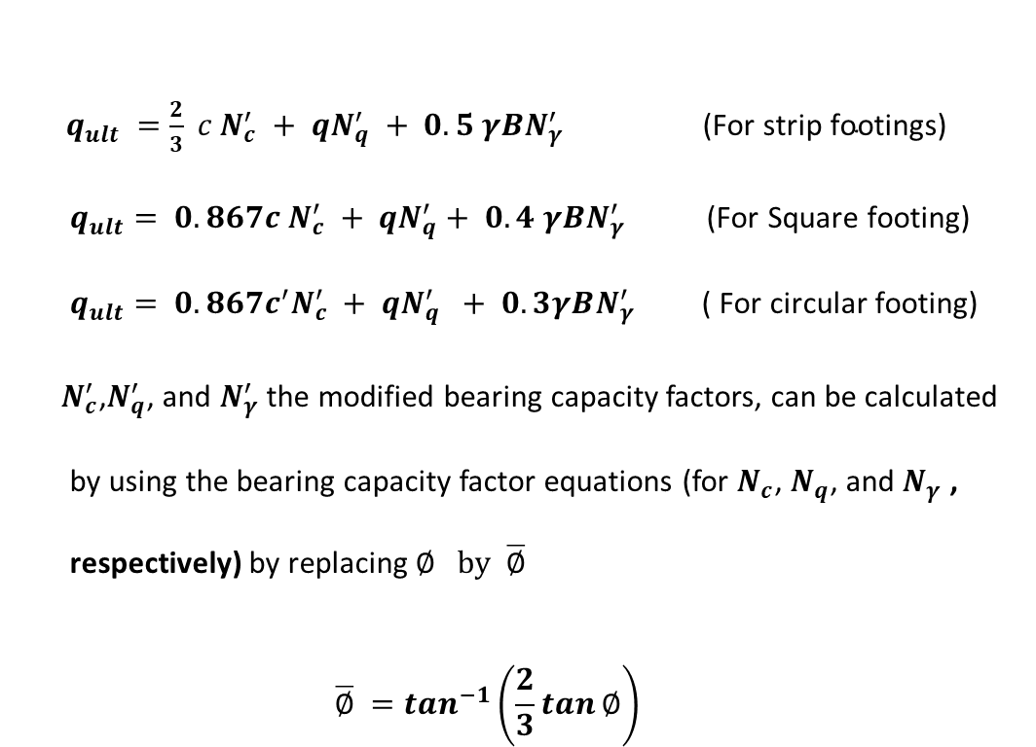
For foundations that exhibit the local shear failure mode in soils, Terzaghi suggested that the following modifications to equations (3.1), (3.5) and (3.6)
$q_{ult} =\frac{2}{3} c N_{c}^{′} + qN_{q}^{′} + 0.5 γBN_{γ }^{′} \text{(}\text{For} \text{strip} \text{footings}\text{)}$
$$q_{ult}= 0.867c N_{c}^{′} + qN_{q}^{′}+ 0.4 γBN_{γ}^{′} \text{(}\text{For} \text{Square} \text{footing}\text{)}$$
$$q_{ult}= 0.867c^{′}N_{c}^{′} + qN_{q}^{′} + 0.3γBN_{γ}^{′} \text{( }\text{For} \text{circular} \text{footing}\text{) }$$
$N_{c}^{′}$,$N_{q}^{′}$, and $N_{γ}^{′}$ the modified bearing capacity factors, can be calculated by using the bearing capacity factor equations (for $N_{c}$, $N_{q}$, and $N_{γ}$ , respectively) by replacing $∅ by \overline{∅}$
$$\overline{∅} =\tan^{−1}\left(\frac{2}{3}\tan{∅}\right)$$

Slide 7
Example 1
A square foundation is 1.5 m x 1.5 m in plan. The soil supporting the foundation has a friction angle of = 20° and c = 15.2 kN/m². The unit weight of the soil, $γ$ = 17.8 kN/m³. Assume that the depth of the foundation is (1 m) and that general shear failure occurs in the soil. Compute the ultimate bearing capacity of the soil. Use Terzaghi’ Method.
Solution:
For square footing use
q_{ult} = 1.3cN_{c}+ qN_{q}+ 0.4gBN_{g}
For Ø=20° from table 3-1
Nc =17.7 Nq =7.40 N_{g} =5
q_{u}=(1.3)(15.2)(17.69)+(1x17.8)(7.4)+(0.4)(17.8)(1.5)(5)
=349.55+131.72+53.4= 534.67kN/m²
Example 2
A circular foundation with 2m diameter. The soil supporting the foundation has Ø = 20° and c = 25 kN/m². The unit weight of the soil, $γ=18 kN/m^{3}$. Assume that the depth of the foundation is (1 m) and that local shear failure occurs in the soil. Compute the ultimate bearing capacity of the soil. Use Terzaghi’ Method.
Solution:
For circular footing (local shear failure)
q_{ult} = 0.867cN_{c}+ qN_{q}+ 0.3g BN_{g}
For Ø = 20°
$\overline{∅} =\tan^{−1}\left(\frac{2}{3}\tan{∅}\right)={13.64}^{°}$
N_{c}=11.85 N_{q}=3.88 N_{γ}=2.13
q_{u}= 0.867(25)(11.85)+(1x18)(3.88)+0.3(18)(2)(2.13)
= 256.8+69.8+23
=349.6 kPa

Slide 8
Allowable Bearing Capacity q_{all} :
q_{all} is the permissible soil pressure which keeps the footing safe against shear failure
$$q_{all}=\frac{q_{ult}}{FS}$$
where F.S is factor of safety against bearing capacity ranges between(2 – 4 )average of (3) is commonly used in most designs.
There are more uncertainties in determining the allowable strength of the soil than in the superstructure elements. A number of these uncertainties may be summarized as follows:
1- Complexity of soil behavior
2- Lack of control over environmental changes after construction
3- Incomplete knowledge of subsurface conditions
4-Inability to develop a good mathematical model for the foundation
5- Inability to determine the soil parameters accurately

Slide 9
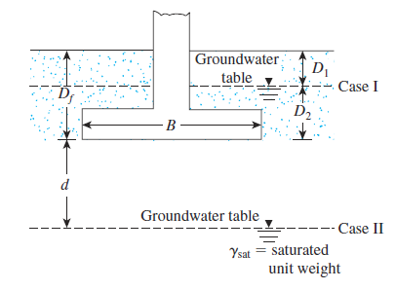
Effect of Water Table on Bearing Capacity
If the water table is close to the foundation, some modifications of the bearing capacity equations will be necessary. (See the Figure 3.4)
Figure 3.4 Modification of bearing capacity equations for water table

Slide 10

Meyerhof Equation
(vertical or inclined load- eccentricity – horizontal ground – horizontal base)
q_{ult}= cN_{c} s_{c} d_{c}+ q′ N_{q} s_{q} d_{q}+ 0.5 γ B N_{γ} s_{γ} d_{γ} for vertical load
q_{ult}= cN_{c} d_{c} i_{c+} q′ N_{q} d_{q} i_{q}+ 0.5 γ B N_{γ} d_{γ} i_{γ} for inclined load
$$N_{q}=\tan^{2}\left(45+\frac{ ∅}{2} \right)∗e^{π tan}∅^{′} 3.7$$
$$N_{c}=\left(N_{q}−1\right) ∗cot∅ for ∅^{′}>0 3.8$$
$$N_{c}=5.14 for ∅^{′}=0$$
$N_{γ}=\left(N_{q}−1\right) tan{1.4 ∅}^{′} 3.9$

Slide 11
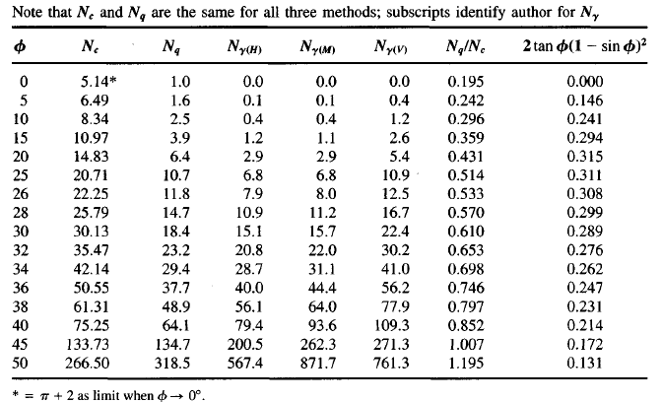
Table 3.2
Bearing-capacity factors for the Meyerhof, Hansen, and Vesic bearing capacity equations

Slide 12
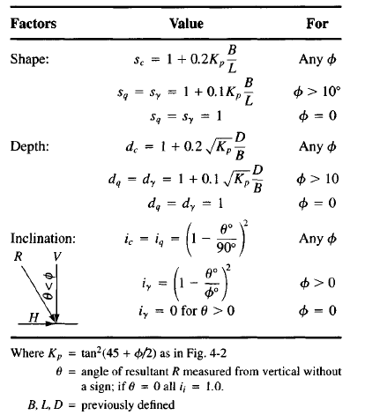
Table 3.3
Shape, depth, and inclination factors for the Meyerhof bearing-capacity equations of Table 3.2

Slide 13
Hansen Equation
(vertical or inclined load- eccentricity – horizontal. or slope ground – horizontal or slope base)
q_{ult}= cN_{c} s_{c} d_{c} i_{c} g_{c} b_{c}+ q′ N_{q} s_{q} d_{q} i_{q} g_{q} b_{q} + 0.5 γ B′N_{γ}s_{γ}d_{γ}i_{γ}g_{γ} b_{γ}
for general
When $∅=0 ⟹ N_{γ}=0,$
$Therefore$ ;
q_{ult}= 5.14c_{u} (1+s′_{c} +d′_{c} -i′_{c} - b′_{c}-g′_{c} )+ q′
N_{c}, N_{γ} , N_{q} = bearing capacity factors see Tables 3.2 or by the following equations
$N_{q}=\tan^{2}\left(45+\frac{ ∅}{2} \right)∗e^{π tan}∅^{′} 3.7$
$N_{c}=\left(N_{q}−1\right) ∗cot∅ for ∅^{′}>0 3.8$
$N_{c}=5.14 for ∅^{′}=0$
$N_{γ}=1.5 \left(N_{q}−1\right) tan{ ∅}^{′} 3.10$
c= cohesion of the soil ,q or q′= overburden pressure at footing base,
γ or γ′ = density of foundation soil
B′ = least dimension of the footing (width)
s_{c,} d_{c,} i_{c ,}g_{c} ,b_{c ,}s_{q,} d_{q,} i_{q ,}g_{q,} b_{q, ,}s_{γ ,}d_{γ,} i_{γ ,}g_{γ,} b_{γ} : are shape, depth, inclination, ground , and foot base factors from table 3.4 & 3.5.

Slide 14
The ultimate bearing capacity for footings with eccentricity, using either the Meyerhof or Hansen equations, is found in either of two ways:
Method 1.
Use either the Hansen bearing-capacity equation with the following adjustments:
a. Use B' in the γBN_{γ} term.
b. Use B' and L' in computing the shape factors
c. Use actual B and L for all depth factors. The computed ultimate bearing capacity q_{ult} is then reduced to an allowable value q_{all} with an appropriate safety factor SF as q_{all} = q_{ult}/SF
Method 2.
Use the Meyerhof general bearing-capacity equation and a reduction factor Re used as q_{uIt,} = q_{uIt, comp} * Re
it should be used only with the Meyerhof equation to compute the bearing capacity. The original Meyerhof method gave reduction curves; however, the following equations are suitable for obtaining the reduction factor:
Re = 1 - 2e/B (cohesive soil)
Re = 1 – (e/B)^{1/2} (cohesionless soil and for 0 < e/B < 0.3)
Alternatively, one may directly use the Meyerhof equation with B' and L' used to compute the shape and depth factors and B' used in the 0.5gB'N_{g} term.

Slide 15
Example 3
A footing load test made by a designer produced the following data:
D = 0.5 m B = 0.5 m L = 2.0 m
g' = 9.31 kN/m³ Ø triaxial= 42.5° Cohesion c = 0
P_{ult} = 1863 kN (measured) , q_{ult} = 1863/(0.5x2)=1863 kPa (computed)
Required
Compute the ultimate bearing capacity by both Hansen and Meyerhof equations and compare these values with the measured value.
Use Hanson equation
Since c = 0, any factors with subscript c do not need computing. All g,i and b factors are 1.00; with these factors identified, the Hansen equation simplifies to
q_{ult}= q′ N_{q} s_{q} d_{q} i_{q} g_{q} b_{q} + 0.5 γ B N_{γ} s_{γ} d_{γ} i_{γ} g_{γ} b_{γ}
LIB = 2/0.5 = 4
Ø_{ps} = 1.5(42.5) - 17 = 46.75°
Use Ø = 47°
From Hanson equations table 3-5 for Ø=47 obtain
N_{q}=187 N_{γ}=299
Calculate s factor
s_{q} = 1 + B’/L’ sin Ø eqn. from table 3-6
=1+ (0.5/2) sin47 = 1.18
s_{g} = 1 - 0.4 (B’/L’) eqn. from table 3-6
= 1- 0.4 (0.5/2) = 0.9 ≥ 0.6
Calculate d factor
k=(D/B) for (D/B)≤1 0.5/0.5=1
d_{q}= 1+2tan Ø(1-sinØ)² (D/B)
= 1+0.155 (D/B)
= 1+0.155 (0.5/0.5) =1.155
d_{γ}=1 for all Ø
q_{ult}=9.31(0.5)(187)(1.18)(1.155)+0.5(9.31)(0.5)(299)(0.9)(1)=1812kPa

Slide 16
Using Meyerhof equation
By the Meyerhof equations of Table 3-5 , and Ø_{ps}= 47°,
we can proceed as follows N_{q}=187
N_{γ}=(N_{q}-1)tan(1.4 Ø)
N_{γ}=(187-1)tan(1.4 x47)
=413.8=414
K_{p}=tan²(45+ Ø/2)=6.44
calculate s factors
s_{q}= s_{γ}= 1+ 0.1K_{p}(B/L) = 1+0.1( 6.44)(0.5/2)=1.16
calculate d factors
d_{q}= d_{γ} = 1+ 0.1(Kp)^{1/2}(D/B) = 1+0.1( 2.54)(0.5/0.5)= 1.25
Substitute into the Meyerhof equation (ignoring any c subscripts):
q_{ult}= q′ N_{q} s_{q} d_{q}+ 0.5 γ B N_{γ} s_{γ} d_{γ}
q_{ult}= 9.31(0.5)(187)(l.16)(1.25) + 0.5(9.31)(0.5)(414)(1.16)(1.25)
=2659kPa
Example 4
A square footing 1.8mx1.8m is loaded with an axial total column load of 1820kN at center and M_{x}=275kN.m,M_{y}=165kN.m. The column size is 0.4mx0.4m. Undrained triaxial test give Ø= 36º and c=9kPa. The foundation base is at 1.8m depth the soil has g= 15.6kN/m³ and the water table is at 6m depth. What is the allowable gross q_{all} if factor of safety =3 is required against shear failure use:
1- Hanson B.C equation and the effective area method.
2- Meyerhof B.C equation and the eccentricity reduction factor.

Slide 17
Solution:
1-Using Hanson BC equation
q_{ult}= cN_{c} s_{c} d_{c} i_{c} g_{c} b_{c}+ q′ N_{q} s_{q} d_{q} i_{q} g_{q} b_{q} + 0.5 γ B N_{γ} s_{γ} d_{γ} i_{γ} g_{γ} b_{γ}
From table 3-3 for Ø= 36º N_{c}=50.55 N_{q}= 37.7 N_{γ}= 40
Bʹ= B- 2e L′= L- 2e e_{B}= 275/1820=0.15m
e_{L}= 165/1820=0.09m
L′ = 1.8 - 2x.09 = 1.62m Bʹ = 1.8 -2x0.15 = 1.5m
For h=0 all b factors will equal to 1
For b=0 all g factors will equal to 1
The resultant of all load is vertical so H_{B} and H_{L} =0 all (i) factors are 1
The overburden soil is above W.T γ _{eff.} = γ_{tot.} = 15.6kN/m³
Determine S factors
s_{c}= 1+(N_{q}/N_{c}). (B’/L’)
s_{c}= 1+(37.7/50.5)(1.5/1.62)=1.69
s_{q} = 1 + (B’/L’) sin Ø
s_{q}= 1+(1.5/1.62) sin36=1.54
s_{g} = 1 - 0.4 (B’/L’)
=1-0.4 (1.5/1.62)= 0.62> 0.6
determine d factor
d_{c}= 1+0.4k
k= D/B for D/B≤1
d_{c}= 1+0.4 (1.8/1.8) = 1.4
d_{q}= 1+2tan Ø(1-sinØ)² k
d_{q}=1+2tan36(1- sin 36)² 1
= 1+0.247= 1.247
d_{γ}=1 for all Ø
q_{ult}=9(50.55)(1.69)(1.4)+1.8(15.6)(37.7)(1.54)(1.247)
+0.5(15.6)(1.5)(40)(0.62)(1)
1076+2033+290=3399kPa
Allowable BC q_{all}= 3399/3=1133kPa

Slide 18
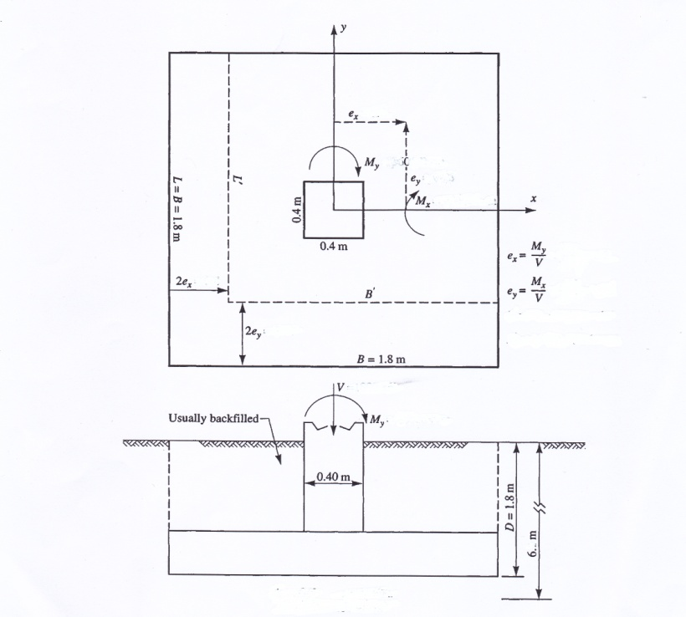
2- Meyerhof B.C equation
q_{ult}= cN_{c} s_{c} d_{c}+ q′ N_{q} s_{q} d_{q}+ 0.5 γ B N_{γ} s_{γ} d_{γ}
For Ø = 36 from table3-3 N_{c}=50.55 N_{q}=37.8 N_{γ}=44.4
s_{c}= 1+ 0.2K_{p}(B/L)
K_{p}=tan²(45+ Ø/2)= tan²(45+18)=3.84
s_{c}= 1+0.2(3.84)(1.8/1.8)=1.77
s_{q}= s_{γ}= 1+ 0.1K_{p}(B/L)
=1+0.1(3.84)(1.8/1.8)=1.39
d factor
dc = 1+ 0.2 K_{p}^{1/2} (D/B)
= 1+ 0.2 (3.84)^{1/2} (1.8/1.8)= 1.39
d_{q}= d_{γ} = 1+ 0.1 K_{p}^{1/2} (D/B)
=1+0.1(3.84)^{1/2}(1.8/1.8)= 1.2
q_{ult}= 9(50.55)(1.77)(1.39)
+1.8(15.6)(37.8)(1.39)(1.2)
+0.5(15.6)(1.8)(44.4)(1.39)(1.2)
=1119.3+1770+1039=3929kPa
Allowable BC q_{all}= 3929/3=1309kPa
Re_{B}=1-(e_{B}/B)^{1/2}=1-(0.15/1.8)^{1/2}=0.71
Re_{L}=1-(e_{L}/L)^{1/2}= 1- (0.09/1.8)^{1/2}=0.77
q_{all}= q_{all}. Re_{B}. Re_{L}= 1309(0.71)(0.77)= 715.6kPa

Slide 19
Using the Inclination Factors
In the general case of inclined loading there is a horizontal component parallel to each base dimension defined as
Hi = H_{B} parallel to the B dimension
For H_{B} = 0 ; i_{c,B} , i_{q,B} , i_{g,B} are all 1.0
Hi = H_{L} parallel to the L dimension
For H_{L} = 0 ; i_{c, L} , i_{q, L} , i_{g, L} are all 1.0
These Hi values are used to compute inclination factors for the Hansen equation as follows.
d_{q,B}= 1+2tan Ø(1-sinØ)² D/B d_{q,L}= 1+2tan Ø(1-sinØ)²D/L
d_{c,B}= 1+0.4(D/B) d_{c,L}= 1+0.4(D/L)
d_{c,B}= 1+0.4tan⁻¹(D/B) d_{c,L}= 1+0.4tan⁻¹(D/L)
s_{q,B} = 1 + (Bʹ i_{q,B}/L ʹ) sin Ø s_{q,L} = 1 + (Lʹ i_{q,L}/B ʹ) sin Ø
s_{g ,B}= 1 - 0.4 (Bʹ i_{g,B}/Lʹ i_{g,L}) s_{g ,L}= 1 - 0.4 (Lʹ i_{g,L}/Bʹ i_{g,B})
s_{g,I} ≥ 0.6 (if less than 0.6 use 0.6)
s_{c,B}= 1+(Nq/Nc). (Bʹ i_{c,B}/Lʹ) s_{c,L}= 1+(Nq/Nc). (Bʹ i_{c,L}/Bʹ)
i_{c,B}= i_{q,B}-{(1-i_{q,B})/(N_{q}-1)} i_{c,L}= i_{q,L}-{(1-i_{q,L})/(N_{q}-1)}
i_{q,B}= {1- (0.5H_{B})/( V + A_{f} C_{a} cot Ø)}^{α1} i_{q,L}= {1- (0.5H_{L})/( V + A_{f} C_{a} cot Ø)}^{α1}
i_{g,B}= {1- (0.7H_{B})/( V + A_{f} C_{a} cot Ø)}^{α2} i_{g,L}= {1- (0.7H_{L})/( V + A_{f} C_{a} cot Ø)}^{α2}
These are used in the following modifications of the "edited" Hansen bearing capacity equation
q_{ult,B}= cN_{c} s_{c,B} d_{c,B} i_{c,B} g_{c,B} b_{c,B} + q′ N_{q} s_{q,B} d_{q,B} i_{q,B} g_{q,B} b_{q,B} + 0.5 γ B N_{γ} s_{γ,B} d_{γ,B} i_{γ,B} g_{γ,B} b_{γ,B}
q_{ult,L}= cN_{c} s_{c,L} d_{c,L} i_{c,L} g_{c,L} b_{c,L} + q′ N_{q} s_{q,L} d_{q,L} i_{q,L} g_{q,L} b_{q,L} + 0.5 γ L N_{γ} s_{γ,L} d_{γ,L} i_{γ,L} g_{γ,L} b_{γ,L}

Slide 20
Example 5
You are given the data shown on the sketch of a load test
H_{L,ult} = 382 kN, V_{ult} = 1060 kN
Required: Find the ultimate bearing capacity by the Hansen method.
Ø_{ps} = 1.50 Ø_{tri} - 17° = 1.5(43) - 17 = 47.5°
Use Ø_{ps} = 47°.
N_{q} = 187 N_{g} = 299
N_{c}=(N_{q}-1)cot Ø
=(187-1)cot47=174
2tan Ø(1-sinØ)² =0.155 N_{q}/N_{c}=187/174=1.07
All bi = gi = 1.0 , since both the base and ground are horizontal.
d_{q,B}= 1+2tan Ø(1-sinØ)² D/B
1 + 0.155(0.5/0.5) = 1.16
d_{q,L}= 1+2tan Ø(1-sinØ)²D/L
= 1 + 0.155(0.5/2.0) = 1.04
d_{g,B} = d_{g,L} = 1
i_{q,B}= {1- (0.5H_{B})/( V + A_{f} C_{a} cot Ø)}^{α1}=1
i_{g,B}= {1- (0.7H_{B})/( V + A_{f} C_{a} cot Ø)}^{α2}= 1
i_{q,L}= {1- (0.5H_{L})/( V + A_{f} C_{a} cot Ø)}^{α1}
i_{q,L}= {1- (0.5*382)/( 1060 + 0)}^{2.5}=0.608

Slide 21
i_{g,L}= {1- (0.7H_{L})/( V + A_{f} C_{a} cot Ø)}^{α2}
i_{g,L}= {1- (0.7*382)/( 1060 + 0)}^{2.5}=0.361
s_{q,B} = 1 + (B’ i_{q,B}/L ’) sin Ø
s_{q,B} = 1 + (0.5*1/2) sin 47=1.18
s_{q,L} = 1 + (L’ i_{q,L}/B ’) sin Ø
s_{q,L} = 1 + (2*0.608/0.5) sin 47=2.78
s_{g ,B}= 1 - 0.4 (B’ i_{g,B}/L’ i_{g,L})
=1 - 0.4[(0.5 x l)/(2 x 0.361)] = 0.723 > 0.6
s_{g ,L}= 1 - 0.4 (L’ i_{g,L}/B’ i_{g,B})
= 1 - 0.4[(2 X 0.361)/(0.5 X I)] = 0.422 < 0.6 (use 0.60)
q_{ult}= cN_{c} s_{c} d_{c} i_{c} g_{c} b_{c}+ q′ N_{q} s_{q} d_{q} i_{q} g_{q} b_{q} + 0.5 γ B N_{γ} s_{γ} d_{γ} i_{γ} g_{γ} b_{γ}
q_{ult,B}=q′ N_{q} s_{q,B} d_{q,B} i_{q,B} + 0.5 γ B N_{γ} s_{γ,B} d_{γ,B} i_{γ,B}
= 0.5(9.43)(187)(1.18)(1.16)(l) + 0.5(9.43)(0.5)(299)(0.732)(l)(l)
= 1206.9 + 511.3 = 1718.2 1700kPa
q_{ult,L}=q′ N_{q} s_{q,L} d_{q,L} i_{q,L} + 0.5 γ B N_{γ} s_{γ,L} d_{γ,L} i_{γ,L}
= 0.5(9.43)(187)(2.78)(1.04)(0.608) + 0.5(9.43)(2.0)(299)(0.60)(1.0)(0.361)
= 1549.9 + 612.76 = 2162.7 215OkPa
Use the smaller computed value, we find the Hansen method seems to give q_{ult} = 1700 kPa » 106OkPa of load test.

