Slide 1
Colligative properties of solutions
Colligative properties of solutions are properties that depend upon the concentration of solute molecules or ions, but not upon the nature of the solute. Colligative properties include freezing point depression, boiling point elevation, vapor pressure lowering, and osmotic pressure.

Slide 2
Any solution containing some non volatile solute exhibits four properties:
1.Vapour pressure lowering of the solvent.
2.Boiling point elevation of the solution.
3.Freezing point depression of the solution.
4.Osmosis and osmotic pressure of the solution.
These properties depend on the amount of solute present but not on its nature for this reason they called colligative properties depending on the collection.

Slide 3
The solute should not undergo any association or dissociation, if there is, the no. of particles will be changed, & will be differed from original no. of particles present in the solution & values of these properties will be changed
For discussing the colligative properties it will assumed that the solution are : very dilute and ideal, i.e the interaction between the solute particles are negligibly small.
1, 4 properties are very important for determination of M.wt. of polymers & other macromolecules.

Slide 4
Determination of M.Wt by elevation of the boiling point
True or normal boiling point of a liquid:
is a Temp. at which its vapour and liquid are in equilibrium under a pressure of 1 atm.
But in general the boiling point is the Temp. at which the vapour pressure of liquid is equal to the applied pressure.

Slide 5
When a non-volatile solute is dissolved in a solvent, the vapour pressure (V.P) of the solvent is lowered, as a result the B.P of the solution is higher than that of the pure solvent, and this is due to the decreasing of the ability of the molecules to get ride of the solution surface as the solute molecules are present.
Extent of the elevation (ΔT) depends upon the concentration of the solute, & for dilute, ideal solution.
∆T α m (molality of solution)

Slide 6
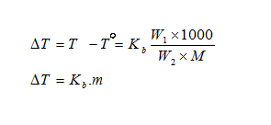
M = M.wt of the solute.
W₁ = weight of the solute.
W₂ = weight of the solvent.
m = molality of the solution.
Kb = molal boiling point elevation constant, and it is a constant characteristic of the solvent. Its unite is (Cº.kg/mol.)

Slide 7
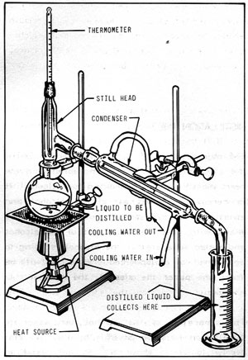
Procedure:
1-A known quantity of organic solvent is placed in the round bottom flask.
2-Heated very gently, and the B.P (T^{º}) of the solvent is determined, at which equilibrium has been attained.
3-Cool it, add (0.5-1)g of the solute & dissolve it in the solvent, then heat very gently until equilibrium is reached & the B.P (T) of solution is determined.
4- ΔT= T-T^{º} ,
5- Determine the M.wt

