Slide 1
Solutions
Solutions
are homogeneous mixtures of two or more substances
Solute
The substance in the lesser amount
Solvent
The substance in the greater amount
Writing An Equation for a Solution:
When NaCl(s) dissolves in water, the reaction can be written as
NaCl(s) in H₂O → Na+ (aq) + Cl- (aq)
solid separation of ions in water

Slide 2
Types of Solutions
The physical states of solute and solvent can be solid, liquid or gas. Thus, depending upon the physical states of the solute and solvent, there are nine types of solution.
Solid-Solid Solution:
The physical state of both solute and solvent is solid.
Example: Metal alloys like steel, bronze.
Solid-Liquid Solution:
The physical state of solute is solid and that of solvent is liquid. Example: Solution of salt in water.

Slide 3
3.Solid-Gas Solution:
The physical state of solute is solid and that of solvent is gas.
Example: Sublimation of camphor in air.
4.Liquid-Solid Solution:
The physical state of solute is liquid and that of solvent is solid.
Example: Water into ice.
5.Liquid-Liquid Solution:
The physical state of both solute and solvent is liquid.
Example: Milk in water.

Slide 4
6.Liquid-Gas Solution:
The physical state of solute is liquid and that of solvent is gas.
Example: Water vapor in air.
7.Gas-Solid Solution:
The physical state of solute is gas and that of solvent is solid.
Example: Hydrogen adsorbed on platinum.
8.Gas-Liquid Solution:
The physical state of solute is gas and that of solvent is liquid.
Example: Aerated drinks.
9.Gas-Gas Solution:
The physical state of both solute and solvent is gas.
Example: Mixture of various gases.

Slide 5
Solution can also be classified depending on the dissolution of the solute in the solvent
1. Depending on the dissolution of the solute in the solvent: There are three types as follows:
Saturated Solution: The solution in which no more solute can be dissolved in the solvent is known as a saturated solution.
Supersaturated Solution: The solution in which more solute is dissolved than required to make a saturated solution is known as a supersaturated solution.
Unsaturated Solution: The solution in which more solute can be dissolved in the solvent to make it a saturated solution is known as an unsaturated solution.

Slide 6
2.Depending on the solvent used: There are two types as follows:
Aqueous Solution: The solution in which the solute is dissolved in water is known as an aqueous solution.
Non-aqueous Solution: The solution in which the solute is dissolved in any other solvent (e.g. kerosene, benzene) than water is known as a non-aqueous solution.

Slide 7
Solution, Units of Concentration
Molarity (M) | moles of solute per liter solution
Normality (N) | equivalences of solute per liter of solution
Mole fraction(x) | moles of A divided by sum of moles of all components
Molality (m) | moles of solute per kilogram of solvent
weight percentage (wt%) | mass of solute per 100 gram of solution
parts per million (ppm) | 1 milligram of solute per liter of solvent

Slide 8
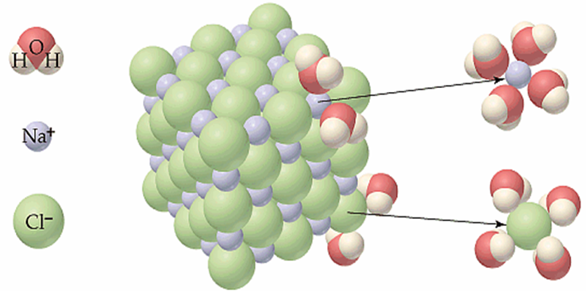
Solution Process (solvation)

Slide 9
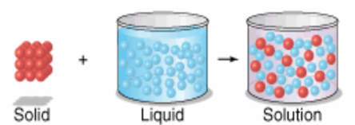
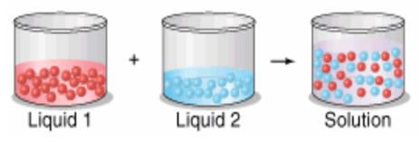
Solid-Liquid Solution
Liquid-liquid solution

Slide 10
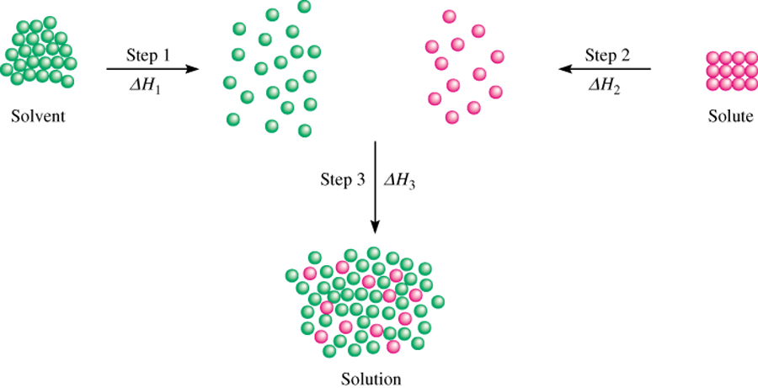
Three types of interactions in the solution process:
1. solvent-solvent interaction
2. solute-solute interaction
3. solvent-solute interaction
∆H_{soln} = ∆H₁ + ΔH₂ + ΔH₃

Slide 11
Heat of Solution

Slide 12
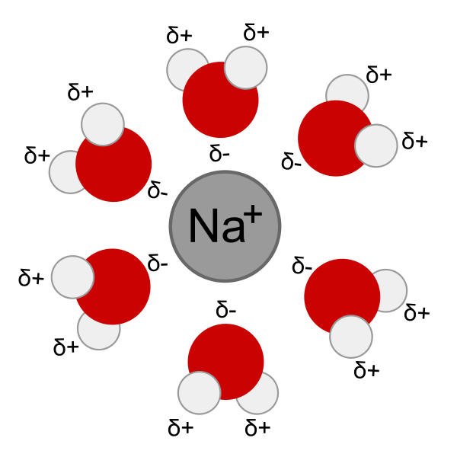
Solvation
Solvation, also sometimes called dissolution, is the process of attraction and association of molecules of a solvent with molecules or ions of a solute. As ions dissolve in a solvent they spread out and become surrounded by solvent molecules.
A sodium ion solvated by water molecules

Slide 13
Solvation involves different types of intermolecular interactions:
hydrogen bonding, ion-dipole, and dipole-dipole attractions or van der Waals forces.
The hydrogen bonding, ion-dipole, and dipole-dipole interactions occur only in polar solvents.
Ion-ion interactions occur only in ionic solvents.
The solvation process will be thermodynamically favoured only if the overall Gibbs energy of the solution is decreased, compared to the Gibbs energy of the separated solvent and solid (or gas or liquid).
This means that the change in enthalpy minus the change in entropy (multiplied by the absolute temperature) is a negative value, or that the Gibbs free energy of the system decreases.

Slide 14
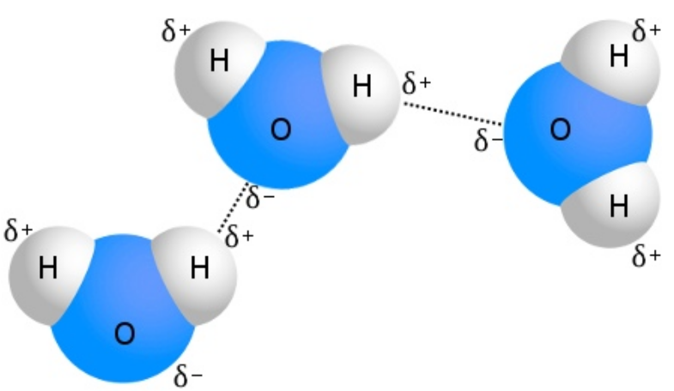
The best known example of hydrogen bonding is water:

Slide 15
Most common solvent
A polar molecule (water)
hydrogen bond

Slide 16
Like dissolves like
A polar solvent such as water is needed to dissolve polar solutes such as methanol and ionic solutes such as NaCl.
A non-polar solvent such as hexane (C₆H₁₄) is needed to dissolve nonpolar solutes such as oil or grease.

Slide 17
Electrolytic and non-electrolytic solutions
Definitions
Electrolytic solution: solution that conducts electricity. Acids, bases and salts in solution are all examples of electrolytes.
Non-electrolyte: a solution that does not conduct electricity
Examples: sugars (exampleC6H12O6), alcohols(like CH3OH etc.)
Why do acids, bases and salts all conduct electricity?

Slide 18
Electrolytic and non-electrolytic solutions
Electrolytic and Non-electrolytic solutions
If you place a light bulb containing two electrodes in a sugar solution, the light fails to illuminate. What happens if you dip the same bulb into a NaCl solution?
Definitions
Electrolytic solution: solution that conducts electricity. Acids, bases and salts in solution are all examples of electrolytes.
Non-electrolyte: a solution that does not conduct electricity
Examples: sugars (exampleC6H12O6), alcohols(like CH3OH etc.)
Why do acids, bases and salts all conduct electricity?

Slide 19
Miscibility
Two liquids are said to be miscible if upon mixing, a single phase
solution is obtained (Single phase no separation)
Immiscible liquids will separate out into two or more distinct phases after mixing.
Some of the liquids will dissolved into each other form a partially miscible liquids. One can separate two or more phases based on the difference in the liquid density.

Slide 20
Comparison: Solution, Colloid & Suspension
Solution
Have small particles (ions or molecules)
Are transparent
Do not separate
Cannot be filtered
Do not scatter light.

Slide 21
Colloids
Have medium size particles
Cannot be filtered
Separated with semipermeable membranes
Scatter light (Tyndall effect)
Examples of Colloids
Fog
Whipped cream
Milk
Cheese
Blood plasma
Pearls

Slide 22
Suspensions
Have very large particles
Settle out
Can be filtered
Must stir to stay suspended
Examples of Suspension
Blood platelets
Muddy water
Calamine lotion

Slide 23
Ideal and non-ideal solutions
Ideal Solution:
An ideal mixture is one which obeys Raoult's Law
The diagram is for a 50/50 mixture of the two liquids. If the red molecules have the same tendency to escape as before, that must mean that the intermolecular attraction between two red molecules must be exactly the same as the intermolecular forces between a red and a blue molecule.
Examples
hexane and heptane
benzene and methylbenzene
1-propanol and 2-propanol

Slide 24
If the forces were any different, the tendency to escape would change.
The intermolecular attractions between two red molecules, two blue molecules or a red and a blue molecule must all be exactly the same if the mixture is to be ideal.
Ideal mixture of two liquids will have zero enthalpy change of mixing.
∆Hmix = 0

Slide 25
Raoult’s Law
Raoult's Law only works for ideal mixtures.
The partial vapor pressure of a component in a mixture is equal to the vapor pressure of the pure component at that temperature multiplied by its mole fraction in the mixture.
P_{A} = X_{A} x Pº_{A}
P_{B} = X_{B} x Pº_{B}
Where P_{A} & X_{A} and P_{B} & X_{B} are the partial vapor
pressures and the mole fraction of the
components A and B.
Total Vapor pressure = P_{A} + P_{B}

Slide 26
Vapor pressure Composition Phase Diagram

