Slide 1
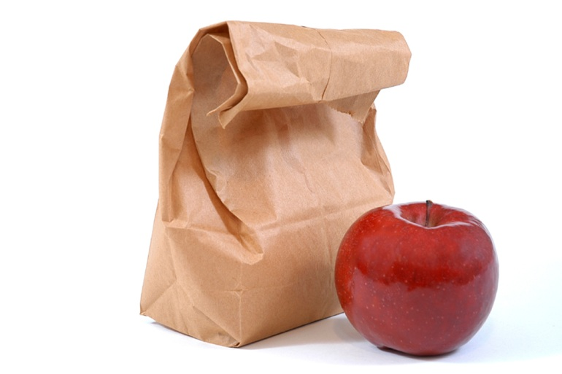
Physical Properties of Matter
Any characteristic of a material that can be observed or measured without changing the composition of the substance.

Slide 2
Examples of Physical Properties
Viscosity-resistance to flow
Conductivity-ability to allow heat to flow
Malleability-ability of solid to be hammared without shattering
Hardness-scratch test
Melting point- is the temperature at which a given solid material changes from a solid to a liquid. and boiling point is the temperature at which the liquid changes to a gas.
Density-ratio of mass to volume

Slide 3
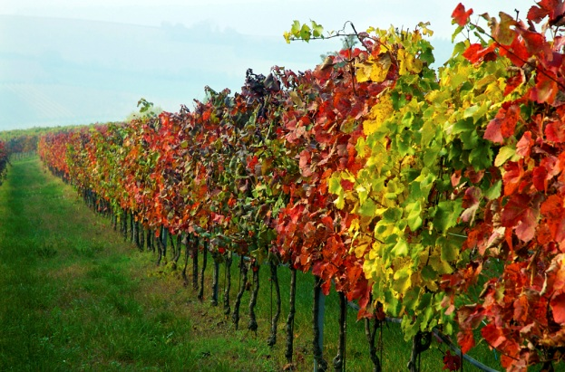
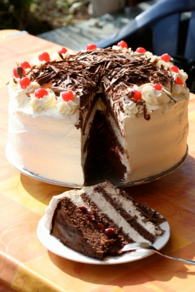
Chemical Changes
When substances react with each other and form one or more new substances.
Tree leaves change color
Baking a cake
Wood burning

Slide 4
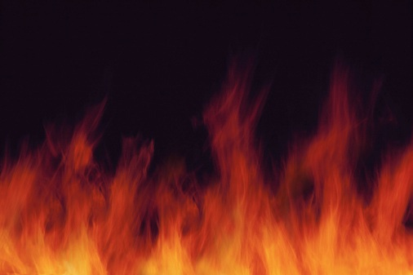
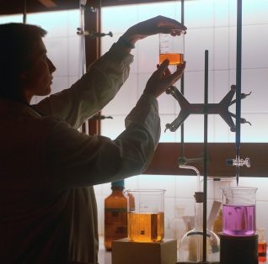
Chemical Properties
Flammability-ability to burn in
presence of oxygen
Reactivity-how readily a substance
combines with other substances.

Slide 5
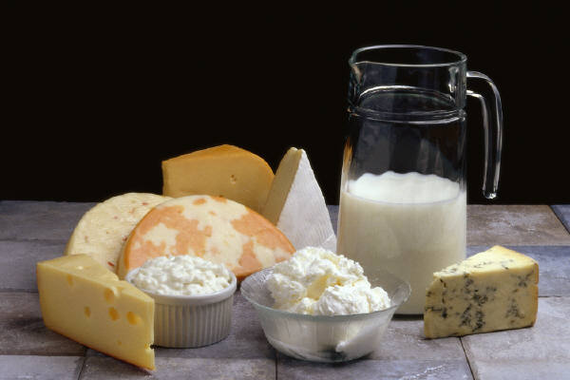
Evidence of Chemical Change
Change in color
Production of gas
Formation of a precipitate-any solid that forms and separates from a liquid mixture.
Cottage cheese

