Slide 1
Phase
phase is a region of space (a thermodynamic system), throughout which all physical properties of a material are essentially uniform.
“Any part of a system which is uniform and has a boundary which separates it from other parts”
A simple description is that a phase is a region of material that is chemically uniform, physically distinct, and (often) mechanically separable.

Slide 2
Phase
The term phase is sometimes used as a synonym for state of matter,
there can be several immiscible phases of the same state of matter.
Also, the term phase is sometimes used to refer to a set of equilibrium states demarcated in terms of state variables such as pressure and temperature by a phase boundary on a phase diagram.
Because phase boundaries relate to changes in the organization of matter, such as a change from liquid to solid or a more subtle change from one crystal structure to another.

Slide 3
Phase Changes
When one phase changes to another.
Particles must change their kinetic energy, how fast they are moving.
You can do this by adding or taking away heat.

Slide 4
Phase Changes

Slide 5
The Gibbs Phase Rule
F = C - P + 2
F = number degrees of freedom, or The number of intensive parameters that must be specified in order to completely determine the system

Slide 6
F = C - P + 2
P = number of phases
phases are mechanically separable constituents
C = minimum number of components (the no. of chemical constituents that must be specified in order to define all phases)

Slide 7
F = C - P + 2
2 = the number of intensive parameters
Usually = 2 for Temperature and Pressure and this is especially useful for chemists

Slide 8
Gibb’s Phase Rule
F=C-P+2
1- IF Temp. or pressure is constant
F=C-P+1
2-IF both Temp. and pressure are constant
F=C-P
In the cases above (1&2) the rule is called (Reduced Phase Rule).

Slide 9
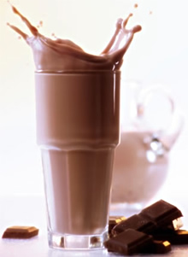
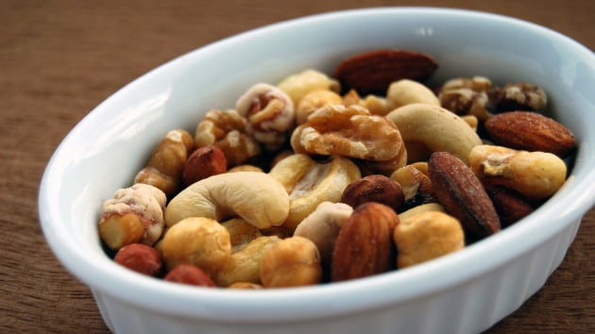
Phase
Any part of a system with uniform composition and properties is called a phase.
On a homogenous mixture you have “one phase” only. on a heterogenous mixture you have “two or more phases”.
Phases in a heterogenous mixture
Phases in homogeneous mixture

Slide 10
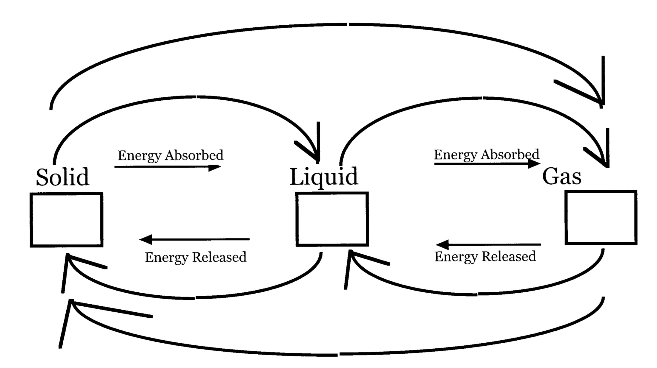
Phase Change (Phase Equilibria)
Sublimation
Fusion
Evaporation
Condensation
Solidification

