Slide 1
A phase diagram summarizes the conditions at which a substance exists as a solid, liquid, or gas.
The triple point is where all 3 phases meet.
A phase diagram in physical chemistry, engineering, mineralogy, and materials science is a type of chart used to show conditions at which thermodynamically distinct phases can occur at equilibrium.

Slide 2
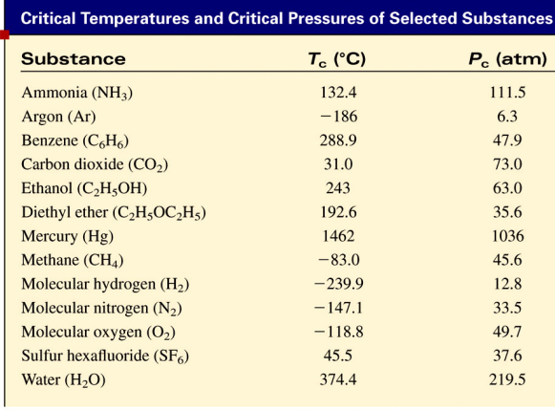
The critical temperature (T_{c}) is the temperature above which the gas cannot be made to liquefy, no matter how great the applied pressure.
The critical pressure (P_{c}) is the minimum pressure that must be applied to bring about liquefaction at the critical temperature.

Slide 3
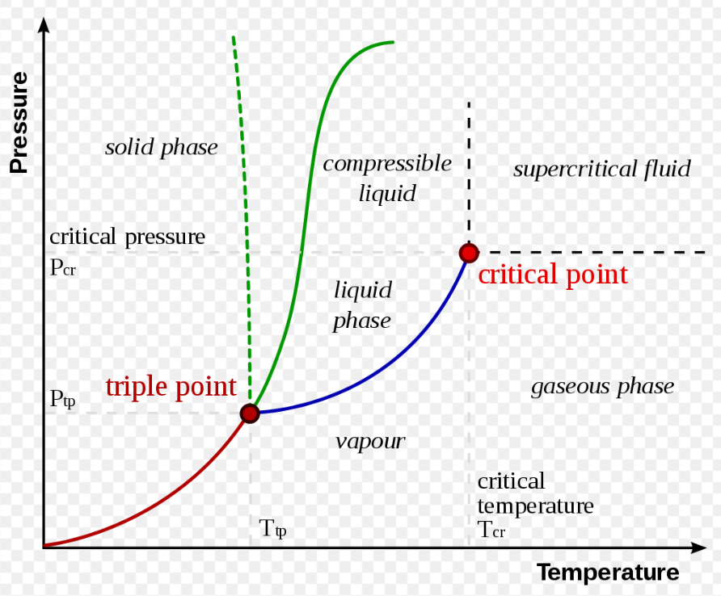
Liquid–vapor critical point

Slide 4
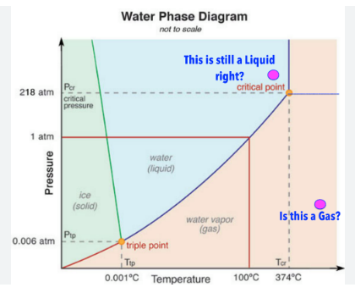

Slide 5
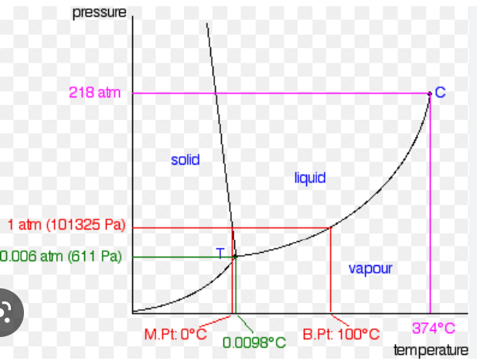

Slide 6
Phase Diagram of Water

Slide 7
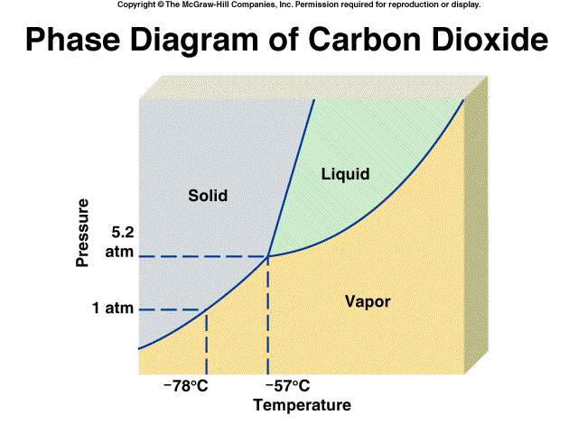

Slide 8
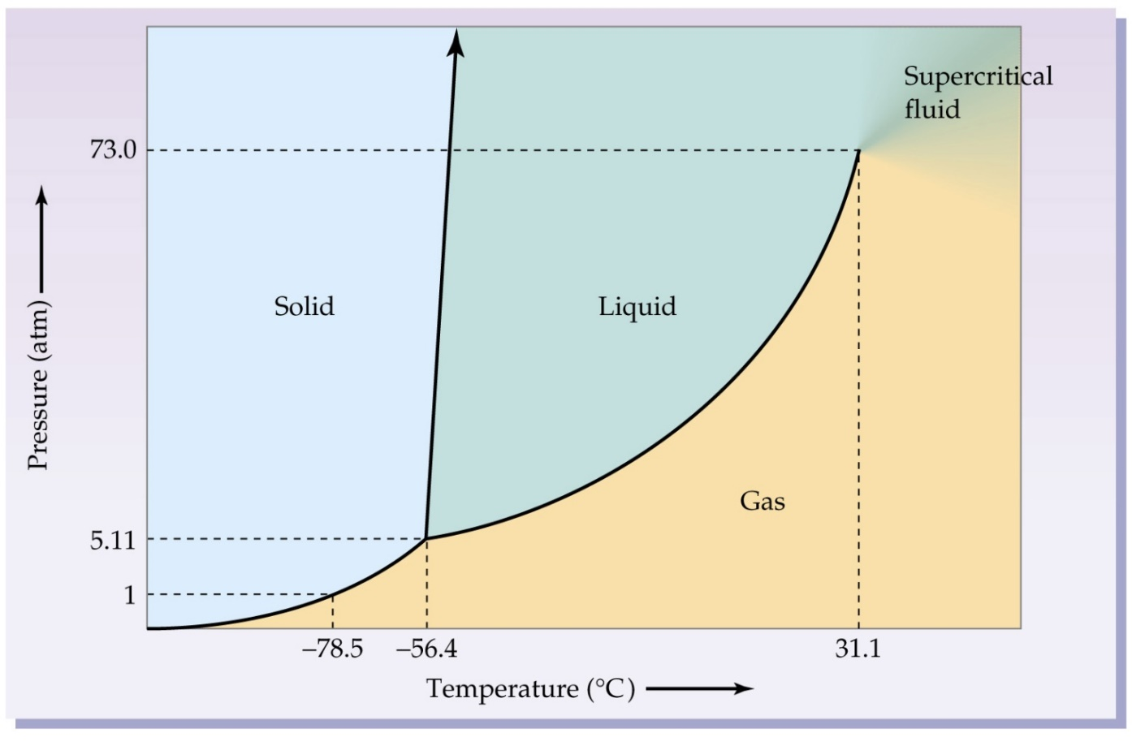
Can you find…
The Triple Point?
Critical pressure?
Critical temperature?
Where fusion occurs?
Where vaporization occurs?
Melting point (at 1 atm)?
Boiling point (at 6 atm)?
Carbon Dioxide

Slide 9
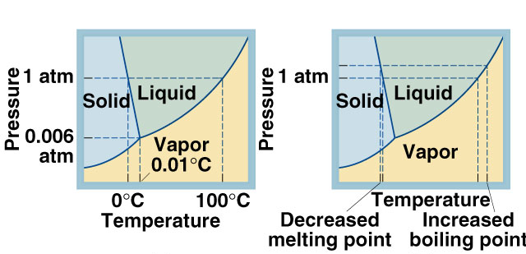

Slide 10
Phase diagram
Phase Diagram for Sulfur

Slide 11
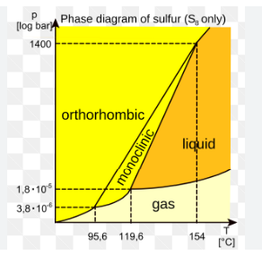

Slide 12
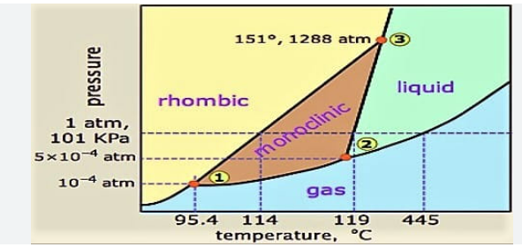

Slide 13
At the first triple point the rhombic solid, monoclinic solid, and the gas form co-exist and the temperature is 95.31∘C at 5.1 x 10−6 atm
At the second triple point, the monoclinic solid, the gas form, and the liquid form co-exists and the temperature is 115.18∘C
at 3.2 x 10−5atm.
At the third triple point, the monoclinic solid form, the rhombic solid form, and the liquid form co-exist and the temperature is 153∘C
at 1420 atm.

