Slide 1
University of Salahaddin
College of science
Department of physics
Nuclear Lab.
Second Course
2022-2023

Slide 2
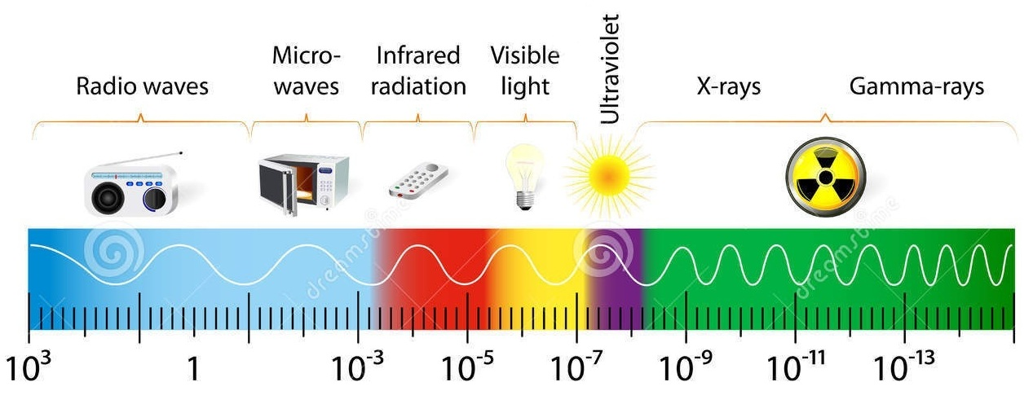
Radiation
Radiation is an energy in the form of electro-magnetic waves or particulate matter, traveling in the air.
λ (m)
Non-ionizing radiation
Ionizing radiation
The spectrum of electromagnetic radiation.

Slide 3
Radiation
Radiation is classified as:
Ionizing Radiation
Higher energy electromagnetic waves (gamma and X-ray) or Light and heavy particles (beta and alpha).
High enough energy to eject electron from an atom.
Non-ionizing Radiation
Lower energy electromagnetic waves.
Not enough energy to eject electron from an atom, but can excite the electron.

Slide 4
Interaction of Radiation with Matter
Ionizing
Excitation
High
energy
low energy

Slide 5
Definition of Nuclear Radiation
Nuclear radiation is the energy emitted by an unstable nucleus to became more stable.
Energy
Radiation
Unstable nucleus
Particle
Fig. Unstable nucleus emits radiation

Slide 6
Types of Nuclear Radiation
Nuclear Radiation
Alpha particles
Beta particles
Gamma rays
Beta-minus particle
Beta-plus particle

Slide 7
Penetrating power and Absorption of Nuclear Radiation
paper
aluminum
lead
Alpha particles
Beta particles
Gamma rays
Proton
Neutron
Electron
Animation (1)

Slide 8
Penetrating power and Absorption of Nuclear Radiation
paper
aluminum
lead
Alpha particles
Beta particles
Gamma rays
Proton
Neutron
Electron
Animation (1):
Penetration power and absorption of alpha, beta, and gamma rays.

Slide 9
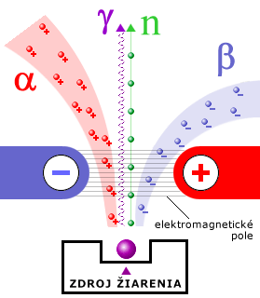
Effect of electric and magnetic fields on the nuclear radiation.
S
N
Magnetic field
Electric field
(a)
(b)
Animation (2). Shows how the different types of radiation are affected by:
(a) Magnetic field. (b) Electric field.
Notes:
Effect of a magnetic an electric fields on alpha ,beta and gamma radiation.
Behavior of alpha ,beta and gamma rays in magnetic and electric field
The radiations emitted by the uranium mineral could be resolved into three types by the application of electrical field.
(a) The rays which deflected slightly towards –ve electrode were named as alpha (a) rays.
(b) The rays which deflected towards +ve electrode were named as beta (~) rays.
(c) The rays which remained undeflected were named as gamma (y) rays.

Slide 10
Summary
Types of nuclear radiation | Alpha(α) | Beta(β) | Gamma(ɣ)
Structure
Charge | +2 |  | 0
Mass | Heavy | Light | Rest mass zero
Ionizing | strong | weak | Very weak
Effects of fields | deflected by magnetic and electric fields | deflected by magnetic and electric fields | not deflected by magnetic or electric fields
Penetration effect | Stopped by a piece of paper | Stopped by a few millimeters of aluminum | Stopped by a several centimeters of lead
2 Proton
2Neutron
-
+
+
+
Electron
or
Positron
EM waves
-1
or
+1

Slide 11
Geiger Muller Detectors
wall
fill gas
Anode (+)
Output
End window
Or wall
Cathode (-)
or
A
R

Slide 12
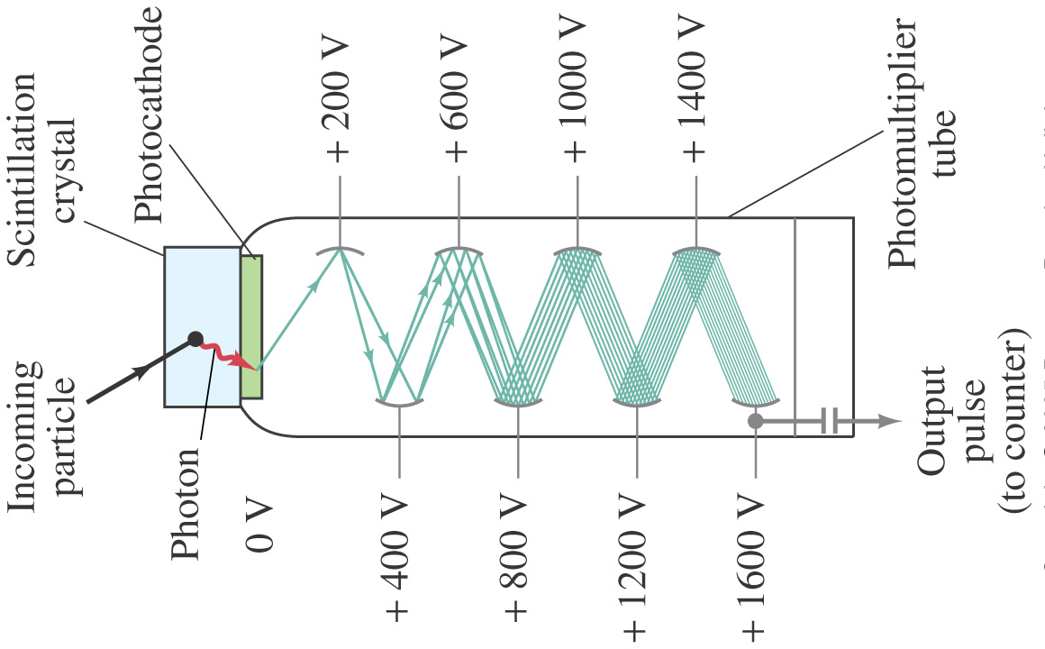
Scintillation Detectors

Slide 13
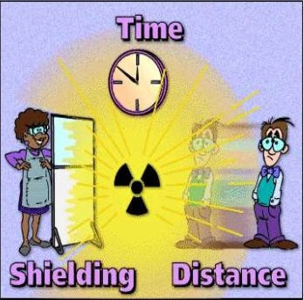
General Radiation Safety
Reduce TIME of your exposure.
Increase DISTANCE from the source.
Make use of available SHIELDING.

Slide 14
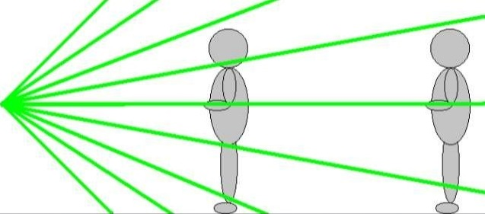
Exp. (1)
Verification of Inverse Square Law for γ-Ray
Purpose
The student will verify the inverse square relationship between the distance and intensity of radiation.
This intensity is given by
Where
N is the total number of photos /s from the source
A is the total area of the sphere in cm².
$$n=\frac{Nr^{2}}{4d^{2}} ……….(3)$$
Equation (3) is required form of the inverse square law

Slide 15
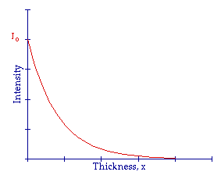
Exp. (2)
Absorption coefficient for γ - rays
Purpose
The purpose of the experiment is to measure experimentally the linear and mass absorption coefficient in lead and copper for 662 KeV gamma rays.
Where
I: intensity after the absorber.
I₀: intensity before the absorber.
μ: linear mass absorption coefficient in cm⁻¹.
x: is the thickness in cm

Slide 16
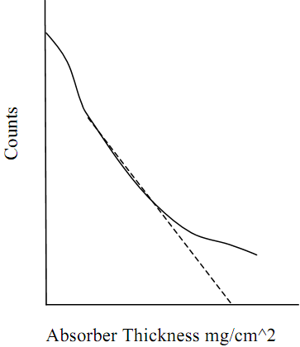
Exp. (3)
Determining energy and range of beta particles in aluminum (¹³Al)
Purpose
To investigate the absorption of beta particles and determine the range and maximum energy of beta particles.
The range, R, will then be substituted into the empirical formula
Where
R is the of beta particle in material, expressed in (g/cm²). E_{m} is the maximum energy of the beta particle emitted, expressed in (KeV).

Slide 17
Exp. (4)
Activity measurement of Gamma – Source (relative method)
Purpose
The purpose of this experiment is to outline one procedure by which the activity of a source can be determined, called the relative method.
The activity is defined as the number of disintegration per second in radioactive sample.

Slide 18
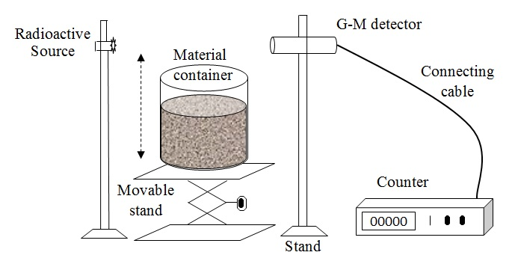
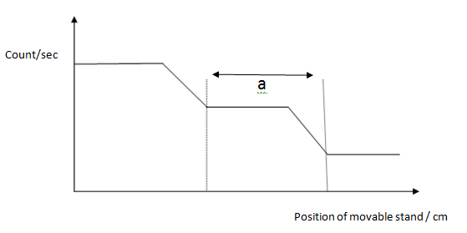
Exp. (5)
Foundation of material height in closed containers.
Purpose
The purpose of the experiment is to determine the material height in a closed container.
Introduction
The level of material (foods, dyes, oils,……) in closed containers can be determined by the γ-ray absorption method.
The absorption of γ-ray in air is different from its absorption in the container walls and also through the wall + material inside.

Slide 19
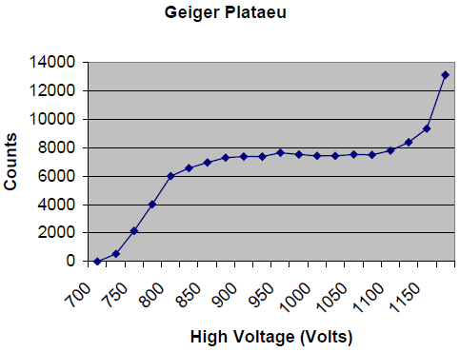
Exp. (6)
Operating Plateau for the Geiger Tube
Purpose
To determine the plateau and optimal operating voltage of a Geiger-Müller counter.
The equation for slope is
where
R₁ and R₂ are the activities for the beginning and end points, respectively.
V₁ and V₂ and the voltages for the beginning and end points, respectively.

