Slide 1
Unit 2 and 19

Slide 2
THREE Facts about Tenses
The Form (the rules)
Positive
Negative
Question (interrogative)
The Usage (the uses)

Slide 6
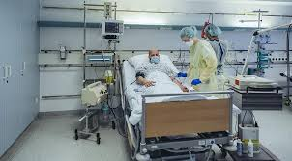
Usage
Something happens all the time or repeatedly:
- Nurses look after patients in hospitals.
- I usually go away at weekends.
- The cafe opens at 7.30 in the morning.

Slide 7
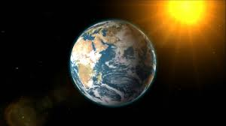
2. Something which is TRUE in general or a FACT:
The earth goes round the sun.
Water boils at 100 centigrade.
It doesn’t rain much in hot deserts.

Slide 8
3. I apologise … / I advise … / I insist … / I agree … / I refuse … etc.
I promise I won’t be late.
What do you suggest I do?’

Slide 9
4. Future timetables and programmes (for example, transport or cinema times)
- I have to go. My train leaves at 11.30.
- What time does the film start tonight?
The meeting is at nine o’clock tomorrow.
I have an exam next week.

Slide 10
Adverbials
Everyday = daily
Monthly
Always
Often
Sometimes
Usually
In the morning
In the afternoon

Slide 11
Examples
I don’t go away very often.
The cafe opens at 7.30 in the morning.

