Slide 1
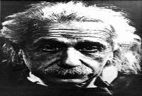
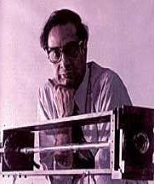
Laser Physics By Dr.Runas y.sula
2022-2023
Chapter One Introduction
1.1: Historical Preview
Laser is an acronym for "Light Amplification by Stimulated Emission of Radiation", where the keywords are mostly stimulated and amplification.
Einstein was able to conclude in 1917 that an interaction existed between light and matter called stimulated emission that would amplify light.
Albert Einstein
Born: March 14, 1879
Died: April 18, 1955
In 1958, Townes and Schawlow proposed optical masers (today's lasers) based on theoretical calculations.
Maser is an acronym for "Microwave Amplification by Stimulated Emission of Radiation”.
Arthur Leonard Schawlow Born: May 5, 1921
Died: April 28, 1999
Charles Hard Townes Born: July 28, 1915
Died: February 16, 2007
A solution looking for a problem is how many scientists described the first working laser, set up by Maiman in 1960 at Hughes Research Laboratories in Malibu, California.
The first gas laser was developed in 1961 by Javan of Bell Laboratories, using a mixture of helium and neon gases.
Theodore Harold Maiman Born: July 11, 1927
Died: May 05, 2007
Ali Javan
Born: December 26,
1926
Died: July 1, 2008
More Information;

Slide 2
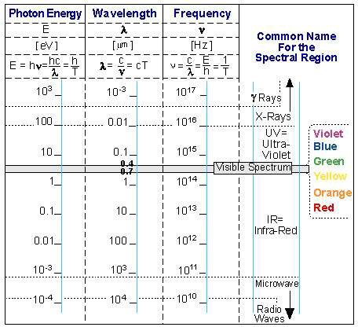
Laser Physics By Dr.Runas y.sula 2022-2023
https://www.photonics.com/Articles/A_History_of_the_Laser_1960_-
_2019/a42279
1.2:1: Electromagnetic Radiation
The electromagnetic radiation out of the laser can be in any part of the spectrum, including the visible spectrum, the Ultra-Violet (UV) spectrum, the Infra-Red (IR) spectrum, and beyond.
Figure: The Electromagnetic Spectrum
In the following pages the properties of electromagnetic radiation is briefly described:
1.2.2: Electromagnetic Radiation in vacuum
Electromagnetic Radiation is a transverse wave, advancing in vacuum at a constant speed which is called: velocity of light.
All electromagnetic waves have the same velocity in vacuum, and its value is approximately:

Slide 3
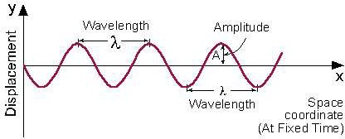
Laser Physics By Dr.Runas y.sula
2022-2023
𝒄 = 𝟑𝟎𝟎, 𝟎𝟎𝟎 [𝒌𝒎/𝒔𝒆𝒄] = 𝟑 × 𝟏𝟎^{𝟖} [𝒎/𝒔𝒆𝒄] = 𝟏𝟖𝟔, 𝟎𝟎𝟎 [𝒎𝒊𝒍𝒆𝒔/𝒔𝒆𝒄]
One of the most important parameters of a wave is its wavelength.
Wavelength (𝝀) (Lamda) is the distance between two adjacent points on the wave, which have the same phase. As an example (see this figure below) the distance between two adjacent peaks of the wave.
Figure: Displacement as a function of space coordinates (at fixed time)
A = Amplitude = Maximum displacement from equilibrium.
The minimum distance between two adjacent points with the same phase is period (T).
Frequency (𝒇) is defined by the number of times that the wave oscillates per second (or the number of periods of oscillations per second).
Between these two parameters the relation is:
𝒄 = 𝝀 ∗ 𝒇
Note: The speed of light is the same for visible light, radio waves, or x-rays.
1.2.3: Electromagnetic Radiation in Matter
Note: We shall use the words "electromagnetic radiation" and "light" as synonyms.
Light Velocity in Matter (𝒗)
When electromagnetic radiation passes through matter with index of refraction n, its velocity (𝒗) is less than the velocity of light in vacuum (𝒄), and given by the equation:

Slide 4
Laser Physics By Dr.Runas y.sula
2022-2023
𝒄
√𝝁𝜺 𝒏
𝟏
𝒗 = =
This equation is used as a definition of the index of refraction (n):
𝒔𝒑𝒆𝒆𝒅 𝒐𝒇 𝒍𝒊𝒈𝒉𝒕 𝒊𝒏 𝒗𝒂𝒄𝒖𝒖𝒎 𝒄
𝒗
𝒏 =
𝒔𝒑𝒆𝒆𝒅 𝒐𝒇 𝒍𝒊𝒈𝒉𝒕 𝒊𝒏 𝒎𝒂𝒕𝒕𝒆𝒓
=
Gases, including air, are usually considered as having index of refraction equal to
vacuum 𝒏_{𝟎} = 𝟏.
The values of the index of refraction of most materials transparent in the visible spectrum is between 1.4-1.8, while those of materials transparent in the Infra- Red (IR) spectrum are higher, and are 2.0-4.0.
1:3: Refraction of Light Beam - Snell Law
Reducing the velocity of light in matter, and reducing its wavelength, causes refraction of the beam of light.
While crossing the border between two different materials, the light changes its direction of propagation according to the Snell Equation:
Ex1: Wavelength in Matter
The velocity of Red light (λ0= 0.6 [μm]) in a certain medium is 1.5*10⁸ [m/s]. What is the wavelength of this light in this material?
Solution:
First find the index of refraction:
Using n, calculate the wavelength in the material:

Slide 5
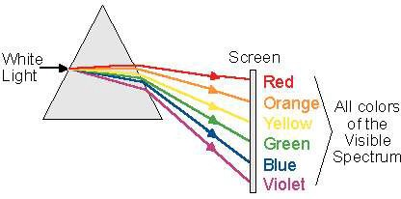
Laser Physics By Dr.Runas y.sula
2022-2023
1.4: Properties of Laser Radiation
"Ordinary light" (from the sun or lamps) is composed of many different wavelengths, radiating in all directions, and there is no phase relation between the different waves out of the source.
Laser radiation is characterized by certain properties which are not present in other electromagnetic radiation:
A. Monochromaticity:
Monochromaticity means "One color".
To understand this term, examine "white light" which is the color interpreted in the mind when we see all colors together.
When "white light" is transmitted through a prism, it is divided into the different colors which are in it, as seen in this figure.
Figure: White light passing through a prism
In the theoretical sense "One Color", which is called "spectral line", means one
wavelength (λ0).
In reality, every spectral line has a finite spectral width (Δλ) around its central wavelength (λ0).

Slide 6
Laser Physics By Dr.Runas y.sula
2022-2023
Figure: Bandwidth of laser radiation in Theory and in Reality
B. Directionality:
Radiation comes out of the laser in a certain direction, and spreads at a defined divergence angle (𝜽) (see this figure).
This angular spreading of a laser beam is very small compared to other sources of electromagnetic radiation, and described by a small divergence angle (of the order of milli-radians).
Figure: comparison between the light out of a laser, and the light out of an incandescent lamp
Divergence Angle is the full angle of opening of the beam.
Spot Size Measurement:
R = Radius of the illuminated spot at a distance L from the laser (see figure below).

Slide 7
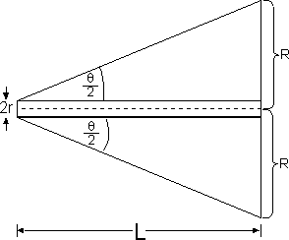
Laser Physics By Dr.Runas y.sula
2022-2023
If the spot size measurement is done near the laser (where the spot is small), then the size of the beam at the output of the laser needs to be taken into account:
Because the laser radiation has a very small divergence, the small angle approximation can be used. Thus, we have set the tangent of the angle equal to the angle.
On a screen, the laser produces a spot. The diameter of this spot (2R) determines the spot size.
When the measurement is done very far from
the laser, the spot size (2R) is big compared to the beam size at the laser output (2r), and it is accurate enough to measure the spot diameter and divide it by the distance, to find the beam divergence.
C. Coherence:
Since electromagnetic radiation is a wave phenomenon, every electromagnetic wave can be described as a sum (superposition) of sine waves as a function of time. From wave theory we know that every wave is described by a wave function:
𝒚 = 𝑨𝒄𝒐𝒔(𝝎𝒕 + 𝝓)
Where
𝑨 = Amplitude.
𝝎 = 𝟐𝝅𝒇 = Angular Frequency.
𝝓 = Initial Phase of the wave (Describe the starting point in time of the oscillation).
(𝝎𝒕 + 𝝓) = Phase of the wave.
Superposition of Waves:
Coherent waves are waves that maintain the relative phase between them.

Slide 8
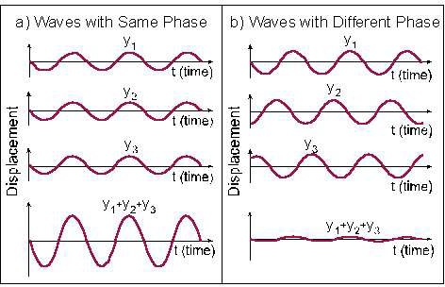
Laser Physics By Dr.Runas y.sula
2022-2023
Figure: Superposition of waves
This figure describes, using the same time base, 3 waves marked y1, y2, y3, and their superposition. In figure a, the waves are coherent, like the waves out of a laser. In figure b, the waves have the same wavelength, but are not coherent with each other. Light from an incandescent lamp is composed of waves at many wavelengths, and each wave appears randomly with no systematic relation between its phase and that of the other wave.
Laser radiation is composed of waves at the same wavelength, which start at
the same time and keep their relative phase as they advance. By adding (superposition) the wave amplitudes of the different waves, higher peaks are measured for laser radiation.
Coherence depends on monochromaticity. Coherence is important for applications like interference and diffraction, and the entire process of holography is based upon it.
1.5: Electromagnetic Wave Classification
Class |  |  | Freq- uency | Wave- length | Energy per photon
Ionizing radiation | γ | Gamma rays | 300 EHz | 1 pm | 1.24 MeV
 |  |  | 30 EHz | 10 pm | 124 KeV
 | HX | Hard X-rays
 |  |  | 3 EHz | 100 pm | 12.4 KeV
 | SX | Soft X-rays
 |  |  | 300 PHz | 1 nm | 1.24 KeV
 |  |  | 30 PHz | 10 nm | 124 eV
 | EUV | Extreme ultraviolet
 |  |  | 3 PHz | 100 nm | 12.4 eV

Slide 9
Laser Physics By Dr.Runas y.sula
2022-2023
 | NUV | Near ultraviolet, visible | 300 THz | 1 μm | 1.24 eV
 | NIR | Near infrared
 |  |  | 30 THz | 10 μm | 124 meV
 | MIR | Mid infrared
 |  |  | 3 THz | 100 μm | 12.4 meV
 | FIR | Far infrared
 |  |  | 300 GHz | 1 mm | 1.24 meV
Micro- waves and radio waves | EHF | Extremely high frequency
 |  |  | 30 GHz | 1 cm | 124 μeV
 | SHF | Super high frequency
 |  |  | 3 GHz | 1 dm | 12.4 μeV
 | UHF | Ultra high frequency
 |  |  | 300 MHz | 1 m | 1.24 μeV
 | VHF | Very high frequency
 |  |  | 30 MHz | 10 m | 124 neV
 | HF | High frequency
 |  |  | 3 MHz | 100 m | 12.4 neV
 | MF | Medium frequency
 |  |  | 300 kHz | 1 km | 1.24 neV
 | LF | Low frequency
 |  |  | 30 kHz | 10 km | 124 peV
 | VLF | Very low frequency
 |  |  | 3 kHz | 100 km | 12.4 peV
 | ULF | Ultra low frequency
 |  |  | 300 Hz | 1000 km | 1.24 peV
 | SLF | Super low frequency
 |  |  | 30 Hz | 10000 km | 124 feV
 | ELF | Extremely low frequency
 |  |  | 3 Hz | 100000 km | 12.4 feV

