Slide 1
Structure Analysis by staad pro
By: mr. rushdi khalis esa

Slide 2
Contents
1.Introduction
2.Geometry
3.Aditional tools for Modeling
4.Properties
5.Constants ,supports and other specifications
6.Loading
7.Analysis
8.Post processing
9.Design

Slide 3
Introduction
STAAD PRO is a Structural Analysis design program application
It includes a state-of-the-art user interface, visualization tools and International design codes.
It is one of the application created to help structural engineers to automated their tasks and to remove the tedious and long procedures of the manual methods.

Slide 4
AnalysisTo calculate
Stress distribution
Natural frequencies
Displacement
Inertial forces
Critical Buckling load

Slide 5
Module 1 Introduction to STAAD Pro
STAAD Software
Method of Analysis
Starting STAAD Pro
Creating New File
STAAD Pro Screen
Opening and closing a Existing STAAD Pro file.
Saving & Saving As

Slide 7
Module 2 Geometry
What are Nodes, Beams, and Plates
How things are done in the Input file
Geometry Creation Methods
1: Using Structure Wizard
2: Drafting the Geometry using Snap node
3: Using Copy/Cut with Paste
4: Using Spreadsheet (Excel) Copy and Paste
5: Using DXF importing file function

Slide 9
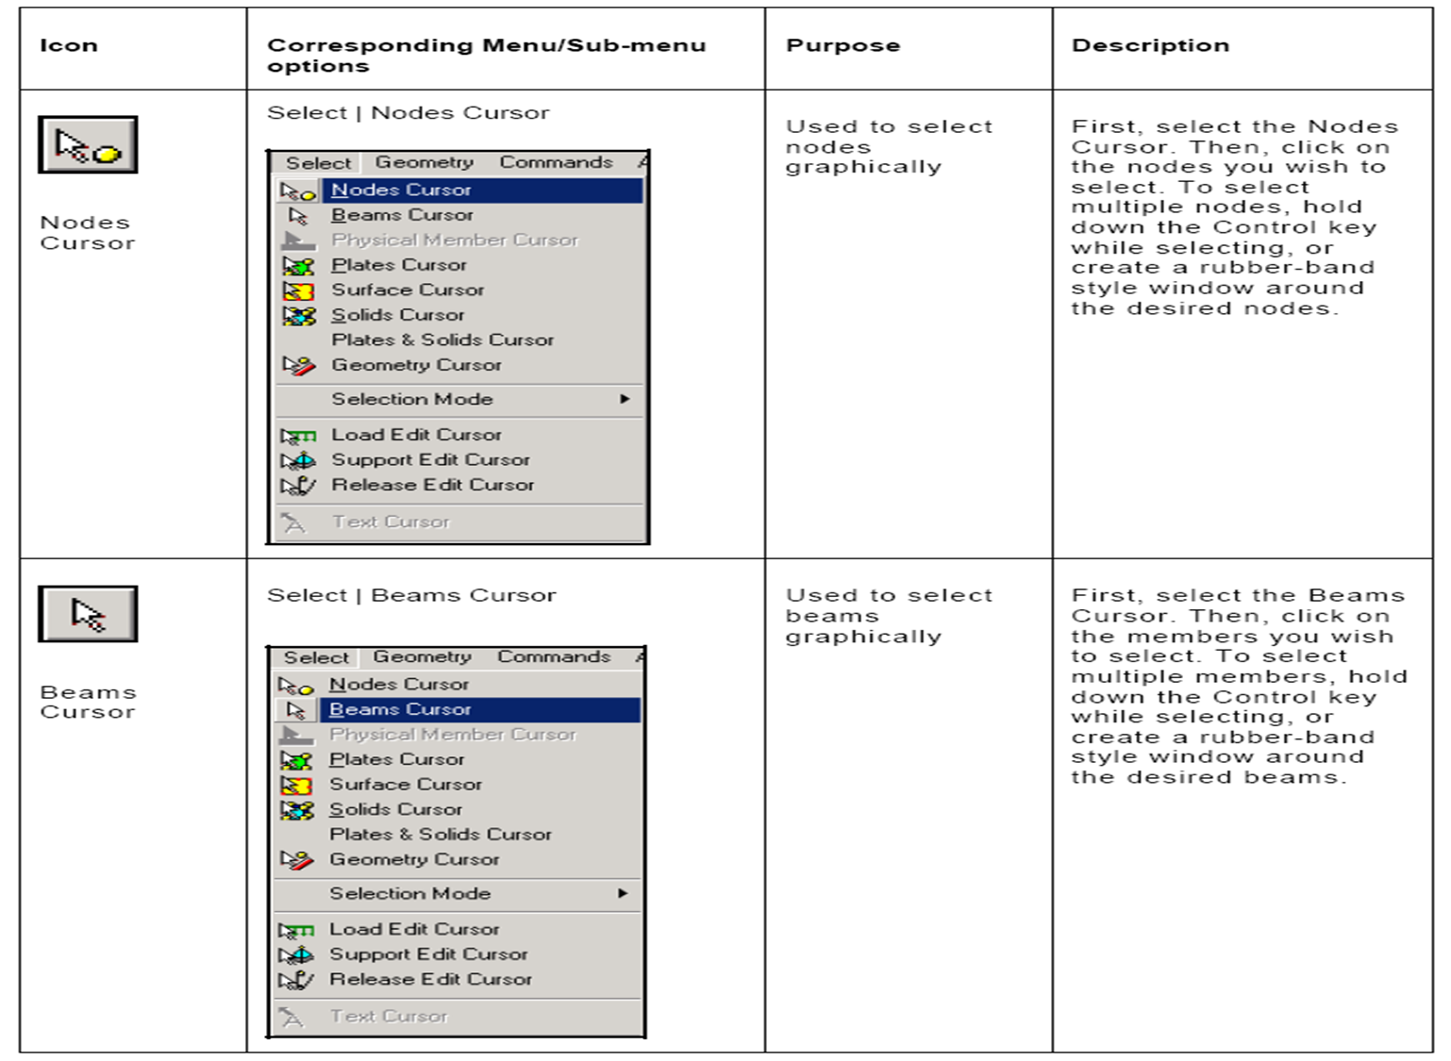

Slide 10
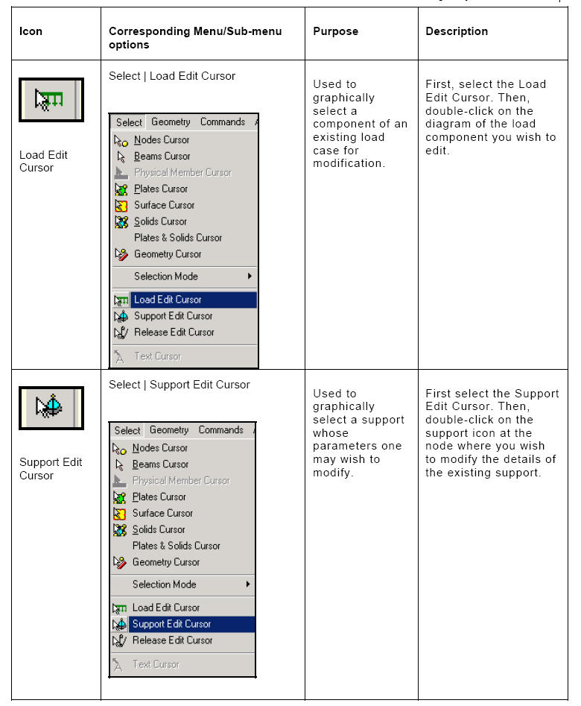

Slide 11
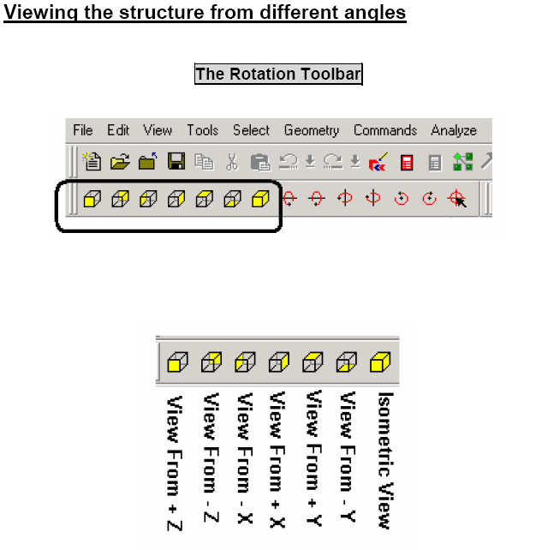

Slide 12
Module 3 Additional tools for modeling
Translational Repeat
Circular Repeat
Mirror
Rotate
Move
Insert Node

Slide 13
Add Beam Between Mid-Points
Add Beam by Perpendicular Intersection
Delete
Undo/Redo
Zooming/Panning
Dimensioning

Slide 14
Module 4 Properties
Property Types
Type 1: Prismatic
Viewing Cross-Section
Type 2: Built-In Steel Table
Type 3: Thickness
General Notes About Property Assigning

Slide 15
Module 5 Constants, Supports, and Specifications
Material Constants
Geometry Constant
Supports
How to Assign Supports
Editing Supports
Specifications

Slide 16
Module 6 Loading
How to Create Primary Load ?
Individual Loads:
Self weight
Members
Area Load
Floor Load
Plate Loads
Node
How to Create Manual Combinations ?

Slide 17
Module 7 Analysis
Perform Analysis Command

Slide 18
Module 8 Post Processing
Results
Node Displacement
Node Reactions
Beam Forces
Beam Stresses
Beam Graphs
Animation
Other Ways: Double-Clicking a Beam

Slide 19
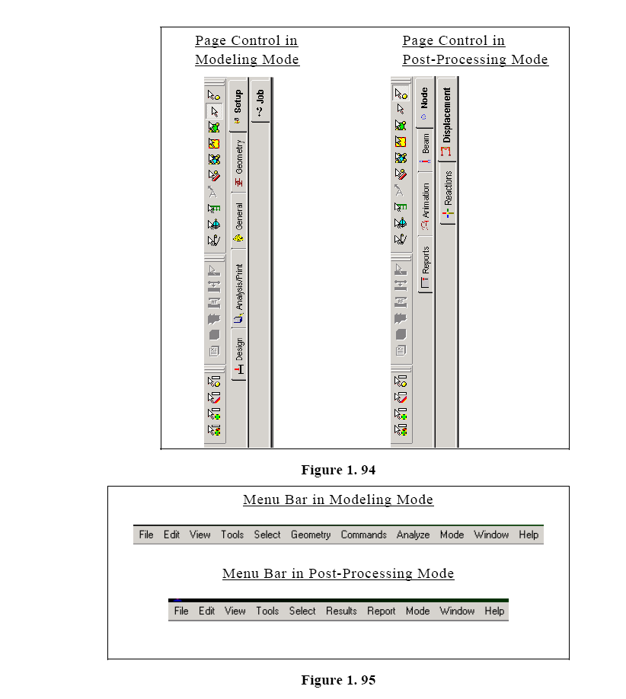

Slide 20
Types Structures
A STRUCTURE can be defined as an assemblage of elements. STAAD is capable of analyzing and designing structures consisting of both frame, and Finite elements. Almost any type of structure can be analyzed by STAAD.
Frame elements – Beam elements – 2 nodes
Finite elements – 1.) Plate – 3 or 4 nodes
2.) Solid – 4 to 8 nodes
Remember for staad -
Node becomes Joint it has a number and xyz cordinates
Beam becomes Member it has a number and nodes at its ends
Plate becomes Element it has a number and node at its corners

Slide 21
Continue…
A TRUSS structure consists of truss members which can have only axial member forces and no bending in the members
A PLANE structure is bound by a global X-Y coordinate system with loads in the same plane
A SPACE structure, which is a three dimensional framed structure with loads applied in any plane, is the most general.
A FLOOR structure is a two or three dimensional structure having no horizontal (global X or Z) movement of the structure [FX, FZ & MY are restrained at every joint]. The floor framing (in global X-Z plane) of a building is an ideal example of a FLOOR structure. Columns can also be modeled with the floor in a FLOOR structure as long as the structure has no horizontal loading. If there is any horizontal load, it must be analyzed as a SPACE structure.

Slide 23
Coordinate Systems

Slide 24
Working Methodethod
In order to build up a good input file we have to understand STAAD Pro way. This procedure will enable us to:
Organize our thoughts.
Put each step in its right position, not before, and not after.
Make sure that all of the STAAD Pro commands are present in the input file (none of them is overlooked).
Provide us with speedy and guaranteed way to create the input file.
Avoid error messages.

