Slide 1
University of Salahaddin- Erbil College of administration and Economics Department of Economics Fourth Stage(1,2st semester) Lecturer's name: Samyia Khalid Hasan Academic Year: 2023-2024
Subject: Application Economics with SPSS

Slide 2
Lecturer1 LEARNING OBJECTIVES
Understand basic concepts of biostatistics and computer software SPSS.
Select appropriate statistical tests for particular types of data.
Recognize and interpret the output from statistical analyses.
Report statistical output in a concise and appropriate manner

Slide 3
BASIC TERMINOLOGY
Statistics, Biostatistics, Variable, Measurement Scale, Data, Medical Data, type of data, Data Analysis

Slide 4
VARIABLE, SCALE, DATA
Variable is a characteristics which varies and scale is a device on which observations are taken. Data is set of observations/measurements taken from experiment/survey or external source of a specific variable using some appropriate measurement scale

Slide 5
NATURE OF DATA
Data is the value you get from observing (measuring, counting, assessing etc.) from experiment or survey. Data is either categorical or metric. Categorical data is further divided into Nominal and ordinal, whereas metric into discrete and continuous (quantitative) data.

Slide 6
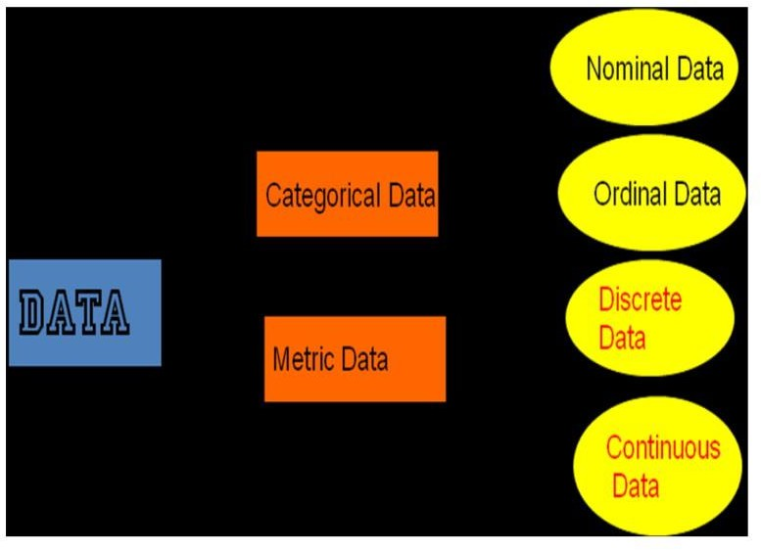

Slide 7
