Slide 1
University of Salahaddin- Erbil College of administration and Economics Department of Economics Fourth Stage(1,2st semester) Lecturer's name: Samyia Khalid Hasan Academic Year: 2023-2024
Subject: Application Economics with SPSS

Slide 2
Lecturer2 Type of data
Nominal data The data is divided into classes or categories. Blood type, sex, causes of disease, urban/rural, alive/ dead, infected/not infected, hair color, smoking status. No meaningful order of classes.
Ordinal data
The data is also divided into classes or categories but be put in meaningful
order.
For example satisfaction level:-Very satisfied, satisfied, neutral, unsatisfied, very unsatisfied. Pain as mild, moderate, sever. Socioeconomic status: poor, middle, rich, grade of breast cancer, better, same, worst.

Slide 3
Discrete and Continuous
Discrete data
When data is taken from some counting process, for example number of patients in different wards, number of nurses, number of hospitals in different cities.
Continuous or quantitative data
When data is taken from some measuring process, for example, height, weight,
Temperature, uric acid, blood glucose and serum level.

Slide 4
Primary Scales of Measurement

Slide 5
SPSS
SPSS is a statistical Packages for data analysis, it is a very popular software because of its friendly usage in Social & Medical sciences

Slide 7
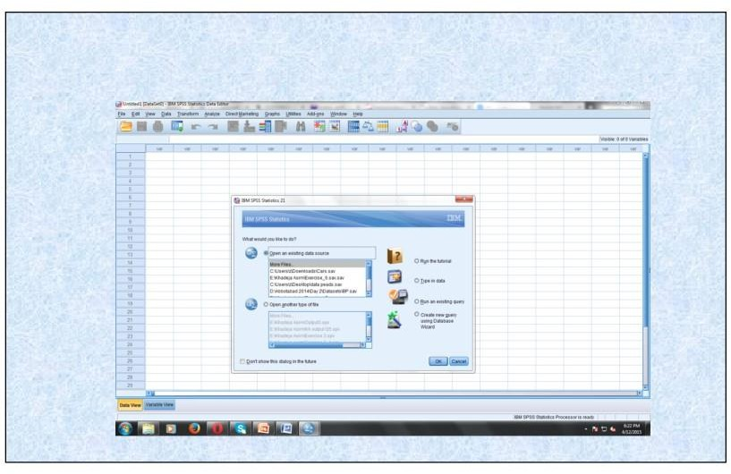
On clicking of SPSS this window will open then click on cancel button if you like to enter data in a new file or click on OK for opening an existing file. A window will open known as data editor with variable view

Slide 8
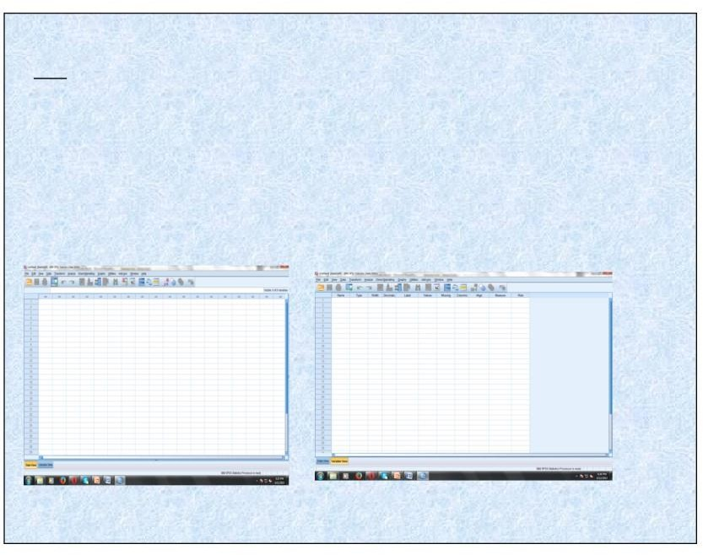
SPSS WINDOWS
There are a number of different types of windows in SPSS. The window in which you are currently working is called the active window. Some of the frequently used windows are:
Data Editor Window: It displays the contents of the data file. This is the window that opens automatically when you start an SPSS session. In this window, you can create new data files or modify existing ones. When you open more than one data file, each data file has a separate Data Editor Window. The Data Editor Window provides two view of the data:
Data View: It displays the data values. Each variable is a column. Each row is a case.
Variable View: It displays a table consisting of variable names and their attributes. You can modify the properties of each variable or add new variables or delete existing variables in the Variable View Window.
Data view window variable view window

