Slide 1
Erbil-Polytechnic University Department Administration Fourth Stage (Semester one) Lecturer's name: Samyia Khalid Hasan Academic Year: 2023-2024
Subject: Advanced Computer (SPSS)

Slide 2
Lecturer3 PULL-DOWN MENUS
Many tasks in SPSS are performed by selecting appropriate "pull-down" menus. Each window in SPSS has its own menu bar with appropriate menu selections and toolbars. The Analyze and Graphs menus are available in all windows. Here are some Data Editor Window menus and their uses:
File Menu: From the file menu you can open several different existing files or a database file such as an excel file or read in a text file. You can also save any changes to the current file.
Edit Menu: from the Edit menu, you can cut, copy, paste, insert variables, insert cases, or use find in the Data Editor window.
Data Menu: The data menu allows you to define variable properties, sort cases, merge files, split files, select cases and use a variable to weight cases.

Slide 3
PULL-DOWN MENUS
Transform Menu: The transform menu is where you will find the options to do some computations on
variables, to create new variables from existing ones or recode old variables.
Analyze Menu: The analyze menu is where all statistical analysis takes place. From descriptive statistics to regression analysis to nonparametric tests
Graphs Menu: The graph menu is where you can create high resolution plots and graphs to be edited in the chart editor window or you can create interactive graphs.
Utilities Menu: The utilities menu is used to display information on the contents of SPSS data files or to run scripts.

Slide 4
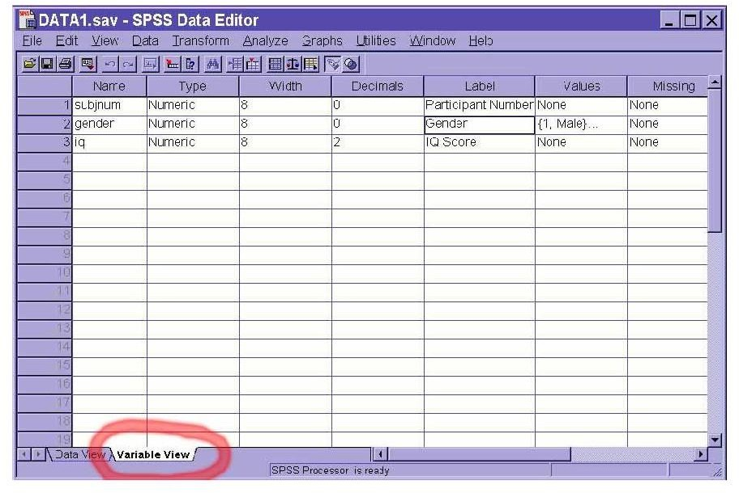

Slide 5
TYPE
THE TWO BASIC TYPES OF VARIABLES THAT YOU WILL USE ARE NUMERIC AND STRING. NUMERIC VARIABLES MAY ONLY HAVE NUMBERS ASSIGNED. STRING VARIABLES MAY CONTAIN LETTERS OR NUMBERS, BUT EVEN IF A STRING VARIABLE HAPPENS TO CONTAIN ONLY NUMBERS, NUMERIC OPERATIONS ON THAT VARIABLE WILL NOT BE ALLOWED (E.G., FINDING THE MEAN, VARIANCE, STANDARD DEVIATION, ETC...). TO CHANGE A VARIABLE TYPE, CLICK IN THAT CELL ON THE GREY BOX WITH ...

Slide 6
Decimals , Label
The decimal of a variable is the number of decimal places that SPSS will display. If more decimals have been entered (or computed by SPSS), the additional information will be retained internally but not displayed on screen. For whole numbers, you would reduce the number of decimals to zero. You can change the number of decimal places by clicking in the decimals cell for the desired variable and typing a new number or you can use the arrow keys at the edge of the cell
The label of a variable is a string of text to indentify in more detail what a variable represents. Unlike the name, the label is limited to 255 characters and may contain spaces and punctuation. For instance, if there is a variable for each question on a questionnaire, you would type the question as the variable label. To change or edit a variable label, simply click anywhere within the cell

Slide 7
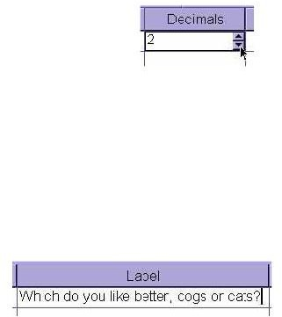

Slide 8
Values
Although the variable label goes a long way to explaining what the variable represents, for categorical data (discrete data of both nominal and ordinal levels of measurement), we often need to know which numbers represent which categories. To indicate how these numbers are assigned, one can add labels to specific values by clicking on the ... box in the values cell

Slide 9
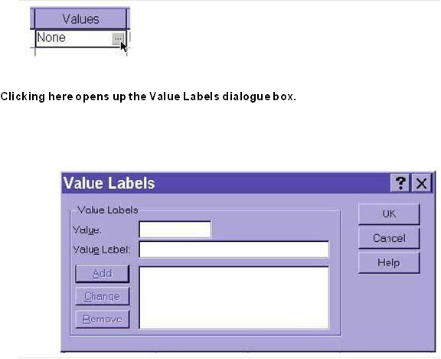
Values

