Slide 1
wind
Lab 5

Slide 2
Wind
If we listen to the weather forecasts, you will often hear the terms low pressure or high pressure. Wind is caused by air moving from areas of high pressure to areas of low pressure.
Measurement of Wind
Wind speed measure by special equipment called Anemometer and the equipment record movement of wind m/min and has the ability to record wind speed to 900 miles/hour.
The speed of wind in the upland areas measure by equipment called Radiosonde or by balloons.
The Beaufort scale
It is easy to estimate the effect of wind speed by the looking at that the wind has on subject. This is given as a number between 0 to 12 on the beau-fort Scale, and the scale was created by the British naval commander Sir Francis Beaufort around 1806.

Slide 3
Effects of wind on plant productivity
1. Structural damage
Cuticle damage on leaves – increases water loss
Broken branches
Loss of petals on flowers
Soil displacement causing soil erosion
2. Increased erosion and removal of topsoil as dust.
3. Wind may cause the spread of weeds and types of fungi that causes to diseases as rust in the Chestnut tree. meaning more costs of removal.
4. Wind leads to damage in production when ridden fruits and buds of trees and other plants. Wind-damaged fruit does not store as well and is less marketable.
5. May bring salt spray or cause spray drift
6.Wind prevent insects from performance of their function between flowers.

Slide 4
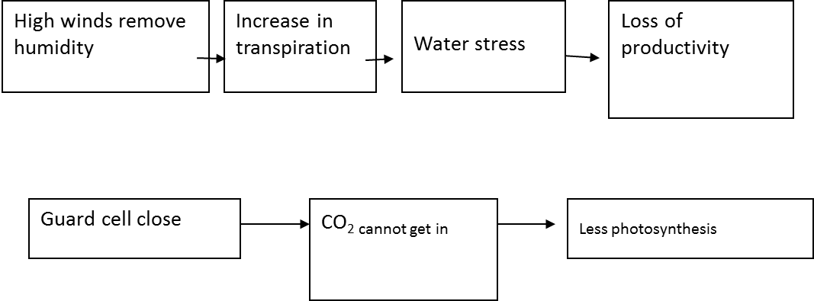
Physiological damage
Remove the layer of humid air around the leaves which forms a protective environment. This causes:

Slide 5
Positive effects of the wind
Reduced likelihood of frost
Providing air movement that will dry the outer leaves of a plant and therefore prevent the growth of fungal diseases
Assisting with the pollination of wind pollinated plants
Aid the drying of hay or grains before harvest

Slide 6
The different effect of wind on trees and forests
Trees type seasons and age of tree, some of them resist the wind, while some of them irresistible the wind.
Small seedlings affect by wind more than perennial seedlings.
Effect of wind in spring and summer will be more than in other seasons.
Forest trees are different to their resistance to wind. Trees divide according to their effect to wind to six groups are:
1- Trees that affect by wind:
Larix spp, Fagus spp

Slide 7
2- Trees that are not affect by wind:
Abies spp, Pinus nigra, Quercus spp, Alnus spp
3- Trees affect by storm a little bit:
Castanea spp., Populus spp., Juglans regia, Tilia spp
4- The trees affect by storms which effect on the economic:
Abies alba, Fagus silvatica
5-Trees affect storms which are pulling from the root and affect on the economic:
Picea spp
6-Trees that are not affect by storms:
Fraxinus spp, Acer spp, Robinia spp, Betula spp

Slide 8
The effect of forest on wind
Effect of forest (windbreak) substantially impact on the severity and speed of wind and can cause reducing of its speed and this impact different by difference of
Quality of trees (needle or deciduous trees),
Quality of the forest (mixed or pure)
Density of forest (permeable or impermeable)
Height of trees. This reduction of speed of wind may reach to more than half speed of the wind.

Slide 9
As a result of the impact of the forest on speed of wind, the mechanical and physiological of the wind effect reduce on seedlings, saplings, small trees and shrubs and this case lead to reduction of physiological effect for wind on the trees. . Studies have shown that windbreaks reduce speed of evaporation about 13% and increase proportion of relative humidity about 30%, in addition to its importance in maintaining soil fertility by prevent of soil erosion and add them to remnants that decompose after period of time and become fertilizer for trees.

Slide 10
