Slide 1
Moisture
Lab 3

Slide 2
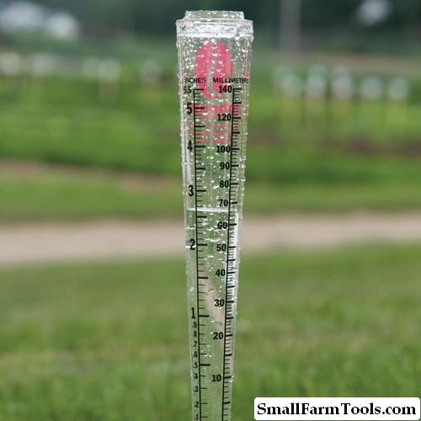
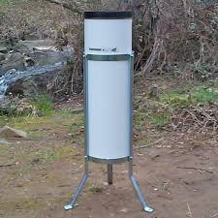
Moisture plays an important role in growth of trees and forests composition and distribution on the surface of the globe, and is the comes after temperature in influencing the spread of the trees on the surface of the globe, and the Precipitation (Rain, Snow and Hail) are the most important sources of moisture. Rain, Snow and Hail are measuring by millimeter, and air humidity are measuring in percentage or in grams).
Rain gauge

Slide 3
Moisture find in the form of water in Protoplasm and the plants cells and without it can not be process of respiration, , transpiration and photosynthesis, so water is the fundamental for growth of plants and can not survival without it for a long time. Plants utilize (0.1 - 0.3%) of the moisture that taken from ground in the construction processes and come out the remaining of the plant through evaporation and transpiration, so the loss of moisture is the most sensitive points of humidity, notice that the appropriate areas of temperature can not grow forests without the adequate of moisture and turn the region into the Steppe or Prairies or Desert.

Slide 4
There are three types of moisture are:
Minimum moisture (Desert) is very important for growth and development of trees and other plants. Decrease in amount of moisture under minimum moisture of soil causes to change in leaves color into yellow or wilt, drought or death in trees and plants. As well as maximum moisture is danger for trees and plants, because trees exposed to death due to lack of oxygen or roots unable to obtain the oxygen that need to growth.

Slide 5
Forest trees different to their requirements to moisture and divided into the following:
1- Trees that tolerant to low moisture (able to grow in dry soil)
○ Pinus spp
○ Juniperus spp
○ Eucalyptus camaldulensis
2- Trees that tolerant semi-moisture:
• Casuarinas equisetifolia
• Melia azedarch

Slide 6
3- Trees that require high moisture:
• Alnus glutinosa
• Populus nigra
• Populus euphratica
• Salix spp
Platanus spp
Fraxinus rotundifolia (Ash)

Slide 7
Precipitation Resources
Precipitation (Rain, Snow and Hail) are the most important sources of moisture.
Rains
Rain is an evaporation that gets from rivers, seas, oceans and vegetation. The ground moisture be through condensation of water vapor that comes from oceans, seas and rivers by the wind in the upland areas to the regular water droplets with diameter about (2.5 to 5.5) mm and drops down to the earth's surface in forms (rain).

Slide 8
Snow
The moisture condensation in the atmosphere as a result to its exposition to waves of low heat air, in the form of small hexagonal crystals, cohere the crystals with each other as a result air movements and fall down on the form of crystals of snow. This crystals may be in the form of powdery dust is called Powder snow, or in the form of icy crystals with surface of water has not been completed to freezing is called wet snow, but the icy crystals that occur with the very strong winds from the hail and snow waves is called snow Storms.
Snow has many damages which are different according to
Trees species as conifers (needle trees) or deciduous
Trees age and forest quality (pure or mixed )
The density of forest
Crown form
Quality of snow falling in the region, and wind

Slide 9
Hail
Hail is blocks of fragile ice in diameter (5-50) mm. The hail becomes harmful to plants by severity and direction of wind and causes to wounds in the bark of branches and stem, then lead to deterioration of wood economic value after their infection to insects and fungi. Hail also leads to break tops of seedlings and killing of small seedlings.
The effect of forest on moisture:
Part of precipitation remains relates to parts of tree such as crown, twigs and leaves, and after a period of time come down to the land of forest in the form of drops of water called
through full from the trunks of trees to the land of forest and called stem flow and parts of it evaporates by the leaves or crown coronary before coming to the surface of soil.

Slide 10
The runoff that gets through stem affect by many factors, including:
2- Tree form
3- The relative height of the trees
4- Trees age
5- Type of Barks

Slide 11
Quantity and quality of water that reach into the land of forest different by difference of regions, the seasons, amount of rain, quality of the trees, ages of the trees, coronary density, quality of the forest (pure or mixed), quality of tree bark and form of tree.
Amount of moisture in soils of forest is more than the amount of moisture in bare soils, as a result of the falling of retained precipitation, whether it is in the form of rain or snow or other through crowns, leaves and trunk into the land of forest.
The impact of forests on the amount of retained snow differs by difference of trees species and ages of the trees. As the thickness of snow in the forest be as much as (2-3) times the thickness of the snow in bare forest

Slide 12
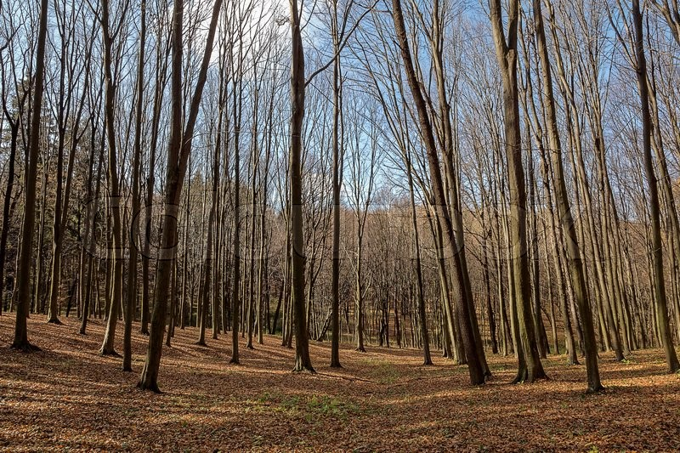

Slide 13
Practical part:-
1- We take three seedling of evergreen trees. 2- The one of seedling irrigated 100% 3- The second one irrigated 50% 4- The third one irrigated 0% some measurement were taken

