Slide 1
Environmental Science and Health Department
Lord increase our knowledge
Lab. 3 Plant Identification and Classification
Dr. Badr Qader Surchi and M. Sakar Abdulqadr Saheed
Assist. Professor Lecturer

Slide 2
Identification is a basic activity and one of the primary objectives of systematics. Although identification is a separate activity or process, in practice it involves both classification and nomenclature.
Identification is simply the determination of the similarities or differences between two elements, i.e., two elements are the same or they are different. The comparison of an unknown plant with a named specimen and the determination that the two elements are the same also involves classification.

Slide 3
Plant Classification
Taxonomy: the study of the principles and methods of classification.
Systematics: The study of the kinds and diversity of organisms and any and all relationships among them.
Classification: is the science of naming organisms and placing them in a hierarchical structure, each level being given a name (e.g., kingdom, division (phylum), class, order, family, genus, species).
Plant taxonomy is the science that finds, identifies, describes, classifies, and names plants.

Slide 4
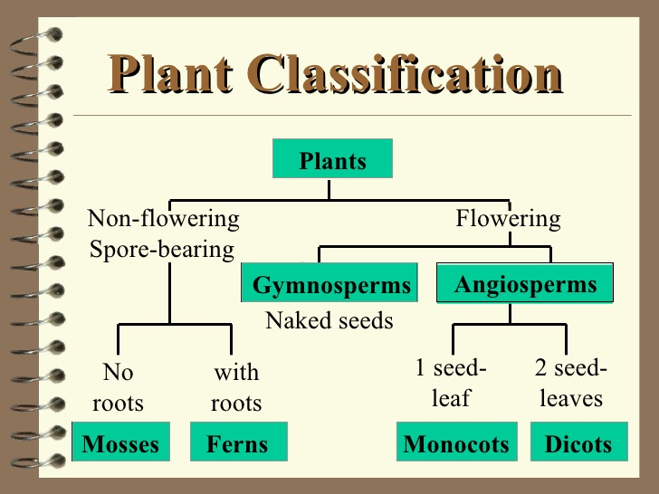

Slide 7
Kingdom Plantae – Plants
Subkingdom Tracheobionta – Vascular plants
Superdivision Spermatophyta – Seed plants
Division Magnoliophyta – Flowering plants
Class Liliopsida – Monocotyledons
Subclass Liliidae
Order Liliales
Family Liliaceae – Lily family
Genus Allium L. – onion
Species Allium cepa L. – garden onion

Slide 8
Herbarium:
Herbarium is a kind of repository or storehouse of collected specimens of plants that are usually dried, pressed and preserved on sheets.
Herbarium technique:-
(a). Collection of the specimen (plants).
(b). Pressing and drying of the specimen.
c). Poisoning of specimens or protection of plants from insects or pests.
(d). Mounting and labelling of specimen
After drying, the specimens are mounted on the herbarium sheets of size 41×29cm.

Slide 9
Labelling should be done on the right hand side lower corner of the herbarium sheet. Generally the size of the label is 7×12 cm.
The sheets are properly labelled and arranged accordingly with the accepted system of classification
Labelling includes information like
Date of collection, Vernacular names (local names), Scientific name, Family, Habitat, Collector’s name.
(e). Storing of herbarium sheets.
The sheets are now stored in the almirahs (steel) to protect them from fire.

Slide 10
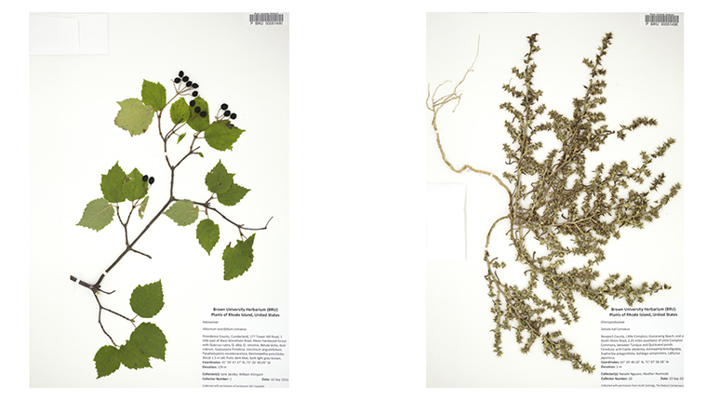

Slide 11
Importance of herbarium :
It provides detailed scientific information about the plants for research and exhibition and thus acts as a quick referral system in taxonomic studies.
It can be used for the identification and classification of unknown flora (plants).
It provides safety to the important specimens.
Compilation of Flora, Manuals and Monographs

