Slide 1
Determination of available nitrogen in soil
Lab 4

Slide 2
Nitrogen, or N, using its scientific abbreviation, is a colorless, odorless element. Nitrogen is in the soil under our feet, in the water we drink, and in the air we breathe. In fact, nitrogen is the most abundant element in Earth's atmosphere: approximately 78% of the atmosphere is nitrogen
In the atmosphere, the predominant form of nitrogen is dinitrogen gas (N2 ), which is relatively inert and must be converted into different forms to be utilized by most organisms. There are several avenues for these conversion processes, collectively called nitrogen fixation, in which N2 gas is converted to ammonium (NH4 +). A small amount of nitrate (NO3 -) is produced by high voltage electrical discharged in the atmosphere during lightning storms

Slide 3
Nitrate (NO3 -):-
Nitrate (NO3 -) is a form of inorganic nitrogen (N) naturally occurring in soils. Sources of soil NO3 – include decomposing plant residues and animal manure/compost, chemical fertilizers, exudates from living plants, rainfall, and lightning. Eventually, nitrate ions immobilized by microorganisms (nitrate taken up by microorganisms) are converted into organic forms and released back to the soil in plant-available forms when dead soil organisms are fed upon or decompose. In well drained soils, ammonium (NH4 +) and ammonia (NH3) are converted into NO3 by very specific populations of aerobic bacteria. This process is known as nitrification.

Slide 4
Another biological N transformation is denitrification, which is the conversion of NO3 – into nitrous oxide (N2O), nitrogen dioxide (NO2), and nitrogen gas (N2) that often occurs in anaerobic soils, such as waterlogged soils and wetlands. Even when nitrifying bacteria are very active in the outer parts of aggregates in well aerated soils, denitrification may still occur in anaerobic microsites inside the aggregates. Nitrate is very soluble in water and can be easily transported by runoff and other surface and subsurface flows to rivers and lakes or moved downward to ground water.

Slide 5
Relationship to Soil Function
The primary function of NO3 – is to serve as a source of nitrogen for the nutrition and growth of plants and soil microorganisms.
Problems with Poor Activity
Denitrification results in nitrogen loss from soil and produces some forms of intermediate gaseous nitrogen (e.g., N2O) that are harmful to the environment. Problems associated with high NO3 – concentration include the pollution of ground water and surface water and an increased risk of eutrophication that threatens the survival of aquatic life. Nitrification can potentially result in soil acidification by hydrogen ions (H+) released during the process.

Slide 6
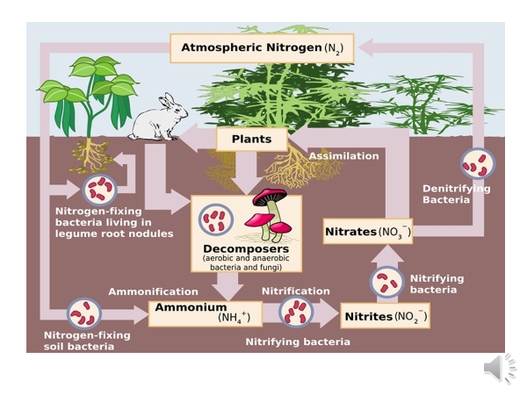

Slide 7
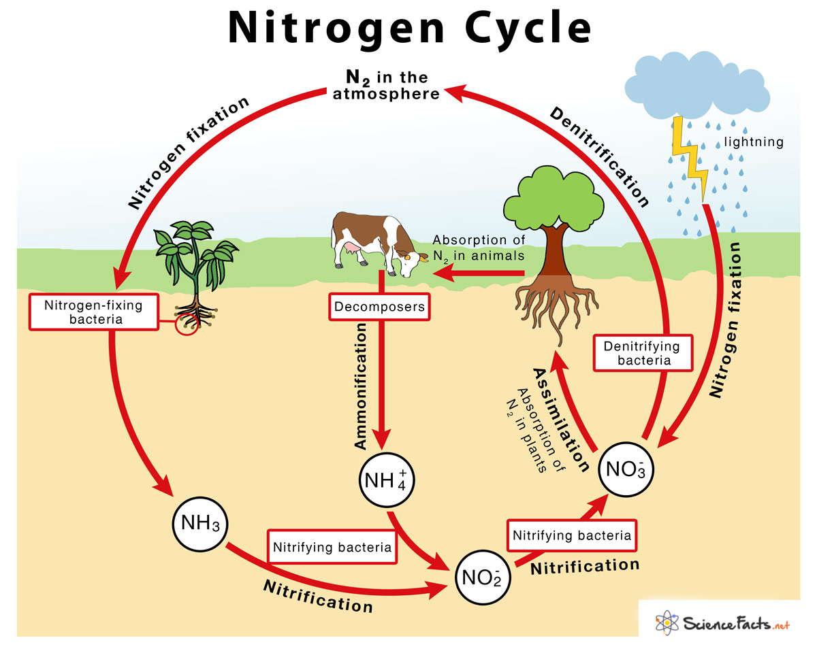

Slide 8
Factor effects on rate nitrogen in soil
1. Nature of Organic Materials
2. Soil Moisture
3. Temperature
4. Alternate Wetting and Drying
5. Amount and Sources of Applied Nitrogen
6. Soil Reaction
7. Amount of Nitrogen in Soil
8. Aeration
9. Soil-Plant Interactions

Slide 9
Procedure for determination NO3
Reagents
0.02N of (CUSO4.5H2O)
1N HCl
1- Put 10 g 0f soil add 50 ml of 0.02N(CUSO4.5H20) .
2- Shake solution for 15 minute.
3- Filtrate solution throw filterpaper.
4- after filteration 50 ml of sample add 1ml of 1NHcl to extract.
5- read the absorbance by spectrophotometer.in two wave length 220nm and 275nm.

Slide 10
Calculation:-
Y=Ab220-Ab275
NO3concentration= Y/N

