Slide 1
Design Strategy
Clarity Guidance Direction
3rd Lecture theory of Architecture
Master program

Slide 2
WHY
WHAT
HOW
CASES

Slide 3
WHY
“Organizations resist change because they are made up of individuals who are working at what has always worked.”
Roger Martin, dean of the Rotman School of Management at the University of Toronto,

Slide 4
Evolution of Design
Design is rapidly moving from posters and toasters to include processes, systems, and organizations.

Slide 5
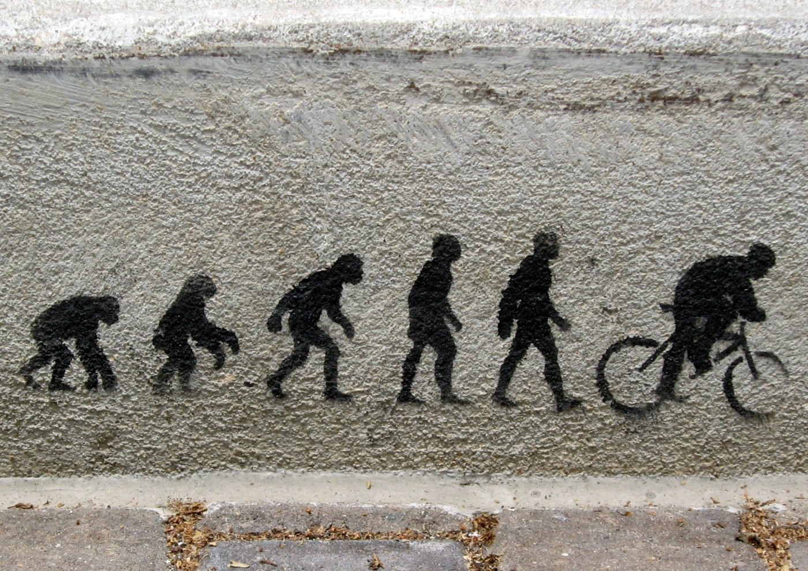
DESIGN AS ;
Anton
2009-03-14 14:02:05
--------------------------------------------
If we look at the evolution of design it can furthermore be transferred in the way design presence evolves within an organization. Design as an action for boosting the aesthetic value, to take a more proactive position as a business asset.
an aesthetic value
direction driver
decision indicator
a functional & technical driver
d
ecision driver
a business asset

Slide 6
Design as Tactic
Business Strategy
Brand Strategy
Design
Management
Design Identity
Brand Identity
Design
Development
Production
Distribution
Design as Strategy

Slide 7
High Fees Executive
Level
Leaders
Creators
Moste Design Firms
Makers
Low Fees Low Influence
Determine Business Strategy
Determine Brand Strategy
Define Customer Experience
Create Concepts
Develop Design
Manage Standards
Produce
Distribute

Slide 8
Competition
Environment
Technology
Market
Customers
Value
Business
Global issues
Economy
Social trends
Government regulations

Slide 9
Mystery Heuristics
Design
Strategy
Marry business and design
Algorithms Code
Business
Learning how to describe design’s benefits in financial and strategic language is key.

Slide 10
BUSINESS GOALS
COSTUMER NEEDS
Vision
Value
Design
Objectives Goals
Brand
Research
Identity
Processes

Slide 11
Strategy should bring clarity to an organization
Product/service design: decide how to create something
Design strategy: decide what to create, with a perspective beyond the current cycle (e.g. 3-5 years)
Business strategy: decide what a business should do, with a perspective beyond the current cycle (e.g. 3-5 years)

Slide 12
Design drives innovation, Innovation powers brands, brands build loyalty,
and loyalty sustains profits.
If you want long-term profits, don’t start with technology
—Start with design.

Slide 13
Innovation = Invention x Implementation

Slide 14
WHAT
The difference between a dreamer and a pioneer is discipline and process

Slide 15
Process Innovation PM
TECHNOLOGY
Feasibility
Engineers EE, ME
BUSINESS
Viability
Sales, Marketing
Experience Innovation
HUMAN VALUES
Usability, Desirebility, Need
Design & Interaction Functional Innovation
Strategy
Emotional Innovation
Design Strategist acts in the crossroads of design, research insight and business strategy, where design methods are used to generate furthermore illustrate strategies as well as tactics for planning, implementation and businesses.

Slide 16
Design strategy is a discipline which helps firms determine what to make and do, why do it and how to innovate contextually, both immediately and over the long term

Slide 17
Design Strategist acts in the crossroads of design, research insight and business strategy, where design methods are used to generate furthermore illustrate strategies as well as tactics for planning, implementation and businesses.

Slide 18
Strategic thinking stresses a systemic perspective of interrelations and interdependence

Slide 19
Strategic thinking
Over look the big picture to increase the projects hit rate and decrease sunk cost

Slide 20
Strategy is about choice
which affects the outcomes

Slide 21
A Strategy is a long term plan of action designed to achieve a particular goal

Slide 22
Strategies are used to make the problem easier to understand and solve.

Slide 23
HOW
“We will not win on technology alone”
We have to build in Design in to the company DNA AG Patrick Lynch P.N.G

Slide 24
Research Insights
Brand Decode
Design Strategy creates consistency throughout the design process and link the elements
Directions
Design Principals
Marketing
Product design
Graphic design
Packaging design

Slide 25
Key Responsibilities
Provide support to decode clarify and achieve goals and objectives.
Identify business problems and provides context for design opportunities.
Identify the key questions and issues that the client’s organization should address.
Translating insights into actionable solutions
Connecting design efforts to an organization’s business strategy
Integrating design as a fundamental aspect of strategic brand intent
Through a wide and deep approach, explore the market to create compelling user experiences, via products services and/or systems in its appropriate context.

Slide 26
Business Goal: The overall business aim within which you will be required to develop a strategy
Strategy: A high level plan of how you are going to approach the achievement of the goal
Tactics: Specific methods that you can use to achieve the strategy

Slide 27
SCOPE
What is the potential with the project
CONSUMER VALUE
What does our costumer value & underlying messages
DEFINITION
What are we doing
Detect the most reasonable solution if it should be product, system, or service
FOCUS
What will generate real business value

Slide 28
Discover
Define
Develop
Deliver
DIVERGENCE
CONVERGEN
DIVERGENCE
CONVERGEN
Business
trends and insight
RESEARCH
OBSERVATION
DISPLAY
IDEATION
PRINCEPALS
REFINEMENT
Consumer
trends and insight
RESEARCH PLANNING STRATEGY
Goal and Obejctives
STRUCTURAL INSIGHTS
Friendships
Models
Patterns
Stories
Personas
CONSTRAINES
Technical
Business
Context
Material
Tools
DESIGN ST ATEGIES
3&4&"3$)

Slide 29
Business and Design Strategy
Customer
Corporate Strategy
Product Strategy
Design Strategy
Brand
Competitor
Research & Analysis
Definition & Design

Slide 30
Planned Strategy
Strategy Echo
Emergent Strategy
STRATEGIC MANAGEMENT
Corporate Business Operational
Marketplace
current user behavior
Products
STRATEGIC MARKETING
changed user behavior
Big ideas: Strategic Planning
Brand & Identity
Services
System
Needs, Goals, Perceptions
CUSTOMERS
Strategic Initiatives
Projects
known business value
Communications
improved business value
Strategic
Tactical
Functional
Customer Experience
Planned perceptions
Actual perceptions
STRATEGIC DESIGN & DESIGN MANAGEMENT
Research- driven

Slide 31
DESIGN THINKING FOR
BUSINESS INNOVATION

Slide 32
CASES
Successful brands capture consumers not by selling “product attributes”, but by creating “superior experiences.”

