Slide 1
First Lecture: Design Philosophy
By: A.Prof.Dr. Salahaddin Yasin Baper

Slide 2
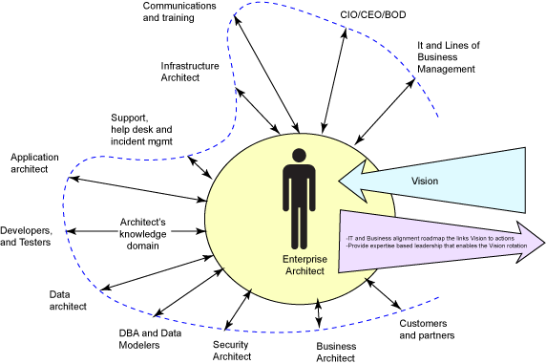
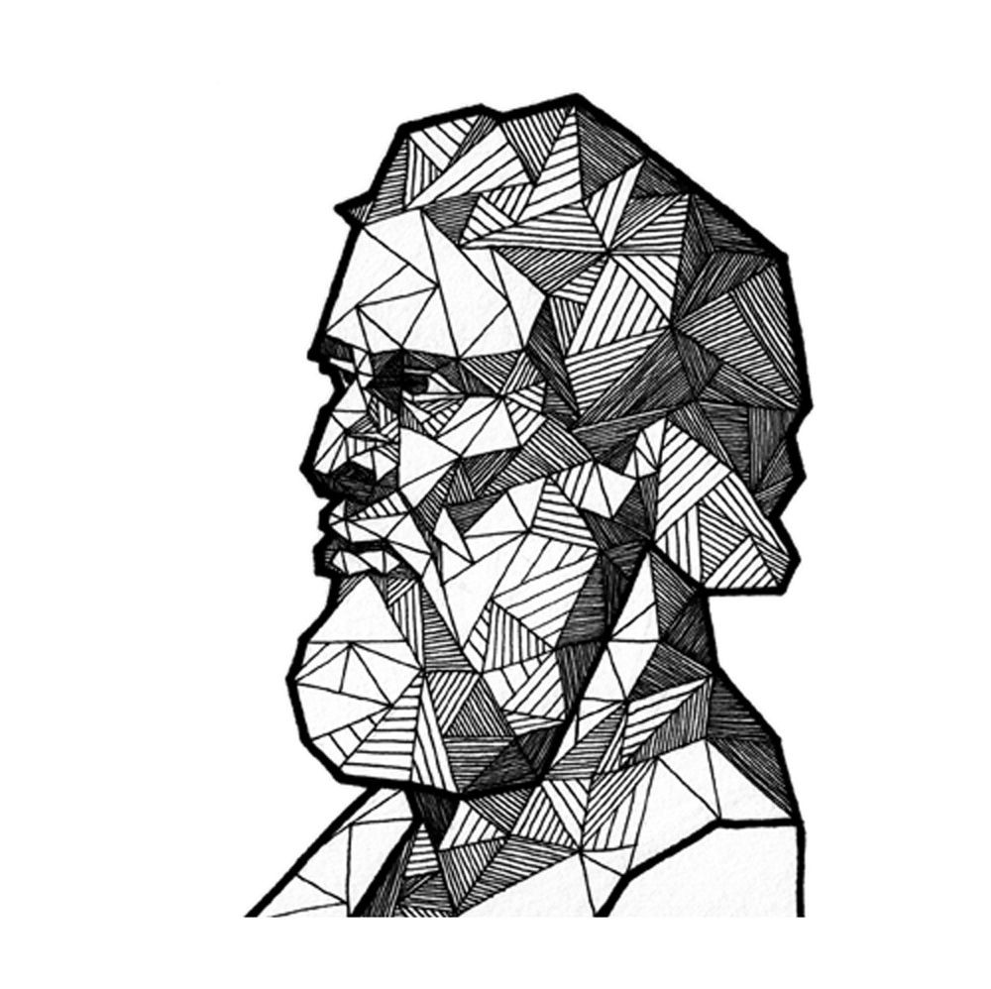
Design Philosophy

Slide 3
Design
Design is the visualization and depiction of form.
Design is the mental process which must intervene between the conception of a specific engineering intention and the issue of drawings to the workshop.
Design is the optimum solution to the sum of the true needs of a particular set of circumstances.
Design is a creative, iterative process serving a bounded objective.
Architectural Engineering Design is the use of scientific principles, technical information and imagination

Slide 4
Design Philosophy

Slide 6
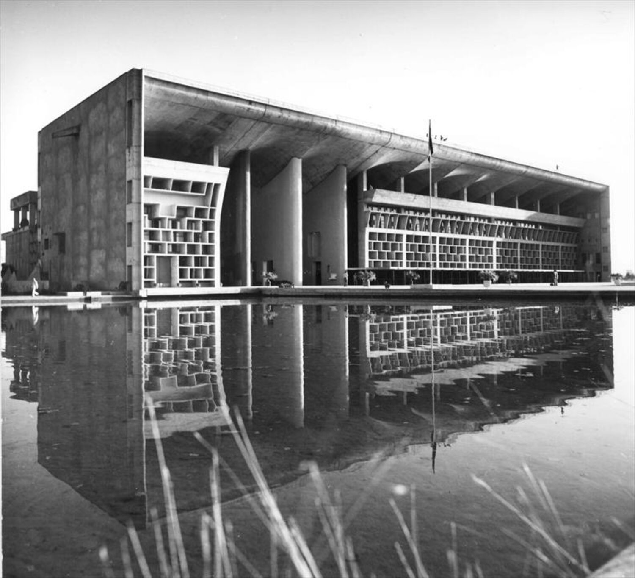

Slide 7
Designer
The Designer is clearly the paragon who carries out such tasks. His/her work can be split into three areas of activity:-
Decision-making regarding the physical form and dimensions of the product.
Communication to the builder, mainly in the form of drawings and specifications (Graphics, Text and Computer Files).
Responsibility for the achievement of the original requirements.
Often the designer must guide the original requirements to limit them to the possible.

Slide 8
Design philosophy
The following is a list of terms, aspects and concepts which reveal some of the general principles arising in design:-
a) Morphology: There is a pattern of events and activities which, by and large, are common to all projects.
b) Design Process: Iteration to solve problems followed by feedback of information from a later stage to review decisions made earlier.
c) Stratification: As the solution to one problem emerges, a sub-stratum of lesser problems is uncovered. Solutions to these must be found before the original problem can be solved.

Slide 9
Design philosophy (contd.)
d) Convergence: Many possible solutions may be processed in search of the one correct solution.
e) Decision-making: Choosing between alternatives.
f) Analysis: Used to establish the characteristics of the product which is the subject of the design. This is a fundamental design tool because it forms the basis on which decisions can be made but it is not the starting point for a design. A first shot must have been made at what the whole product will be like.
g) Synthesis: This is the truly creative part of design - putting together separate elements into a coherent whole. Probably this is the most characteristic part of design.

Slide 10
Design philosophy (contd.)
h) Creativity: Inventiveness - obviously a highly desirable facility in a designer.
i) Practicability: What can be achieved in design is determined not only by what is technologically practicable but also by the capabilities of the design team.
j) Communication: A design is a description of a product and the instructions for its manufacture. The quality of the end product depends critically on how well these two aspects are communicated.
k) Dynamics: Design is not a static process, especially with a large and complex product. Change in requirements or solution is almost unavoidable.

Slide 11
Design philosophy (contd.)
l) Need: The need for the product must be clearly established before starting design work.
m) Economic Worth: The owner of the end product must feel that it is worth the true cost of its acquisition.
n) Optimization: In design terms it may not be possible to devise the optimum solution, where the optimum is determined relative to many disparate constraints and on the basis of incomplete data. The best available solution may be no more than the best compromise that can be made between conflicting qualities within the constraints.

Slide 12
Design philosophy (contd.)
o) Criteria: The objective and quantitative measure of how successful or how near the optimum the design is. Sometimes the criteria are subjective and qualitative – the result of value judgments by those involved in the process.
p) Systems Approach: When a product is part of a broader system (and very few exist in complete isolation) its design must take account of the impact of the rest of the system on it and vice versa.

Slide 13
Types of Marine Vehicles, Structures and Facilities
Transportation
• General cargo ships carrying packed cargoes of various sizes, commonly known as break bulk cargo, of various types and sizes
• Unitized cargo carriers such as container ships, barge carriers and RORO (roll-on roll-off) vessels.
• Passenger vessels such as passenger ferries, cruise ships, passenger ships of various types and sizes and fast transport vessels.
• Ocean research vessels, coastal research vessels or fisheries research vessels, though not transport vessels, are designed like passenger vessels except that these must have a large deck area for scientific sample collection and analysis
• Dry bulk carriers carrying various types of bulk cargo such as ore, fertilizer, grain, etc.
• Liquid bulk cargo carriers such as crude oil carriers, product carriers, chemical tankers and liquefied gas carriers to carry LPG, LNG, ammonia, etc

Slide 14
Types of Marine Vehicles, Structures and Facilities
Defence
• Patrol crafts patrol the coast equipped with some gunfire power. Corvettes operate in littoral waters to protect a country’s assets even far away from the mainland.
• Frigates carry variable depth sonar, towed array, and/or torpedoes, anti-submarine torpedoes, surface-to-air/surface-to-surface missiles, landing deck and hanger to operate helicopters (equipped with sono buoys, magnetic detectors, etc.) and are also used for search-and-rescue operations.
• Destroyers are bigger than frigates with more weapons. Aircraft carriers are the biggest defence vessels having a single normal operating speed.
• Submarines are vehicles designed for going down to a depth below the surface under water and also come up as and when required.

Slide 15
Design philosophy (contd.)
o) Criteria: The objective and quantitative measure of how successful or how near the optimum the design is. Sometimes the criteria are subjective and qualitative – the result of value judgments by those involved in the process.
p) Systems Approach: When a product is part of a broader system (and very few exist in complete isolation) its design must take account of the impact of the rest of the system on it and vice versa.

Slide 16
Design philosophy (contd.)
o) Criteria: The objective and quantitative measure of how successful or how near the optimum the design is. Sometimes the criteria are subjective and qualitative – the result of value judgments by those involved in the process.
p) Systems Approach: When a product is part of a broader system (and very few exist in complete isolation) its design must take account of the impact of the rest of the system on it and vice versa.

