Slide 1
Frames and Machines
Frames and machines are two types of structures which arc often composed of pin-connected multiforce members, i.e. members that are subjected to more than two forces. Frames are used to support loads, whereas machines contain moving parts and are designed to transmit and alter the effect of forces. Provided a frame or machine contains no more supports or members than arc necessary to prevent its collapse, the forces acting at the joints and supports can be determined by applying the equations of equilibrium to each of its members. Once these forces arc obtained, it is then possible to design the size of the members, connections, and supports using the theory of mechanics of materials and an appropriate engineering design code.

Slide 3
Procedure for Analysis
The joint reactions on frames or machines (structures) composed of multiforce members can be determined using the fallowing procedure
Free-Body Diagram.
Draw the free-body diagram of the entire frame or machine, a portion of it, or each of its members. The choice should be made so that it leads to the most direct solution of the problem.
When the free-body diagram of a group of members of a frame or machine is drawn. The forces between the connected parts of this group are internal forces and are not shown on the free-body diagram of the group.
Forces common to two members which are in contact act with equal magnitude but opposite sense on the respective free-body diagrams of the members.
Two-force members, regardless of their shape, have equal but opposite collinear forces acting at the ends of the member.
In many cases it is possible to tell by inspection the proper sense of the unknown forces acting on a member; however, if this seems difficult, the sense can be assumed.
Remember that a couple moments is a free vector and can act at any point on the free-body diagram. Also, a force is a sliding vector and can act at any point along its line of action.

Slide 4
Equations of Equilibrium.
• Count the number of unknowns and compare it to the total number of equilibrium equations that are available. In two dimensions, there are three equilibrium equations that can be written for each member.
• Sum moments about a point that lies at the intersection of the lines of action of as many of the unknown forces as possible.
• If the solution of a force or couple moment magnitude is found to be negative, it means the sense of the force is the reverse of that shown on the free-body diagram.

Slide 5
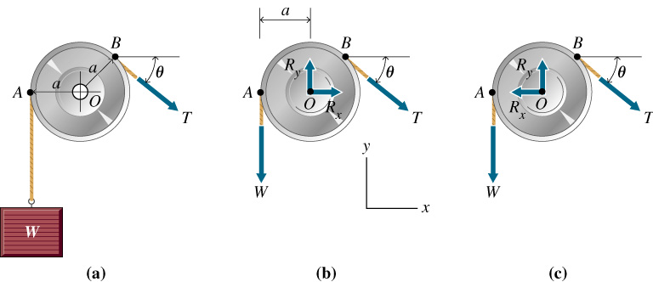
(a) Simple pulley;. (b) free-body diagram of the pulley with assumed senses of axle reactions; (c) diagrams showing correct senses of axle reactions.

Slide 6
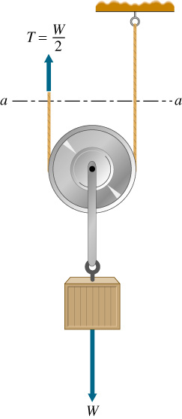
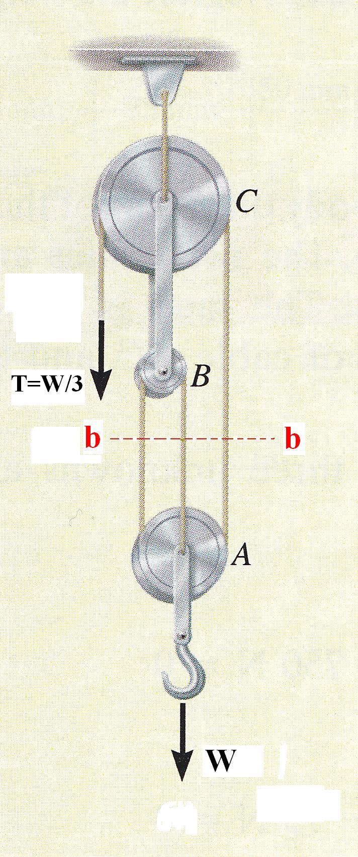
.
Block and tackle with mechanical advantage W/T = 3.0.
Pulley with mechanical advantage W/T = 2.0.

Slide 7
Sample Problem
The frame supports the 400 kg in the manner shown. Compute the horizontal and vertical components of all forces acting on each of the members.
Solution:
From the FBD of the entire frame
∑M_{A} =0 ; -3.924 x 5.5 + 5 D_{y} = 0 D_{y} = 4.32 kN
∑ F_{x} = 0 ; -Ax + 4.32 = 0 Ax = 4.32 kN
∑ F_{y} = 0 ; A_{y} – 3.924 =0 A_{y} = 3.92 kN

Slide 8
Draw a separate FBD of each member
Here we observe that CE is a two-force member.
From FBD of member BF
∑M_{B} =0 ; 0.5 E_{x} x 3 – 3.92 x 5 = 0
E_{x} = 13.07 kN
∑ F_{x} = 0 ; -B_{x} + 13.07 – 3.92 = 0
B_{x} = 9.15 kN
∑ F_{y} = 0 ; - B_{y} + 0.5 x 13.07 – 3.92 = 0
B_{y} = 2.62 kN
From FBD of member CE
C_{x} = E_{x} = 13.07 kN
The equations of equilibrium may now be applied to member AD as a check.

Slide 9
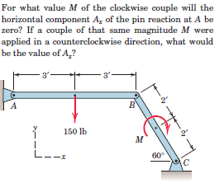
Example 1

Slide 10
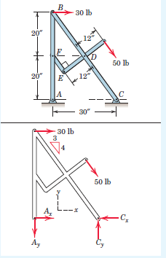
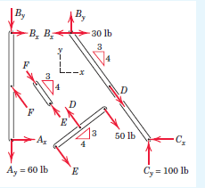
Example 2

Slide 13
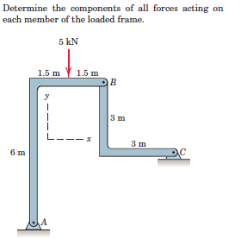

Example 3

Slide 14
