Slide 1
Center of Gravity and Centroid
- Center of Gravity
Center of Mass
Centroid (Volume, Area, and Line)
Center of Gravity
The center of gravity is a point which locates the resultant weight of a system of particles. The analytical location of the center of gravity is simply an application of the principle of moments.

Slide 2
If γ represents the specific weight of the body, measured as a weight per unit volume, then
dW=γdV
Center of Mass
γ= ρ.g
Where ρ is the density, or mass per unit volume.

Slide 3
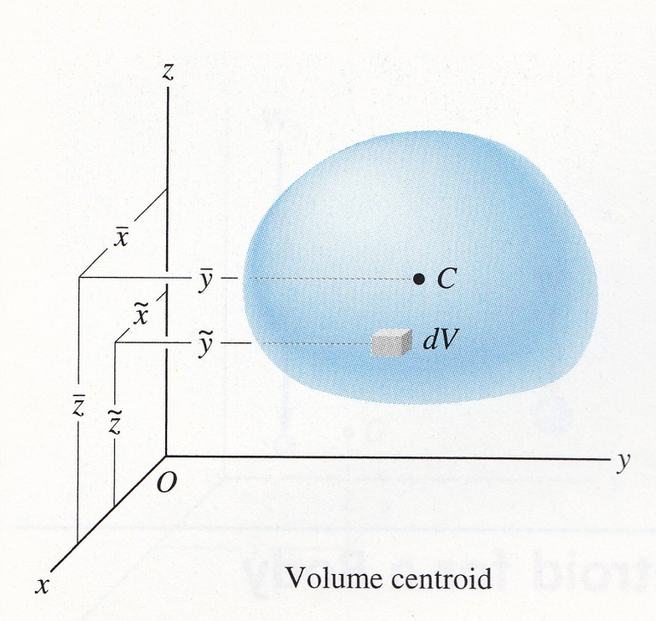
Centroid
The centroid C is a point which defines the geometric center of an object. Its location can be determined from formulas similar to those used to determine the bodys center of gravity or center of mass.
Volume

Slide 4
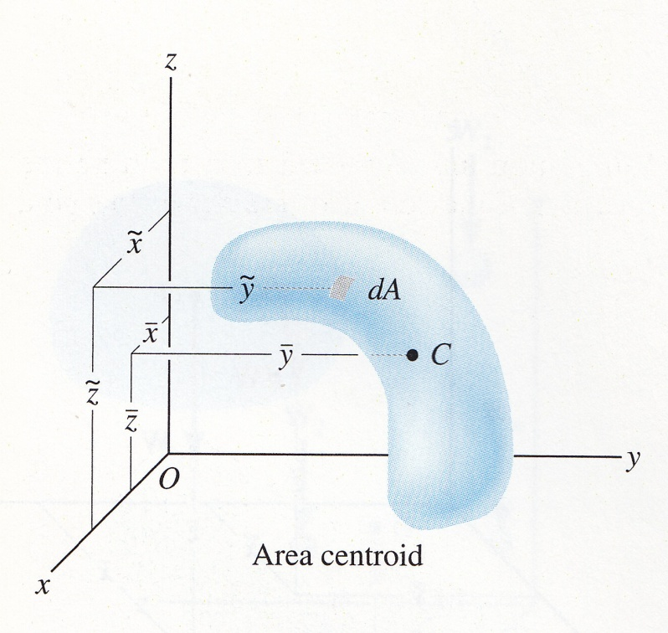
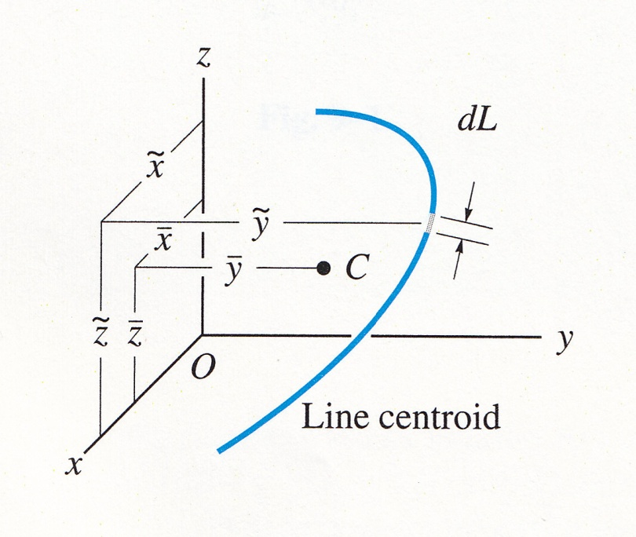
Area
Line

Slide 5
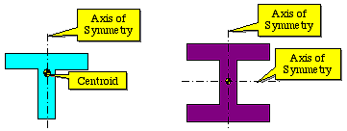
Symmetry
In cases where the shape has an axis of symmetry, the centroid of the shape will lie along that axis.
A Symmetric Shape
A Doubly Symmetric Shape

Slide 6
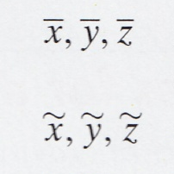
Composite bodies
Bodies that are made up of several parts of different shapes are called composite bodies. The center of gravity of a composite body may be determined from the centers of gravity of its individual parts.
Represents the coordinates of the center of gravity G of the composite body.
Where
Represents the coordinates of the center of gravity of each composite part of the body.

Slide 7
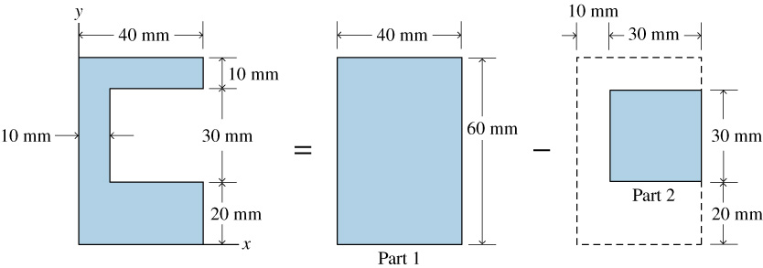

Slide 8
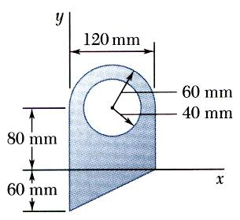
Sample Problem 2
For the plane area shown, determine the first moments with respect to the x and y axes and the location of the centroid.
SOLUTION:
Divide the area into a triangle, rectangle, and semicircle with a circular cutout.
Calculate the first moments of each area with respect to the axes.
Find the total area and first moments of the triangle, rectangle, and semicircle. Subtract the area and first moment of the circular cutout.
Compute the coordinates of the area centroid by dividing the first moments by the total area.

Slide 9
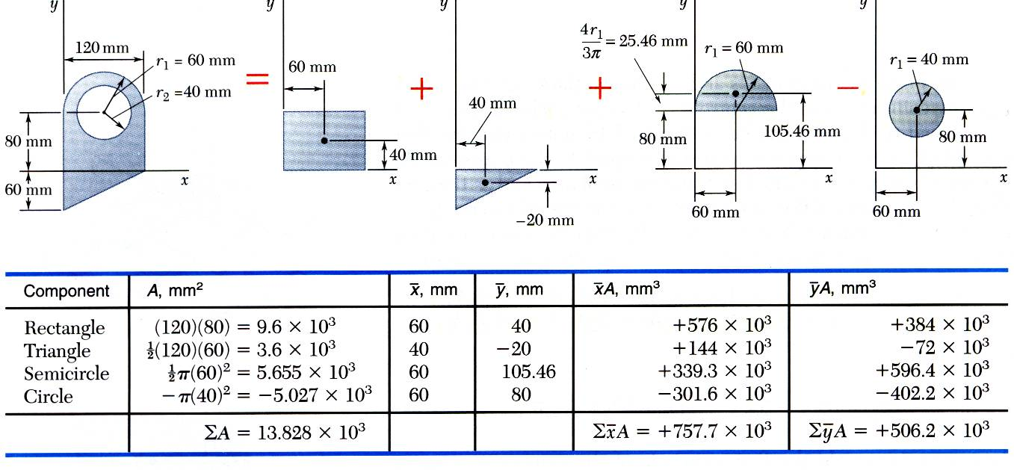
Find the total area and first moments of the triangle, rectangle, and semicircle. Subtract the area and first moment of the circular cutout.

Slide 10
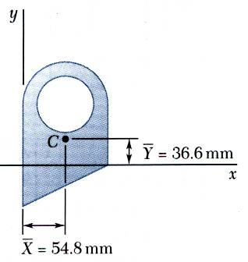
Compute the coordinates of the area centroid by dividing the first moments by the total area.

