Slide 1

Moment of Inertia
(Second Moment of the Area)
- Definition
-Moment of Inertia
-Parallel-Axis Theorem for an Area
-Radius of Gyration of an Area
-Moment of Inertia for Composite Areas
-Product of Inertia for an Area
-Moment of Inertia for an Area About
Inclined Axes

Slide 2
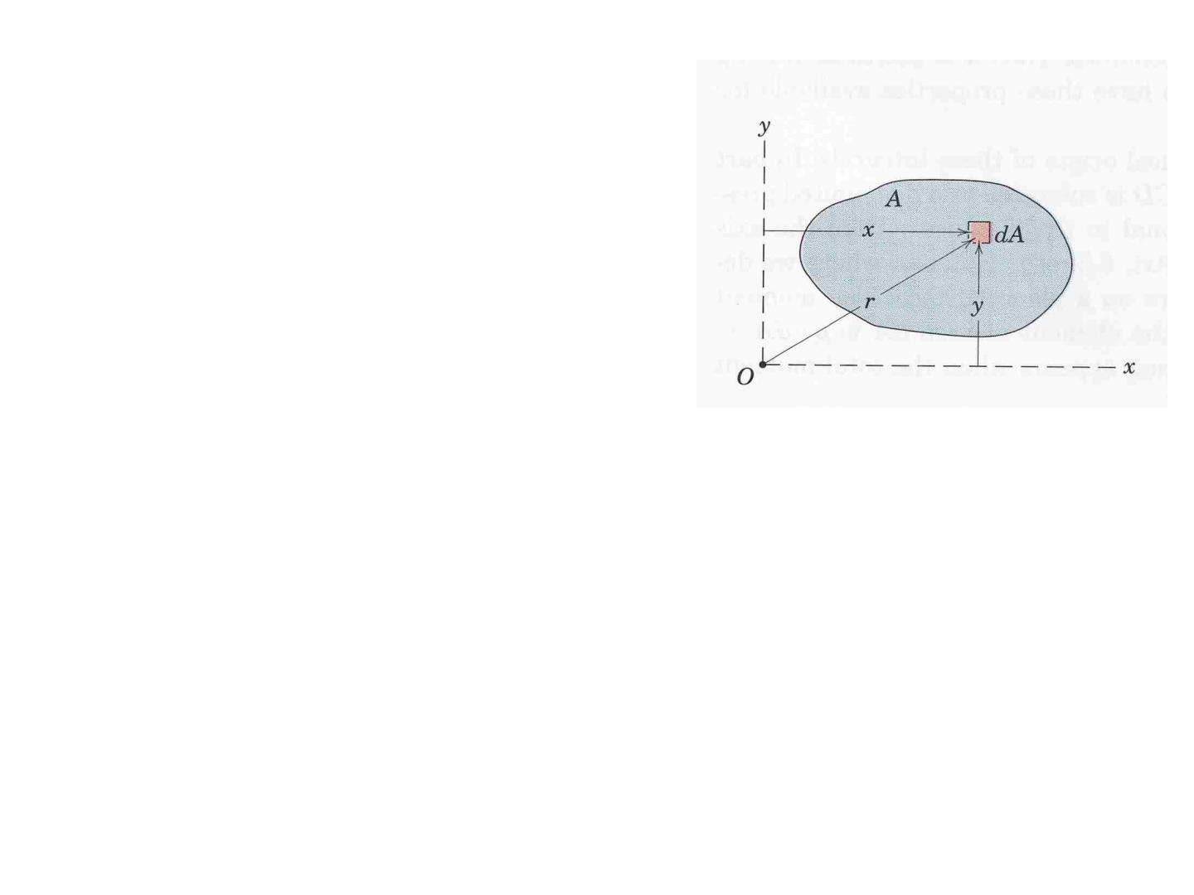
Definition
The area moment of inertia (second
moment of area) of an element area dA
with respect to any axis is defined as the
product of the area of the element and
the square of the distance from the axis
to the element. ∫ x² dA.
dI_{x} = y² dA
dI_{x} is the second moment of area dA
With respect to x-axis
∫ dI_{x} =∫ y² dA.
I_{x} =∫ y² dA.
Similarly:
I_{y} =∫ x² dA.
J_{o} =∫ r ² dA. (second moment of the area
with respect to O or z-axis)

Slide 3
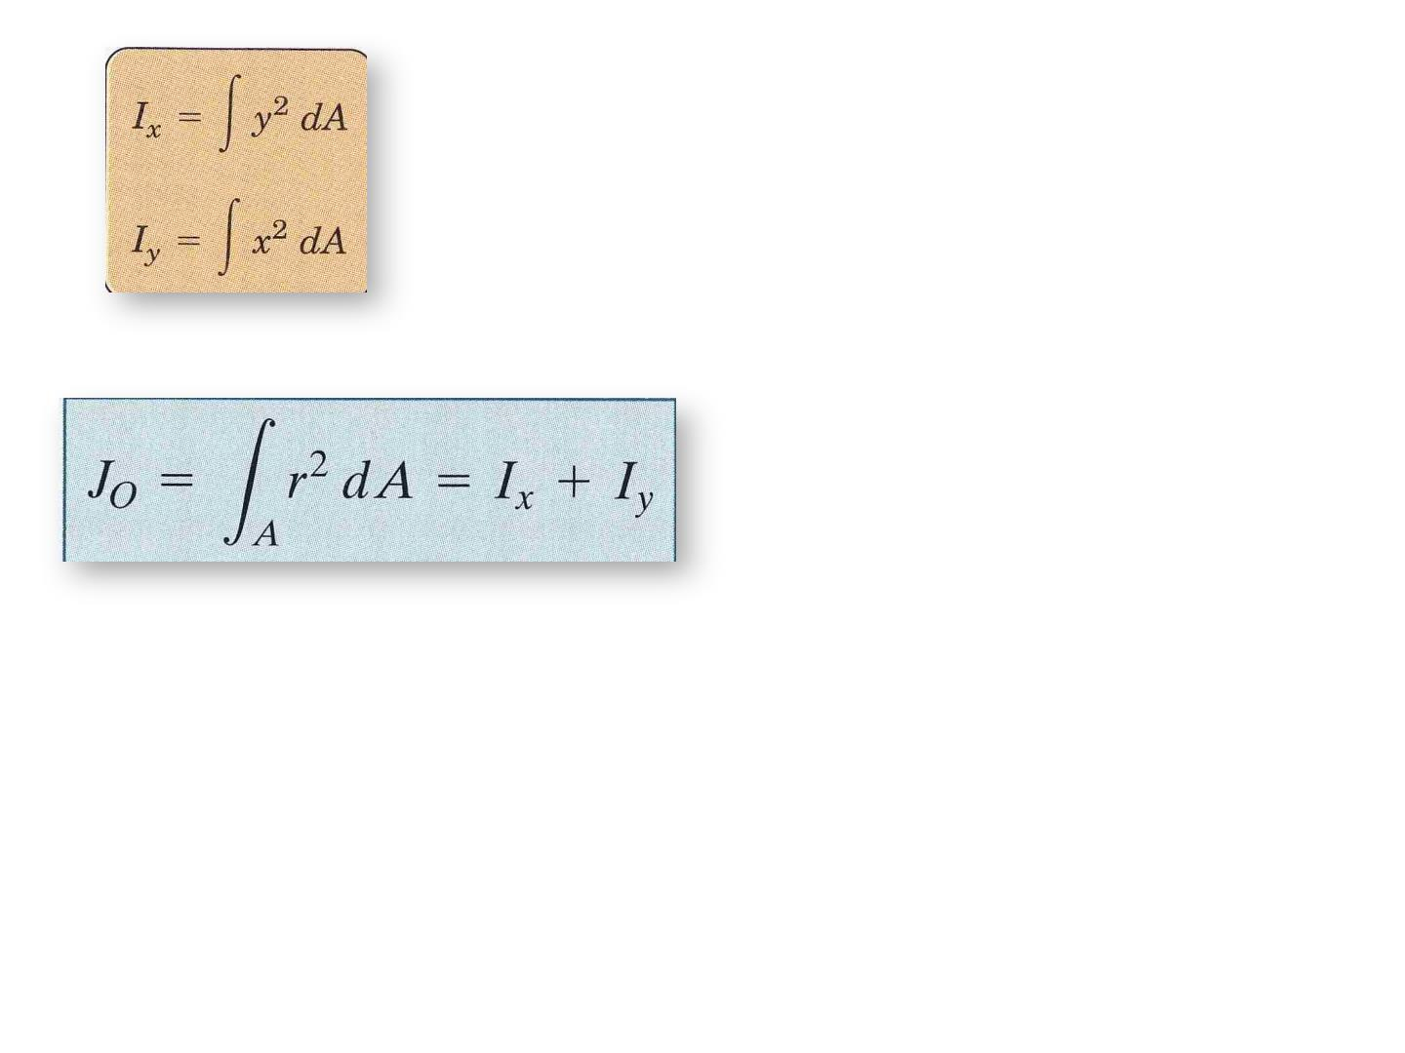
Rectangular moment of inertia
Polar moment of inertia

Slide 4
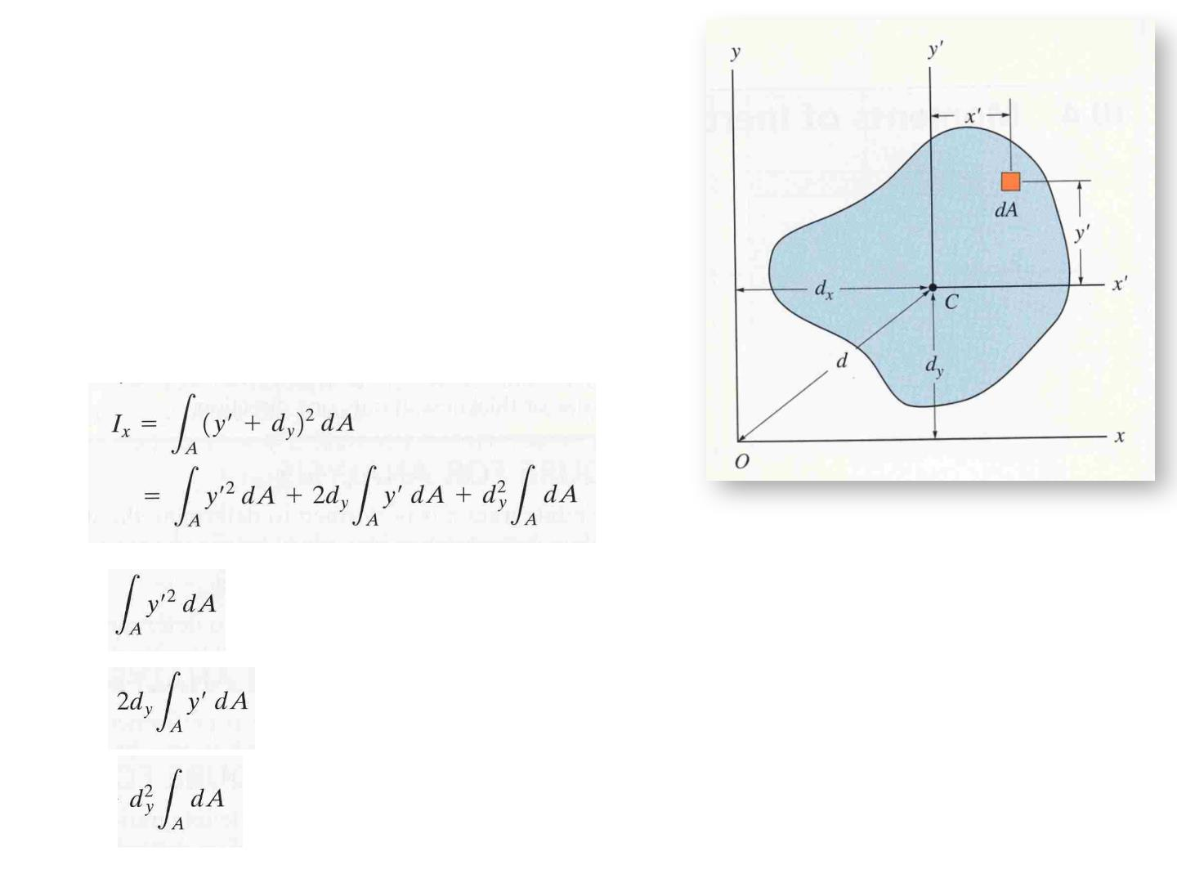
Parallel-Axis Theorem for an Area
(Transfer Formula)
It is often necessary to transfer the moment
of inertia from one axis to another parallel
axis ( this without further integration)
dI = (yʹ+d )² dA
x
y
= Ī_{xʹ} ( I about the centroidal axis)
= 0 ( since the xʹ-axis passes through the C )
= A . d_{y}2

Slide 5
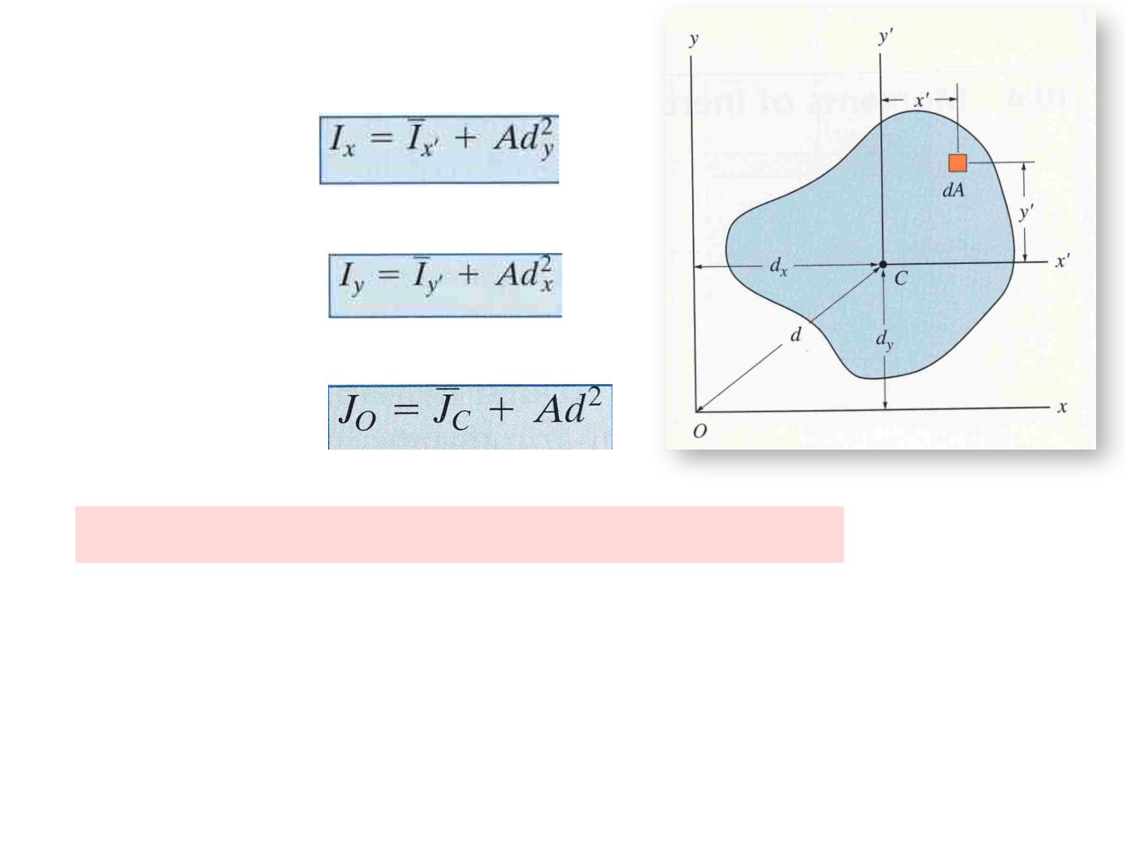
Therefore
similarly
Units of Moment of Inertia is mm⁴ , cm⁴ , in⁴

Slide 6
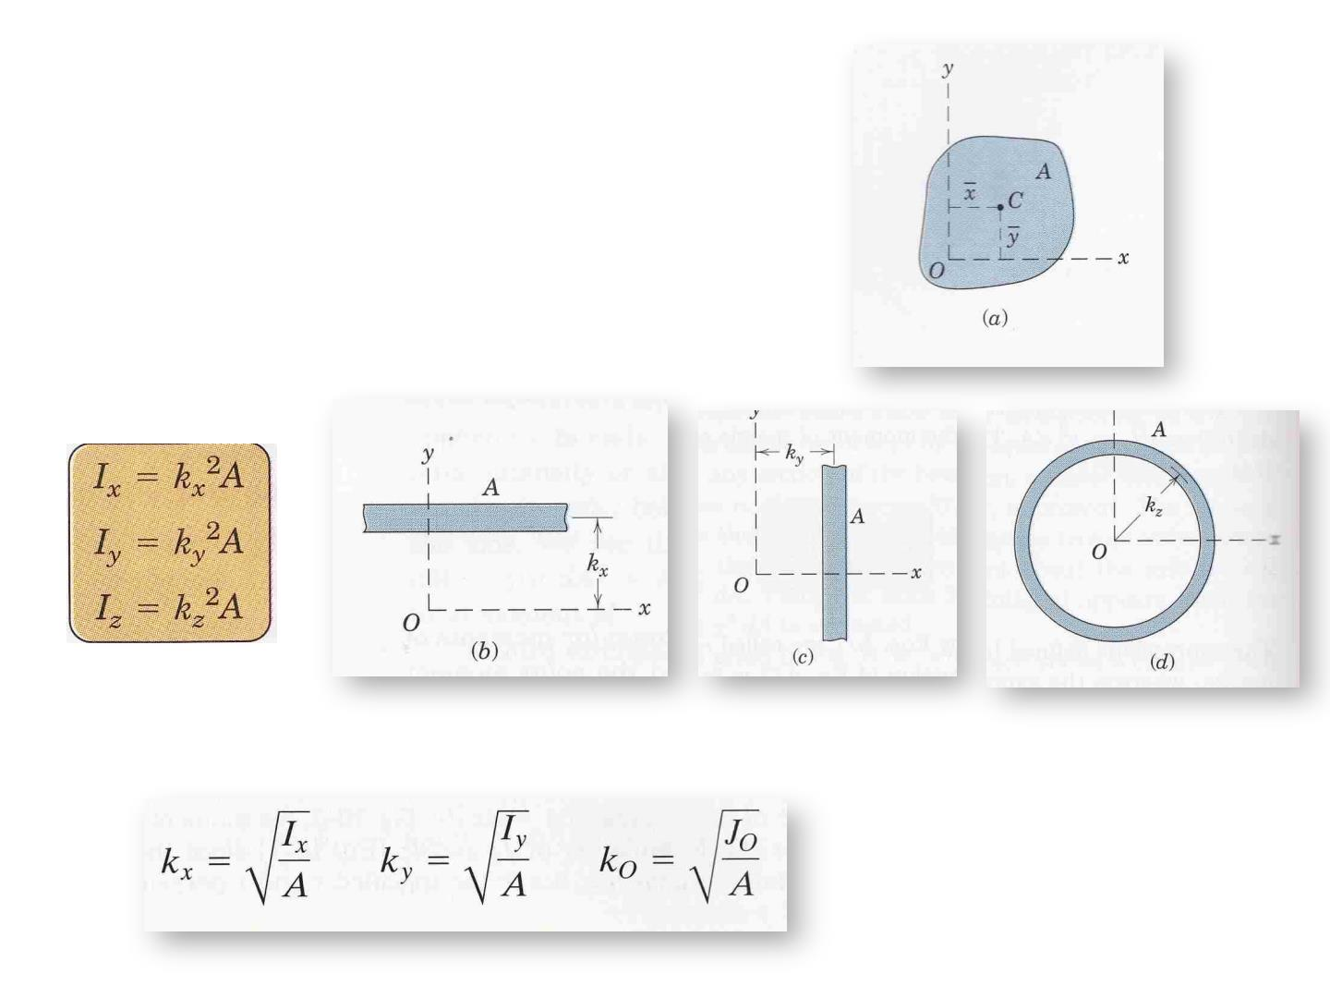
Radius of Gyration of an Area
The radius of gyration of a planar area has a
unit of length and is a quantity that is often
used for the design of columns in structural
mechanics.

Slide 7
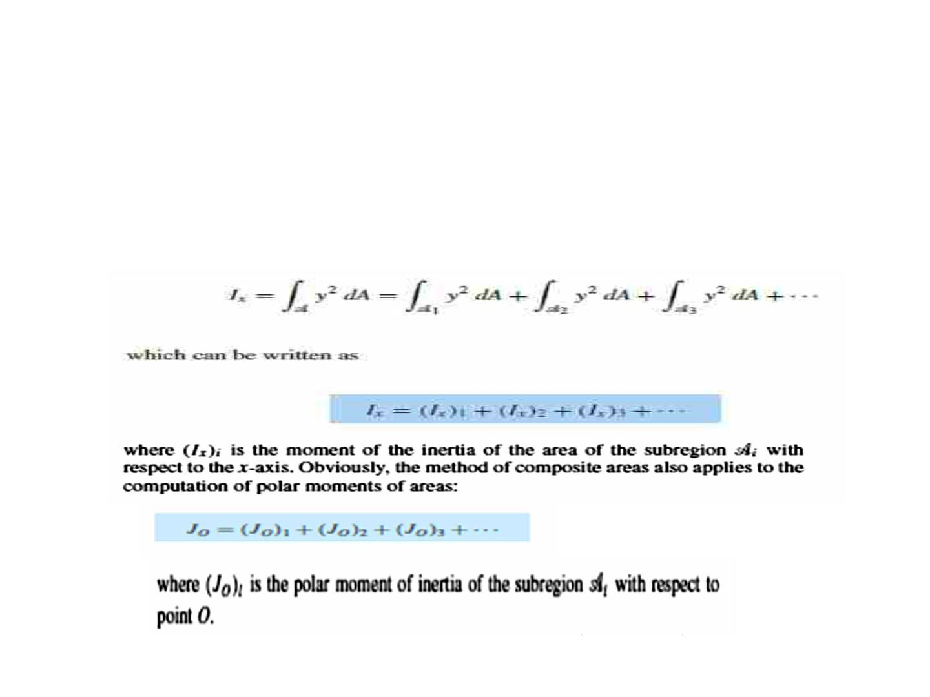
Moments of Inertia for Composite Areas
• A composite area consists of a series of connected “simpler” parts or
shapes, such as rectangles, triangles, and circles. Provided the moment of
inertia of each of these parts is known or can be determined about a
common axis, then the moment of inertia for the composite area about this
axis equals the algebraic sum of the moments of inertia of all its parts.

Slide 8
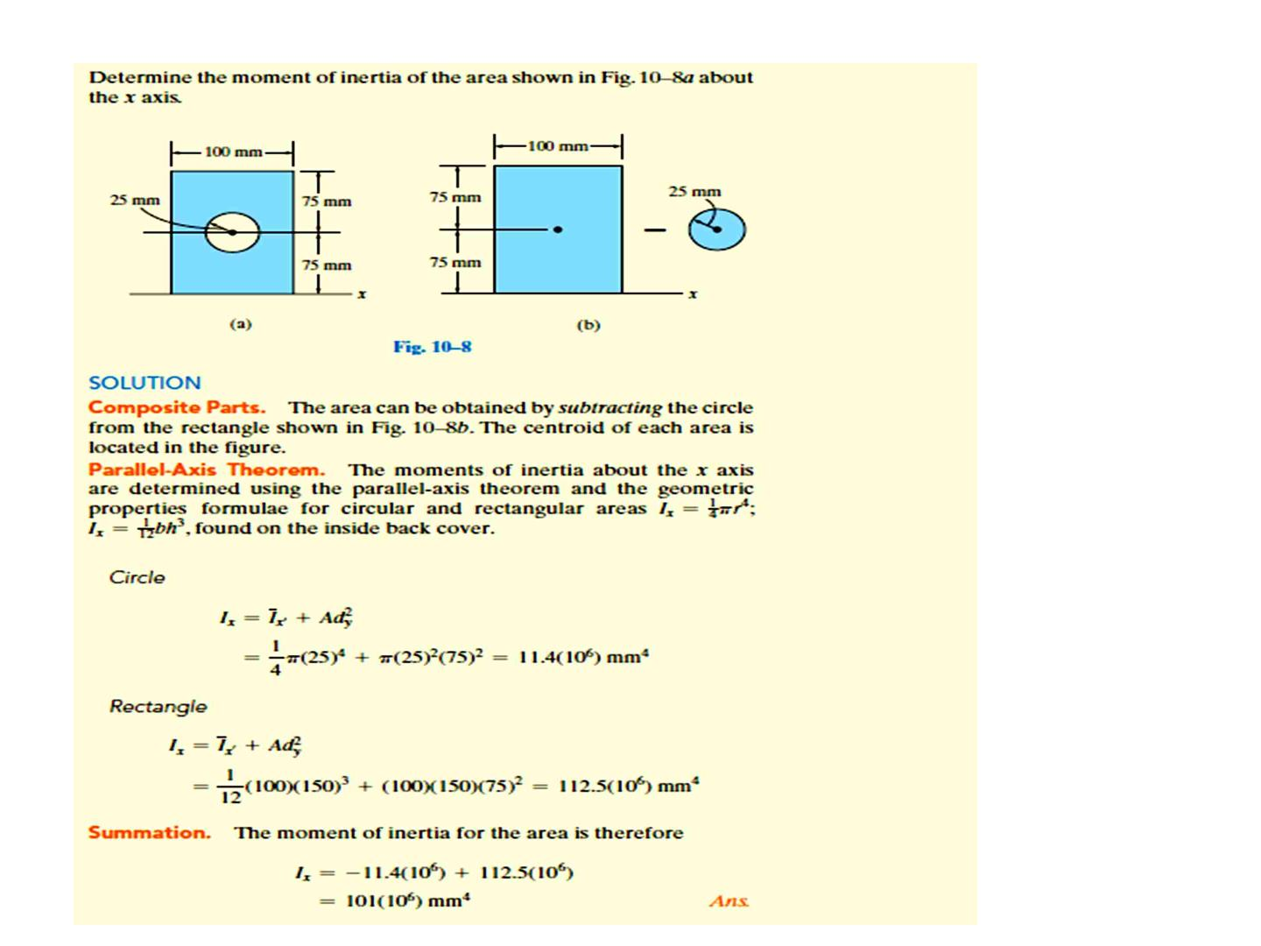
Sample problem 1

Slide 9
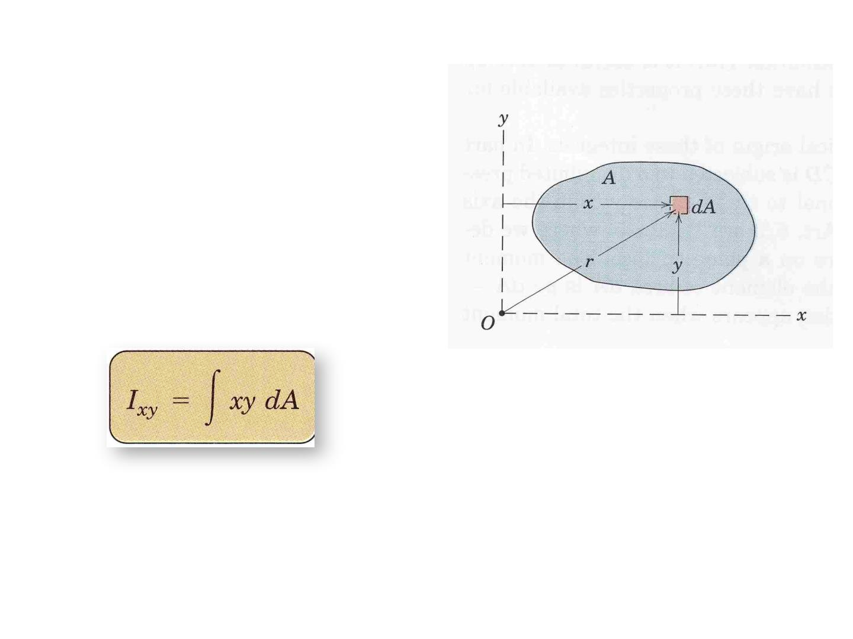
Product of Inertia for an area
The product of inertia for an
element of area dA located at
point (x,y) is defined as dI_{xy} =
xy dA .
Thus, for the entire area A, the
product of inertia is:

Slide 10
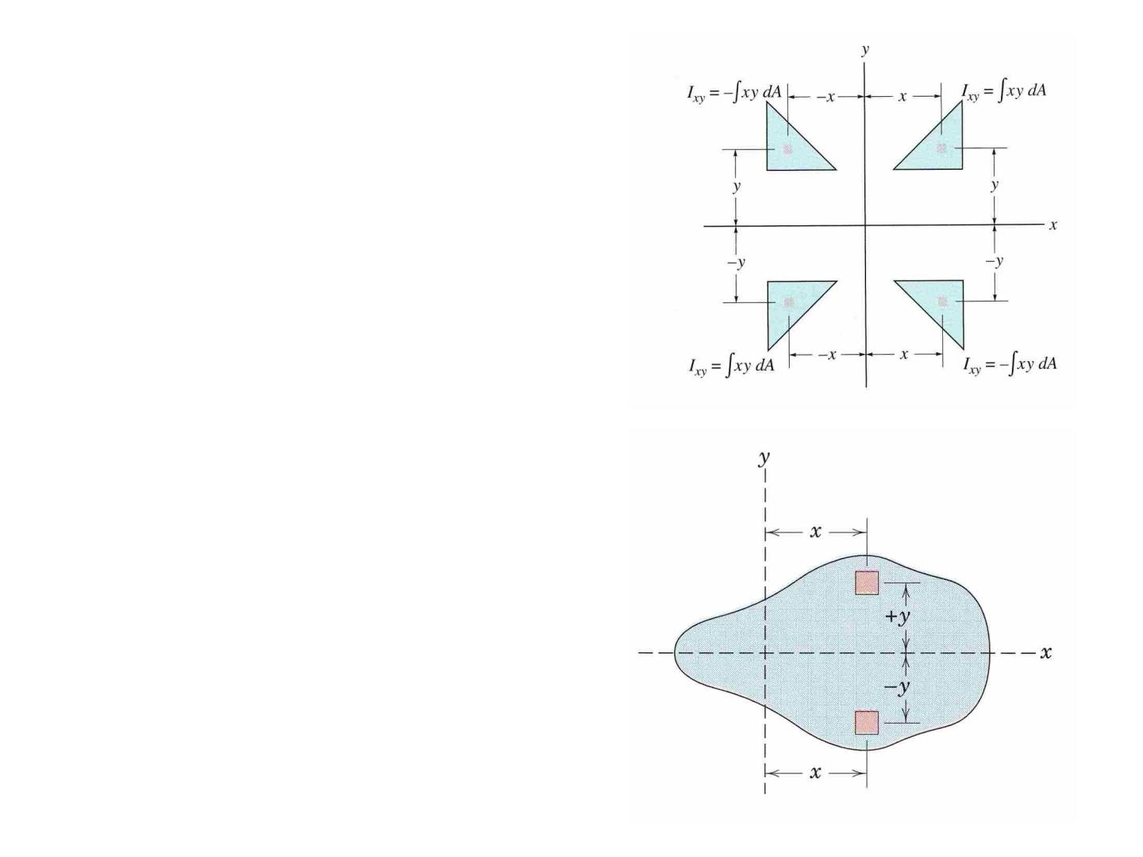
-The product of inertia may be
positive, negative, or zero,
depending on the location and
orientation of the coordinate axes.
Symmetric area about x or y axes
for every element dA, there is an
element dA, which has a product
of inertia equal in magnitude but
opposite in sign.
I_{xy} = zero ( if the area is symmetry
about x or y axes)

Slide 11
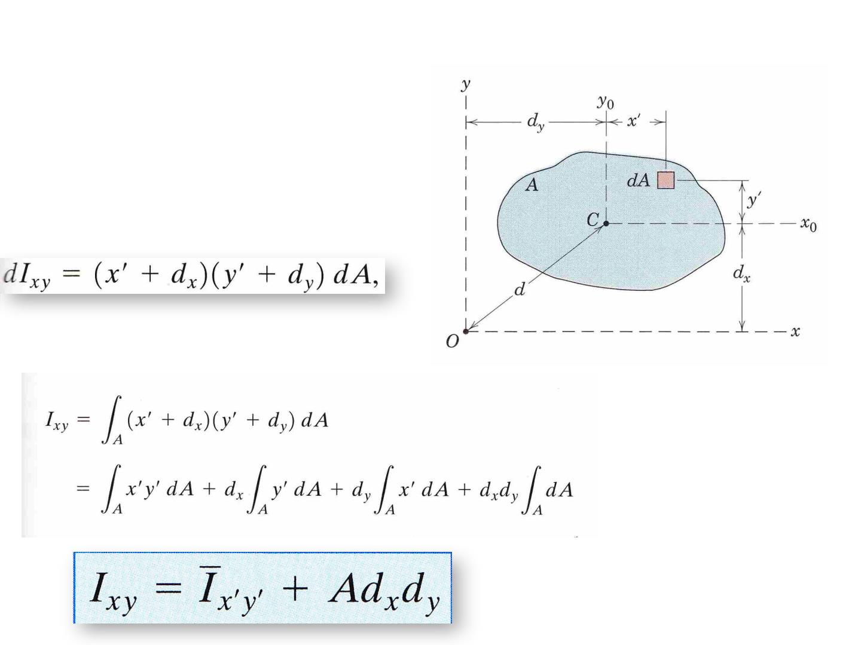
Parallel-Axis Theorem
Consider the shaded area shown
in the figure

Slide 12
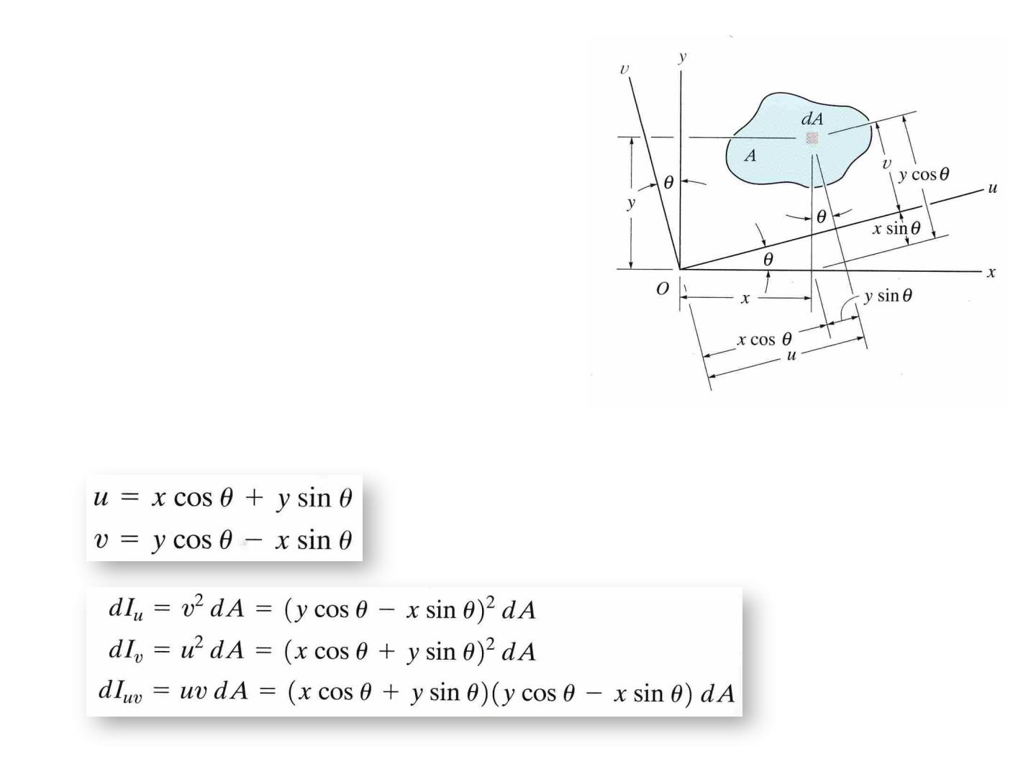
Moment of Inertia for an Area
About Inclined Axes
In structural and mechanical design,
it is sometimes necessary to calculate
the moments and product of inertia
for an area a bout inclined axes such
as u and v axes when the values for θ,
I , I , I are known.
x y xy
Relation between x,y and u,v coordinates

Slide 13
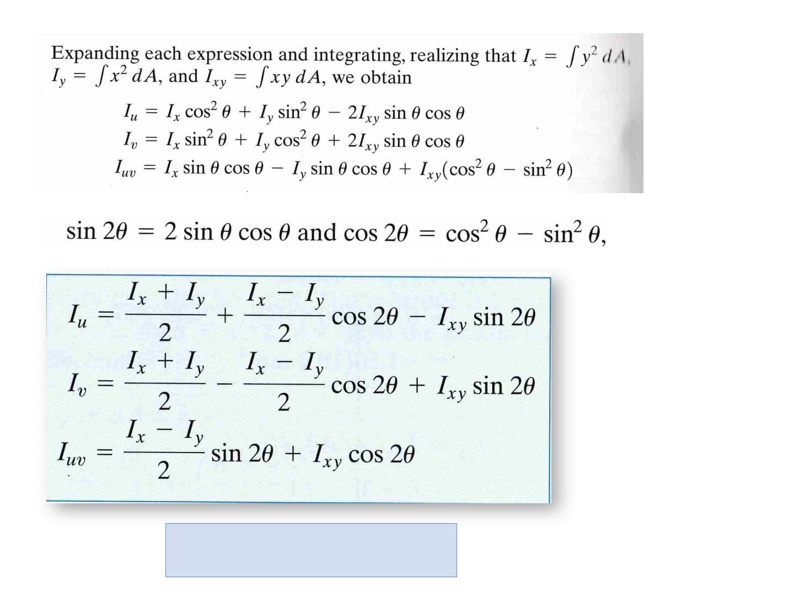
J = I + I = I + I
o
u
v
x
y

Slide 14
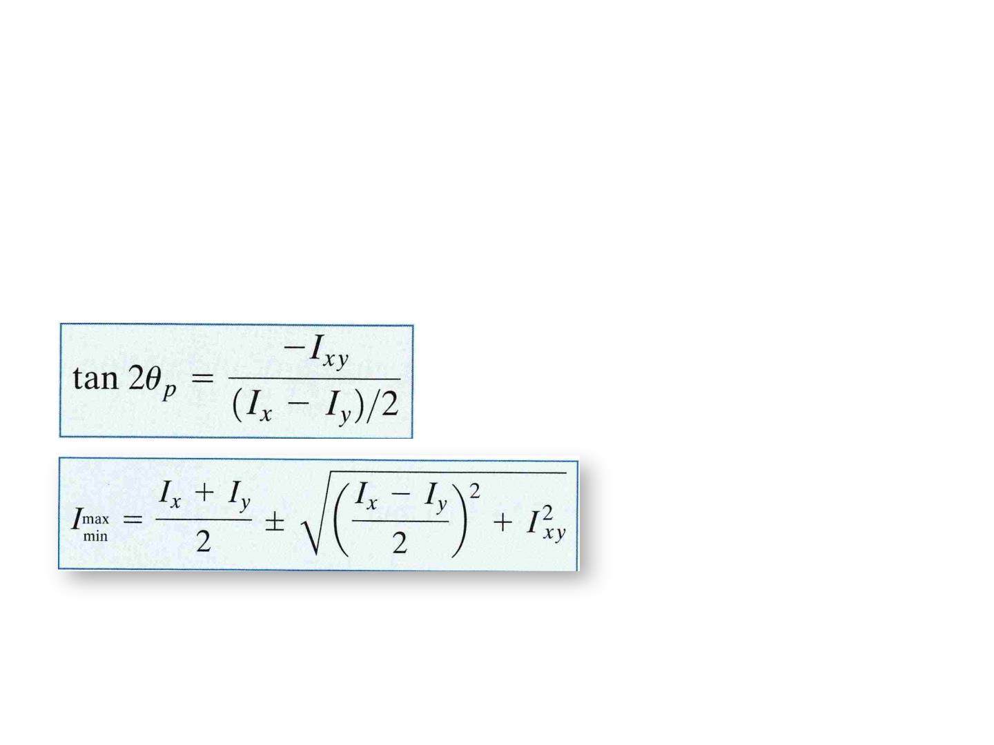
Principal Axes and Principal Moments of Inertia
The principal axes are those for which the product of inertia is
zero, and the moment of inertia is maximum and minimum.
The moments of inertia with respect to these axes are called the
principal moments of inertia. (maximum and minimum moment
of inertia)
θ = orientation angle of the principal
axes for the area
The product of inertia with respect to the principal axes is zero. Since the product
of inertia is zero with respect to any symmetrical axis, it therefore follows that
any symmetrical axis represent a principal axis of inertia for the area.

Slide 15
Mohr’s Circle for Moments and Products of Inertia
• Mohr’s circle is a graphical representation of the transformation equations for
moments and products of inertia. Developed by Otto Mohr, a German engineer in
1882, it is a popular alternative to the transformation equations. There are two
advantages to using Mohr’s circle. First, the circle gives a clear visual representation
of how the inertial properties vary with the orientation of the axes. Second, by
referring to the circle, you can obtain the numerical values without having to
memorize the transformation equations.
• Construction of Mohr’s circle
• Consider the plane region shown in Fig. 9.9(a). Let I , I , and Ixy be the moments and
x y
the product of inertia of the region with respect to the x-y axes that intersect at point
O. Mohr’s circle associated with point O is shown in Fig. 9.9(b). The circle is
constructed as follows:
• 1. Draw a set of axes, the horizontal axis representing the moment of inertia
• (M.I.), and the vertical axis representing the product of inertia (P.I.).
• 2. Plot the point x with coordinates (I
• (I
• 3. Join x and y with a line, and draw a circle with this line as its diameter.
x
, Ixy), and the point y with coordinates
,−Ixy).
y

Slide 16
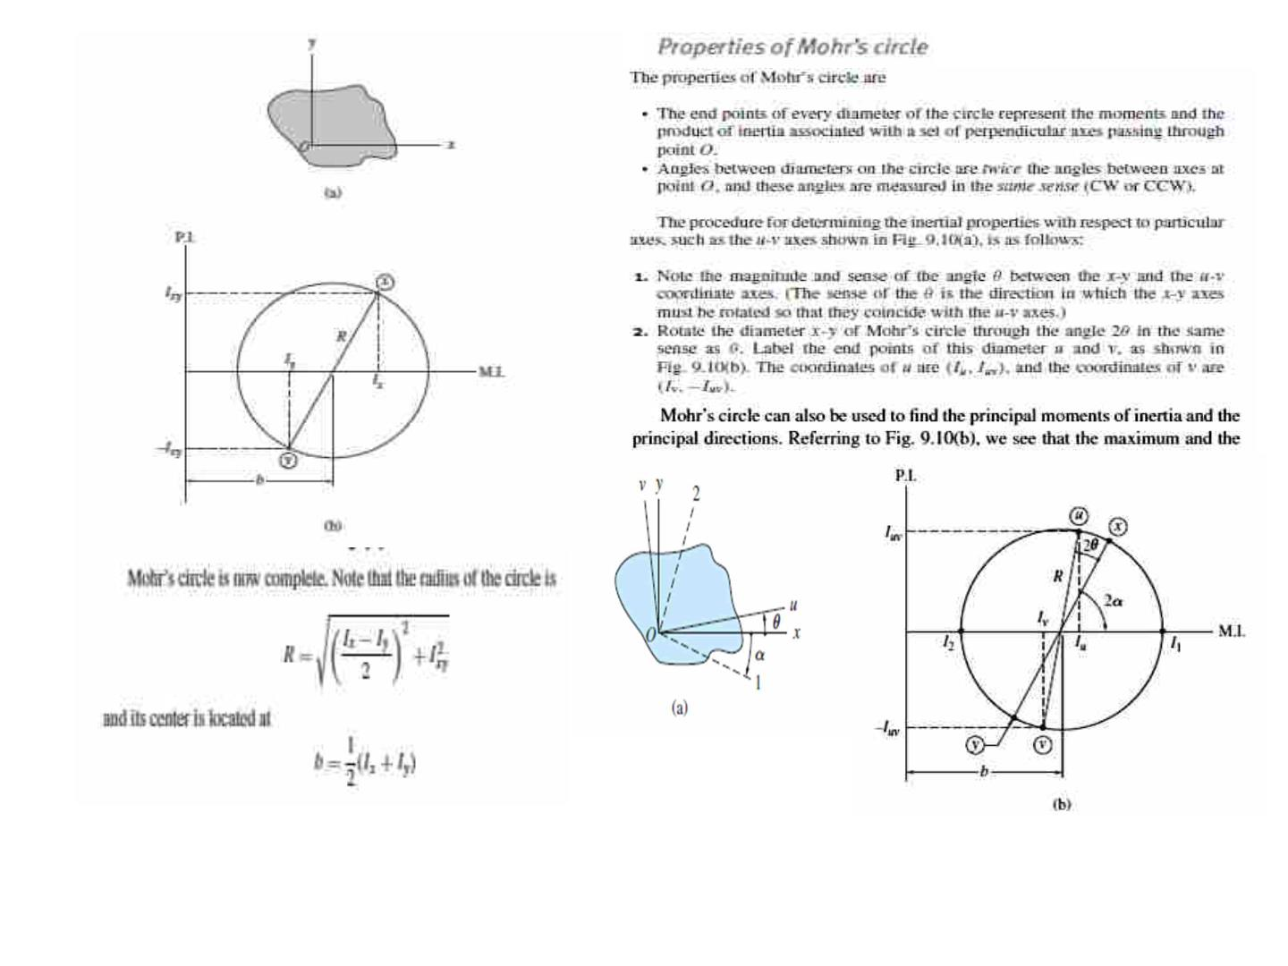

Slide 17
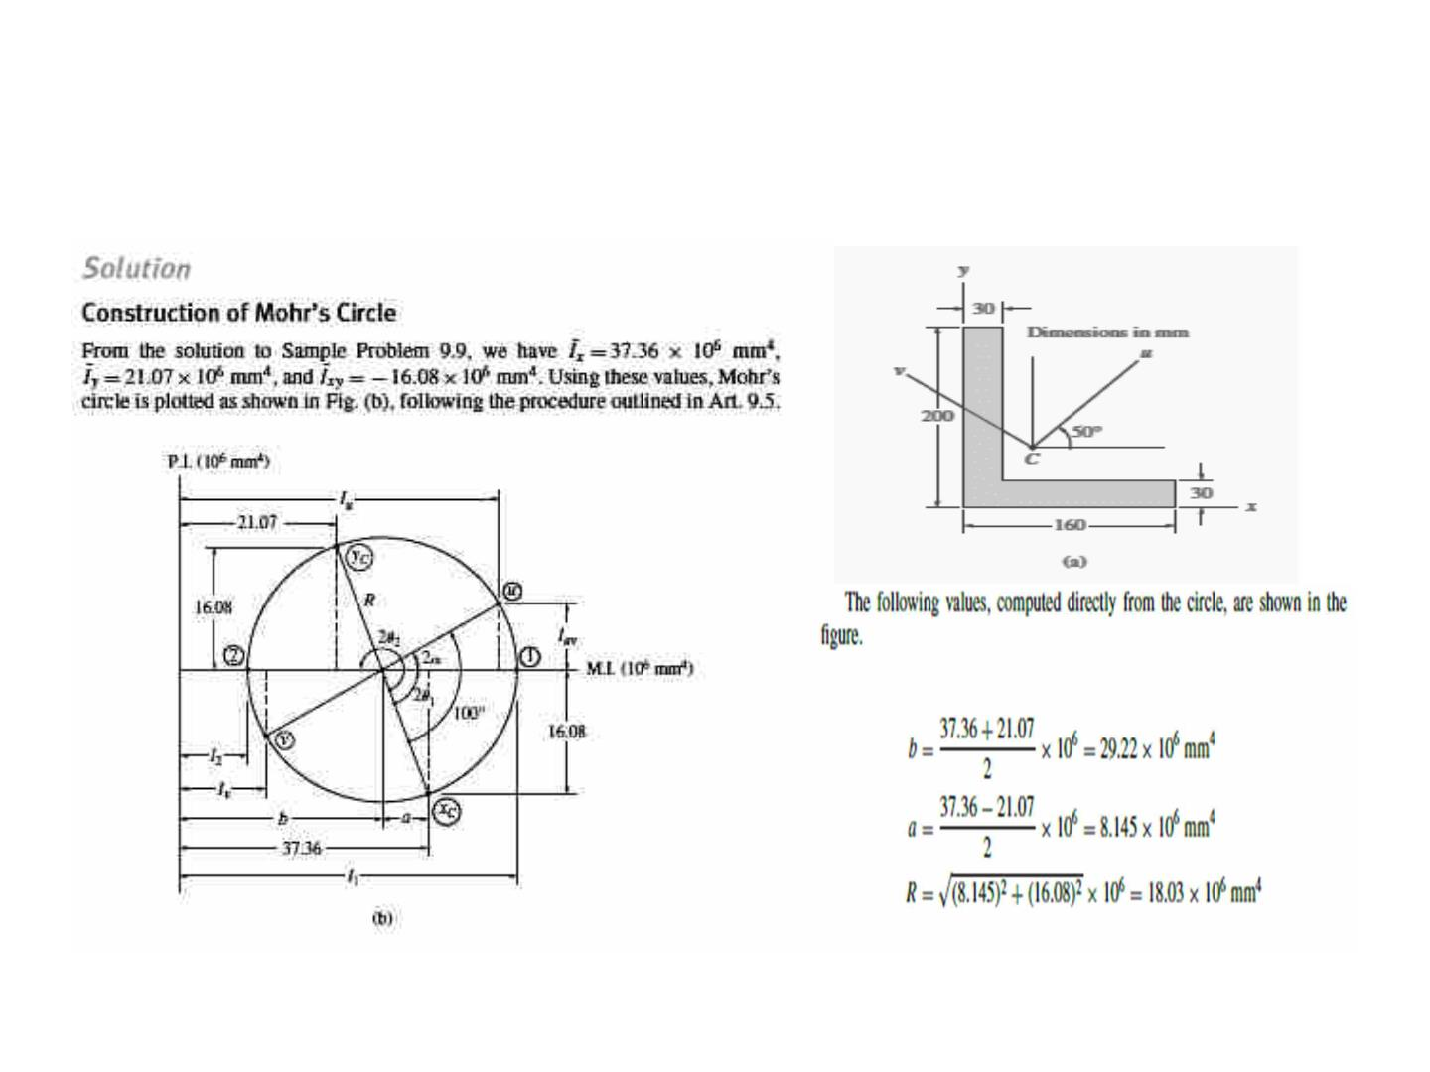
Sample example
For the region shown in Fig. (a), calculate (1) the centroidal principal moments of inertia
and principal directions; and (2) the moments and product of inertia about the u-v axes
through the centroid C. Note that this is the same region as in Sample above

Slide 18
