Slide 1
Force Vectors
Magnitude:
Vector :
or V
or V
: Direction

Slide 2
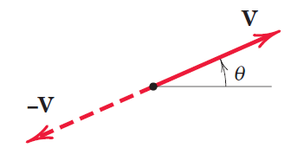
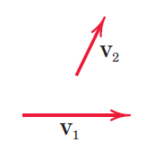
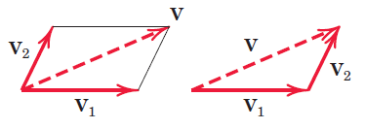
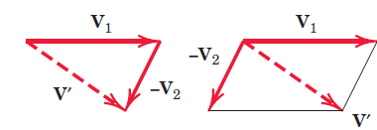
Vectors must obey the parallelogram law of combination.
This law states that two vectors V1 and V2, treated as free vectors, Fig. , may
be replaced by their equivalent vector V, which is the diagonal of the parallelogram formed by V1 and V2 as its two sides, as shown in Fig. . This combination is called the vector sum, and is represented by the vector equation

Slide 3
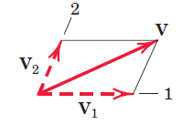
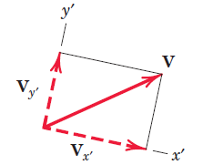
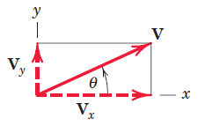
Any two or more vectors whose sum equals a certain vector V are said to be the components of that vector. Thus, the vectors V1 and V2 in Fig. are the components of V in the directions 1 and 2, respectively.
It is usually most convenient to deal with vector components which are mutually perpendicular; these are called rectangular components.

Slide 5
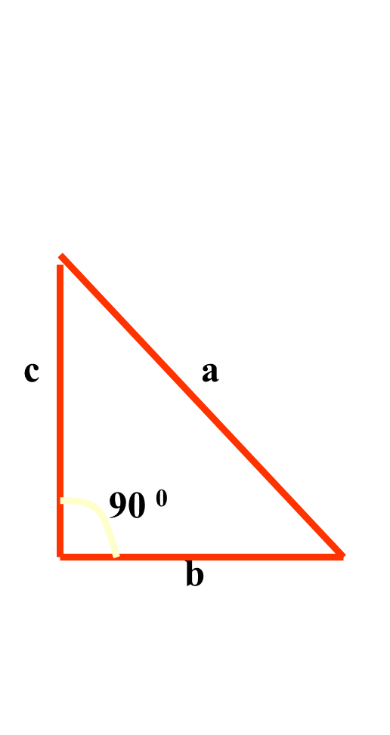
If the cosine rule is applied to a right-angle triangle where α = 90 ⁰ ,
a² = b² + c² – 2bc cos 90 ⁰
since cos 90 ⁰ = 0
a² = b² + c²
(Pythagoras Theorem)

Slide 6
