Slide 1
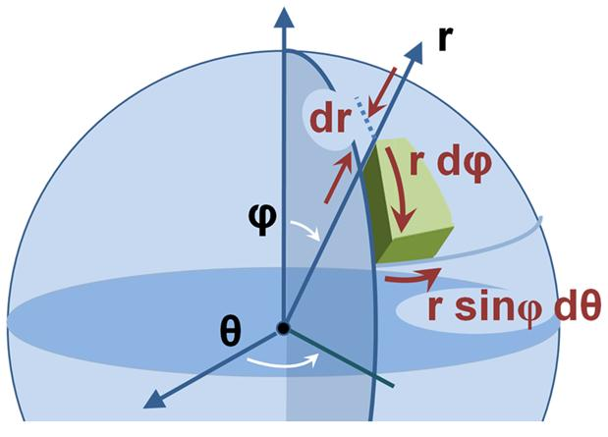
Coordinate Systems
Physics Department
College of Science
Salahaddin University

Slide 2
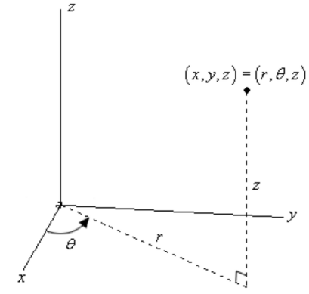
Cylindrical Coordinates
MP09 Coordinate Systems

Slide 3
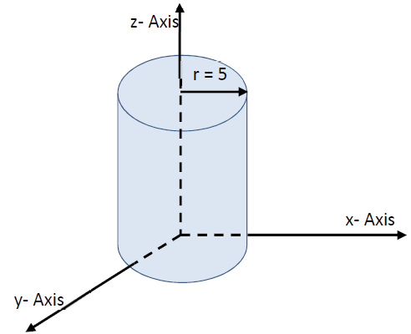
MP09 Coordinate Systems

Slide 4
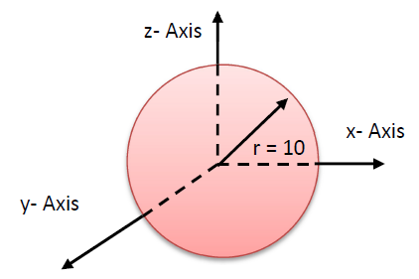
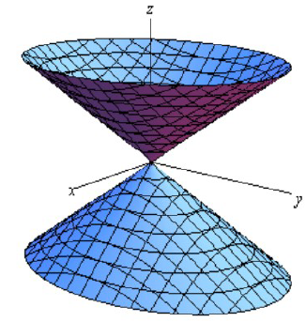
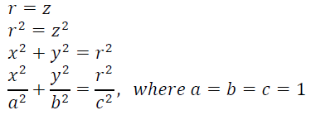
MP09 Coordinate Systems

Slide 5
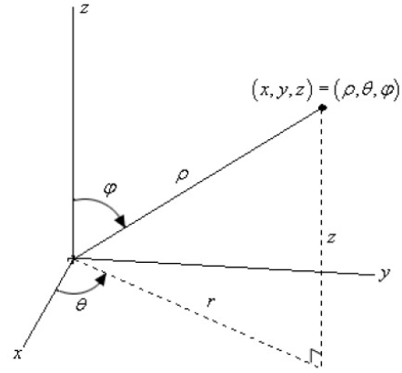
Spherical Coordinates
MP09 Coordinate Systems

Slide 6
MP09 Coordinate Systems

Slide 7
MP09 Coordinate Systems

Slide 8
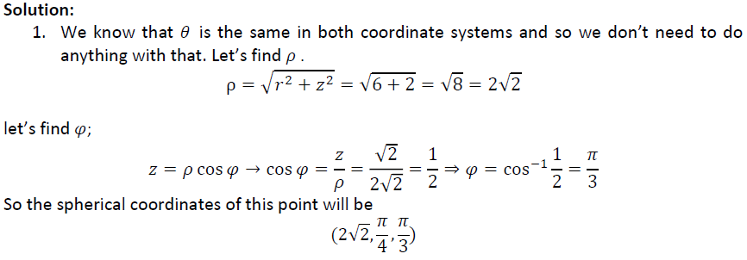
MP09 Coordinate Systems

Slide 9
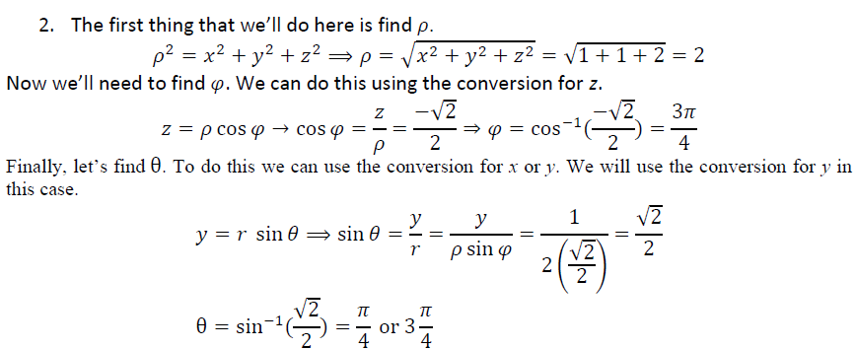
MP09 Coordinate Systems

