Slide 1
Nomenclature rules:1
Nomenclature of Coordination Compounds
The formulas and names adopted for coordination entities are based on the recommendations of the International Union of Pure and Applied Chemistry (IUPAC).
The IUPAC names are more correct, but trivial names and abbreviations are still commonly used.
The positive ion (cation) comes first, followed by the negative ion (anion).
[Ag(NH₃)₂]Cl
K₃[Fe(CN)₆]
diamminesilver(I) chloride
potassium hexacyanoferrate(III)
Tetraamminedichloronickel(II)
Hexaamminenickel(II) ion

Slide 2
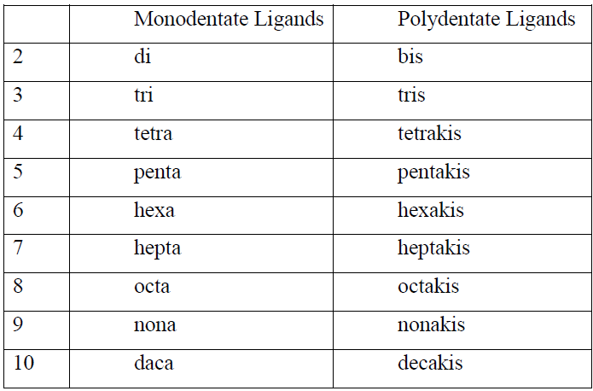
Nomenclature rules:2
Within the coordination sphere, the ligands are named before the metal, but in formulas the metal ion is written first.
[Cu(NH₃)₄]SO₄
[Co(NH₃)₆]Cl₃
K[V(CO)₆]
tetraamminecopper(II) sulfate
hexaarnminecobalt(III) chloride
Potassium hexacarbonyl Vanadate (-1)
Nomenclature rules:3
The number of ligands of one kind is given by the following prefixes.
[Co(NH₃)₆]Cl₃
_{Hexaammincobalt(III) chloride}
[Co(NH₂CH₂CH₂NH₂)₃]Cl₃
Tris(ethylenediamine)cobalt(III) chloride
[Co(NH₂CH₂CH₂NH₂)₂Cl₂]⁺
dichlorobis(ethylenediamine)cobalt(III) ion
[Fe(C₅H₄N-C₅H₄N)₃]⁺²
tris(bipyridine)iron(II) ion

Slide 3
Nomenclature rules:4
Ligands are named in alphabetical order (according to the name of the ligand, not the prefix) or gave anionic ligands first, then neutral ligands.
[Co(NH₃)₄Cl₂] Cl
[CoCl₂(NH₃)₄] Cl
tetraamminedichlorocobalt(III) chloride
dichlorotetraamminecobalt(III) chloride
[Pt(NH₃)BrCl(CH₃NH₂)]
amminebromochloromethylamineplatinum(II),
K[Co(NH₃)₂BrCl(CN)₂]
K[CoBrCl(CN)₂(NH₃)₂]

Slide 4
Nomenclature rules:5
Anionic ligands are given an o suffix. Neutral ligands retain their usual name. Coordinated water is called aqua and coordinated ammonia is called ammine.
[Co(NH₃)₄Cl₂] Cl
[Cr(NH₃)₃(H₂O)₃]Cl₃
triamminetriaquachromium(III) chloride
tetraamminedichlorocobalt(III) chloride
[CoCl(NO₂)(NH₃)₄]Cl
tetraamminechloronitrito-N-cobalt(III) Chloride
[CoCl(ONO)(NH₃)₄]Cl
tetraamminechloronitrito-O-cobalt(III)

Slide 5
Nomenclature rules:
The positive ion (cation) comes first, followed by the negative ion (anion).
Within the coordination sphere, the ligands are named before the metal, but in formulas the metal ion is written first.
The number of ligands of one kind is given by the following prefixes.
Ligands are named in alphabetical order (according to the name of the ligand, not the prefix) or gave anionic ligands first, then neutral ligands.
Anionic ligands are given an o suffix. Neutral ligands retain their usual name. Coordinated water is called aqua and coordinated ammonia is called ammine.

Slide 6
Nomenclature rules:6
Two systems exist for designating charge or oxidation number:
The Stock system: The Stock system puts the calculated oxidation number of the metal ion as a Roman numeral in parentheses after the name of the metal.
Ewing-Bassett system: The Ewing-Bassett system puts the charge on the coordination sphere in parentheses after the name of the metal.
[Pt(NH₃)₄]⁺²
The Stock system : tetraammineplatinum(II)
Ewing-Bassett : tetraammineplatinum(2+),
Nomenclature rules:7
if the charge is negative, the suffix -ate is added to the name of the coordination sphere.
[PtCl₄]²⁻
[Pt(NH₃)₄]⁺²
[Fe(CN)₆]³⁻
tetrachloroplatinate(II)
The Stock system : tetraammineplatinum(II)
Ewing-Bassett : tetraammineplatinum(2+),
tetrachloroplatinate(2-)
hexacyanoferrate(III)

Slide 7
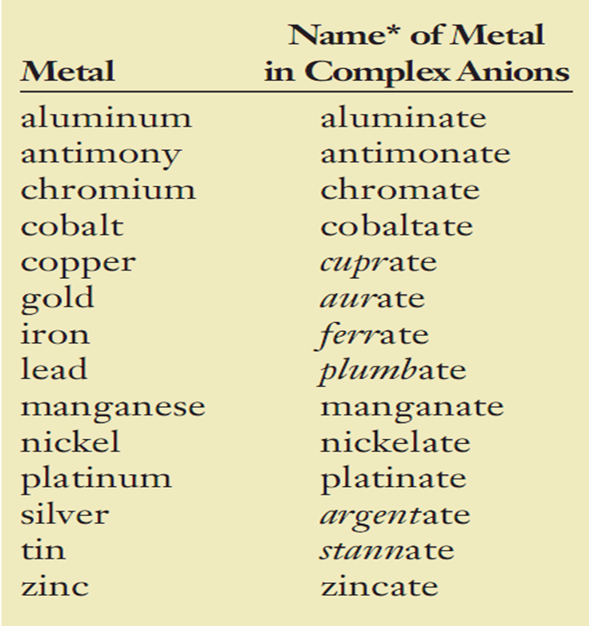
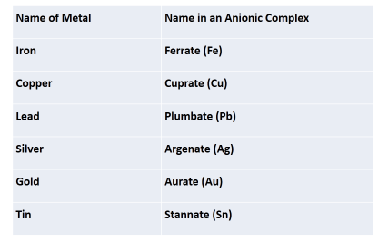
When the complex is negatively charged, the names for the following metals are derived from the sources of their symbols, rather than from their English names:

Slide 8
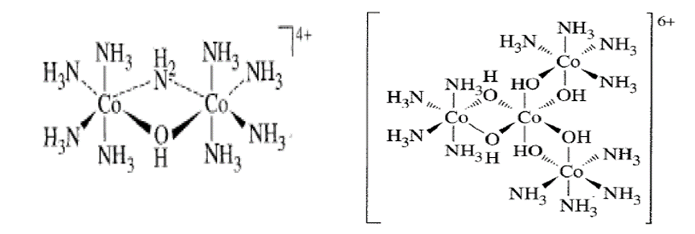
Nomenclature rules: 8
The prefixes cis- and trans- designate adjacent and opposite geometric locations.
[PtC1₂(NH₃)₂]
cis- diamminedichloroplatinum(II),
[PtC1₂(NH₃)₂]
trans-diamminedichloroplatinum(II),
[CoCl₂(NH3)₄]⁺
cis- tetraamminedichlorocobalt(III),
[CoCl₂(NH3)₄]⁺
trans-tetraamminedichlorocobalt(III),
Nomenclature rules: 9
Bridging ligands between two metal ions have the prefix μ-
tris(tetraammine-μ-dihydroxocobalt)cobalt(6+),
[Co(Co(NH3)₄(OH)₂)₃ ]⁺⁶
μ -amido- μ -hydroxobis(tetramminecobalt)(4+),
[(NH₃)₄Co(OH)(NH₂)Co(NH₃)₄]⁺⁴

Slide 9
Nomenclature rules:
The positive ion (cation) comes first, followed by the negative ion (anion).
Within the coordination sphere, the ligands are named before the metal, but in formulas the metal ion is written first.
The number of ligands of one kind is given by the following prefixes.
Ligands are named in alphabetical order (according to the name of the ligand, not the prefix) or gave anionic ligands first, then neutral ligands.
Anionic ligands are given an o suffix. Neutral ligands retain their usual name. Coordinated water is called aqua and coordinated ammonia is called ammine.
Two systems exist for designating charge or oxidation number:
The Stock system
Ewing-Bassett system
if the charge is negative, the suffix -ate is added to the name of the coordination sphere.
The prefixes cis- and trans- designate adjacent and opposite geometric locations
Bridging ligands between two metal ions have the prefix μ-
When the complex is negatively charged, the names for the following metals are derived from the sources of their symbols,

Slide 10
Examples
(NH₄)₂[Ni(C₂O₄)₂(H₂O)₂]
[Ag(NH₃)₂][Ag(CN)₂]
[Fe(NH₃)₆][Cr(CN)₆]
pentaamminebromocobalt(III) sulfate
hexaammineiron(III) hexacyanochromate (III)

