Slide 1
University of Salahaddin–Erbil
College of Science
Department of Physics
4th stage Medical Branch
Electromagnetics Theory (Chapter Six)
Time Varying Field &Propagation of Electromagnetic Field
By: Dr. Saman K. Ezzulddin
saman.ezzlddin@su.edu.krd
2022-2023

Slide 2
Outline:
In this chapter we will cover the following topics:
5-1: Introduction and history
5-2: Sources and Applications of Magnetic Field
5-3: Magnetic Force and Torque
5-3-1: Magnetic force on a carrying current conductor
5-3-2: Magnetic Torque on a current carrying loop
5-3-3: Magnetic dipole moment
5-4: Biot-Savart's Law and Their Application
5-5: Magnetic force between two parallel conductor
5-6: Ampere's Law
5-7: Application of Ampere's Law
5-7-1: Infinite Line Current
5-7-2: Infinite Sheet Current
5-7-3: Infinitely Long Coaxial Transmission Line
5-8: Magnetic Flux Density and Gauss’s law in Magnetostatic fields
5-9: Magnetic Scalar and Vector Potential
5-10: Magnetization and classification of magnetic materials
5-11: Magnetic Scalar and Vector Potential

Slide 3
7-1: Introduction:
After Oersted's experimental discovery (upon which Biot-Savart and Ampere based their laws) that a steady current produces a magnetic field, it seemed logical to find out if magnetism would produce electricity.
In 1831, about 11 years after Oersted's discovery, Michael Faraday in London and Joseph Henry in New York discovered that a time-varying magnetic field would produce an electric current.
According to Faraday's experiments, a static magnetic field produces no current flow, but a time-varying field produces an induced voltage (called electromotive force or simply emf) in a closed circuit, which causes a flow of current. Faraday discovered that the induced emf. (in volts), in any closed circuit is equal to the time rate of change of the magnetic flux linkage by the circuit.

Slide 4
7-2: Faraday’s Law of Induction:
The electric fields and magnetic fields considered up to now have been produced by stationary charges and moving charges (currents), respectively.
Imposing an electric field on a conductor gives rise to a current which in turn generates a magnetic field.
One could then inquire whether or not an electric field could be produced by a magnetic field.
In 1831, Michael Faraday discovered that, by varying magnetic field with time, an electric field could be generated.
The phenomenon is known as electromagnetic induction. Figure below illustrates one of Faraday’s experiments.

Slide 5
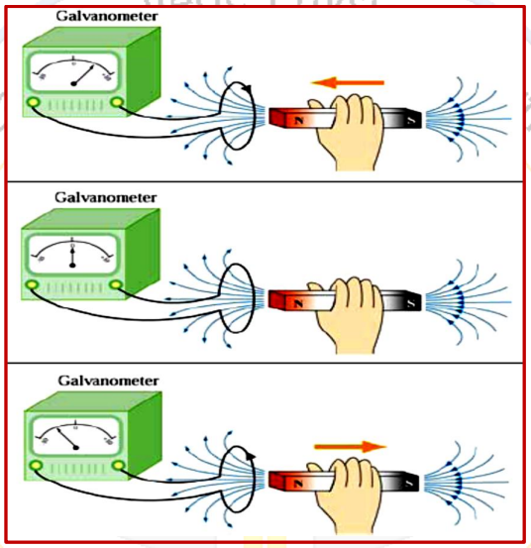
Faraday showed that no current is registered in the galvanometer when bar magnet is stationary with respect to the loop.
However, a current is induced in the loop when a relative motion exists between the bar magnet and the loop.
In particular, the galvanometer deflects in one direction as the magnet approaches the loop, and the opposite direction as it moves away.

Slide 6
Faraday’s experiment demonstrates that an electric current is induced in the loop by changing the magnetic field.
The coil behaves as if it were connected to an emf source.
Experimentally it is found that the induced emf depends on the rate of change of magnetic flux through the coil.
Faraday’s law of induction may be stated as follows: [The induced emf [ 𝑽_{𝒆𝒎𝒇}] in a coil is proportional to the negative of the rate of change of magnetic flux]:

Slide 7
Thus, we see that an emf- may be induced in the following ways:
By having a stationary loop in a time-varying [ 𝐁 ] field.
By having a time-varying loop area in a static [ 𝐁 ] field.
By having a time-varying loop area in a time-varying [ 𝐁 ] field.

