Slide 1
CHAPTER 2
Random Variable

Slide 2
The Idea of Randomness
The word random is part of our daily speech. We feel as if we know what random means, but the idea of randomness , random behavior, random phenomena, and random fluctuations. How can we create random patterns?
How can we recognize random patterns when we are confronted with them? Central to the idea of randomness is the idea of unpredictability. however, difficult to build a theory mathematical or otherwise—based on what something is not.
كلمة العشوائية هي جزء من خطابنا اليومي. نشعر كما لو أننا نعرف يعني ما هي العشوائية، ولكن فكرة العشوائية، والسلوك العشوائي والظواهر العشوائية، والتقلبات العشوائية.
كيف يمكننا خلق أنماط عشوائية؟كيف يمكننا التعرف على الأنماط عشوائية عندما نواجه ؟ المركزية لفكرة العشوائية هي فكرة عدم القدرة على التنبؤ. ومع ذلك، من الصعب بناء نظرية رياضية أو المستندة على شيئا ليس موجود.

Slide 3
A- Definitions: Random Variable
Definition 1
Consider a random experiment with sample space S. A random variable X(w) is a single-valued real function that assigns a real number called the value of X(w) to each sample point (outcome) w of S.
S
X(ω)
ω

Slide 4
Random variables
Definition 2
A random variable is a numerical description of the outcome of a statistical experiment.

Slide 5
Random Variables
Definition 3:
A (scalar) random variable X is a function that maps the outcome of a random event into real scalar values
S
X(ω)
ω

Slide 6
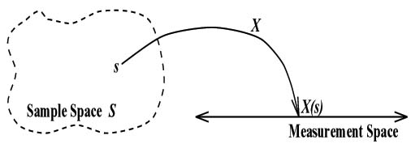
The sample space S is termed the domain of the r.v. X, and the collection of all numbers [values of X(w)] is termed the range of the r.v. X. Thus the range of X is a certain subset of the set of all real numbers
w
X(w)
Note: For each element of an experiment’s sample space, the random variable can take on exactly one value

Slide 7
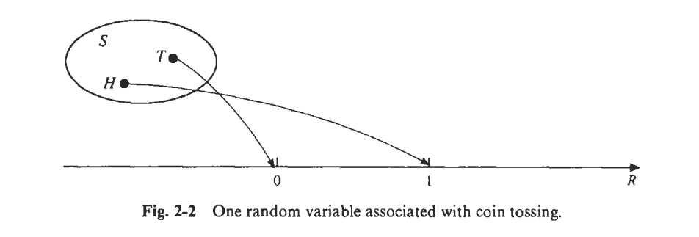
EX: In the experiment of tossing a coin once we might define the r.v. X as X(H) = 1 , X(T) = 0

Slide 8
Type of Random Variable
A discrete random variable is one whose set of assumed values is countable(arises from counting).
A continuous random variable is one whose set of assumed values is uncountable (arises from measurement.).

Slide 9
B-Events Defined by Random Variables
If X is a r.v. and x is a fixed real number, we can define the event (X = x) as
(X = x) = {w: X(w) = x}
Similarly, for fixed numbers x, x1 and x2, we can define the following events:
(X ≤ x) = {w: X(w) ≤ x}
(X > x) = {w: X(w) > x}
(x1 < X ≤ x2) = {w: X1 < X(w) ≤ x2}

Slide 10
Example Consider an experiment that consists of two independent of a coin. S = {HH;HT; TH; TT}. Let A be the event that at least one head and B be the event two head A = {HH;HT; TH}, B={HH}
X(A)={A:X(A)≥1}=3
X(B)={B:X(B)=2}=1

Slide 11
H.W In the experiment of tossing a fair coin three times . If X is the r.v. giving the number of heads obtained, find (a) P(X = 2); (b) P(X < 2).

Slide 12
Probability Distributions
Probability Distribution: Table, Graph, or Formula that describes values a random variable can take on, and its corresponding probability (discrete r.v) or density (continuous r.v)
Discrete Probability Distribution: Assigns probabilities (masses) to the individual outcomes
Continuous Probability Distribution: Assigns density at individual points, probability of ranges can be obtained by integrating density function
Discrete Probabilities denoted by: p(x) = P(X=x)
Continuous Densities denoted by: f(x)
Cumulative Distribution Function: F(x) = P(X≤x)

Slide 13
Discrete Probability Distributions

Slide 14
Example – Rolling 2 Dice (Red/Green)
X = Sum of the up faces of the two die. Table gives value of x for all elements in S
Red\Green | 1 | 2 | 3 | 4 | 5 | 6
1 | 2 | 3 | 4 | 5 | 6 | 7
2 | 3 | 4 | 5 | 6 | 7 | 8
3 | 4 | 5 | 6 | 7 | 8 | 9
4 | 5 | 6 | 7 | 8 | 9 | 10
5 | 6 | 7 | 8 | 9 | 10 | 11
6 | 7 | 8 | 9 | 10 | 11 | 12

Slide 15
Rolling 2 Dice – Probability Mass Function & CDF
.
x | p(x) | F(x)
2 | 1/36 | 1/36
3 | 2/36 | 3/36
4 | 3/36 | 6/36
5 | 4/36 | 10/36
6 | 5/36 | 15/36
7 | 6/36 | 21/36
8 | 5/36 | 26/36
9 | 4/36 | 30/36
10 | 3/36 | 33/36
11 | 2/36 | 35/36
12 | 1/36 | 36/36

Slide 16
Rolling 2 Dice – Probability Mass Function

Slide 17
Rolling 2 Dice – Cumulative Distribution Function
P(x)
x

Slide 18
Def:
Let X be a r.v. with a p.d.f. f(x). (1) The expected value of X or mean of X is
(2) The variance of X is

Slide 19
(3) The standard deviation of X is
(4)The moment-generating function, if it exists, is
(5)The following results still for continuous type

Slide 20
Ex4.1-8:
Let X have the p.d.f.
Find (1)the m.g.f.of X.
(2)
(3)the c.d.f. (or distribution function) of X.

Slide 22
(3)the c.d.f. of X is

Slide 27
P(X=x)=$\left({x+k−1 \atop k−1}\right)$ $p^{k}q^{x} x=0,1,2,… k=1,2,…$
M=$\frac{K}{p}$ , var=$\frac{Kq}{p^{2}}$

Slide 28
:

