Slide 1
Time Series
First Lecture
Dr Saman Hussein Mahmood

Slide 2
Define time series
A time series is a sequence of data points or observations collected or recorded at specific time intervals. These time intervals can be equally spaced (e.g., hourly, daily, monthly) or irregular, and the data points represent measurements, values, or events that occur over time.
Time series data is commonly used in various fields, including economics, finance, meteorology, and signal processing, among others, to analyze and understand how a particular variable changes or evolves over time.

Slide 3
The goal of Time Series analysis:
Analysis: Time series data is analyzed to understand patterns, trends, and fluctuations over time. This analysis can help in making informed decisions, forecasting future values, and identifying potential causes of variation.
Forecasting: One of the primary applications of time series data is forecasting future values based on historical patterns. Techniques like time series modeling and forecasting methods such as ARIMA (AutoRegressive Integrated Moving Average) or machine learning algorithms are used for prediction.
Monitoring: Time series data is used for real-time monitoring and anomaly detection. For example, it can be employed to detect unusual behavior in stock prices, network traffic, or sensor readings, which may indicate a problem or an opportunity.
Control: In control systems, time series data is used to regulate processes and systems.
Decision-making: Time series data helps decision-makers understand how certain variables change over time. This information is essential for making strategic decisions in various fields, such as business, healthcare, and environmental management.

Slide 4
Steps for time series modeling
Model Identification:
Data Exploration:
Visualize the time series data through line plots, histograms, and summary statistics.
Identify any apparent patterns, trends, seasonality, or irregularities.
Stationarity Assessment:
Check if the time series is stationary (constant mean and variance over time).
If non-stationarity is present, apply differencing to achieve stationarity.
Based on data exploration and stationarity assessment, select an appropriate time series model:
For univariate time series: ARIMA (Autoregressive Integrated Moving Average), SARIMA (Seasonal ARIMA), or other suitable models.
For multivariate time series: VAR (Vector Autoregression), VECM (Vector Error Correction Model), or other relevant models.
Consider additional components like seasonality and trends, which may require seasonal decomposition

Slide 5
Types of time series models
Based on data exploration and stationarity assessment, select an appropriate time series model:
univariate time series: ARIMA (Autoregressive Integrated Moving Average), SARIMA (Seasonal ARIMA), or other suitable models.
multivariate time series: VAR (Vector Autoregression), VECM (Vector Error Correction Model), or other relevant models.
Consider additional components like seasonality and trends, which may require seasonal decomposition.
Exponential smoothing models
State space models
GARCH (Generalized Autoregressive Conditional Heteroskedasticity) models (for volatility modeling)
Nonlinear models (if appropriate)

Slide 6
Autocorrelation and Partial Autocorrelation Analysis:
Plot the autocorrelation function (ACF) and partial autocorrelation function (PACF) of the differenced data.
Identify potential orders (p, d, q) for autoregressive (AR), differencing (I), and moving average (MA) components of the model.
Model Selection Criteria:
Use information criteria (e.g., AIC, BIC) to compare different candidate models with varying orders (p, d, q).
Select the model with the lowest AIC or BIC that balances model complexity and goodness of fit.

Slide 7
Model Estimation:
Choose a Model:
Select the final time series model structure (e.g., ARIMA, SARIMA, GARCH) based on the results of the identification phase.
Estimation Method:
Use appropriate estimation methods based on the chosen model type:
Least Squares Estimation (LSE) for linear models (AR, MA, ARMA).
Maximum Likelihood Estimation (MLE) for models with normally distributed errors (ARIMA, GARCH).
For more complex models or multivariate time series, employ suitable estimation techniques.
Initial Parameter Values:
Provide initial parameter guesses, especially for complex models requiring numerical optimization.
Estimate Parameters:
Use the chosen estimation method to compute the parameter values that minimize the discrepancy between model predictions and observed data.
(Note: The estimation of initial parameter values is not always necessary )

Slide 8
Model Diagnostic Checking:
Residual Analysis:
Examine the residuals (model errors) for the estimated model.
Check for stationarity, independence, and normality of residuals.
Investigate patterns or outliers in the residuals.
Autocorrelation and Partial Autocorrelation of Residuals:
Plot ACF and PACF of residuals to ensure no significant autocorrelation remains.
Goodness-of-Fit Tests:
Apply statistical tests (e.g., Ljung-Box test) to assess the adequacy of the model's residuals.
Test for the absence of serial correlation in the residuals.(e.g. The Durbin-Watson Test)
Outlier Detection:
Identify and analyze outliers or influential data points that may affect model fit.
Model Refinement:
If diagnostic testing reveals (detects) problems, consider adjusting the model structure, refining parameter estimates, or addressing specific problems.

Slide 9
4.Forecasting:
Generate Forecasts:
Create forecasts for future time periods using an estimated and validated time series model.
Calculate forecast intervals to account for forecast uncertainty.
Assess the accuracy of the model's forecasts using metrics like mean absolute error (MAE), mean squared error (MSE), or root mean squared error (RMSE).
Monitoring and Updating:
Continuously monitor the model's performance over time.

Slide 10
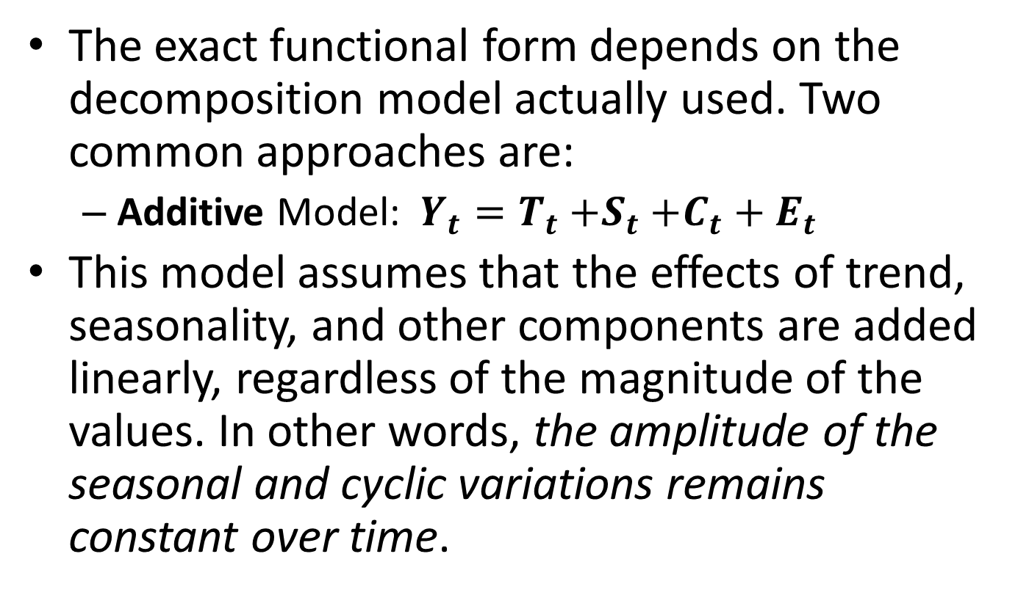
Models of Time Series Analysis
The exact functional form depends on the decomposition model actually used. Two common approaches are:
  Additive Model: $Y_{t}=T_{t}{+S}_{t}+C_{t}+E_{t}$
This model assumes that the effects of trend, seasonality, and other components are added linearly, regardless of the magnitude of the values. In other words, the amplitude of the seasonal and cyclic variations remains constant over time.

