Slide 1
Salahaddin University
College of Engineering
Word Formation Process
By/Sameerah Saleh Balaky
April 2021

Slide 2
How new words are being formed in the language?

Slide 3
Why are new words needed?
1. Because of new inventions and changes
2. Language is dynamic
3. vast amount of new inventions made in the 20th and 21st
4. One of the distinctive properties of human language is creativity.

Slide 5
1. Coinage
The word formation process of inventing entirely new words
Ex: robotics , genocide , black hole ,blog, internet, goggle, Aspirin.
● e-cruitment-online recruitment of employees;
online submission of resumes and cover letters
●netbook–small laptop computer which weighs less than 3 pounds and has a 7 to 10 inch screen
●notspot-an area where there is slow internet access or no connection at all
●slumdog-very poor, underprivileged person who lives in an overcrowded a slum.

Slide 6
Borrowing
Borrowing is the process of actually borrowing words from foreign languages.
The English language has been borrowing words from nearly a hundred languages in the last hundred years‘
The other way round, many countries also have taken many English words into their dictionaries, such as the well-known “OK or internet”

Slide 8
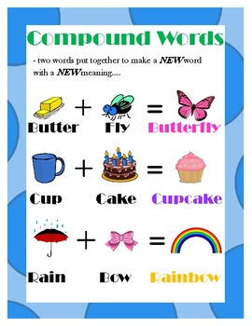
Compounding
Two or more words joined together to form a new word. That does not denote two things, but one and that is pronounced as one unit
Examples:
- Home + work →homework (N.)
-Pick + pocket → pickpocket (N.)
-Low + paid → low-paid (Adj.)
-handbag=hand + bag;
-wallpaper=wall + paper;
-fingerprint=finger + print;
-sunburn=sun + burn,

Slide 9
Derivation
The most common word formation process, builds new words by adding morphemes ----word formation by affixes:
By prefixes: un-usual , mis-pronounce
mis-lead, dis-respect
By suffixes: care-less,
child-ish , faith-ful
prefix and suffix:
dis-loyal-ty
un-erring-ly

Slide 10
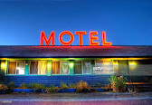
Blending
A blending is a combination of two or more words to create a new one, usually by taking the beginning of the other word and the end of the other one
Ex:
brunch =breakfast+ lunch
motel = motor + hotel
smog = smoke + fog
transistor = transfer + resistor
emoticon = emotion + icon
webinar = web+ seminar

Slide 11
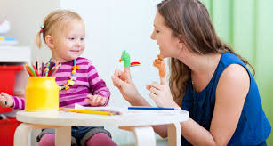
Backformation
■ --nouns > verbs: reduction of nouns to form verbs
Ex:
television = televise
donation = donate
option = opt
emotion = emote
enthusiasm = enthuse
editor = edit
Babysitter=babysit

Slide 12
Clipping
Shortening a word by deleting one or more syllables
Ex: facsimile = fax
fanatic = fan
telephone= phone
gasoline = gas
influenza = flu
cable telegram= cablegram
Hamburger= burger
Advertisement =ad

