Slide 1
How to pronounce popular brand names
By Sameerah Saleh Balaky
2024

Slide 2
This is a scenario that happens quite often: you are among a group of people and mistakenly mispronounce a word that most of them know the correct pronunciation to. You are then met by distinct reactions; some unintentionally condescending, some aggressively condescending, and then there are some others, who just tell you the correct pronunciation. But they might still be giggling inside.

Slide 3
People who attack innocent mistakes like that are readers of dickhead-shineries and sufferers of douche-bagitus. There is only one way to beat them, and that is to know the words yourself. Knowledge is power.
Here are 27 brand names that you should master pronouncing quickly to minimise inevitable annoyance.

Slide 5
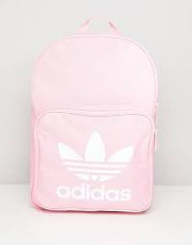
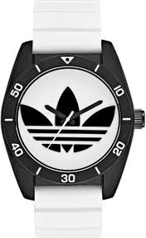
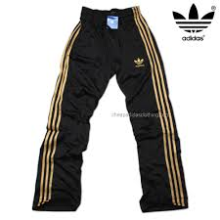
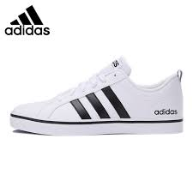
Adidas brands

Slide 7
