Slide 1
Mathematical Analysis
first lecture
Outline:
Definition of Finite and infinite set.
Some example on finite and infinite set.
Definition of Countable and uncountable set
Field and its properties.
Ordered field and its properties.

Slide 2
Definition 1: A set A is finite if there is $k∈N,$such that $A≈N_{k},$where $N_{k}$={1,2,3,…,k}.
That’s mean there is a function $f:N_{k}→A$ which is one –to- one and onto
Example1: A={2,7,8} is a finite set, because there is k=3 $∈N$, such that $A≈N_{3}$

Slide 3
Definition 2(i): A set A is infinite if it is not finite
That’s mean there is no $k∈N,$such that $A≈N_{k}.$
Definition 2(ii): A set $A$ is infinite, if there is a proper subset $B$ of $A$, such that $A≈B.$
That’s mean if there is $f:A→B$ which is one to one and onto.
Example2: The set of all natural numbers is infinite.

Slide 4
Example 3: The set of all integer numbers is infinite set.
Definition 3: A set A is Denumerable if $A≈N,$ where $N$={1,2,3,…}.
Example 4: The set of all negative integer numbers is denumerable set.
Example 5: $A=\left\{\frac{n}{n+1};n∈N\right\}$ is denumerable set.

Slide 5
Definition 4: A set A is Countable if it is finite or denumerable set .
Example 6:
The set of all odd natural numbers is countable.
The set of all integer numbers is countable.
The set of all rational numbers is countable.

Slide 6
Example: The set of all real numbers is not countable.
Solution: Suppose that R is countable, that’s mean
$R=\{x_{1},x_{2}$, $x_{3}$,…}
….

Slide 7
Field and its properties
Definition:
Let F be a non-empty set, and let +& . be binary operations on F, then (F,+,.) is said to be a field if satisfies the following conditions
(F,+) is a commutative group.
(F-{0},.) is a commutative group.
i) a.(b+c)=a.b+a.c
ii) (a+b).c=a.c+b.c

Slide 8
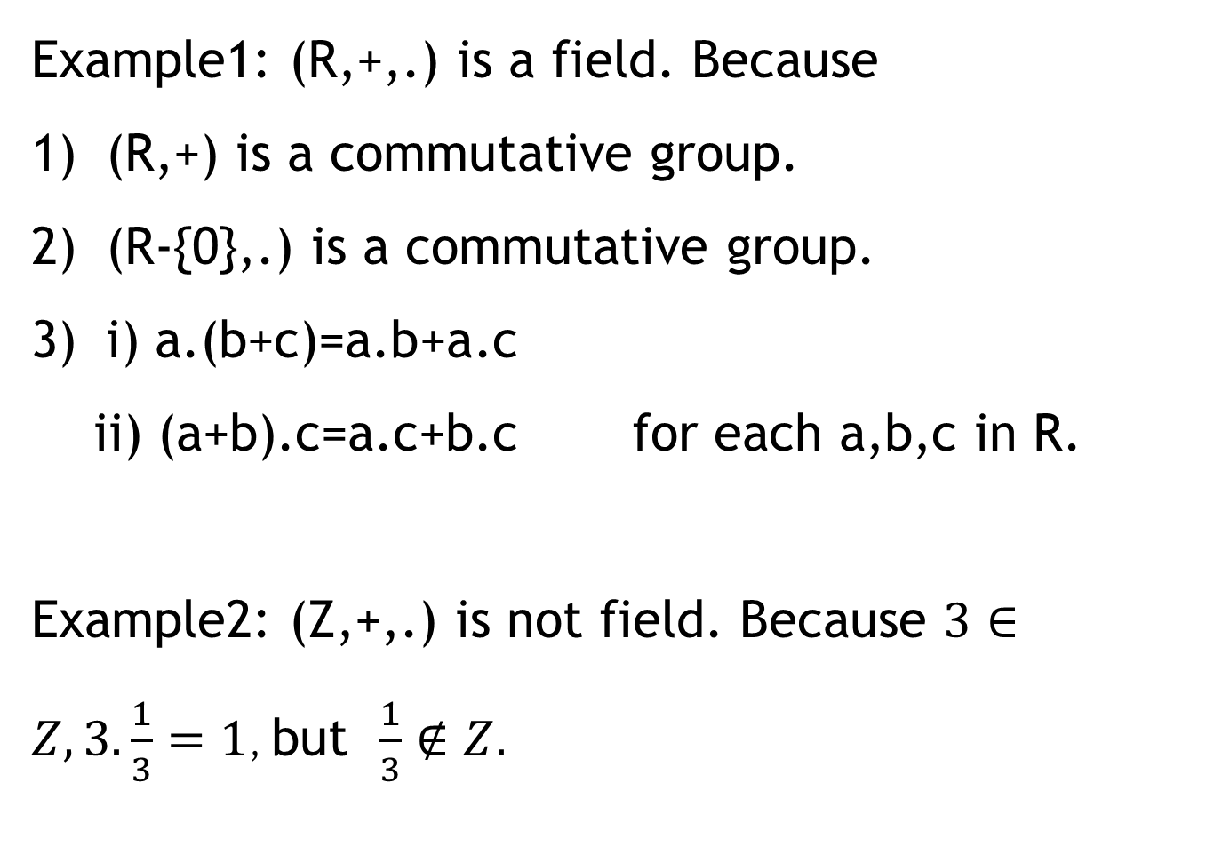
Example1: (R,+,.) is a field. Because
(R,+) is a commutative group.
(R-{0},.) is a commutative group.
i) a.(b+c)=a.b+a.c
ii) (a+b).c=a.c+b.c for each a,b,c in R.
Example2: (Z,+,.) is not field. Because $3∈Z, 3.\frac{1}{3}=1$, but $\frac{1}{3}∉Z.$

Slide 9
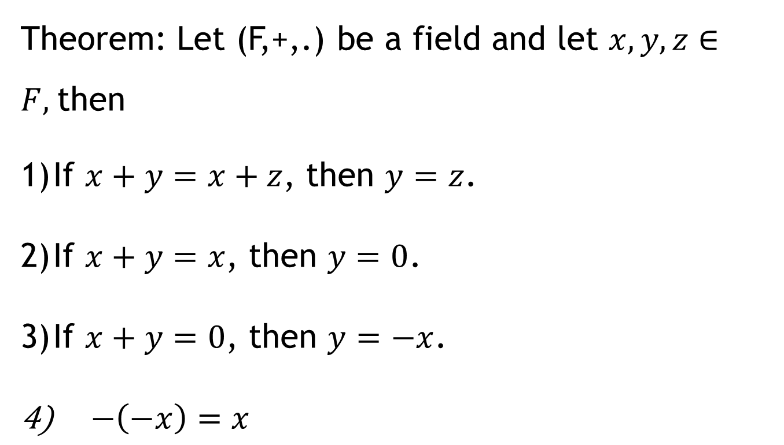
Some Properties of a field
Theorem: Let (F,+,.) be a field and let $x,y,z∈F,$then
If $x+y=x+z$, then $y=z$.
If $x+y=x$, then $y=0$.
If $x+y=0$, then $y=−x$.
$−\left(−x\right)=x$

Slide 10
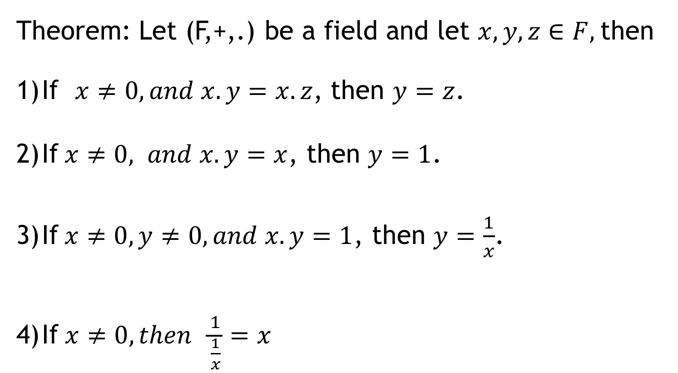
Theorem: Let (F,+,.) be a field and let $x,y,z∈F,$then
If $x≠0, and x.y=x.z$, then $y=z$.
If$x≠0, and x.y=x$, then $y=1$.
If$x≠0, y≠0, and x.y=1$, then $y=\frac{1}{x}$.
$\text{If} x≠0, then \frac{1}{\frac{1}{x}}=x$

Slide 11
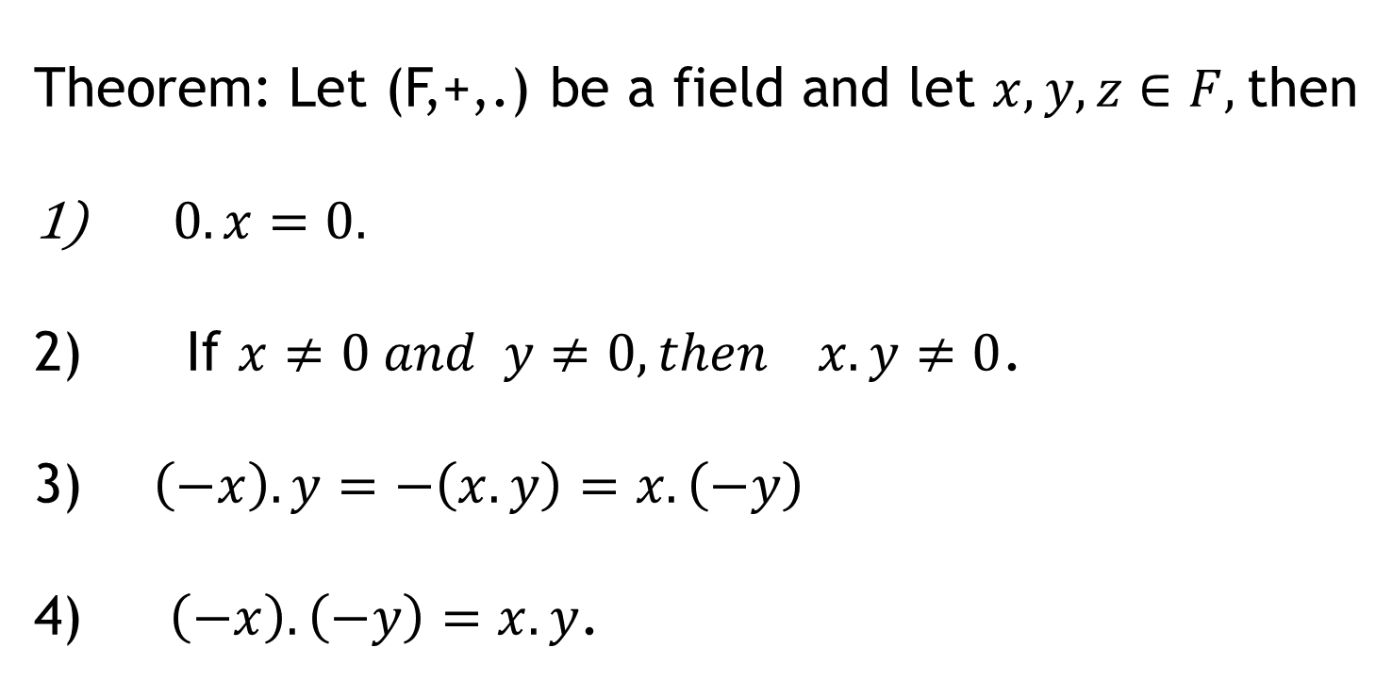
Theorem: Let (F,+,.) be a field and let $x,y,z∈F,$then
$0.x=0.$
If $x≠0 and y≠0, then x.y≠0$.
$\left(−x\right).y=−\left(x.y\right)=x.\left(−y\right)$
$\left(−x\right).\left(−y\right)=x.y$.

Slide 12
Ordered Field
Definition: A field (F,+,.) is said to be ordered field if satisfies the following conditions
If $x,y∈F$, then one and only one of the statements $x<y, x=y , y<x$is true.
If $x,y,z∈F,$ if $x<y$ and $y<z$,then $x<z$.
If $x<y$, then $x+z<y+z$.
If $x>0,and y>0$, then $x.y>0.$

Slide 13
Some Properties of an ordered field
Theorem: The following statements are true in every ordered field.
1) If $x>0, then −x<0$ and vice versa.
2) If $x>0$ and $y<z$, then $xy<xz$.
3) If $x<0$ and $y<z$, then $xy>xz$.
4) If $x≠0$, then $x^{2}>0.$
5) If $0<x<y$, then $0<\frac{1}{y}<\frac{1}{x}$.

Slide 14
Boundedness in Mathematical Analysis
Definition: Let $A$ be a subset of an ordered field F, then
We say that $n∈F$ is an upper bound of A, if $x≤n$ , $∀ x∈A.$
The set of all upper bounds of A, will be denoted by $U(A)$.
2) An upper bound $n_{0}$is said to be least upper bound if${ n}_{0}≤n$, for each upper bound $n$. and is denoted by Sup(A)
3) We say that $m∈F$ is a lower bound of A, if $m≤x$ , $∀ x∈A.$
The set of all lower bounds of A, will be denoted by $L(A)$.
4) A lower bound $m_{0}$is said to be greatest lower bound if$m≤m_{0}$, for each upper bound $m$. and is denoted by Inf(A).

Slide 15
5) A set A is said to be bounded above, if it has least upper bound.
6) A set A is said to be bounded below, if it has greatest lower bound.
7) A set A is bounded if it is bounded above and bounded below.
Example: Let F=R ( the set of all real numbers) and let A=(1,3). Then show that A is bounded set.

Slide 16
Archimedean Principle:
If $x∈R,y∈R$, and $x>0$, then there is a positive integer n such that $nx>y.$
Corollary : $∀ ε>0, ∃ n∈N, such that \frac{1}{n}<ε$.
Dense of rational and irrational numbers
If $x∈R,y∈R$, and $x<y$, then there exists a $r∈Q$, such that $x<r<y$ .

Slide 17
Theorem: Between any two distinct real numbers, there is infinite set of rational numbers.
Dense of irrational numbers
If $x∈R,y∈R$, and $x<y$, then there exists a $s∈Q^{c}$, such that $x<s<y$ .
Theorem: Between any two distinct real numbers, there is infinite set of irrational numbers.

Slide 18
Chapter Two: Sequences of real numbers
Definition: A sequence of real numbers is a function whose domain N an co-domain is a subset of R.
We use $\left\{a_{n}\right\} or<a_{n}>$ to denote a sequence.
Example: $\left\{a_{n}\right\}$=$\left\{\frac{n}{n+1}\right\} \left\{b_{n}\right\}=\left\{3\right\}$

Slide 19
Definition 2 is illustrated by Figure 4, in which the terms a₁, a₂, a₃ , . . . are plotted on a number line.
No matter how small an interval (L – ε, L + ε) is chosen, there exists an N such that all terms of the sequence from a_{N+1} onward must lie in that interval.

Slide 21
Definition : A real sequence $\left\{a_{n}\right\}$ is said to be bounded if there is $M∈R^{+}$ such that $\left|a_{n}\right|≤M. ∀ n∈N$
Theorem 1 : Every Convergent sequence is bounded.
Proof: Let $\left\{a_{n}\right\}$ be a convergent sequence and converges to $a_{0 }$……….

Slide 22
Theorem 2: If $\{a_{n}\}$ converges to $a_{0}$ and $\{b_{n}\}$ converges to $b_{0}$ , then $\left\{a_{n}+b_{n}\right\}$converges to $a_{0}$+$b_{0}$.
Theorem 3: If $\{a_{n}\}$ converges to $a_{0}$ and $\{b_{n}\}$ converges to $b_{0}$ , then $\left\{a_{n}−b_{n}\right\}$converges to $a_{0}$-$b_{0}$.
Theorem 4: If $\{a_{n}\}$ converges to $a_{0}$ and $\{b_{n}\}$ converges to $b_{0}$ , then $\left\{a_{n}.b_{n}\right\}$converges to $a_{0}$.$b_{0}$.

Slide 23
Theorem 5: If $\{a_{n}\}$ converges to $a_{0}$ , $k∈R$ , then $\left\{ka_{n}\right\}$converges to ${ka}_{0}$
Theorem 6: If $\{a_{n}\}$ converges to $a_{0}$ such that $a_{n}≠0 and a_{0}≠0$ for all n, then $\left\{1/{a_{n}}\right\}$converges to 1/$a_{0}$.
Definition: A real sequence $\{a_{n}\}$ is said to be Cauchy sequence if $∀ ε>0, ∃ N∈N; \left|a_{n}−a_{m}\right|<ε, ∀ n,m>N$

