Slide 1
Topology
Outline:
Examples on infinite collection makes topology.
Comparison of topologies
Union and intersection of topologies.
Closed sets
Characterization of topological space in term of closed sets.
The Usual Topology

Slide 2
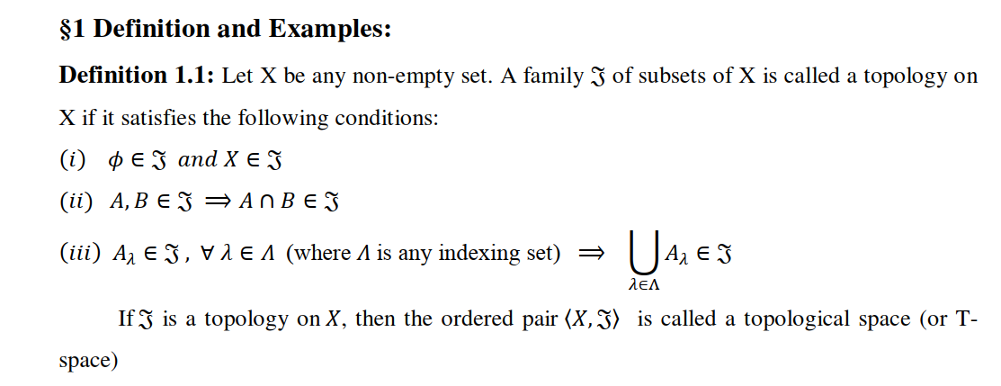

Slide 6
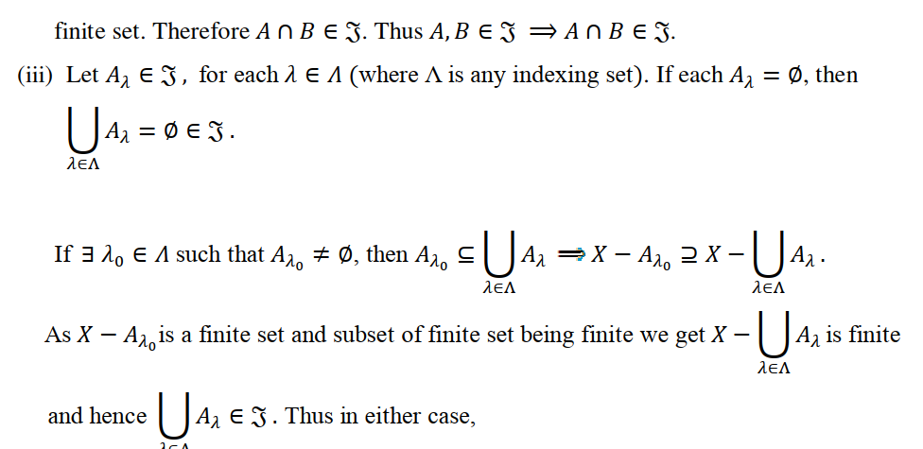

Slide 8
Example1: Let X=R, and $τ=\left\{G⊆R;−1∉G\right\}∪\{R\}$, then show that $τ$ is a topology for R.
Example2: Let X=R, and
$τ=\left\{G⊆R;x∈G→−x∈G\right\}∪\{φ\}$
then show that $τ$ is a topology for R.
Example3: Let X=R, and $τ=\left\{G⊆R;3∈G\right\}∪\{φ\}$, then show that $τ$ is a topology for R.

Slide 9
Definition 2: Let X be a non-empty set and let $τ_{1} andτ_{2}$ be topologies for X, then
1) We say that $τ_{1}$ is weaker than $τ_{2}$ or $τ_{2}$ is stronger than $τ_{1}$ if $τ_{1}⊆τ_{2}$.
2) If $τ_{1}⊆τ_{2}$ or $τ_{2}⊆τ_{1}$ then $τ_{1} and τ_{2}$ are comparable
otherwise are incomparable.

Slide 10
Example: Let X={a,b,c}, $τ_{1}=\left\{φ,X\right\}, { and τ}_{2}=P\left(X\right), then$
${ τ}_{1} is weaker than τ_{2}$ and $τ_{2}$ is stronger than $τ_{1},$
$τ_{1}$ and $τ_{2}$ are comparable.
Example: Let X={a,b,c}, $τ_{1}=\left\{φ,\left\{a\right\}, X\right\}, { and τ}_{2}=\left\{φ,\left\{b\right\}, X\right\},then$
${ τ}_{1} is not weaker than τ_{2}$ and $τ_{2}$ is not stronger than $τ_{1},$
$τ_{1}$ and $τ_{2}$ are not comparable.

Slide 11
Union and Intersection of topologies
Union of two topologies may not be topology in general.
For example
Example: Let X={a,b,c}, $τ_{1}=\left\{φ,\left\{a\right\}, X\right\}, { and τ}_{2}=\left\{φ,\left\{b\right\}, X\right\},then$
$τ_{1}$ and $τ_{2}$ are topologies for X, but $τ_{1}∪τ_{2}=\left\{φ,\left\{a\right\},\left\{b\right\}, X\right\},$is not topology for X

Slide 12
Union and Intersection of topologies
2) Intersection of two topologies is also topology.
in general arbitrary intersection of topologies is also topology for X
Proof: Let $τ_{1}$and $τ_{2}$ be two topologies for X, we have to show that $τ_{1}∩τ_{2}$ is also topology for X.

Slide 13
Closed sets:
Definition: Let $(X,τ)$ be a topological space, A subset F of X is said to be closed set, if its complement is open.
That’s mean F is closed set iff $F^{c}$ is open set.
Example: Let X={a,b,c}, $τ_{1}=\left\{φ,\left\{a\right\}, \left\{a,b\right\},X\right\}$ then closed sets are X, {b,c},{c} and $φ$.

Slide 14
Remark:
Since $∅$ is open, it follows that $∅^{c}=X$ is closed
Since X is open, it follows that $X^{c}=∅$ is closed
Thus $∅ and X$ are open as well as closed sets

Slide 15
Theorem: Let $F_{1}$ and $F_{2}$ be two closed subsets of a topological space X, then $F_{1}∪{F }_{2}$ is a closed set.
Theorem: IF $\{F_{λ}, λ∈Δ\}$ is any collection of closed sub sets of a topological space X, then $∩\{F_{λ}, λ∈Δ\}$ is a closed set.

Slide 16
Usual Topology for R.
Let X=R( the set of all real numbers) and let $τ$consist of $φ$ and all those subsets G of X having the property that to each $x∈G$, there exist $ε>0$, such that $x∈\left(x−ε,x+ε\right)⊆G$
Then $τ$ is a topology and is called usual topology.
Solution:
Examples on open and closed sets in (R,U).

Slide 17
Question : Give an example to show that the union of an infinite collection of closed subsets of a space X is not necessarily closed.
Example: In (R,U), let $F_{n}=[\frac{1}{n+1},1]$, $n∈N$
Question : Give an example to show that the intersection of an infinite collection of open subsets of a space X is not necessarily open.

Slide 18
Characterization of a topological space in term of closed sets
Theorem:
Let X be a non-empty set and F a family of subsets of X such that
[F1] $∅∈F, and X∈F$
[F2] $F_{1},F_{2}∈F →$ $F_{1}∪F_{2}∈F$
[F3] $F_{λ}∈F→∩F_{λ}∈F$ , for each $λ∈∆$
Then there exists a unique topology for X. such that the closed subsets of X are the members of F.

Slide 19
Proof: Let $τ$ consist of the complements of the members of F, first we have to show that $τ$ is a topology for X,
That’s mean we must show that $τ$=$\left\{G; G^{c}∈F\right\} is a topology$
Now, ……..

Slide 20
Neighborhoods
Definition: Let $(X,τ)$ be a topological space, and let $x∈X$, A subset N of X is said to be a neighborhood of $x$ if there is $G∈τ$, such that $x∈G⊆N.$
The collection of all neighborhoods of $x$ is called neighborhood system and is denoted by $N\left(x\right).$
Example: Let $X=\left\{a,b,c,d\right\}, and let τ=\{φ,\left\{a\right\},\left\{a,b\right\},\left\{a,b,c\right\},X\}$, then find N(a), N(b),N(c) and N(d)

Slide 21
Theorem: Let X be a topological space, and for each $x∈X$, let $N(x)$ be the collection of all neighborhoods of $x$, then
N1) $∀ x∈X, N(x)≠∅$
N2) $N∈N(x)→x∈N$
N3) $N∈N(x)$ and $N⊆M→M∈N(x)$
N4) $if N,M∈N\left(x\right)→N∩M∈N\left(x\right).$

Slide 22
(Limit points, accumulation point cluster point)
Derived sets
Definition.
Let $(X,τ)$ be a topological space and let A be a subset of X. A point $x∈X$is called limit point of A, iff every neighborhood of $x$ contains a point of A other than $x$.
$$That′s mean$$
$x∈X$ is a limit point of A iff $A−\{x\}∩N≠φ$, $∀ nhd. N of x$
The set of all limit points of A is called derived set and is denoted by D(A) or d(A)

Slide 23
Example: Let $X=\left\{a,b,c\right\},$ and $τ=\{φ,\left\{a\right\},\left\{a,b\right\},X\}$ and let A={a,c} find derived set
Properties of Derived set.
Theorem: Let A and B be subsets of a topological space X, then
$D\left(∅\right)=∅$
$A⊆B ⇒D(A)⊆D(B$)
$D\left(A∩B\right)⊆D\left(A\right)∩D\left(B\right).$
$D\left(A∪B\right)=D\left(A\right)∪D\left(B\right).$

Slide 24
Closure:
Definition: Let $(X,τ)$ be a topological space and let A be a subset of X. then the intersection of all closed supersets of A is called the closure of A and is denoted by $\overline{A}$ or Cl(A) or c(A).
That’s mean $\overline{A}=∩\{F;F is closed and A⊆F\}$

Slide 25
Theorem: Let A be a subset of a topological space and $A⊆X$, then
$\overline{A}$ is the smallest closed set containing A
A is closed set $↔$ $\overline{A}$=A
$\overline{A}=A∪D(A)$

Slide 26
Properties of Closure.
Theorem: Let A and B be subsets of a topological space (X,$τ)$, then
$\overline{∅}=∅, \overline{X}=X$
$A⊆B ⇒\overline{A}⊆\overline{B}$
$\overline{ \left(A∩B\right)}⊆\overline{A}∩\overline{B}.$
$\overline{\left(A∪B\right)}=\overline{A}∪\overline{B}.$
$\overset{̿}{ A}=\overline{A}$.

