Slide 1
LIST OF EXPERIMENTS 1. spherical and chromatic aberration of a lens 2. Determination the wavelength of He-Ne laser using Michelson interferometer 3. Resolving Power of Optical Instruments 4. Polarization and Malus' law. 5. A- Determination of the refractive index of glass prism using spectrometer. B- Diffraction grating. 6. Determination of wavelength of laser light using Fresnel's Biprism . 7. Determination the wavelength of light source using Newton rings( or radius of curvature of a lens .
Optics LAB

Slide 2
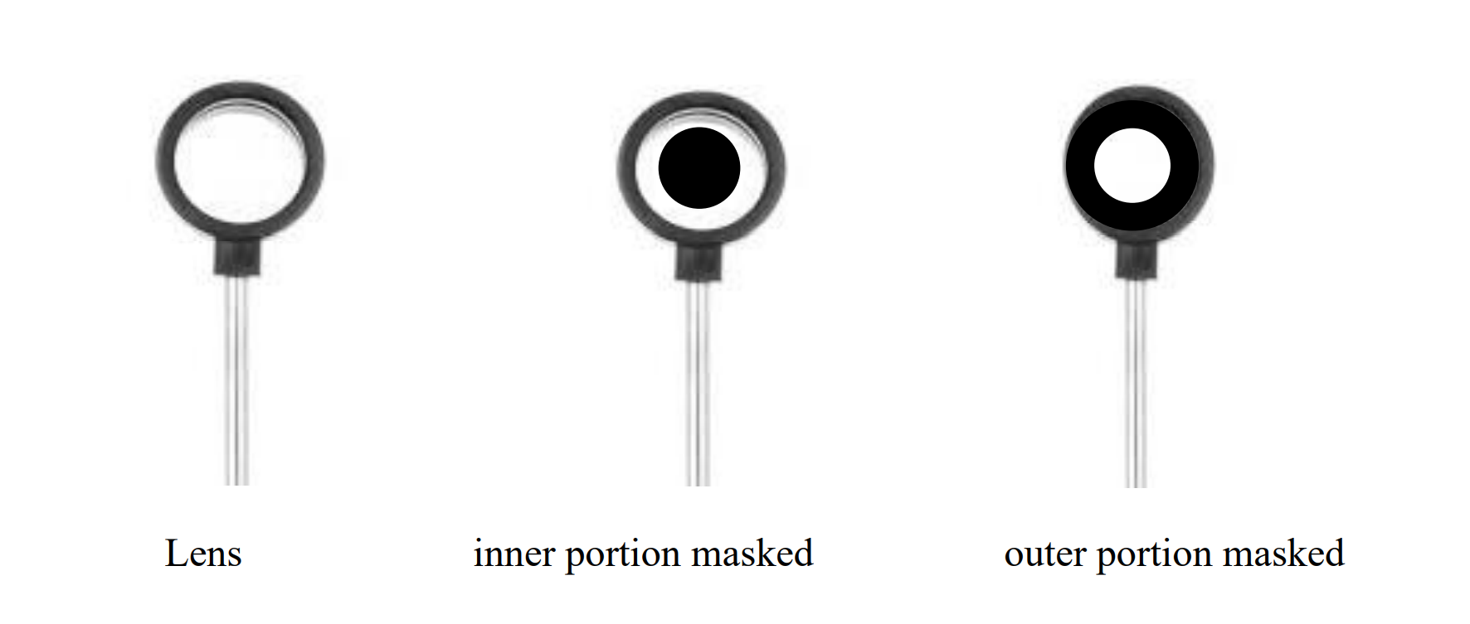
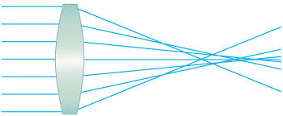
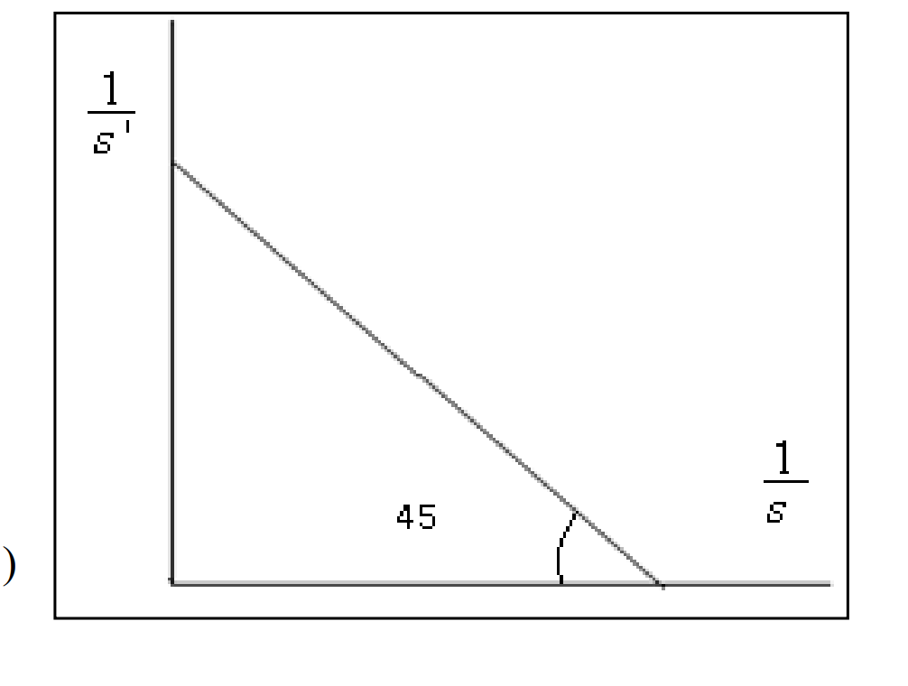
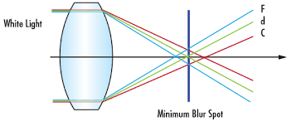
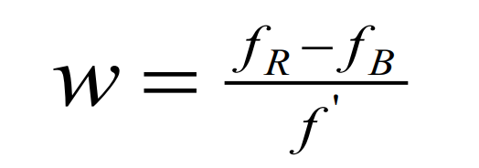
1-spherical and chromatic aberration of a lens
spherical aberration of a lens
chromatic aberration of a lens

Slide 3
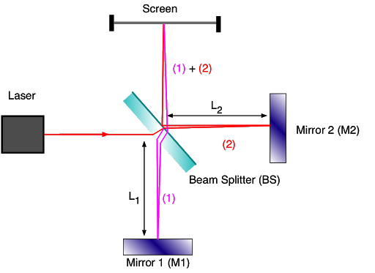
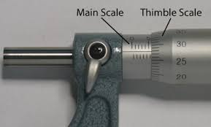
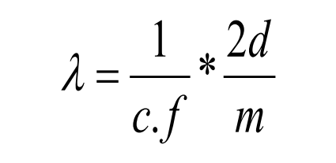
-2Determination the wavelength of He-Ne laser using Michelson interferometer

Slide 4
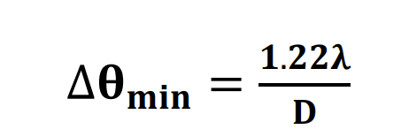
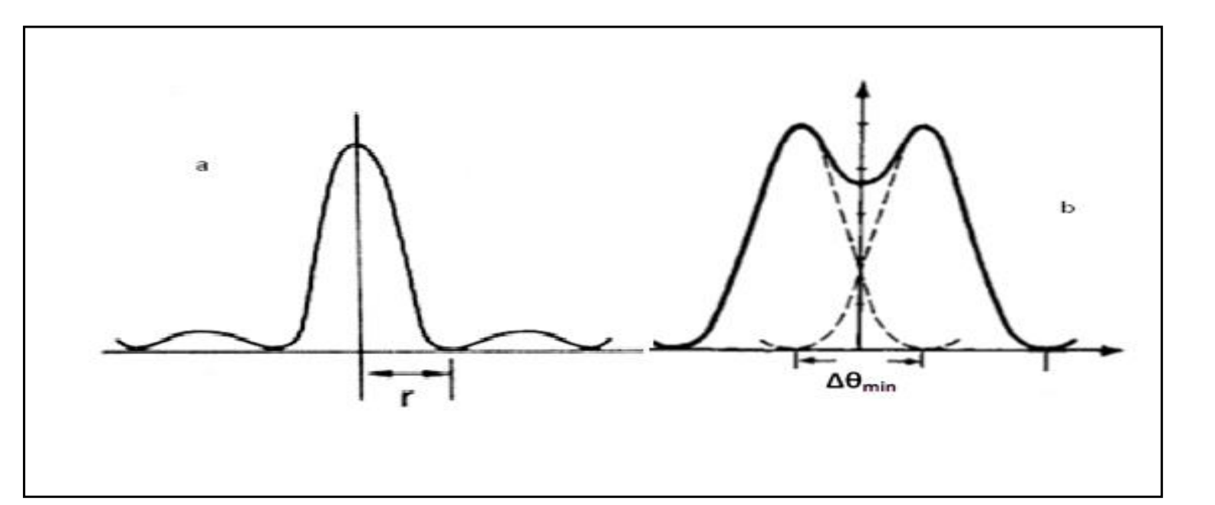
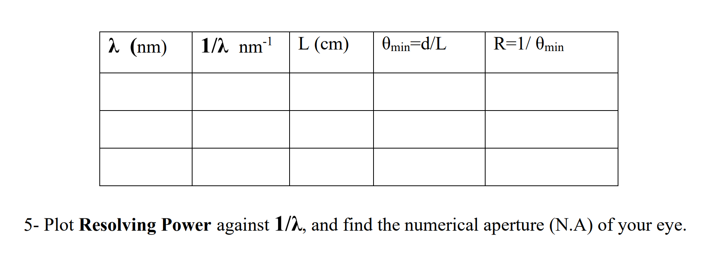
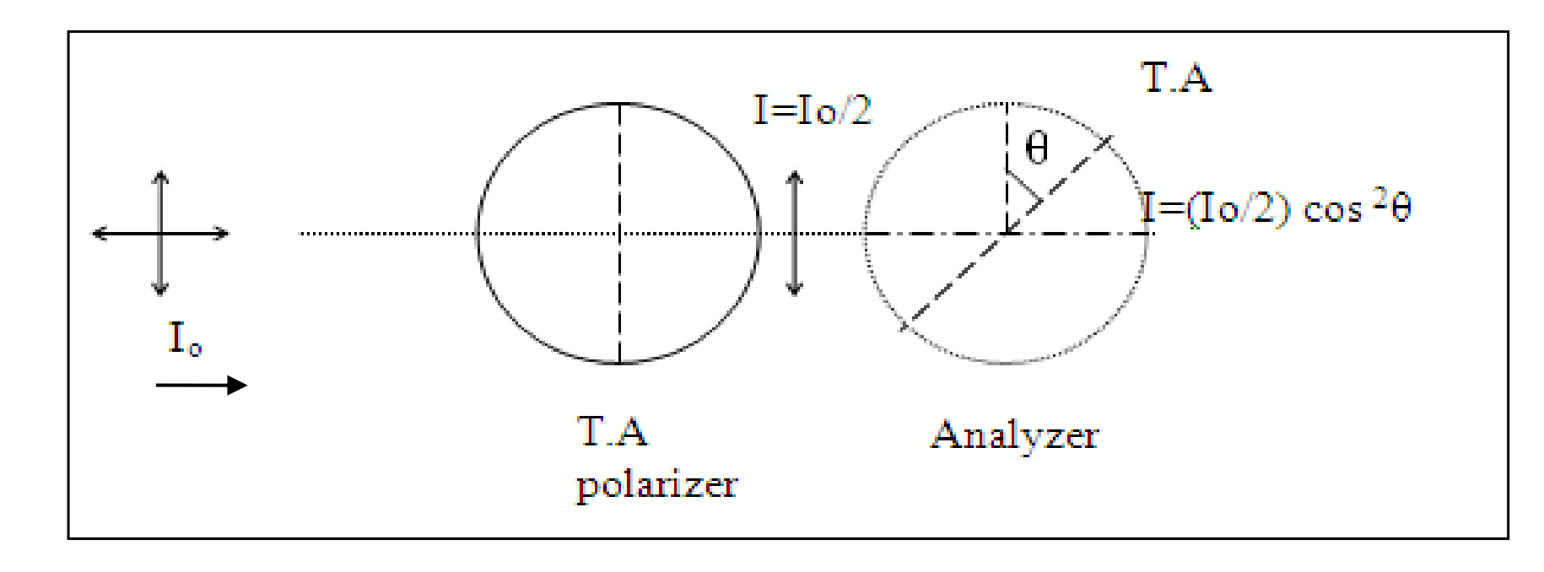
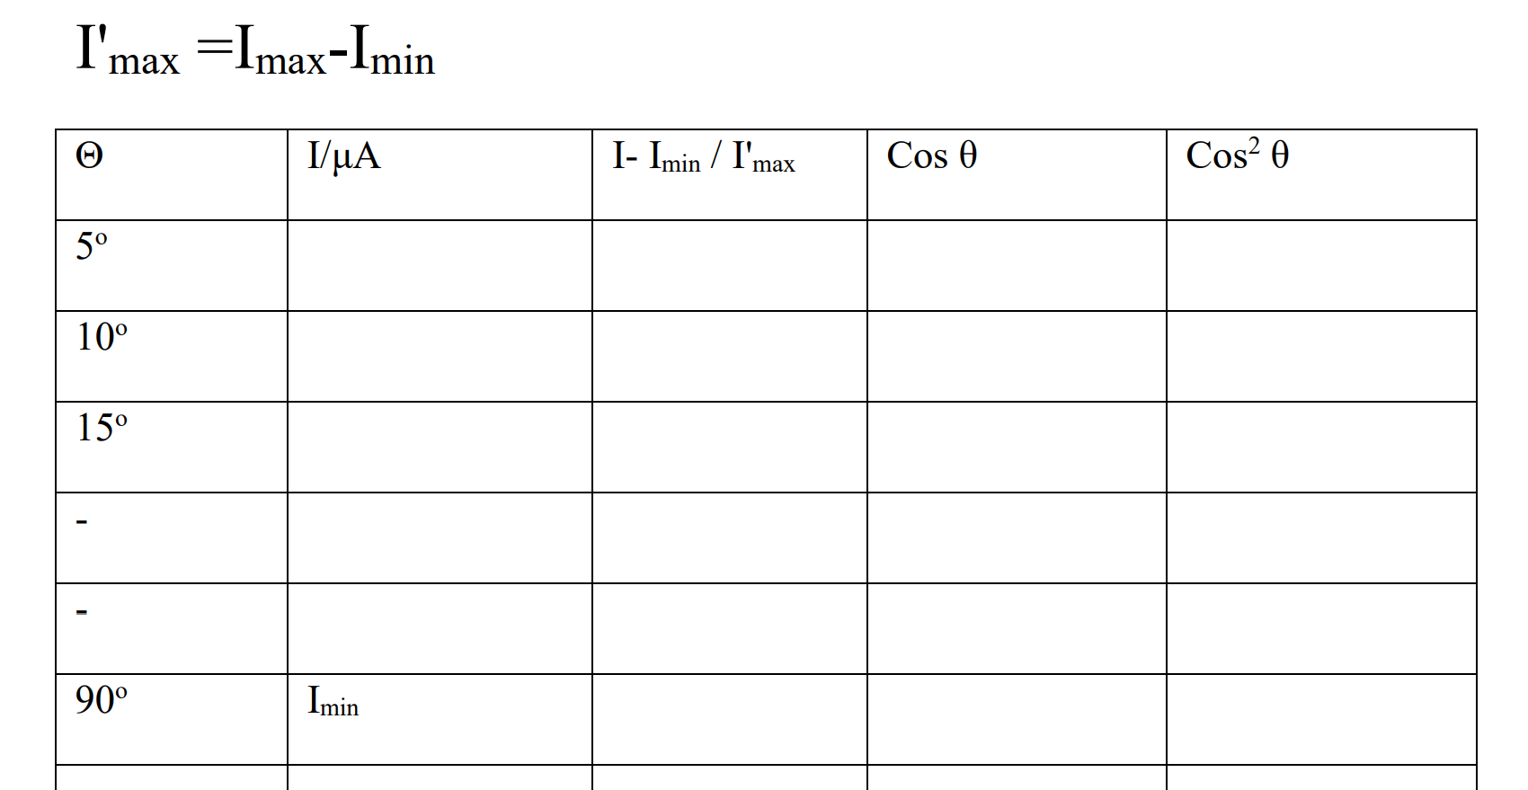
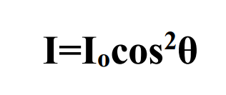
4. Polarization and Malus' law.
-3 Resolving Power of Optical Instruments

Slide 5
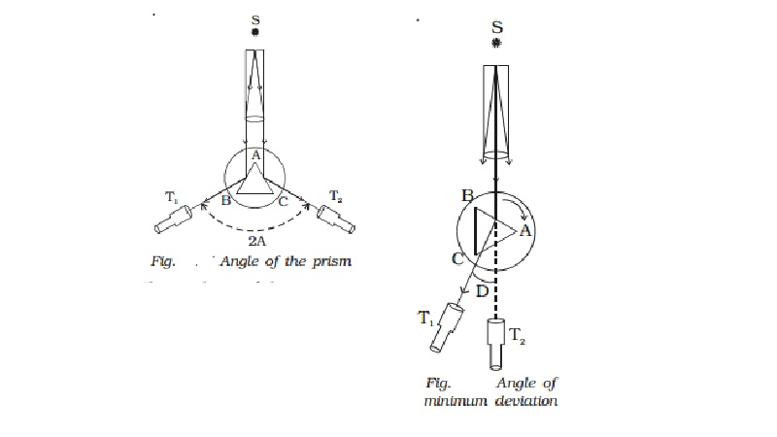
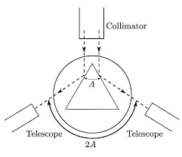
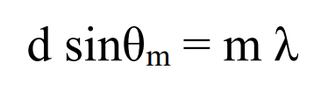
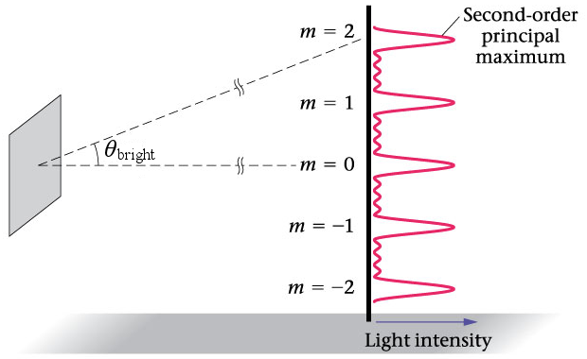
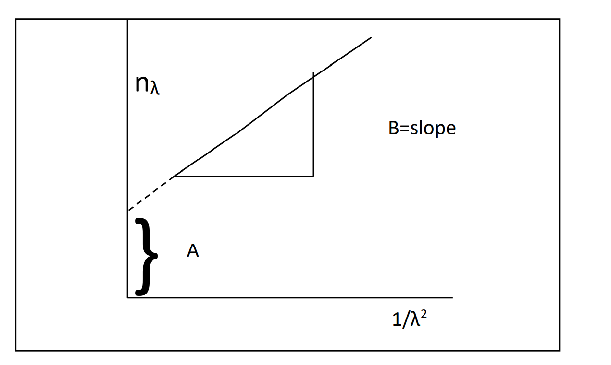
-5A- Determination of the refractive index of glass prism using spectrometer
B-Diffraction grating

Slide 6
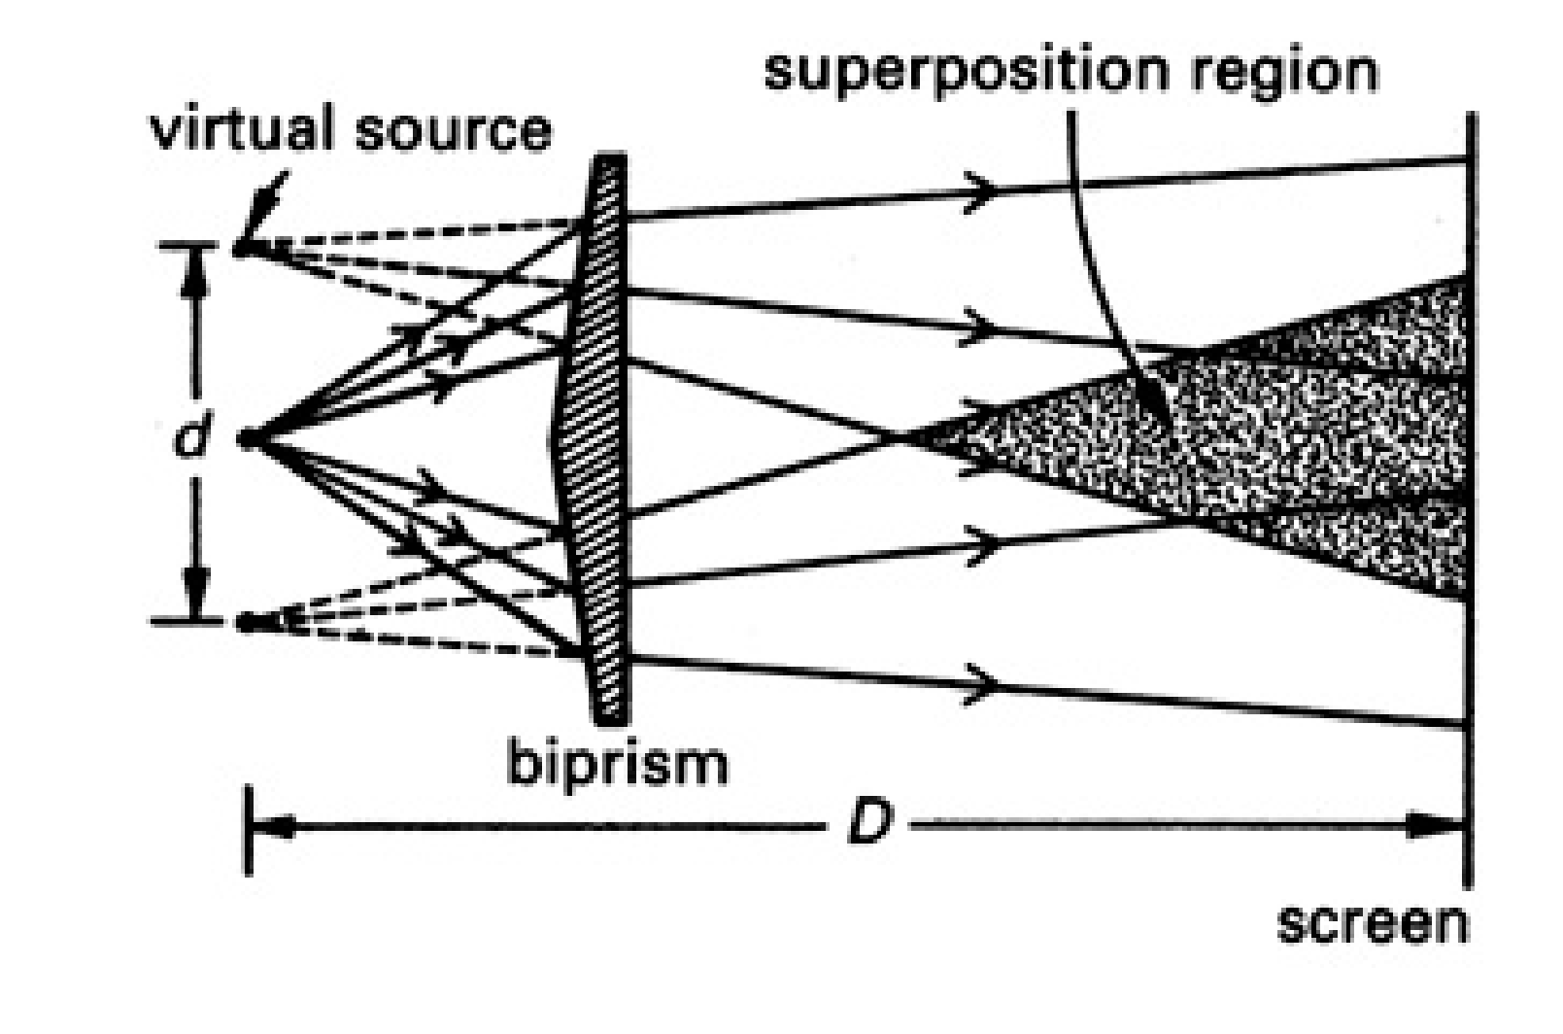
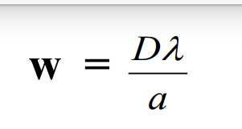
6- Fresnel's Biprism

Slide 7
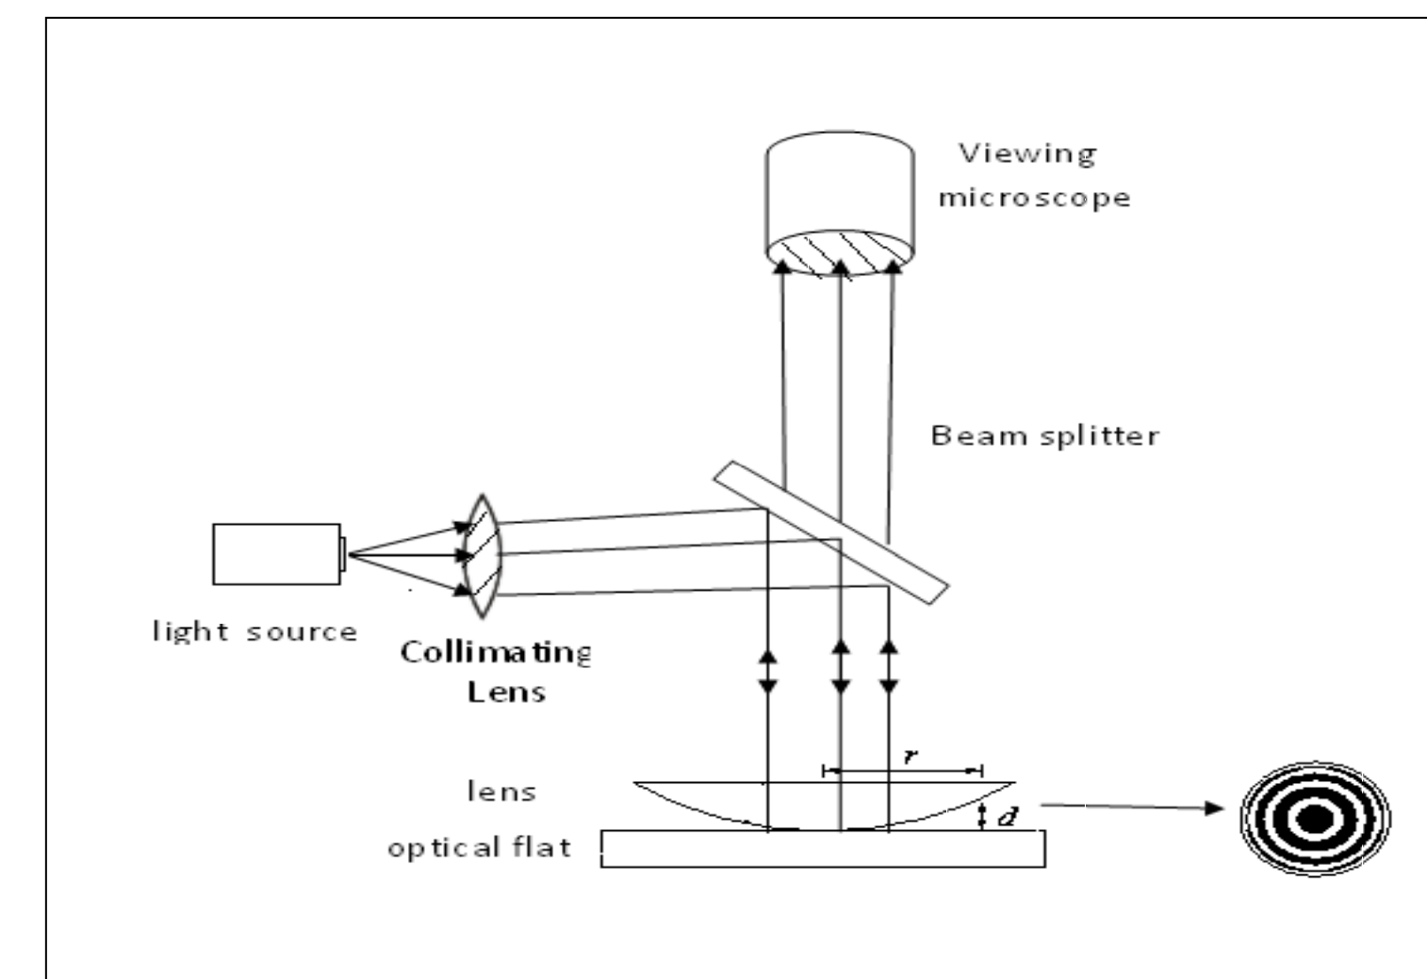
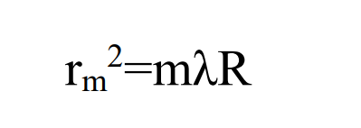
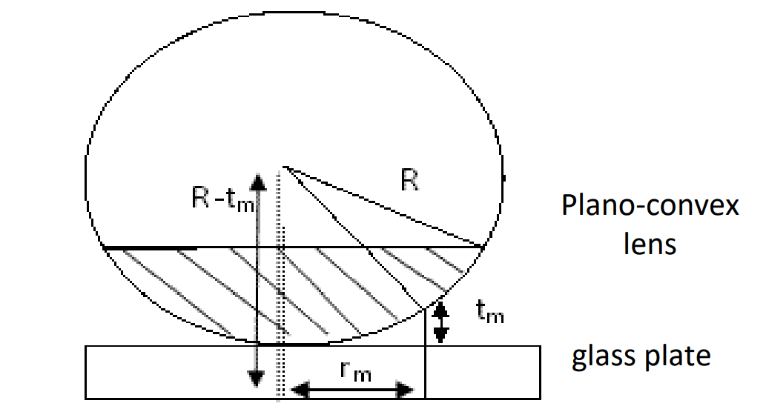
7- Determination of the wavelength of Na-light by Newton's rings

