Slide 1
Laser Lab. Experiment
4th stage Medical and communication Physics
Experiment
Describe the structure and operating principle of laser (semiconductor, gas, and solid-state laser).
Spatial Profile of a Laser Beam
2. Describe the physical mechanism of interaction of laser beam with Tissue.
3. To measure the pulse duration, pulse repetition time, and average power of a repetitively pulsed laser and calculation the maximum power, pulse repetition rate, duty cycle, and energy per pulse
4. To determine the Specific rotation of sugar solution and to determine the sugar concentration of the unknown solution
5. To measure Doppler frequency and Calculation the velocity of water flow
6- To measure the absorption coefficient in glass and plastic for the He-Ne laser,

Slide 2
7. To quantify the effect of distance on the irradiance and beam homogeneity from Quartz-tungsten lamp, LED, and laser curing lights at different irradiation distances (2 mm and 9 mm). 2- Improving the Inverse Square Law Experiment When Using the LED Light Source (the power detected within a unit area is inversely proportional to the square of the distance from the light source and illumination with time.
8. To study the bending lose in fiber optic cable
9. Measuring Concentration of Liquids Using a Laser Pointer: Part A: Determine the concentration of a liquid by measuring the solution's index of refraction (Tyndall effect)
Part B:1-Measurement of concentration Measurement of absorption coefficient (α).. analyze the effects of light interaction with matter.
10. studying the fiber optic characteristic.
11. safe handling of laser equipment.
12. List the safety aspects and concerns of cutaneous laser systems

Slide 3
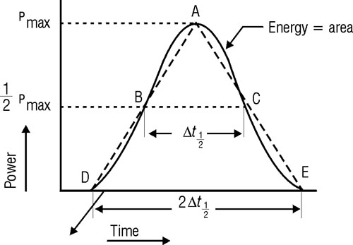
Laser Pulse Characteristic
Trial | PRR (pulses/sec) | PRT (ms) | Δt_{1/2} (ms) | Duty Cycle | P_{avg} (µW) | P_{max} | E/pulse (µJ)
1
2
3

Slide 4
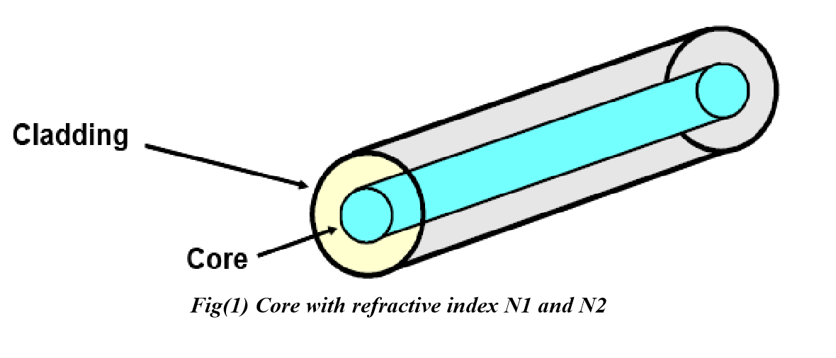
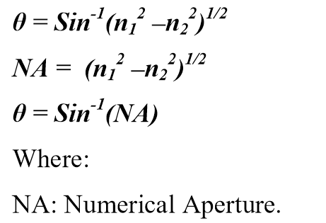
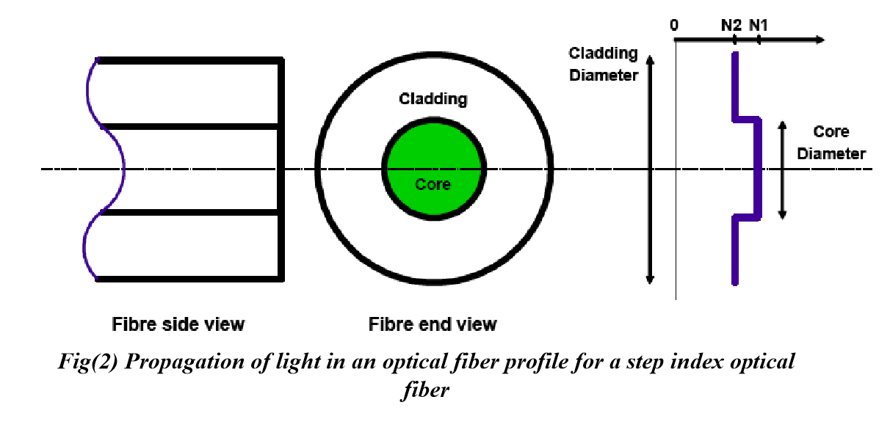
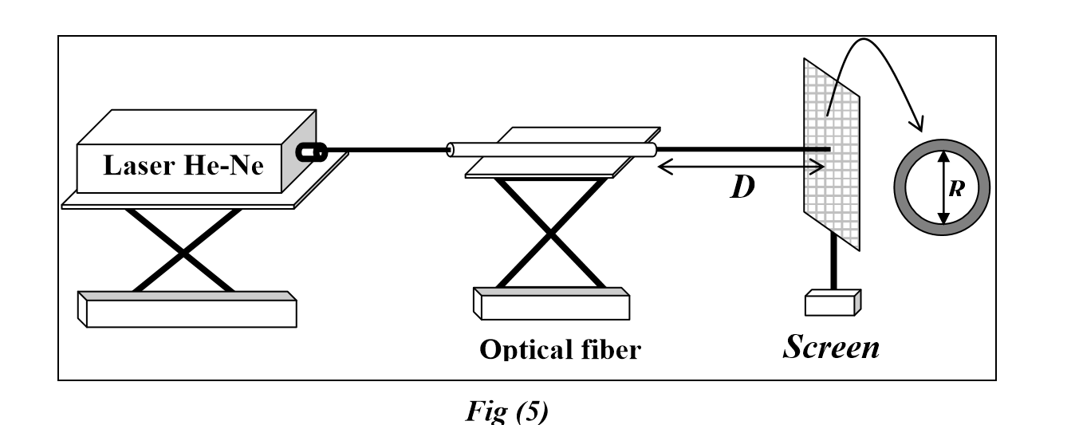
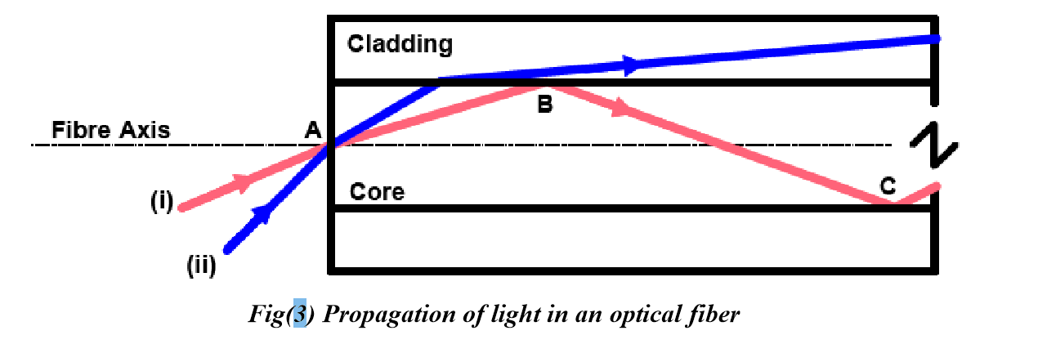
Study the properties of optical fibre

Slide 5
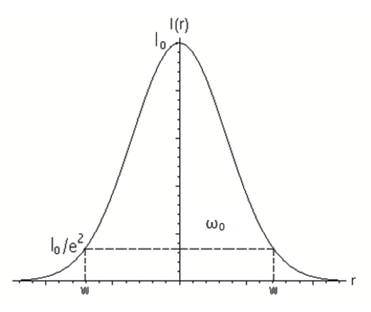
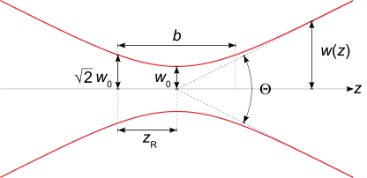
Spatial Profile of a Laser Beam
Rayleigh range and confocal parameter
Radius of curvature R(z)
3-Beam divergence
Angular Spread and M²
M² = Θ / θ

