Slide 1
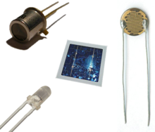
Department of physics/ Medical branch
College of Science /Salahaddin University
Lectures notes / Detectors
Samira Y. Asoka
Second semester
2022-2023
reference book – Detection of light
George H. Rieki

Slide 2
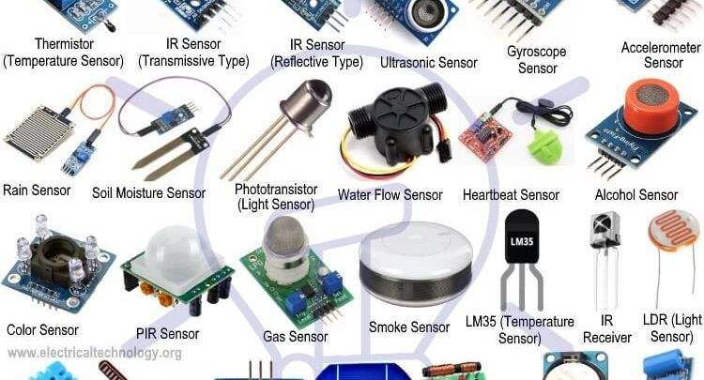
Chapter One
introduction
detector characteristics
1- quantum efficiency ( the fraction of the incoming photon stream absorbed)
2- noise and the ratio of signal to noise .
3- Resolution of images produced by a detector
4- speed of response of a detector.

Slide 3
1- Radiometry / Concepts and Terminology
Radiometry is the science of measurement of electromagnetic radiation.
As electromagnetic radiation, a photon has both electric and magnetic components, oscillating in phase perpendicular to each other and perpendicular to the direction of energy propagation.
The amplitude of the electric field, its wavelength and phase, and the direction it is moving characterize the photon.
The behavior of the electric field can be expressed as
A photon has an energy of
where h = 6.626 × 10⁻³⁴ J s is Planck’s constant,
ν is the frequency (in hertz = 1/seconds)
λ is wavelength (in meters) of the electromagnetic wave, and c = 2.998×10⁸ m/s .

Slide 4
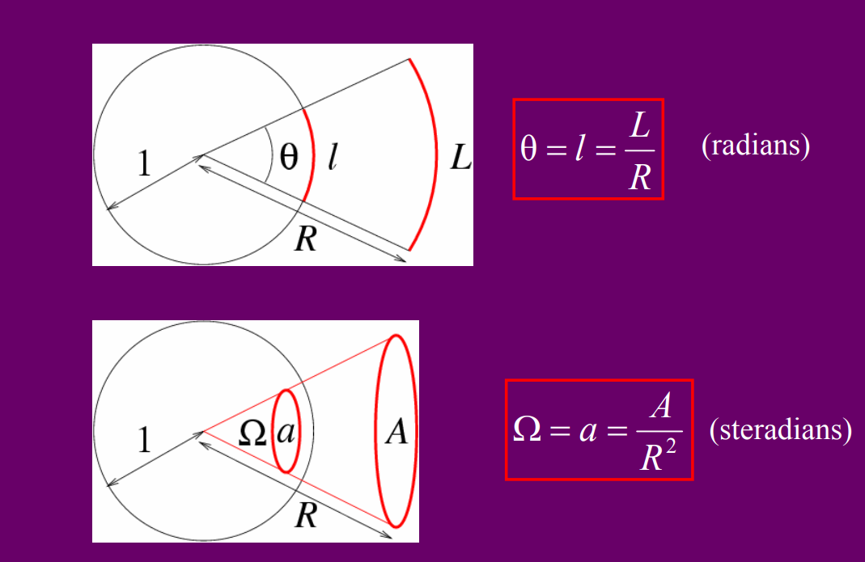
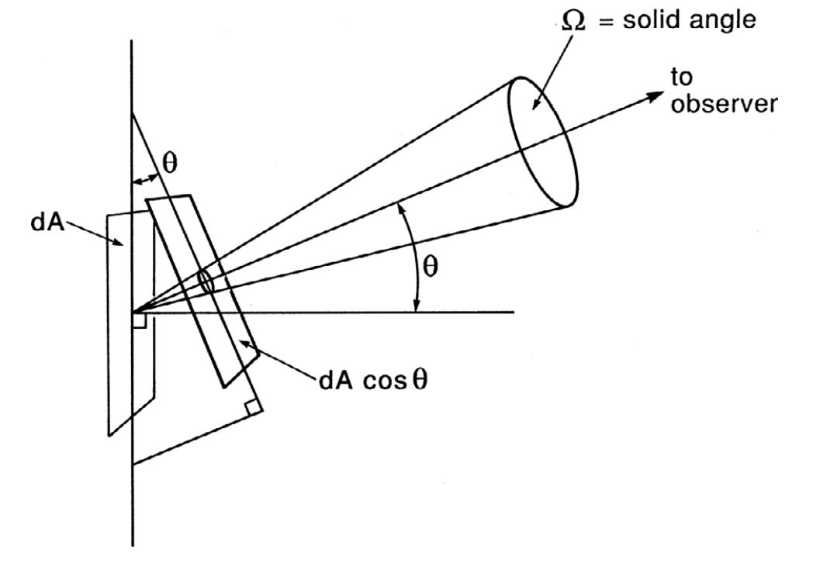
To compute the emission of an object
L_{ν} is the spectral radiance per frequency interval , which is the power(watts) leaving a unit projected area of the surface of the source (square meters) into a unit solid angle (steradians) and unit frequency interval (hertz )
The projected area of a surface element (dA )onto a plane perpendicular to the direction of observation is dA cosθ,
where θ is the angle between the direction of observation and the outward normal to dA
L_{ν} has units of W m⁻² Hz ⁻¹ ster ⁻¹.

Slide 5
The radiance L is the spectral radiance integrated over all frequencies or wavelengths;
it has units of W m⁻² ster⁻¹
The radiant exitance, M, is the integral of the radiance over solid angle, and it is a measure of the total power emitted per unit surface area in units of W m⁻² or is the amount of light, emitted by an area of surface of a radiating body
The flux emitted by the source, φ , is the radiant exitance times the total surface area of the source, that is the power emitted by the entire source
for a spherical source of radius R

Slide 6
we consider sources that have spectra like those of blackbodies, for which the spectral radiance in frequency units is
where ε is the emissivity of the source,
n is the refractive index of the medium into which the source radiates,
k = 1.38×10⁻²³ J K⁻¹ is the Boltzmann constant.
The emissivity (ranging from 0 to 1) is the efficiency with which the source radiates compared to that of a perfect blackbody, which by definition has ε = 1.
According to Kirchhoff’s law, the absorption efficiency, or absorptivity, and the emissivity are equal for any source.

Slide 7
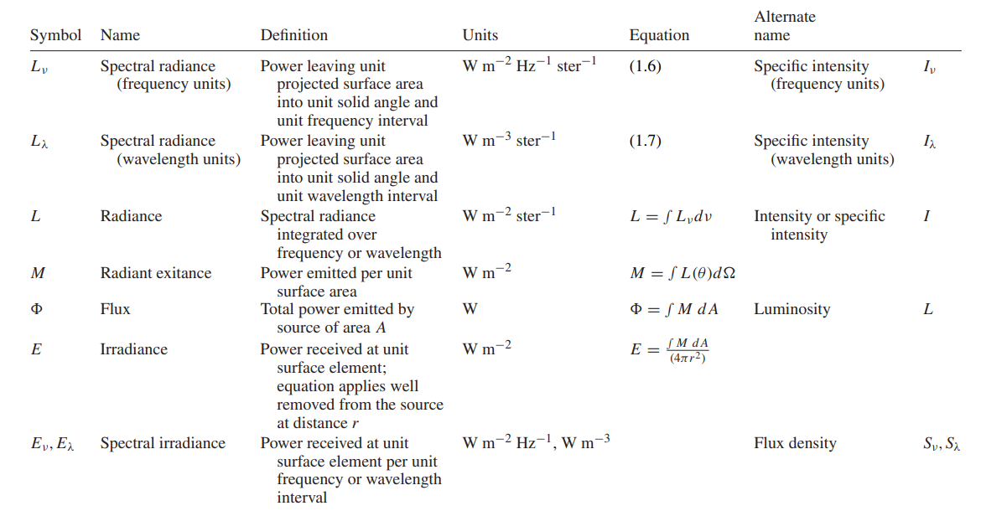
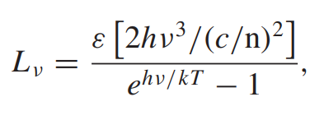
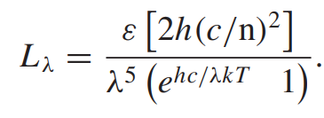

Slide 8
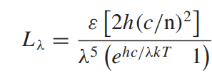
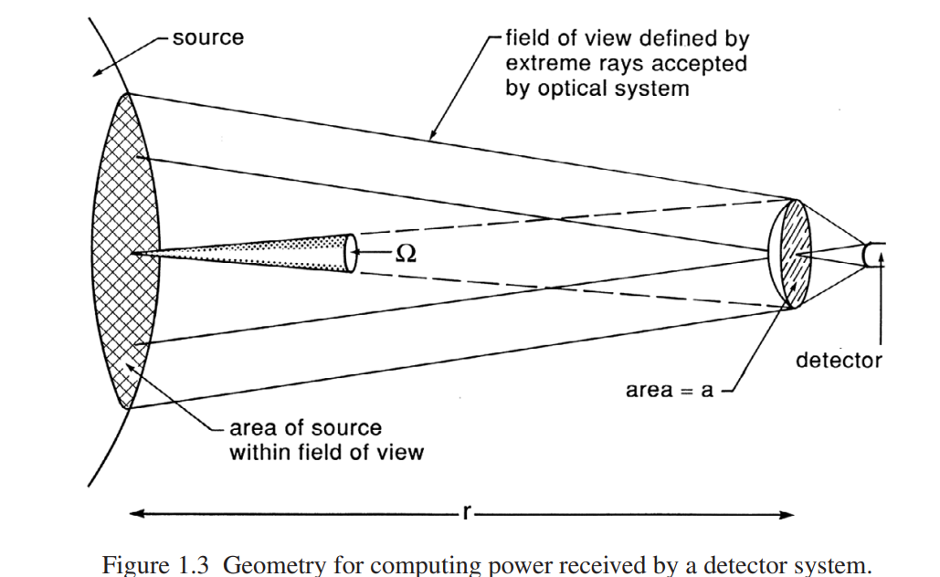
In wavelength units, the spectral radiance is
-
The solid angle subtended by the detector system is
where a is the area of the entrance aperture of the system
r is its distance from the source.
We will deal only with Lambertian sources; the defining characteristic of such a source is that its radiance is constant regardless of the direction from which it is viewed.
A blackbody is one example of the emission of a Lambertian source

Slide 9
Example: A 1000 K spherical blackbody source of radius 1 m is viewed in air by a detector system from a distance of 1000 m. The entrance aperture of the system has a radius of 5 cm, and the optical system has a field of view half angle of 0.1º. The detector operates at a wavelength of 1 μm with a spectral bandpass of 1%, and its optical system is 50% efficient.
1- Compute the spectral radiances in both frequency and wavelength units.
2-Calculate the corresponding spectral irradiances at the detector entrance aperture, and the power received by the detector.
3- Compute the number of photons hitting the detector per second.
4- Describe how these answers would change if the blackbody source were 10 m in radius rather than 1 m. (HW)
sol: refractive index of air is n = 1, ε = n = 1 , λ= 1 μm the corresponding frequency= ν = c/λ = 2.998 × 10¹⁴ Hz
source radius =1 m , source to detector distance =1000m ,radius of entrance aperture = 5cm , spectral band pass 0.01 , optical system is 50% efficient
L_{v} = ?
L_{λ} =?
Ω = ?
E_{v} =?
E_{λ} =?
No.of photon hitting detector

Slide 10
1- Radiometry /2- The Detection Process
Only a portion of the power received by the optical system is passed on to the detector. The system will have inefficiencies due to
-absorption and scattering of energy in its elements,
because of optical aberrations and diffraction.
In addition, the range of frequencies or wavelengths to which the system is sensitive
Transmittance
accounting of the spectral response requires that the spectral radiance of the source be multiplied point-by-point by the spectral transmittances of all the spectrally active elements in the optical path to the detector, and by the detector spectral response, and the resulting function subsequently integrated over frequency or wavelength to determine the total power effective in generating a signal.

Slide 11
1- Detector Types
all detectors act as transducers that receive photons and produce an electrical response that can be amplified and converted into a form intelligible to suitably conditioned human beings
There are three basic ways that detect photon
Photodetectors respond directly to individual photons. An absorbed photon releases one or more bound charge carriers in the detector that may
modulate the electric current in the material
move directly to an output amplifier
lead to a chemical change.
most common photodetectors are based on semiconducting materials and are used throughout the X-ray, ultraviolet, visible, and infrared spectral regions.
Example : photoconductors , photodiode, charge coupled devices (CCDs) , photographic materials , photo emissive detectors , and quantum well detectors .

Slide 12
1- Detector Types
(b) Thermal detectors absorb photons and thermalize their energy.
this energy changes the electrical properties of the detector material, resulting in a modulation of the electric current passing through it.
Thermal detectors have a very broad and nonspecific spectral response, but they are particularly important at infrared and submillimeter wavelengths, and as X-ray detectors.
Example ; Bolometer
(c) Coherent detectors respond to the electric field strength of the signal and can preserve phase information about the incoming photons. They operate by interference of the electric field of the incident photon with the electric field from a local oscillator.
- These detectors are primarily used in the radio and submillimeter regions but also have specialized applications in the visible and infrared

Slide 13
2- Performance Characteristics
Good detectors preserve a large proportion of the information contained in the incoming stream of photons. A variety of parameters are relevant to this goal:
a) Spectral response – the total wavelength or frequency range over which photons can be detected with reasonable efficiency.
b) Spectral bandwidth – the wavelength or frequency range over which photons are detected at any one time; some detectors can operate in one or more bands placed within a broader range of spectral response.
Linearity – the degree to which the output signal is proportional to the number of incoming photons that were received to produce the signal.
d) Dynamic range – the maximum variation in signal over which the detector output represents the photon flux without losing significant amounts of information.
The dynamic range of an instrument is its ability to measure both weak and strong signals, and is closely related to the maximum signal-to-noise ratio it can deliver

Slide 14
2- Performance Characteristics
e) Quantum efficiency – the fraction of the incoming photon stream that is converted into signal.
Noise – the uncertainty in the output signal. Ideally, the noise consists only of statistical fluctuations due to the finite number of photons producing the signal.
Imaging properties the number of detectors (“pixels”) in an array determines in principle how many picture elements the detector can record simultaneously.
Because signal may blend from one detector to adjacent ones, the resolution that can be realized may be less, however, than indicated just by the pixel count
h) Time response the minimum interval of time over which the detector can distinguish changes in the photon arrival rate.

Slide 15
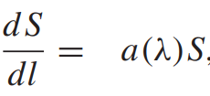
3- Quantum Efficiency
photons to be detects it must be absorbed , The absorption of a flux of photons S passing through a differential thickness element dl is expressed by
where a(λ) is the absorption coefficient in the detector material has units of cm⁻¹. or
-
The portion of the flux absorbed by the detector divided by the flux that enters it is
-
where d₁ is the thickness of the detector.
The quantity η_{ab} is known as the absorption factor.
The quantum efficiency, η, is the flux absorbed in the detector divided by the total flux incident on its surface.
Photons are lost by reflection from the surface before they enter the detector volume, leading to a reduction in quantum efficiency below η_{ab}.
:

Slide 16
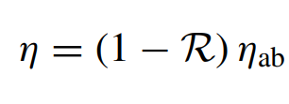
Minimum reflection occurs for photons striking a nonabsorptive material at normal incidence
r =
-
where r is the fraction of the incident flux of photons that is reflected, n is the refractive index of the material, a(λ) is the absorption coefficient at wavelength λ
Reflection from the back of the detector can result in absorption of photons that would otherwise escape If we ignore this potential gain, the net quantum efficiency is
Example, Calculate quantum efficiency for a detector operating at a wavelength of 0.83 µm that is 20 µm thick and made of material with n = 3.5 and a (0.83 µm) = 1000 cm⁻¹
n= 3.5 , λ= 0.83μm
a(λ)= 1000 cm⁻¹
η= ?

Slide 17
Example : determine quantum efficiency of a Ge and In_{0.53}Ga_{0.47}As crystal layer that needed for absorbing 90% of incident radiation at 1.5μm , The reflection of the light from the surface of the photodetector is neglected
λ= 1.5 μm
a(λ)= 6 x 10⁵ m⁻¹ for Ge
a(λ)= 7.5 x 10⁵ m⁻¹ for In_{0.53}Ga_{0.47}As
η= ?

Slide 18
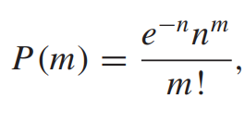
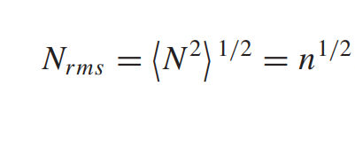
4- Noise and Signal to Noise
the ratio of signal, S, to noise, N, in the incoming photon stream and then compares it with what can be achieved in the detector as a function of the quantum efficiency will be as follow:
it can be assumed that the input photon flux follows Poisson statistics,
Poisson distribution is a statistical distribution showing the likely number of times that an event will occur within a specified period of time.
where P(m) is the probability of detecting m photons in a given time interval,
n is the average number of photons detected in this time interval
The root-mean square noise in a number of independent events, each of which has an expected noise N, is the square root of the mean, n,
The errors in the detected number of photons in two experiments can usually be taken to be independent, and hence they add quadratically the noise in two measurements yielding n₁ and n₂ events, respectively, is

Slide 19
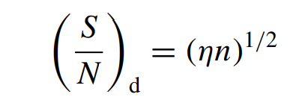
4- Noise and Signal to Noise
for n photons incident on the detector,
So the signal-to-noise ratio for Poisson-distributed events is
The quantum efficiency is the fraction of incoming photons converted into useful signal in the first stage of detector action.
if the detector converts an individual photon into a single, mobile charge carrier that is collected as the signal
in this case the quantum efficiency is the ratio of the number of charge carriers freed to the number of photons received.
For simple detector example, photons that do not free charge carriers cannot contribute to either signal or noise; they might as well not exist.
The portion of information they were carrying is therefore lost.
in the ideal case where both signal and noise are determined only by the photon statistics

Slide 20
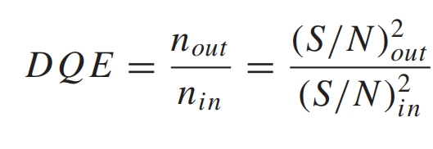
4- Noise and Signal to Noise
The quantum efficiency defined in equation (1.18) refers only to the fraction of incoming photons converted into a signal in the first stage of detector action. Ideally, the signal-to-noise ratio attained in a measurement is controlled entirely by the number of photons absorbed in the first stage.
Additional steps in the detection process can degrade the information present in the photon stream absorbed by the detector, either by losing signal or by adding noise.
the detective quantum efficiency (DQE) describes this degradation succinctly in terms of the number of photons that could produce an output signal with an equivalent ratio of signal to noise if no degradation occurred.
So the detective quantum efficiency define as
Where n_{in} is the actual input photon signal, n _{out} is an imaginary input signal that would produce, with a perfect detector system, the same information content in the output signal as is received from the actual system.
(S/N)_{out} is the observed signal-to-noise ratio, while (S/N)_{in} is the potential signal-to-noise ratio of the incoming photon stream, it is easily shown that the DQE is just the quantum efficiency defined in equation
if there is no subsequent degradation of the signal to noise.

Slide 21
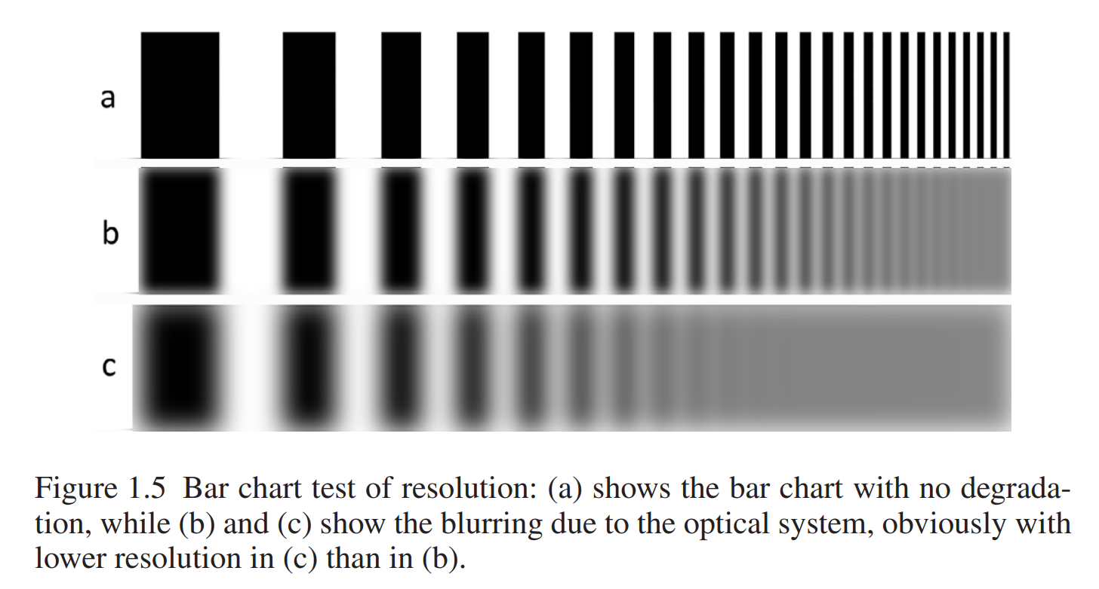
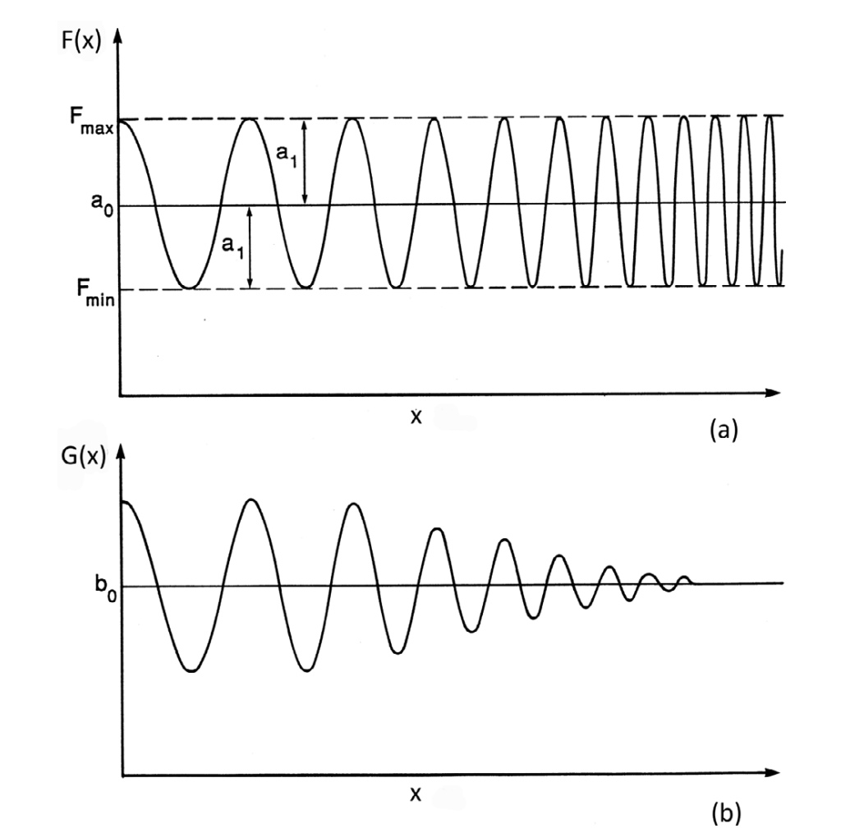
5- Imaging Properties
The resolution of an array of detectors can be most simply measured by exposing it to a pattern of alternating white and black lines (a “bar chart”) and determining the minimum spacing of line pairs that can be distinguished,
The eye can identify such a pattern if the light dark variation is 4% or greater. The resolution of the detector array is expressed in line pairs per millimeter corresponding to the highest density of lines that produces a pattern at this threshold
A more general concept is the modulation transfer function, or MTF
Imagine that the detector array is exposed to a field with a sinusoidal spatial variation of the intensity of the input, of period P and amplitude F(x),
The modulation of this signal is defined as

Slide 22
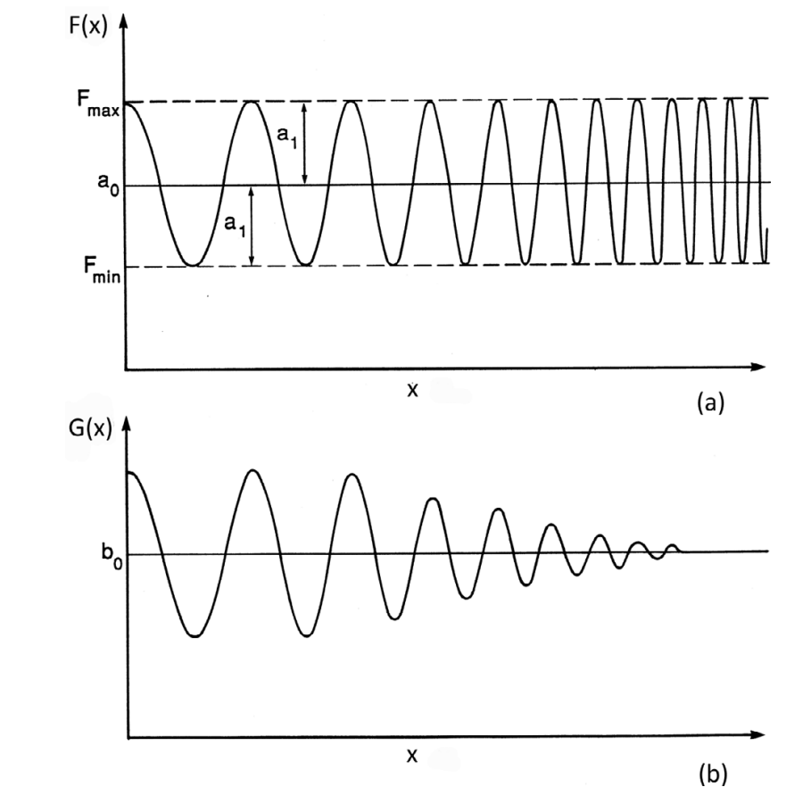
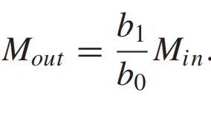
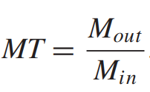
5- Imaging Properties
Assuming that the resulting image output from the detector is also sinusoidal (which may be only approximately true due to nonlinearities), it can be represented by
The modulation in the image will be
The modulation transfer factor is
A separate value of the MT will apply at each spatial frequency;
Figure (a) illustrates an input signal that contains a range of spatial frequencies, (b) shows a corresponding output in which the modulation decreases with increasing spatial frequency.
This frequency dependence of the MT is expressed in the modulation transfer function (MTF).

Slide 23
1.1 A spherical blackbody source at 300 K and of radius 0.1 m is viewed from a distance of 1000 m by a detector system with an entrance aperture of radius 1 cm and field of view half angle of 0.1 degree. (a) Compute the spectral radiances in frequency units at 1 and 10 μm. (b) Compute the spectral irradiances at the entrance aperture. (c) For spectral bandwidths 1% of the wavelengths of operation and assuming that 50% of the incident photons are absorbed in the optics before they reach the detector, compute the powers received by the detector. (d) Compute the numbers of photons hitting the detector per second.

