Slide 1
Position, Velocity, Speed and Acceleration lecture (10)
By
Sanaa I. khaleel
MSc. In structural engineering

Slide 2
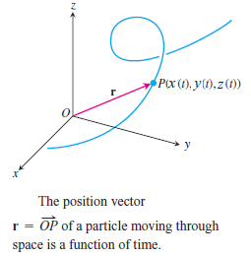
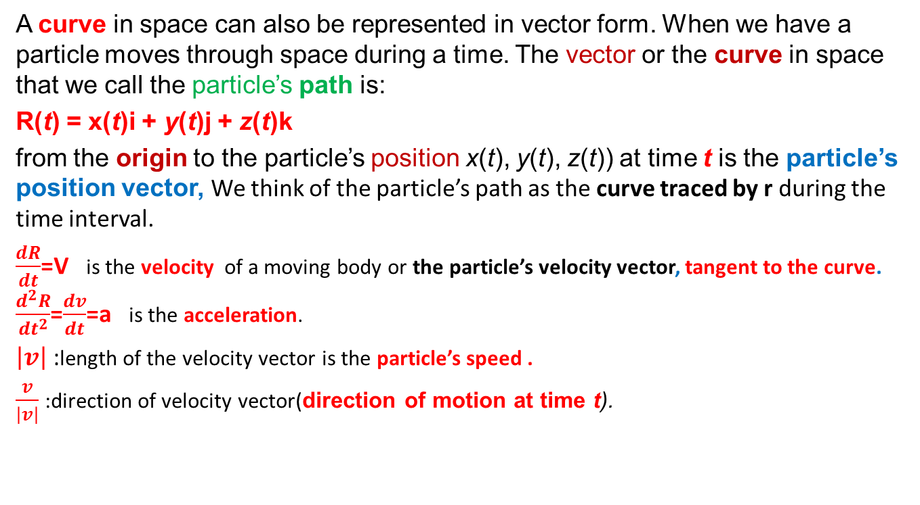
A curve in space can also be represented in vector form. When we have a particle moves through space during a time. The vector or the curve in space that we call the particle’s path is:
R(t) = x(t)i + y(t)j + z(t)k
from the origin to the particle’s position x(t), y(t), z(t)) at time t is the particle’s position vector, We think of the particle’s path as the curve traced by r during the time interval.
$\frac{dR}{dt}$=V is the velocity of a moving body or the particle’s velocity vector, tangent to the curve. $\frac{d^{2}R}{{dt}^{2}}$=$\frac{dv}{dt}$=a is the acceleration.
$\left|v\right|$ :length of the velocity vector is the particle’s speed .
$\frac{v}{\left|v\right|}$ :direction of velocity vector(direction of motion at time t).

Slide 3
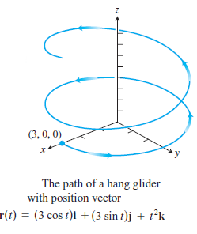

EX: A person on a hang glider is spiraling upward due
to rapidly rising air on a path having position vector
R(t)=(3 cos t)i+(3 sin t)j +$t^{2}$k The path is similar
to that of a helix(although it’s not a helix) for 0$≤t≤4π$.
Find:
(a) the velocity and acceleration vectors,
(b) the glider’s speed at any time t,
(c) the times, if any, when the glider’s acceleration is
orthogonal to its velocity

Slide 4
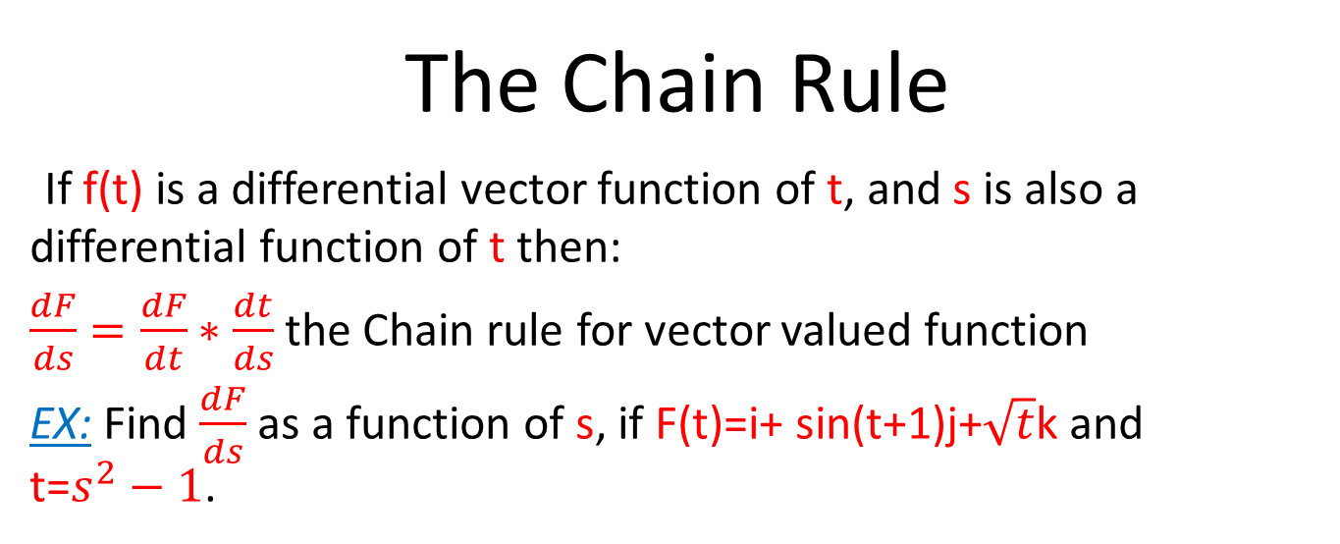
The Chain Rule
If f(t) is a differential vector function of t, and s is also a differential function of t then:
$\frac{dF}{ds}=\frac{dF}{dt}∗\frac{dt}{ds}$ the Chain rule for vector valued function
EX: Find $\frac{dF}{ds}$ as a function of s, if F(t)=i+ sin(t+1)j+$\sqrt{t}$k and t=$s^{2}−1$.

Slide 5
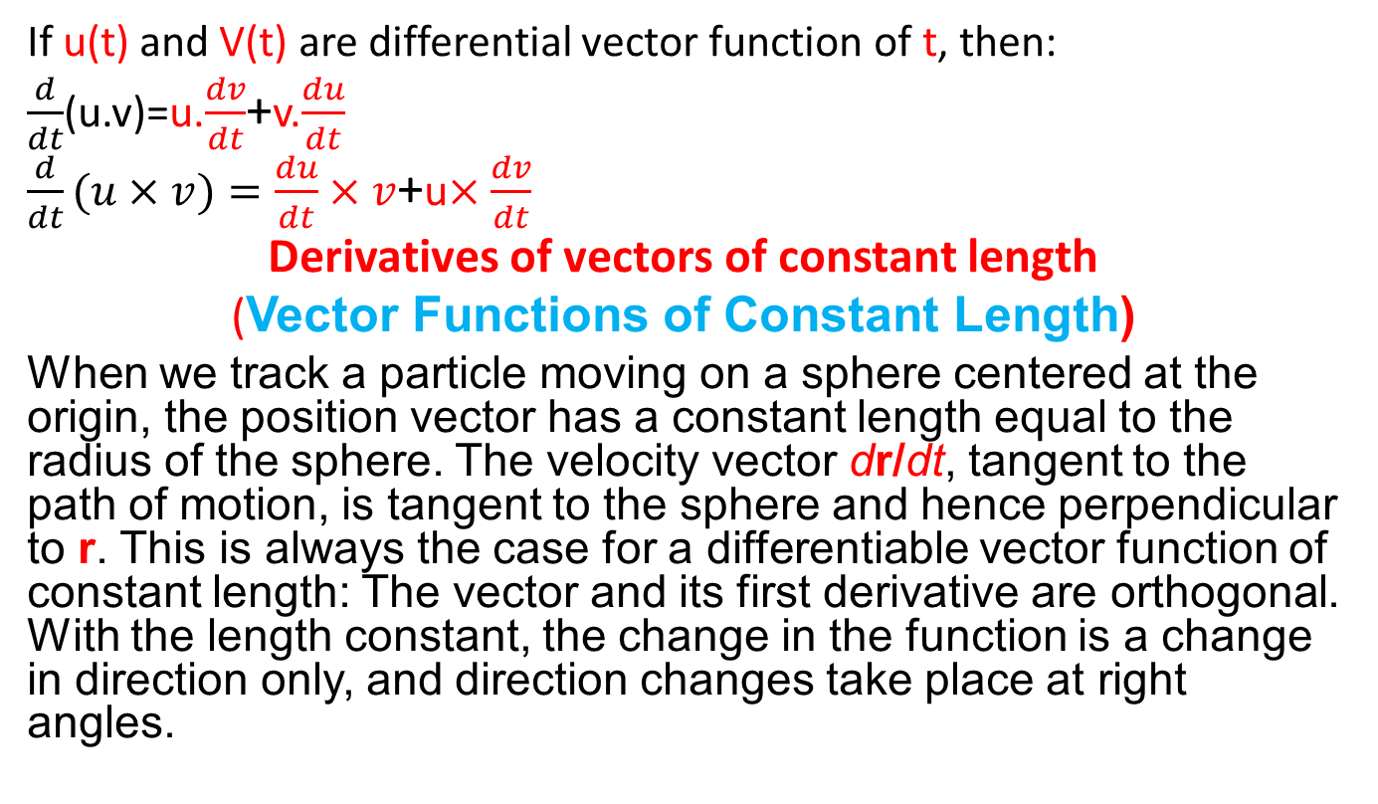
Derivatives of Dot product and Cross products
If u(t) and V(t) are differential vector function of t, then:
$\frac{d}{dt}$(u.v)=u.$\frac{dv}{dt}$+v.$\frac{du}{dt}$
$\frac{d}{dt}(u×v)=\frac{du}{dt}×v$+u$×\frac{dv}{dt}$
Derivatives of vectors of constant length
(Vector Functions of Constant Length)
When we track a particle moving on a sphere centered at the origin, the position vector has a constant length equal to the radius of the sphere. The velocity vector dr/dt, tangent to the path of motion, is tangent to the sphere and hence perpendicular to r. This is always the case for a differentiable vector function of constant length: The vector and its first derivative are orthogonal. With the length constant, the change in the function is a change in direction only, and direction changes take place at right angles.

Slide 6
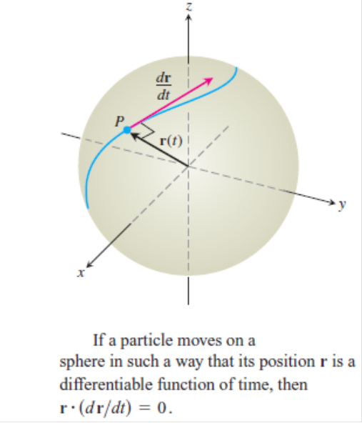

If V(t) are differential vector function of t, whose length is a constant , then:
v.v=${\left|v\right|}^{2}$
v.$\frac{dv}{dt}+\frac{dv}{dt}$.v=0
2(v.$\frac{dv}{dt}$)=0
v.$\frac{dv}{dt}$=0 This means that v(t) and $\acute{v}$(t) are orthogonal.

Slide 7
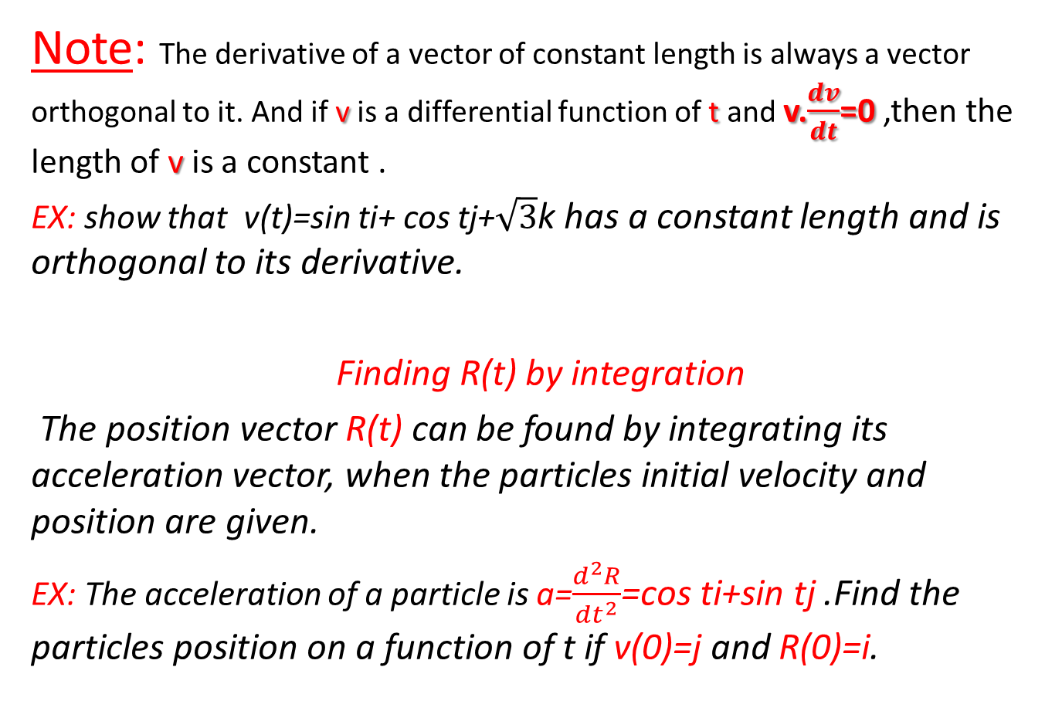
Note: The derivative of a vector of constant length is always a vector orthogonal to it. And if v is a differential function of t and v.$\frac{dv}{dt}$=0 ,then the length of v is a constant .
EX: show that v(t)=sin ti+ cos tj+$\sqrt{3}$k has a constant length and is orthogonal to its derivative.
Finding R(t) by integration
The position vector R(t) can be found by integrating its acceleration vector, when the particles initial velocity and position are given.
EX: The acceleration of a particle is a=$\frac{d^{2}R}{{dt}^{2}}$=cos ti+sin tj .Find the particles position on a function of t if v(0)=j and R(0)=i.

Slide 8
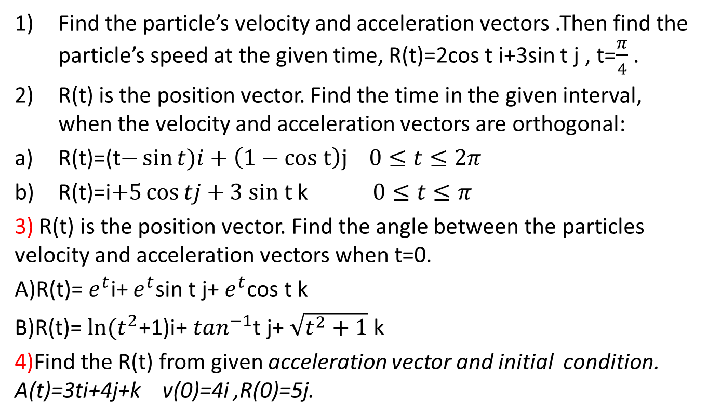
Problems
Find the particle’s velocity and acceleration vectors .Then find the particle’s speed at the given time, R(t)=2cos t i+3sin t j , t=$\frac{π}{4}$ .
R(t) is the position vector. Find the time in the given interval, when the velocity and acceleration vectors are orthogonal:
R(t)=(t$−\sin{t)i}+\left(1−cos t\right)j$ $0≤t≤2π$
R(t)=i$+5\cos{tj}+3 sin t$k $0≤t≤π$
3) R(t) is the position vector. Find the angle between the particles velocity and acceleration vectors when t=0.
A)R(t)= $e^{t}$i+ $e^{t}$sin t j+ $e^{t}$cos t k
B)R(t)= $ln⁡(t^{2}$+1)i+ $\tan^{−1}$t j+ $\sqrt{t^{2}+1}$ k
4)Find the R(t) from given acceleration vector and initial condition. A(t)=3ti+4j+k v(0)=4i ,R(0)=5j.

Slide 9
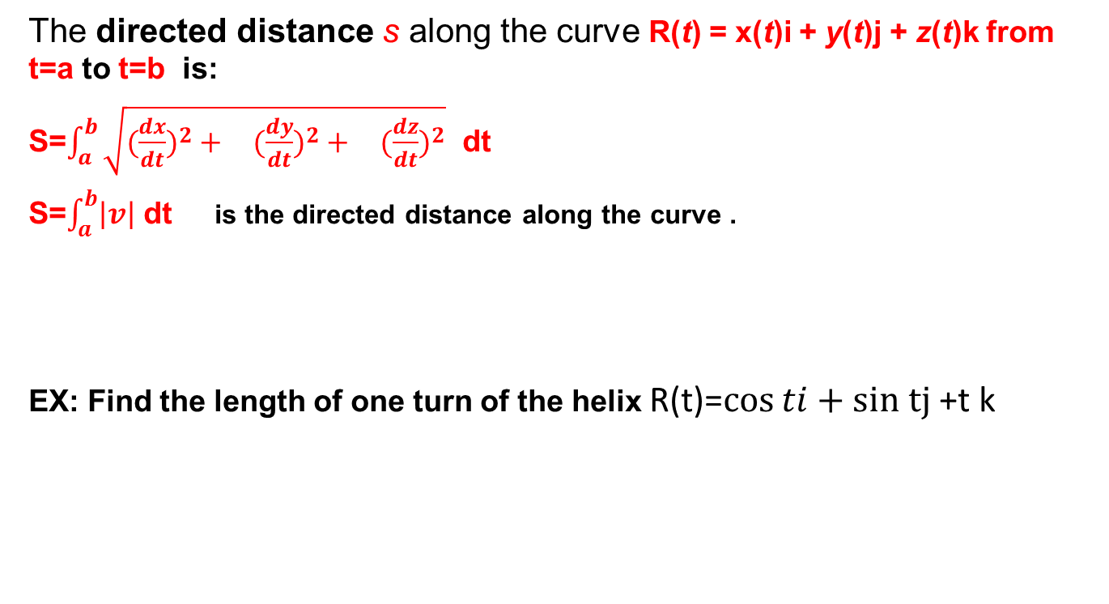
directed distance
The directed distance s along the curve R(t) = x(t)i + y(t)j + z(t)k from t=a to t=b is:
S=$\int_{a}^{b}{\sqrt{(\begin{matrix}{\frac{dx}{dt})}^{2}+ & ({\frac{dy}{dt})}^{2}+ & ({\frac{dz}{dt})}^{2}\end{matrix}}}$ dt
S=$\int_{a}^{b}{\left|v\right|}$ dt is the directed distance along the curve .
EX: Find the length of one turn of the helix R(t)=$\cos{ti}+sin tj$ +t k

