Slide 1
Salahadden-Halwer University Computer Department College of Science Fourth Stage – CS & IT
Image Compression
Assist. Lecturer
Sangar Hasan
Email: Sangar.Ismael@su.edu.krd
Academic Year
2018 - 2019

Slide 2
Overview
Aim of Compression
Lossless and Lossy Coding
Generic Image Compression
Transform Coding
Quantisation
Entropy Coding
Image Decoding
Bibliography

Slide 3
Compression Challenge
Raw digital multimedia data e.g. video contains an large amount of data.
For example...
Coloré Image: 512 x 512 pixel color image (512 x 512 x 24bits) = 786 Kbytes
Video conference: QCIF resolution using 4 : 2 : 0 at 25 fps gives a bitrate of ~ 7.6 Mbps [(176x144)+(88x72)]x8x2x25=76Mbps [(176 x 144 )+ (88 x 72)] x 8 x 2 x 25 = 7.6Mbps
Digital TV: 720 X 576 resolution using 4 : 2 : 0 at 25 fps gives a bitrate of ~ 124 Mbps [(720 x 576) + (360 x 288)]x 8 x 2 x 25 = 124Mbps
HDTV: 1440 X 1152 resolution using 4 : 2 : 0 at 25 fps gives a bitrate of 497 Mbps [(1440 x 1152) + (720 x 576)] x 8 x 2 x 25 = 497Mbps
Notes:
FPS stand for frames per second, a measurement for how many unique consecutive images a camera can handle each second. It depends on the place you want to capture the image if you want to capture picture on the high-way you can have 25 fps but if you are walking on the big garden or field during two minutes you can have 1 fps because it is a good quality image and during two minutes you can have 120 frames and avoid the unnecessary frames.

Slide 4
Compression Challenge (Cont.)
There is too much data that can be sustained on the broadband networks e.g. ADSL.
Communication links or storage capacities can also sometimes be limited and expensive.

Slide 5
Aim of Compression
Aim is:
To reduce the amount of data required to be stored or transmitted.
whilst maintaining an acceptable level of video quality.

Slide 6
Achieving Compression (Cont.)
To achieving Compression
Reduce redundancy
Reduce irrelevancy
Sources of redundancy
Spatial redundancy
Nearby/neighbouring pixels are often correlated with each other within a frame.
Temporal redundancy
Adjacent or neighboring frames are often highly correlated.
Color space
RGB components are often correlated among themselves.
Irrelevancy
Perceptually unimportant information

Slide 7
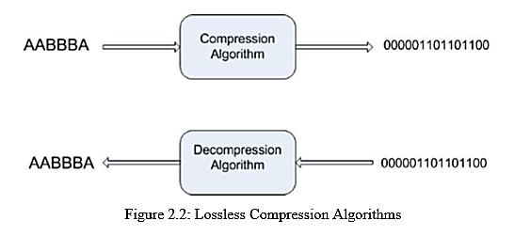
Lossless and Lossy Coding
Compression can be categorized as either
Lossless compression
Data is compressed and reconstituted with NO loss of the original information.
Example: Zipping and extracting a file

Slide 8
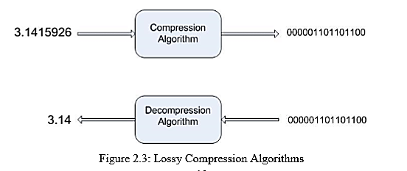
Lossless and Lossy Coding (Cont.)
Lossy compression
Works on the assumption that the data does not have to be stored perfectly i.e. removing redundancy as long as it has an acceptable quality.
Example: JPEG and MPEG standards

Slide 9
Issues to Consider in CODEC Design
A CODEC
Performs both compression and decompression
Key issues that needs to consider when designing a CODEC:
Compression efficiency and image quality
Computational complexity
Frame rate

Slide 10
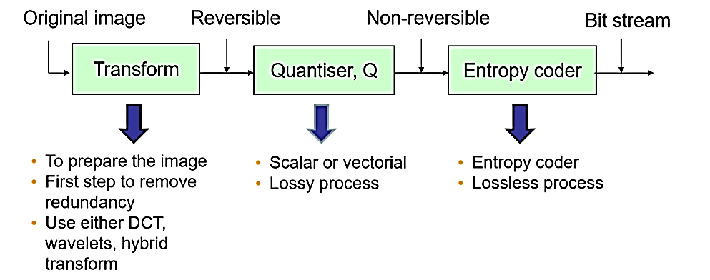
Generic Image Compression
Consist of 3 main blocks of operation:

Slide 11
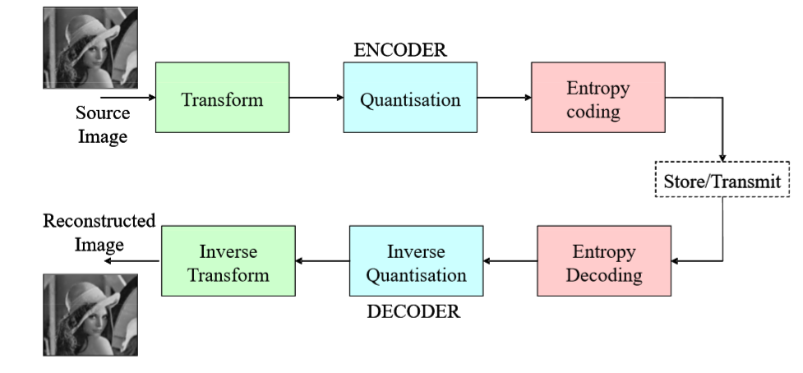
Image CODEC e.g. JPEG

Slide 12
Step1:Transform Coding
Image samples are transformed into another domain (representation) --represented by transform coefficients
Aim: Used to remove spatial redundancies ideally leaving
a small number of visually significant transform coefficients (important to the appearance of the original image)
a large number of insignificant transform coefficients (can be discarded without affecting image visual quality)

Slide 13
Transform Coding(Cont.)
*Note* that the transform process in itself does not achieve compression, it is the next process that helps with removing the insignificant transform coefficients.
Examples of transform coding.
Fourier Transform (FT)
Discrete Cosine Transform (DCT) –popular !
Discrete Wavelet Transform (DWT)
In JPEG image compression, DCT is the common form of transform coding used.

Slide 14
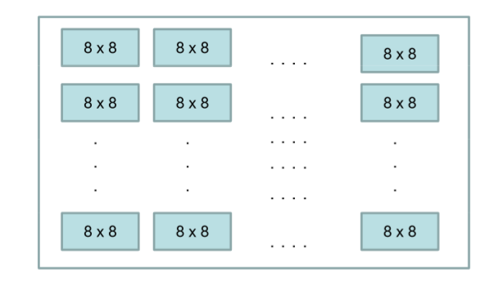
Transform Coding - JPEG
In JPEG, a grey scale picture is divided into 8 x 8 pixel blocks

Slide 15
Transform Coding – JPEG (Cont.)
The idea is to change the picture into a linear (vector) set of numbers to reveal the redundancies”
Then the redundancies can be removed by using one of the transform coding methods, in this case...DCT

Slide 16
Discrete Cosine Transform (DCT) in JPEG
Each block of 64 pixels goes through the DCT transformation.
The DCT is a relative of the Fourier transform and also gives a frequency map with 8 x 8 components.
Thus, you now have numbers representing
the average value in each block and
higher-frequency successively changes with in the 8x8 pixel block

Slide 17
DCT in JPEG (Cont.)
This changes to the 64 values (8 x 8 pixel block) will reveal the relationship between pixels (will be kept) but redundancies (that will be removed)
Therefore, you can now remove high-frequency information without affecting low-frequency information.

Slide 18
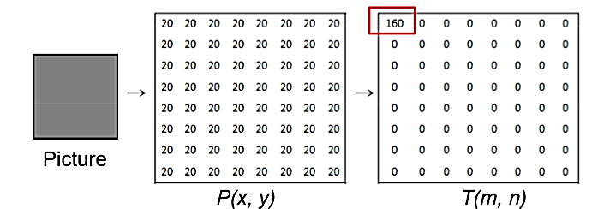
Example: Uniform Grey Scale
A block of uniform grey scale; value of each pixel is 20.
When transformed, we get a non-zero value for the 1st element and rest of the pixels have a value of 0.

Slide 19
Step2:Quantisation
The next stage is “Quantisation”
Idea: Reduce the amount of information required for encoding (transformed coefficients) by converting amplitudes that fall in certain ranges to one within a set of quantisation levels.
This reduction uses quantisation coefficients from a defined quantisation table.

Slide 20
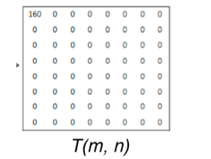
Quantisation (Cont.)
In each block, each of the 64 transform coefficients are divided by a separate quantisation coefficient (from the quantisation table).
This is the fundamental lossy step in JPEG compression.
Note: The larger the quantisation coefficients, the more data is discarded.

Slide 21
Quantisation (Cont.)
Possible to vary of quantisation either with a quantiser “scale factor” or “step size”.

Slide 22
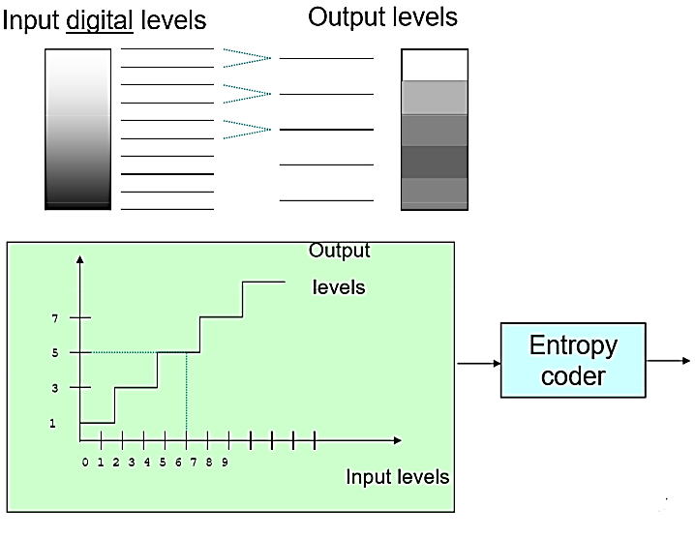
Quantisation (Cont.)

Slide 23
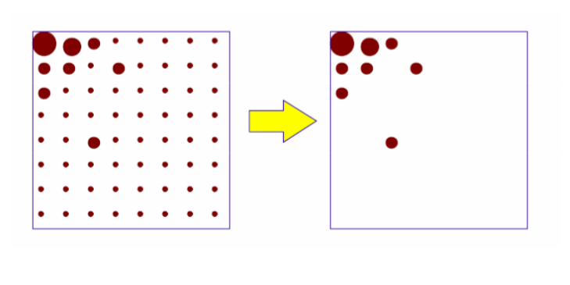
Quantisation (Cont.)
Normally left with very few non-zero values.

Slide 24
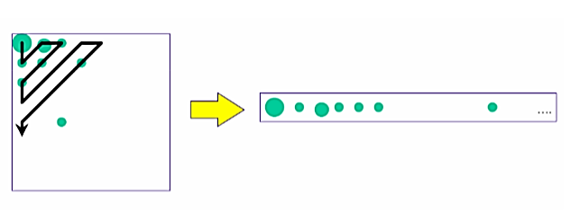
Scanning Zig-zag Order Scanning
Reorder quantised data (coefficients)
Uses zig-zag order scanning from low frequency to high frequency to group them together.
Non-zero quantised data (coefficients) are often at the top left corner.
Notes:
Zig zag scanning is used in image and video coding to reduce the number of coded zero transform coefficients, typically coded by a lossless encoder. ... Zig zag scanning allows you to find the zero coefficients much faster and increase coding efficiency.

Slide 25
Step3: Entropy Coding
Entropy coding is a lossless step (does not affect image quality) and based on statistical properties of the image
used to further compress the remaining non-zero data within the image.

Slide 26
Entropy Coding (Cont.)
It is a two steps process…
Run-Length Coding (RLC)
of quantised data (coefficients) using a pair of numbers.
First number -number of consecutive zeros
Second number -value between zero-run lengths.
Variable Length Coding (VLC)
Assigns a variable length code (VLC) to the RLC data, producing variable length bit-stream data.
Common VLC: Arithmetic coding and Huffman coding

Slide 27
Run-Level Coding(RLC)
Run-level coding
Represent each quantised coefficient value as a (run, level) pairs.
Run–no. of zeros preceding value
Level–non-zero value
Reduced to a short sequence of (run, level) pairs making easy to compress using the entropy encoder.
E.g.

Slide 28
Variable Length Coding
Encode each (run, level) pair by using VLC (based on a VLC table).
Frequently occurring groups
Assign short code
Infrequent occurring groups
Assign long code
Popular VLC are Huffman Coding and Arithmetic coding.
Compressed version ready for transmission or storage.

Slide 29
Image Decoding
Reverse the above operation to reconstruct the image.
Information loss through lossy compression at quantisation step will cause...
Reconstructed image not to be identical to the original image

Slide 30
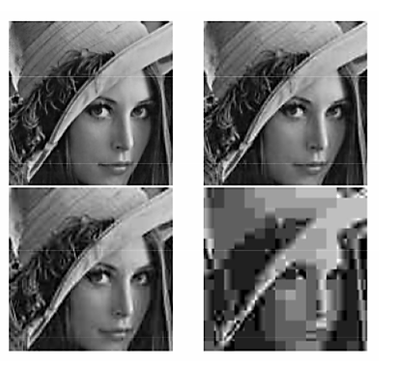
Image Decoding (Cont.)
In general,
More compression = more quality is loss
Too much compression will cause “blockiness” and “mosquito noise”.

Slide 31
Bibliography
I.E.G. Richardson, “Video Codec Design: Developing Image and Video Compression Systems, John Wiley & Sons, ISBN 0-470-84837-5, August 2003
R.J. Clarke, “Image and Video Compression: A SCCCPdiVl102032 Survey, CCC Proceedings, Vol. 10 pp. 20 –32, 1990.
Y.Wang, J.Osternmann, Y.Zhang, “Video Processing and Communications, Prentice Hall, ISBN0130175471 ISBN 0-13-017547-1.

