Slide 5
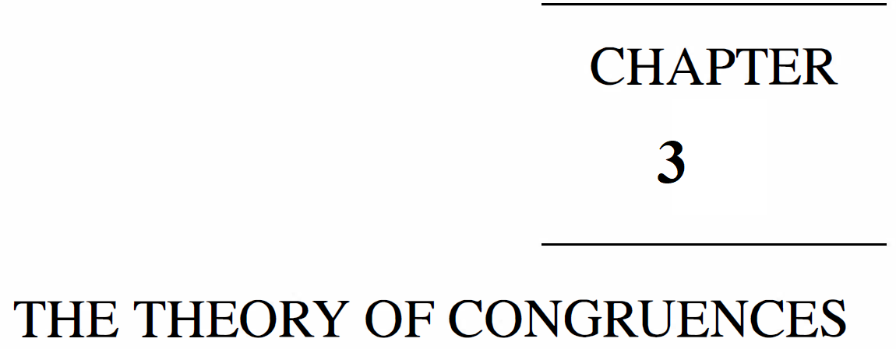

Slide 6
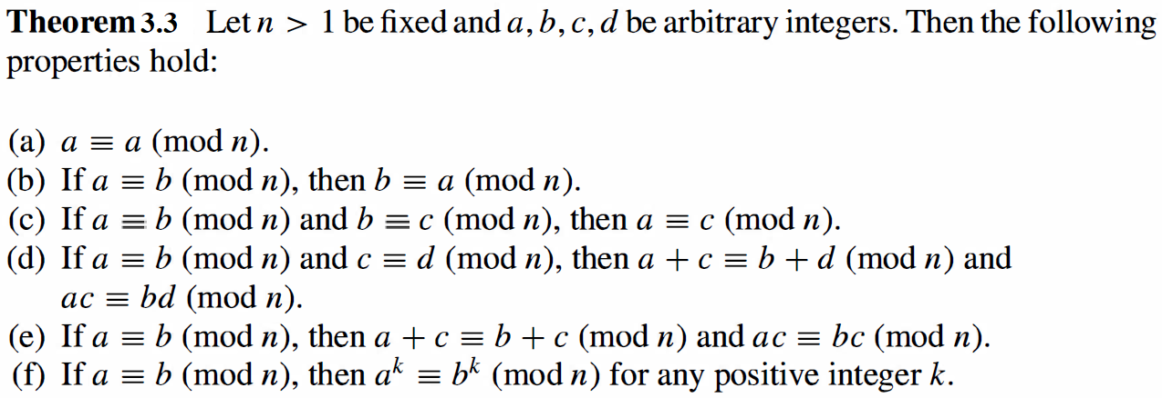

Slide 10
then it is called the decimal system(from the Latin decem, ten)

