Slide 1
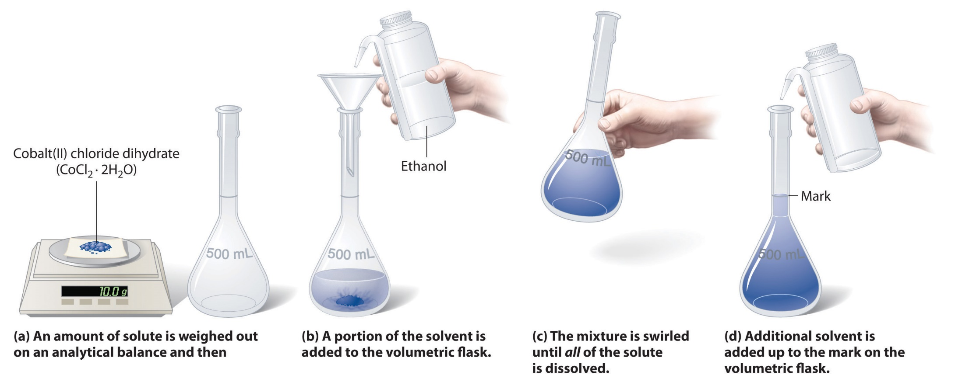
Volumetric Analysis
Practical Chemistry
2nd Stage- Medical Physics
Dr. Ibrahim Q. Saeed
M.Sc. Sarah Assaf
B.sc. Kosari Y. Ahmad

Slide 2
Experiment No.1
Preparation and standardization of 0.1N hydrochloric acid (HCl) using standard sodium carbonate (Na₂CO₃)

Slide 3
Hydrochloric acid (HCl) is not standard substance; Because HCl cannot be obtained at a very high purity and HCl does not have a high molecular mass. therefore it must standardize by using standard sodium carbonate (Na₂CO₃).

Slide 4
Preparation of solutions
1- Prepare 0.1N Na₂CO₃ in 250mL of distilled water
Na₂CO₃ is a solid substance.
Dissolve 1.325 g Na₂CO₃ in approximately 250 ml of distilled water to obtain 0.1N Na₂CO₃.

Slide 5
2- Prepare 0.1N HCl in 250mL of distilled water
HCl is a liquid substance.
Sp.gr = 1.19 g/ml
%HCl = 37%

Slide 6
Take 2.1 ml of concentrated HCl with a pipet, and dilute to 250 ml with distilled water in a 250ml-volumetric flask to obtain approximately 0.1 N HCl.

Slide 7
Procedure:

Slide 9
Experiment No. 2
Preparation and standardization of approximately 0.1N sodium hydroxide (NaOH) using standardized hydrochloric acid (HCl)

Slide 10
Sodium hydroxide are always coated with thin layer of sodium carbonate as a result of reaction of hydroxide with atmospheric carbon dioxide (CO₂).
Pure sodium hydroxide cannot be obtained; so that a standard solution of NaOH cannot be prepared by dissolving a known weight in a definite volume of water. Therefore sodium carbonate should remove from sodium hydroxide before preparation of the solution. Several methods are available for this purpose:-

Slide 11
1- Ba(OH)₂ method:
A slight excess of barium hydroxide is added to the solution of NaOH to precipitate carbonate as BaCO₃ (precipitation), then filtered the solution to remove the precipitate (Filtration).

Slide 12
2-Anion exchange method
It involves passing NaOH solution through a column of a strongly basic anion exchanger which has higher affinity to carbonate anion CO₃⁻² than for hydroxide OH⁻. The carbonate is removed and replaced by OH⁻ of the anion exchanger.

Slide 13
Preparation of solutions
Prepare 250mL aqueous solution of an approximate 0.1N HCl.
Prepare 250mL aqueous solution of an approximate 0.1N NaOH
Reaction:
NaOH + HCl NaCl + H₂O

Slide 14
Preparation of 250mL solution of approximate 0.1N NaOH
Dissolve 1.00 gm of NaOH in small amount of water then complete to 250 ml with distilled water to obtain 0.1N NaOH solution.

Slide 15
Procedure:

Slide 17
Experiment No. 3
Preparation and standardization of approximately 0.1N acetic acid solution (CH₃COOH) by using standardized sodium hydroxide (NaOH)

Slide 18
Acetic acid (CH₃COOH) also known as ethanoic acid, (K_{a} = 1.8 × 10⁻⁵ at 25 ◦C) and partially dissociated in an aqueous solution.
Glacial acetic acid is a pure and water-free acetic acid. It is a colorless liquid that absorbs water from the environment (hygroscopic), freeze at 16.5 ◦C and change to a colorless crystalline solid.
Acetic acid can be detected by its characteristic smell which has a distinctive (clear) pungent (hot) odour.

Slide 19
Concentrated acetic acid is corrosive and therefore must be handled with appropriate care, since it can cause skin burns and permanent eye damage. These burns may not appear until hours after exposure.
The titration of CH₃COOH against NaOH solution is a titration of weak acid against strong base.

Slide 20
The solution at equivalence point not neutral, but slightly alkaline, the calculated pH at equivalence point is 8.72.
In this experiment, (methyl orange) or (methyl red) cannot be used because they change their color at a much lower pH (acidic medium), i.e. the color is changed before the equivalence point. Therefore, phenolphthalein (ph.ph) is used as indicator because its color changes in the alkaline region at a pH range of (8-9.6).
Preparation of solutions:
1- Prepare 0.1 N NaOH in 250 mL of distilled water.
2- Prepare approximately 0.1 N CH₃COOH in 250 mL of distilled water.

Slide 21
Prepare approximately 0.1 N CH₃COOH in 250 mL of distilled water.
Sp.gr = 1.049 , % = 98% , Formula weight = 60 g/mole.
≈ 1.5 mL
You must take 1.5 ml of concentrated CH₃COOH with a pipet, and dilute to 250 ml with distilled water in a 250ml-volumetric flask to obtain approximately 0.1 N CH₃COOH.

Slide 22
Procedure:
1. Pipet 5 ml of acetic acid solution into a conical flask.
2. Add 2-3 drops of phenolphthalein indicator. The solution will be colorless.
3. Titrate the solution with the standardized NaOH solution from the burette until the color of solution changes into pink. Repeat the titration three (3) times.
V CH₃COOH (ml) | V NaOH (ml)
5 | V₁
5 | V₂
5 | V₃

Slide 25
Experiment No. 4
Application of Neutralization Titration (Acid – Base Titration): Determination of Acetic Acid in Vinegar
Vinegar is a combination of acetic acid and water made by a two-step fermentation process. First, yeast feed on the sugar or starch of any liquid from a plant food such as fruits, whole grains, potatoes, or rice. This liquid ferments into alcohol. The alcohol is then exposed to oxygen and the acetic acid bacteria Acetobacter to ferment again over weeks or months, forming vinegar. Most commercial vinegars contain about 5% by weight of acetic acid.
Procedure
Take 10 ml of vinegar and dilute to 250 ml.

Slide 27
Calculation (N) of acetic acid in 250 ml vinegar
(N × V)_{NaOH} = (N × V)_{A.A.}
(0.1 × V_{average})_{NaOH} = (N × 10)_{A.A.}
N = X eq./L (Normal) (Acetic acid in 250 ml vinegar)
Calculation (N) of acetic acid in 10 ml vinegar
(N × V)_{Before dil.} = (N × V)_{After dil.}
(N × 10)_{Before dil.} = (X × 250)_{After dil.}
N = Y eq./L (Normal) (Acetic acid in 10 ml vinegar)

Slide 28
Y
Wt.= B g (Acetic acid in 10 ml vinegar)

