Slide 1
Haemostasis

Slide 2
Hemostasis: The stoppage of bleeding or hemorrhage
The normal haemostatic response; to vascular damage depends on a closely linked interaction between the blood vessel wall, circulating platelets and blood coagulation factors .

Slide 3
The five major components involved are
1- blood vessels
2- platelets,
3- coagulation factors,
4- coagulation inhibitors, and
5- fibrinolysis

Slide 5
Platelets
Platelet production; Platelets are produced in the bone marrow by fragmentation of the cytoplasm of megakaryocytes, one of the largest cells in the body.
The precursor of the megakaryocyte
the megakaryoblast, arises by a process of differentiation from the haemopoietic stem cell.
haemopoietic stem cell megakaryoblast megakaryocytes Platelets

Slide 6
Each megakaryocyte giving rise approximately to 1000–5000 platelets.
The time interval from differentiation of the human stem cell to the production of platelets averages 10 days.
Thrombopoietin (TPO) is the major regulator of platelet formation and 95% is produced by the liver.

Slide 7
TPO increases the number and rate of maturation of megakaryocytes via c‐MPL receptor.
Platelet levels start to rise 6 days after the start of therapy.
Although TPO itself is not available for clinical use, thrombo-mimetic agents which bind to c‐MPL are now used clinically to increase the platelet count.

Slide 8
The normal platelet count is approximately 250 × 10⁹/L (range 150–400 × 10⁹/L) and the normal platelet lifespan is 10 days.
Up to one‐third of the marrow output of platelets may be trapped at any one time in the normal spleen but this rises to 90% in cases of massive splenomegaly.

Slide 9
Platelet structure
Platelets are extremely small and discoid, 3.0 × 0.5 μm in diameter. The glycoproteins of the surface coat are particularly important in the platelet reactions of adhesion and aggregation, which are the initial events leading to platelet plug formation during haemostasis.

Slide 10
The membrane phospholipids (previously known as platelet factor 3) are of particular importance in the conversion of coagulation factor X to Xa and prothrombin (factor II) to thrombin (factor IIa)

Slide 11
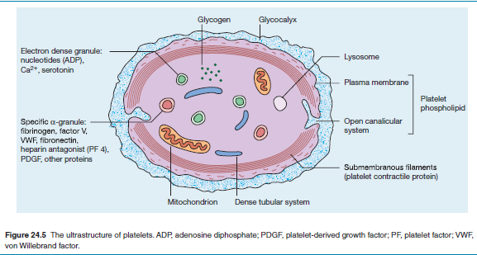
The platelet contains three types of storage granules: α granules, dense and lysosomes.

Slide 12
Platelet function
The main function of platelets is the formation of mechanical plugs during the haemostatic response to vascular injury. In the absence of platelets, spontaneous leakage of blood through small vessels may occur.
There are three major platelet functions: adhesion, aggregation and release reactions and amplification.

Slide 13
Natural inhibitors of platelet function
Nitric oxide (NO)
Prostacyclin synthesized by endothelial cells also inhibits platelet function

Slide 14
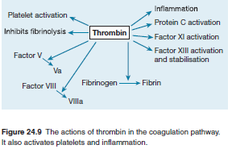

Slide 15
Blood coagulation
The coagulation cascade
Blood coagulation in vivo involves formation of thrombin; this, in turn, converts soluble plasma fibrinogen into fibrin.
The operation of this enzyme cascade requires local concentration of circulating coagulation factors at the site of injury.

Slide 17
Figure 24.8 The pathway of blood coagulation in vivo initiated by tissue factor (TF) on the cell surface. When plasma comes into contact with TF, factor VII binds to TF. The complex of TF and activated VII (VIIa) activates X and IX. The generation of thrombin from prothrombin by the action of Xa–Va complex leads to fibrin formation. Importantly, the small amounts of thrombin generated serve to greatly amplify coagulation. (T)Thrombin activates XI, VIII, V and XIII, and also cleaves VIII from its carrier von Willebrand factor (VWF), massively increasing the formation of VIIIa–IXa and hence of Xa–Va.

Slide 18
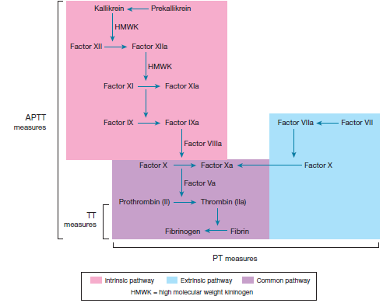
The intrinsic (contact), extrinsic and common pathways of blood coagulation.
The activated partial thromboplastin time (aPPT) tests the intrinsic and common pathways,
the Prothrombin time (PT) the extrinsic and common pathways and
the Thrombin time (TT) tests for thrombin inhibitors and deficiency or abnormality of fibrinogen. HMWK (high molecular weight kininogen)

Slide 19
Physiological limitation of blood coagulation
Blood coagulation would lead to dangerous occlusion of blood vessels (thrombosis) if the protective mechanisms of
1- coagulation factor inhibitors,
2- blood flow and
3- fibrinolysis
were not in operation.

Slide 20
1- Coagulation factor inhibitors
It is important that the effect of thrombin is limited to the site of injury.
The first inhibitor to act is Tissue Factor Pathway Inhibitor-1 (TFPI), which is synthesized in endothelial cells and is present in plasma and platelets and accumulates at the site of injury caused by local platelet activation.
TFPI inhibits Xa and VIIa and tissue factor to limit the main in vivo pathway.

Slide 21
There is also direct inactivation of thrombin and other serine protease factors by other circulating inhibitors, of which antithrombin is the most potent. It inactivates serine proteases.
Heparin potentiates its action markedly.

Slide 22
Another protein,
heparin cofactor II, also inhibits thrombin.
α2‐Macroglobulins,
α2‐antiplasmin,
C1 esterase inhibitor and
α1‐ antitrypsin also exert inhibitory effects on circulating serine proteases.
Protein C and protein S

Slide 23
Protein C and protein S (anticoagulant)
These are vitamin K–dependent (serine protease)inhibitors, which is able to destroy activated factors Va and VIIIa, thus preventing further thrombin generation.
The action of protein C is enhanced by another vitamin K‐dependent protein (protein S), which binds protein C to the platelet surface.
In addition, activated protein C enhances fibrinolysis.

Slide 24
2- Blood flow
At the periphery of a damaged area of tissue, blood flow rapidly achieves dilution and dispersal of activated factors before fibrin formation has occurred.

Slide 25
3- Fibrinolysis
Fibrinolysis (like coagulation) is a normal haemostatic response to vascular injury.
Plasminogen, a proenzyme in blood and tissue fluid, is converted to the serine protease plasmin by activators either from the vessel wall (intrinsic activation) or from the tissues (extrinsic activation).

Slide 26
Disorders of Haemostasis

Slide 27
Disorders of Haemostasis
Various diseases that affect haemostasis exist. These can result in either a failure of coagulation) or a hypercoaguability. A few diseases can produce either effect or both.
1- Bleeding Disorders
2- Hypercoaguable states
3- Disseminated Intravascular Coagulation

Slide 28
1- Bleeding Disorders
Haemophilia A
Haemophilia A; is a disorder of bleeding & Affected patients are deficient in factor VIII.
The gene for factor VIII is located on the X chromosome and because the disease is a recessive condition the vast majority of sufferers are male.

Slide 29
Patients bruise easily and those who have a severe deficiency suffer spontaneous haemorrhage due to their inability to deal with the very minor blood vessel damage that occurs during everyday normal life.
Bleeding into joints is a particular problem in severe haemophilia A and can lead to secondary osteoarthritis and deformity.

Slide 30
Haemophilia B
This is also an X-linked recessive condition and is due to a deficiency of factor IX. It is sometimes known as Christmas disease. The clinical features are the same as haemophilia A.
Von Willebrand Disease
This is caused by a deficiency of von Willebrand factor. Like haemophilia A and B it is an inherited condition, but is autosomal recessive (chromosome 12) so males and females are affected. Its severity is usually less than haemophilia.

Slide 31
Idiopathic Thrombocytopenic Purpura (ITP)
This disease is caused by autoimmune destruction of platelets. Like most autoimmune diseases it is more common in females and not infrequently comes to attention by producing menorrhagia(is menstrual bleeding that lasts more than 7 days).
Thrombocytopenia
Many diseases of the bone marrow can produce thrombocytopenia and drugs may also cause a reduction in the platelet count.

Slide 32
Platelet Dysfunction Syndromes
Various disease exist in which one or other aspect of platelet function is defective.
In Glanzmann's disease a lack of the surface glycoproteins IIb and IIIa prevents platelets from aggregating.
Bernard-Soulier syndrome features a lack of glycoprotein Ib, so platelets cannot recognize and make use of vWF.
Deficiencies of alpha granules and dense granules may also occur.

Slide 33
Blood Vessel Diseases
Blood vessels can also contribute to the panopoly of bleeding disorders.
1- Assorted infections, such as measles, dengue fever and ebola, can damage blood vessels and cause bleeding.
2- Vasculitis also injures blood vessels and may feature haemorrhage.
3- Hereditary haemorrhagic telangiectasia (spider veins) is an autosomal dominant condition in which patients have multiple small swellings of their small blood vessels. These swellings are prone to rupture.

Slide 34
2- Hypercoagulability (Thrombophilia) states
Are defined as a group of inherited or acquired conditions associated with venous thromboembolism (VTE), arterial thrombosis or both .
Protein C and protein S deficiencies
Both of these inherited diseases display an increased tendency of affected patients to develop venous thrombosis and consequent embolism (obstruction).

Slide 35
Factor V Leiden
Factor V Leiden disease is one of the commonest inherited hypercoaguable / thrombophilic conditions. Factor V Leiden is a variant form of standard factor V that is resistant to deactivation by protein C. Like protein C deficiency, the clotting occurs almost exclusively in veins. It is suggested that around 5% of the population are heterozygous for factor V Leiden.

Slide 36
Homocysteine
Homocysteine is an amino acid that is obtained by adding a CH₂ group to cysteine. It increases the tendency to thrombosis and also injures blood vessels through its ability to damage proteins. Homocystinuria is a rare disease that demonstrates elevated levels of homocysteine.

Slide 37
Antiphospholid Syndromes
This group of diseases exhibits an autoimmune response to membrane phospholipids and related proteins.
The autoantibodies may react against protein C to inhibit it, or bind to prothrombin and facilitate its conversion to thrombin.
Both venous and arterial thrombotic events can happen.

Slide 38
Hyperviscosity
The blood is more sludgy and flows less well in hyperviscosity syndromes, so the risk of thrombophilia is not surprising (haemorrhage can also occur).
Hyperviscosity can be caused either by an increase in the protein content of the blood (myeloma, Waldenstrom's macroglobulinaemia) or an increase in the cellular content (polycythaemia; essential thrombocytosis may cause thrombophilia but the platelets that are formed in this disease can be functionally defective so the effect of the elevation of their number is outweighed by the fact that they do not work).
Dehydration can also increase plasma viscosity.

Slide 39
Paroxysmal Nocturnal Haemoglobinuria
PNH is an acquired disease of bone marrow stem cells in which the cells lose the ability to express a cell surface molecule (glucosylphosphatidylinositol) that anchors other molecules which protect the cells against damage mediated by complement.
The resulting myeloid, erythroid and megakaryocytic cells produced by the stem cells are therefore susceptible to destruction by complement. Thrombosis occurs because the platelets in PNH bind complement too readily; the binding of complement by platelets can stimulate them.

Slide 40
Nephrotic Syndrome
Healthy kidneys do not lose any protein in the urine. In nephrotic syndrome there is marked protein loss (at least 3g per day). The lost proteins include antithrombin III. The liver may also respond by pumping out proteins, including fibrinogen, to try to maintain the total plasma protein level.

Slide 41
Elevated oestrogen levels
Oestrogen increases the blood levels of factors II, VII, IX and X, promotes platelet aggregation and reduces levels of antithrombin III; plasminogen levels are also raised so at least the clot busting ability of the body is enhanced to deal with any extra clots that arise.
This may explain the tendency to hypercoaguability that can occur with some oral contraceptive preparations.

Slide 42
Smoking
Amongst its myriad of other harmful effects, smoking promotes a hypercoaguable tendency. When combined with factor V Leiden deficiency and oestrogen-containing oral contraception, the total increase in risk can be very significant.

Slide 43
3- Disseminated Intravascular Coagulation
Disseminated intravascular coagulation (DIC) is a disorder in which there is widespread activation of the clotting system at the microvascular level throughout the circulation. The clots are very small and readily broken down by fibrinolysis.
However, this huge flurry of activity consumes clotting factors and platelets and exhausts their reserves so that a marked tendency to bleeding results.

Slide 44
DIC can be induced by numerous conditions that include infection, malignant tumours, leukaemia (particularly AML M3), eclampsia (high blood pressure in pregnant), acute pancreatitis, snake and other venom, burns, trauma, liver failure, hyperthermia, hypothermia and amniotic fluid embolism.

Slide 45
Thrombotic Thrombocytopenic Purpura Thrombotic thrombocytopenic purpura is a rare disease in which damage to blood vessels at the microvascular level results in haemolytic anemia and thrombocytopenia.
The initial process is inappropriate platelet activation in small blood vessels. This leads to thrombi in these small vessels and the associated clinical features that can be associated with tiny zones of infarction.

Slide 46
The widespread activation of platelets that occurs depletes the circulating pool of platelets, yielding thrombocytopenia, at which point a bleeding tendency can develop. As erythrocytes try to force their way through small blood vessels that are narrow by thrombi they become damaged and destroyed by haemolysis.

Slide 47
Tests
Prothrombin Time and International Normalized Ratio (PT/INR)
Fibrinogen
D-dimer
Thrombin Time
Lupus Anticoagulant Testing
Activated Clotting Time (ACT)
Coagulation Factors
Platelet Count
Heparin Anti-Xa
von Willebrand Factor
Antiphospholipid Antibodies
Conditions
Bleeding Disorders
Excessive Clotting Disorders
Vitamin K Deficiency
Disseminated Intravascular Coagulation (DIC)
Antiphospholipid Syndrome
Deep Vein Thrombosis (DVT)

Slide 48
Thank you

Slide 49
In this amplification phase the intrinsic Xase, formed by IXa and VIIIa on phospholipid surface in the presence of Ca²⁺, activates sufficient Xa, which then, in combination with Va, PL and Ca²⁺, forms the prothrombinase complex and results in the explosive generation of thrombin which acts on fibrinogen to form the fibrin clot.

Slide 50
Factor XI does not seem to have a role in the physiological initiation of coagulation. It has a supplementary role in the activation of factor IX and may be important at major sites of trauma or at operations, in which situations factor XI deficient individuals tend to bleed excessively. It is also involved in the contact pathway (Fig 24.10).
Thrombin hydrolyses fibrinogen, releasing fibrinopeptides. A and B to form fibrin monomers (Fig. 24.11).

Slide 51
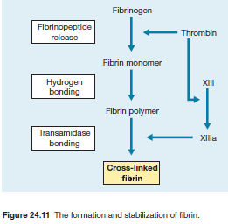

Slide 52
Fibrin monomers link spontaneously by hydrogen bonds to form a loose insoluble fibrin polymer. Factor XIII is also activated by thrombin and stabilizes the fibrin polymers with the formation of covalent bond cross‐links.
Fibrinogen consists of two identical subunits, each containing three dissimilar polypeptide chains (α, β and γ) which are linked by disulphide bonds. After cleavage by thrombin of small fibrinopeptides A and B from the α and β chains, fibrin monomer consists of three paired α, β and γ chains which rapidly polymerise.

Slide 53
Some of the properties of the coagulation factors are listed in Table 24.2. The activity of factors II, VII, IX and X is dependent upon vitamin K, which is responsible for carboxylation of a number of terminal glutamic acid residues on each of these molecules (see Fig. 26.7).
Although factor VIII and V cofactors are not protease enzymes, they circulate in a precursor form that requires limited cleavage by thrombin for expression of full cofactor activity (Fig. 24.9).

Slide 54
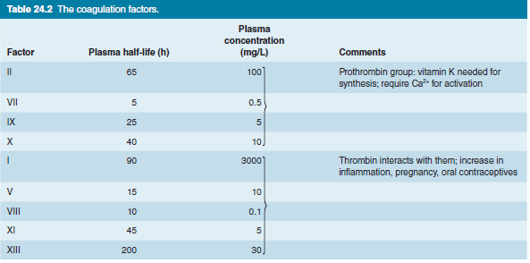

Slide 55
Endothelial cells
The endothelial cell has an active role in the maintenance of vascular integrity. This cell provides the basement membrane that normally separates collagen, elastin and fibronectin of the subendothelial connective tissue from the circulating blood (Fig. 24.12).
Loss of or damage to the endothelium results in both haemorrhage and activation of the haemostatic mechanism.
The endothelial cell also has a potent inhibitory influence on the haemostatic response, largely through the synthesis of prostaglandin, NO, and the ectonucleotidase CD39, which have vasodilatatory properties and inhibit platelet aggregation.

Slide 56
Synthesis of tissue factor that initiates haemostasis only occurs in endothelial cells following activation, when its natural inhibitor, TFPI, is also synthesized.
Endothelial synthesis of prostacyclin, VWF, factor VIII, plasminogen activator, antithrombin and thrombomodulin, the surface protein responsible for activation of protein C, provides agents that are vital to both platelet reactions and blood coagulation (Fig. 24.12).

Slide 57
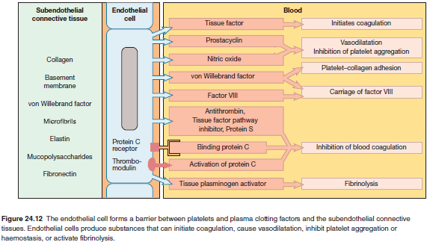

Slide 58
Haemostatic response (Fig. 24.1)
Vasoconstriction
Immediate vasoconstriction of the injured vessel and reflex constriction of adjacent small arteries and arterioles is responsible for an initial slowing of blood flow to the area of injury.
When there is widespread damage, this vascular reaction prevents exsanguination. The reduced blood flow allows contact activation of platelets and coagulation factors. The vasoactive amines and TXA2 liberated from platelets (Fig. 24.6), and the fibrinopeptides liberated during fibrin formation (Fig. 24.11), also have vasoconstrictive activity.

Slide 59
Platelet reactions and primary haemostatic plug formation
Following a break in the endothelial lining, there is an initial adherence of platelets (via GP1a and GP1b receptors) to exposed connective tissue, mediated (GP1b) by VWF. Under conditions of high shear stress (e.g. arterioles) the exposed subendothelial matrix is initially coated with VWF. Collagen exposure and thrombin generated through activation of tissue factor produced at the site of injury cause the adherent platelets to release their granule contents and also activate platelet prostaglandin synthesis, leading to the formation of TXA2. Released ADP causes platelets to swell and aggregate.

Slide 60
Platelet rolling in the direction of blood flow over exposed VWF with activation of GPIIb/IIIa receptors results in firmer binding. Additional platelets from the circulating blood are drawn to the area of injury. This continuing platelet aggregation promotes the growth of the haemostatic plug, which soon covers the exposed connective tissue.
The unstable primary haemostatic plug produced by these platelet reactions in the first minute or so following injury is usually sufficient to provide temporary control of bleeding. The highly localized enhancement of platelet activation by ADP and TXA2 results in a platelet mass large enough to plug the area of endothelial injury.

Slide 61
Stabilization of the platelet plug by fibrin
Definitive haemostasis is achieved when fibrin, formed by blood coagulation, is added to the platelet mass and by platelet‐ induced clot retraction/compaction.
Following vascular injury, the formation of extrinsic Xase (VIIa, TF, PL and Ca²⁺) initiates the coagulation cascade. Platelet aggregation and release reactions accelerate the coagulation process by providing abundant membrane phospholipid.

Slide 62
The much larger amounts of thrombin generated by the secondary intrinsic Xase at the injury site converts soluble plasma fibrinogen into fibrin, potentiates platelet aggregation and secretion and also activates factor XI and XIII and cofactors V and VIII. The fibrin component of the haemostatic plug increases as the fused platelets completely degranulate and autolyse, and after a few hours the entire haemostatic plug is transformed into a solid mass of crosslinked fibrin (Fig. 24.11).

Slide 63
Clot retraction occurs, which is mediated by GPIIb/IIIa receptors which link the cytoplasmic actin filaments to surface‐bound fibrin polymers.
Nevertheless, because of incorporation of plasminogen and TPA (see p. 275), this plug begins to autodigest during the same time frame.

Slide 64
Physiological limitation of blood coagulation
Unchecked, blood coagulation would lead to dangerous occlusion of blood vessels (thrombosis) if the protective mechanisms of coagulation factor inhibitors, blood flow and fibrinolysis were not in operation.

Slide 65
Coagulation factor inhibitors
It is important that the effect of thrombin is limited to the site of injury.
The first inhibitor to act is Tissue Factor Pathway Inhibitor-1 (TFPI), which is synthesized in endothelial cells and is present in plasma and platelets and accumulates at the site of injury caused by local platelet activation.
TFPI inhibits Xa and VIIa and tissue factor to limit the main in vivo pathway. There is also direct inactivation of thrombin and other serine protease factors by other circulating inhibitors, of which antithrombin is the most potent. It inactivates serine proteases (see Fig. 28.3). Heparin potentiates its action markedly.

Slide 66
Another protein,
heparin cofactor II, also inhibits thrombin.
α2‐Macroglobulins,
α2‐antiplasmin,
C1 esterase inhibitor and
α1‐ antitrypsin also exert inhibitory effects on circulating serine proteases.
Protein C and protein S

Slide 67
Protein C and protein S
These are vitamin K–dependent factors inhibitors of coagulation cofactors V and VIII. Thrombin binds to an endothelial cell surface receptor, thrombomodulin.
The resulting complex activates the vitamin K-dependent serine protease, protein C, which is able to destroy activated factors V and VIII, thus preventing further thrombin generation.

Slide 68
The action of protein C is enhanced by another vitamin K‐dependent protein, S, which binds protein C to the platelet surface (Fig. 24.13). An endothelial protein C receptor localizes protein C to the endothelial surface, promoting protein C activation by the thrombin–thrombomodulin complex. In addition, activated protein C enhances fibrinolysis (Fig. 24.13). As with other serine proteases, activated protein C is subject to inactivation by serum protease inactivators (serpins), e.g. antithrombin.

Slide 69
Figure 24.13 Activation and action of protein C by thrombin which has bound to thrombomodulin on the endothelial cell surface. Protein S is a cofactor that facilitates binding of activated protein C to the platelet surface. The inactivation of factors Va and VIIIa results in the inhibition of blood coagulation. The inactivation of tissue plasminogen activator inhibitor (TPAI) enhances fibrinolysis. EPCR, endothelial protein C receptor.

Slide 70
Blood flow
At the periphery of a damaged area of tissue, blood flow rapidly achieves dilution and dispersal of activated factors before fibrin formation has occurred. Activated factors are destroyed by liver parenchymal cells and particulate matter is removed by liver Kupffer cells and other reticuloendothelial cells.

Slide 71
Fibrinolysis
Fibrinolysis (like coagulation) is a normal haemostatic response to vascular injury. Plasminogen, a proenzyme in blood and tissue fluid, is converted to the serine protease plasmin by activators either from the vessel wall (intrinsic activation) or from the tissues (extrinsic activation) (Fig. 24.14).

Slide 72
The most important route follows the release of tissue plasminogen activator (TPA) from endothelial cells. TPA is a serine protease that binds to fibrin. This enhances its capacity to convert thrombus‐bound plasminogen into plasmin. This fibrin dependence of TPA action strongly localizes plasmin generation by TPA to the fibrin clot. Release of TPA occurs after such stimuli as trauma, exercise or emotional stress. Activated protein C stimulates fibrinolysis by destroying plasma inhibitors of TPA (Fig. 24.13).

Slide 73
Plasmin generation at the site of injury limits the extent of the evolving thrombus. The split products of fibrinolysis are also competitive inhibitors of thrombin and fibrin polymerization.
Normally, α2‐antiplasmin inhibits any local free plasmin. Fibrinolytic agents are widely used in clinical practice (see p. 318).
Recombinant TPA, the bacterial agent, streptokinase, and urokinase, initially isolated from human urine, are available.

Slide 74
Plasmin is capable of digesting fibrinogen, fibrin, factors V and VIII and many other proteins. Cleavage of peptide bonds in fibrin and fibrinogen produces a variety of split (degradation) products (Fig. 24.11). Large amounts of the smallest fragments can be detected in the plasma of patients with disseminated intravascular coagulation (see p. 297).

Slide 75
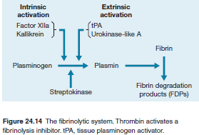

Slide 76
Inactivation of plasmin
Tissue plasminogen activator is inactivated by plasminogen activator inhibitor (PAI). Circulating plasmin is inactivated by the potent inhibitors α2‐antiplasmin and α2‐macroglobulin.
Tests of haemostatic function
Defective haemostasis with abnormal bleeding may result from:
1 A vascular disorder;
2 Thrombocytopenia or a disorder of platelet function; or
3 Defective blood coagulation.
A number of simple tests are employed to assess the platelet, vessel wall and coagulation components of haemostasis

Slide 77
Blood count and blood film examination
As thrombocytopenia is a common cause of abnormal bleeding, patients with suspected bleeding disorders should initially have a blood count including platelet count and blood film examination. In addition to establishing the presence of thrombocytopenia, the cause may be obvious (e.g. acute leukaemia). Modern counters measure platelet volume but this parameter is not used routinely in clinical practice for diagnosis of platelet disorders. The absolute count of immature platelets (which contain RNA) correlates with increased platelet production, e.g. after haemorrhage, but again is not routinely measured or used clinically.

Slide 78
Screening tests of blood coagulation
Screening tests provide an assessment of the ‘extrinsic’ and ‘intrinsic’ systems of blood coagulation and also the central conversion of fibrinogen to fibrin (Fig 24.10, Table 24.3).
The prothrombin time (PT) measures factors VII, X, V, prothrombin and fibrinogen. Tissue thromboplastin (a brain extract) or [synthetic] tissue factor with lipids and calcium is added to citrated plasma. The normal time for clotting is 10–14 s. It may be expressed as the international normalized ratio (INR) (p. 315).

Slide 79
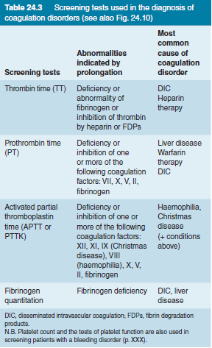

Slide 80
The activated partial thromboplastin time (APTT) measures factors VIII, IX, XI and XII in addition to factors X, V, prothrombin and fibrinogen. Three substances – phospholipid, a surface activator (e.g. kaolin) and calcium – are added to citrated plasma. The normal time for clotting is approximately 30–40 s.
Prolonged clotting times in the PT and APTT because of factor deficiency are corrected by the addition of normal plasma to the test plasma (50 : 50 mix). If there is no correction or incomplete correction with normal plasma, the presence of an inhibitor of coagulation is suspected.

Slide 81
The thrombin (clotting) time (TT) is sensitive to a deficiency of fibrinogen or inhibition of thrombin. Diluted bovine thrombin is added to citrated plasma at a concentration giving a clotting time of 14–16 s with normal subjects.

Slide 82
Specific assays of coagulation factors
Most factor assays are based on an APTT or PT in which all factors except the one to be measured are present in the substrate plasma. This usually requires a supply of plasma from patients with hereditary deficiency of the factor in question or artificially produced factor‐deficient plasma. The corrective effect of the unknown plasma on the prolonged clotting time of the deficient substrate plasma is then compared with the corrective effect of normal plasma. Results are expressed as a percentage of normal activity.
A number of chemical, chromogenic and immunological methods are available for quantification of other proteins such as fibrinogen, VWF, factor Xa and factor VIII.

Slide 83
Bleeding time
The bleeding time is not a reliable assessment of platelet function as it is insensitive and has poor reproducibility. It was used to identify abnormal platelet function, including the diagnosis of VWF deficiency, but is no longer used in routine clinical practice. The test involved the application of pressure to the upper arm with a blood pressure cuff, after which small incisions are made in the flexor surface forearm skin. Bleeding stops normally in 3–8 minutes. It has been replaced by specific platelet aggregation tests, platelet adhesion assays and the platelet function analysis‐100 (PFA‐100) test (see below). The bleeding time is prolonged in thrombocytopenia but is normal in vascular causes of abnormal bleeding.

Slide 84
Tests of platelet function
Conventional platelet aggregometry measures the fall in light absorbance in platelet‐rich plasma as platelets aggregate. Initial (primary) aggregation is caused by an external agent; the secondary response is caused by aggregating agents released from the platelets themselves. The five external aggregating agents most commonly used are ADP, collagen, ristocetin, arachidonic acid and adrenaline.
The pattern of response to each agent helps to make the diagnosis (see Fig. 25.10). Flow cytometry is now increasingly used in routine practice to identify platelet glycoprotein defects.

Slide 85
In the PFA‐100 test, citrated blood is aspirated through a capillary tube on to a membrane coated with collagen/ADP or collagen/adrenaline. Blood flow is maintained. Platelets begin to adhere and aggregate, primarily via VWF interactions with GPIb and GPIIb/IIIa, resulting in occlusion of the aperture. The PFA‐100 is prolonged in VW disease and with other defects of platelet function. The analysis may give false‐negative results with relatively common platelet defects. Full platelet aggregation tests and VWF screening may be required to exclude abnormal platelet function, even if the PFA‐100 test is normal.

Slide 86
Tests of fibrinolysis
Testing for hyperfibrinolysis by traditional tests, such as the euglobulin clot lysis times, is rarely performed. A clinically significant hyperfibrinolytic state, e.g. during liver transplantation, can be detected by viscoelastic measurement of clot stability using thromboelastography (TEG) or thromboelastometry (ROTEM) (see Fig. 26.10). Treatment with tranexamic acid reduces hyperfibrinolysis and reduces bleeding.

Slide 87
D‐dimer is a measurement of fibrin degradation products and is an indication of sequential thrombin and then plasmin activity. The test can be performed on citrated plasma samples along with simple coagulation tests. There are many causes of a high D‐dimer, including infection, cancer and pregnancy, as well as venous thromboembolism. Plasma levels are very high in patients with disseminated intravascular coagulation (DIC).

